Slide 1



Production Control System
(for Nichias VN)
Production Control Principal
AGENDA
Benefit
System Overview
Notes:
Good afternoon everyone.
My name is Khánh. I'm from IT section, and nice to meet you.
Today, I would like to explain to you about our TQM conference.
The theme is : TMA management system at Extruding section.
My safety declaration: Always drive at the right speed.

Slide 2







1. Production Control System.
Production
Corrugate
Inspection
Packing
Report
Tracing history
Users
Product spec: Setting specifications for each product.
Machine params: Setting specifications for each machine.
Scheduling: Production scheduling
Production: Control mass production (follow schedule, follow standard & specification).
Tracing: Production history tracing (what, when, who, how ...)
Report: Summary production report.
Winding
Air blow
Product spec
Impregnation +drying
Painting
Machine Parameter
Schedule Lot
Oven
(calcination)
Grinding
Purchase order
Notes:
The first, my customer is Extruding section.
Every year we have a large amount of TMA return.
These include a lot of GUM types and return from 4 sections (Mixing, Cutting, Extruding, Building)

Slide 3
2. Benefit.
Before: Paper-based production System
After: Utilize Production Control System
All manually & paper-based processes.
Difficult or impossible to ensure Quality level.
Difficult to know actual production result & status
Time consuming processes
Use a lot of paper (cost money, time, lost data …)
Strictly control Quality:
+ Ensure no missed production-step
+ Control production-timing for each step.
+ Automatic judge result (OK/NG) at Impregnation step.
Monitoring ProductionStatus in realtime
Control work standard online.
Fast & Intuitive reporting:
+ Store production data at the server.
+ Synthesize data on server to make reports.
Saving cost:
+ No printing checksheet.
+ No printing report.
+ Reduce manual workload
Notes:
The first, my customer is Extruding section.
Every year we have a large amount of TMA return.
These include a lot of GUM types and return from 4 sections (Mixing, Cutting, Extruding, Building)

Slide 4
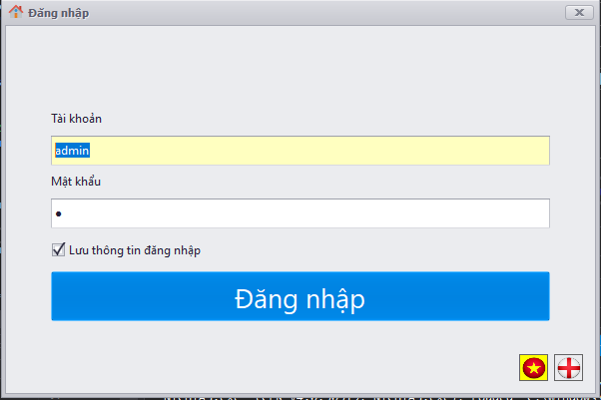
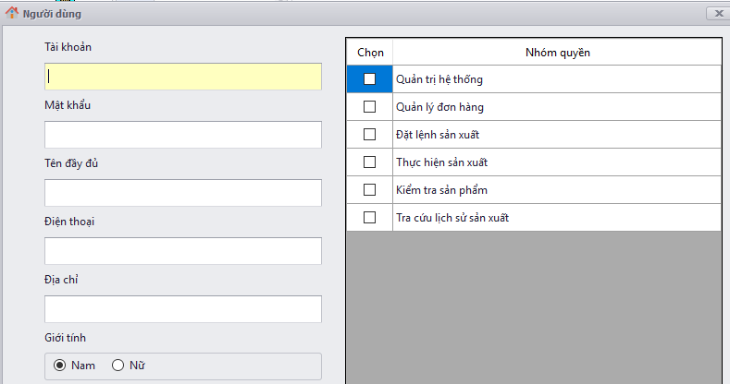
3. System Overview
User management and authorization
Permission
Control
Login to the system with your account
Notes:
The first, my customer is Extruding section.
Every year we have a large amount of TMA return.
These include a lot of GUM types and return from 4 sections (Mixing, Cutting, Extruding, Building)

Slide 5
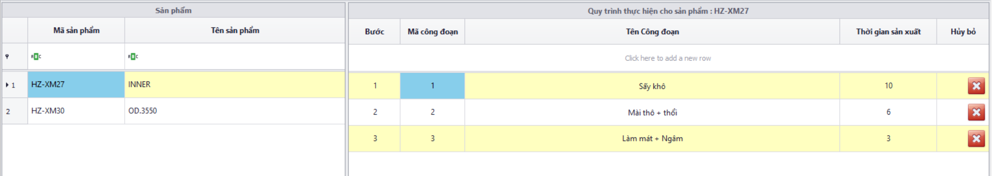
3. System Overview.
Production Specification & Controlling
Production
Corrugate
Inspection
Packing
Winding
Air blow
Register process for each product
Impregnation +drying
Painting
Oven
(calcination)
Grinding
Notes:
The first, my customer is Extruding section.
Every year we have a large amount of TMA return.
These include a lot of GUM types and return from 4 sections (Mixing, Cutting, Extruding, Building)

Slide 6
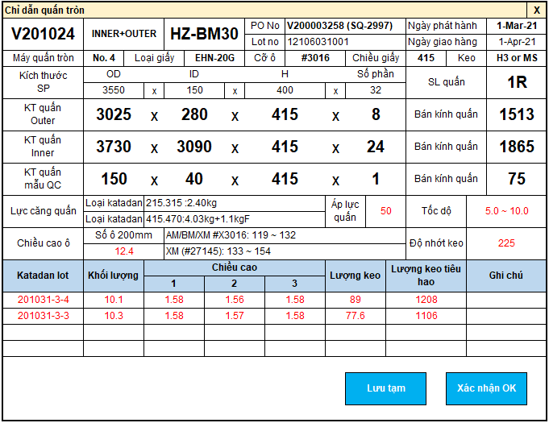
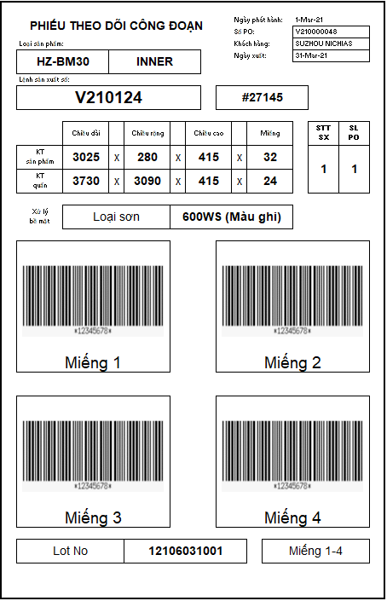
Value of the order, product, spec machine will be displayed
3. System Overview.
At corrugate machine
Operator input production result
Submit result &
print Barcode
Temporary Save (not finished)
Notes:
The first, my customer is Extruding section.
Every year we have a large amount of TMA return.
These include a lot of GUM types and return from 4 sections (Mixing, Cutting, Extruding, Building)

Slide 7
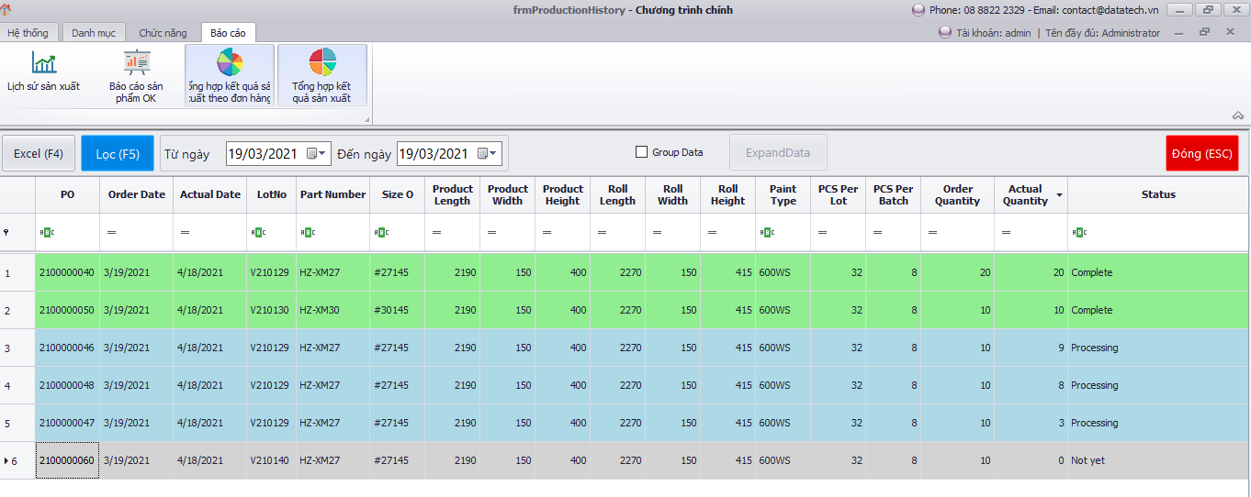
3. System Overview.
Report
Notes:
The first, my customer is Extruding section.
Every year we have a large amount of TMA return.
These include a lot of GUM types and return from 4 sections (Mixing, Cutting, Extruding, Building)

Slide 8
Thanks for watching !!!
Notes:
That's all for my report

