Slide 1

Business Rule Engine
Current version: 7.7.0
Integrated version: 7.1.0

Slide 2
Agenda
Introduction
Core concepts
Rule language
Execution
“Native” Rule Language
Domain Specific Languages
Decision table
References

Slide 3
Introduction
Drools is a business rule management system, allowing fast and reliable evaluation of business rules and complex event processing.
It provides a core Business Rules Engine (BRE), a web authoring and rules management application (Drools Workbench) and an Eclipse IDE plugin for core development.

Slide 4
Introduction
Dependencies and JARs
knowledge-api.jar - Priovide user API and engine API. knowledge-internal-api.jar - This provides internal interfaces and factories. drools-core.jar - This is the core engine, runtime component. This is the only runtime dependency if you are pre-compiling rules. drools-compiler.jar - This contains the compiler/builder components to take rule source, and build executable rule bases. drools-jsr94.jar - This is the JSR-94 compliant implementation.
drools-decisiontables.jar - This is the decision tables 'compiler' component, which uses the drools-compiler component. This supports both excel and CSV input formats.

Slide 5
Concepts - Rule Execution
Model (object)
Rule Engine
Side effects
Rules
Added/Updated model

Slide 6
Concepts - Stateless Session
A stateless session can be called like a function passing it some data and then receiving some results back.
Use cases:
Validation - Is this person eligible to watch adult movies?
Calculation - Compute the salary.
Routing and Filtering - Filter emails into folders.
And more...

Slide 7
Concepts - Stateless Session
Movie streaming application
We have the model:
public class User { private String name; private int age; private boolean can_watch_adult_movies; // getter and setter methods here }

Slide 8
Concepts - Stateless Session
Now, we can write our first rule
package com.aavn.movie.stream rule "Who can watch adult movies" when $user : User( age < 18 ) then $user.setCanWatchAdultMovies( false ); end

Slide 9
Concepts - Stateless Session
What happened?
The User instance is inserted into the engine, then it is evaluated against the constraints of the rules.
In this case, we have 2 constraints for 1 rule:
Object type constraint
Field constraint
The process of matching patterns against the inserted data is, not surprisingly, often referred to as pattern matching.

Slide 10
Concepts - Stateful Session
Stateful Sessions are long lived and allow iterative changes over time.
Use cases:
Monitoring - Stock market monitoring and analysis for semi-automatic buying.
Diagnostics - Fault finding, medical diagnostics
Logistics - Parcel tracking and delivery provisioning

Slide 11
Concepts - Stateful Session
Fire alarm monitoring
public class Room { private String name // getter and setter methods here } public class Sprinkler { // Xịt nước private Room room; private boolean on; // getter and setter methods here } public class Fire { private Room room; // getter and setter methods here } public class Alarm { }

Slide 12
Concepts - Stateful Session
Fire alarm monitoring
rule "When there is a fire turn on the sprinkler" when Fire($room : room) $sprinkler : Sprinkler( room == $room, on == false ) then modify( $sprinkler ) { setOn( true ) }; System.out.println( "Turn on the sprinkler for room " + $room.getName() ); end

Slide 13
Concepts - Stateful Session
Fire alarm monitoring
rule "When the fire is gone turn off the sprinkler" when $room : Room( ) $sprinkler : Sprinkler( room == $room, on == true ) not Fire( room == $room ) then modify( $sprinkler ) { setOn( false ) }; System.out.println( "Turn off the sprinkler for room " + $room.getName() ); end

Slide 14
Concepts - Stateful Session
Fire alarm monitoring
rule "Raise the alarm when we have one or more fires" when exists Fire() then insert( new Alarm() ); System.out.println( "Raise the alarm" ); End
rule "Cancel the alarm when all the fires have gone" when not Fire() $alarm : Alarm() then delete( $alarm ); System.out.println( "Cancel the alarm" ); end

Slide 15
Concepts - Stateful Session
Fire alarm monitoring
rule "Status output when things are ok" when not Alarm() not Sprinkler( on == true ) then System.out.println( "Everything is ok" ); end

Slide 16
Concepts - Stateful Session
Fire alarm monitoring
Add 4 rooms, then fire all rules
kitchen
bedroom
office
living...
off
off
off
off
> Everything is ok

Slide 17
Concepts - Stateful Session
Fire alarm monitoring
Add 2 Fire instances into the session. Then, fire all rules
kitchen
bedroom
office
living...
off
off
off
off
> Raise the alarm > Turn on the sprinkler for room kitchen > Turn on the sprinkler for room office
kitchen
bedroom
office
living...
on
off
on
off
alarm

Slide 18
Concepts - Stateful Session
Fire alarm monitoring
Remove 2 Fire instances from the session. Then, fire all rules
kitchen
bedroom
office
living...
on
off
on
off
alarm
> Cancel the alarm > Turn off the sprinkler for room office > Turn off the sprinkler for room kitchen > Everything is ok
kitchen
bedroom
office
living...
off
off
off
off

Slide 19
Concepts - Cross Products
rule "Show Sprinklers"
when $room : Room() $sprinkler : Sprinkler() then System.out.println( "room:" + $room.getName() + " sprinkler:" + $sprinkler.getRoom().getName() ); end

Slide 20
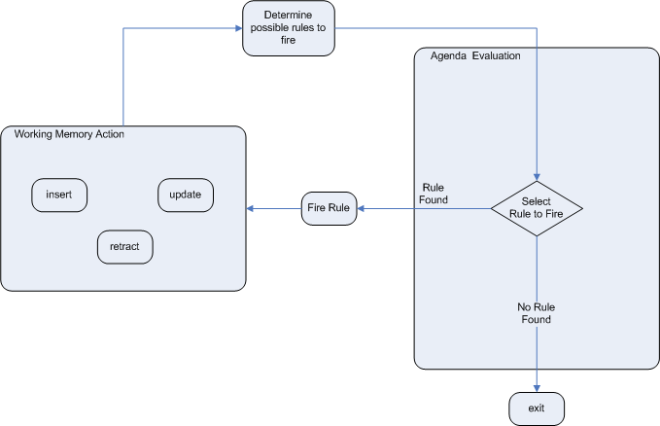
Execution Control - Agenda

Slide 21
Execution Control - Conflict
When there is one or more Rule Match on the Agenda they are said to be in conflict.
The Drools strategy is very simple and based around a salience value.
Each rule has a default value of 0, the higher the value the higher the priority.
As of Drools 6.0 rule definition order in the source file is used to set priority after salience.

Slide 22
Rule Language
Drools has a "native" rule language.
Supports natural and domain specific languages.
A rule file is typically a file with a .drl extension.
In a DRL file you can have multiple rules, queries and functions…
A DRL file is simply a text file.

Slide 23
Rule Language
A typical rule file
package package-name
// imports
// globals
// functions
// queries
// rules

Slide 24
Rule Language
import
Import statements work like import statements in Java.
global
Define global variables - they are used to make application objects available to the rules. Must be set to the session.
function
Similar to static helper method. We can import a static method in a rule file.

Slide 25
Rule Language
Declaring new types
declare Address // Can use annotation or extends another type number : int street_name : String city : String end
/**********************************/
declare enum DaysOfWeek
SUN("Sunday"), MON("Monday"), TUE("Tuesday");
fullName : String end

Slide 26
Rule Language
What makes a rule
rule "name of your rule" [attributes] // dialect, salience, no-loop... when LHS // Left Hand Side - Condition then RHS // Right Hand Side - Action end

Slide 27
Rule Language
Left Hand Side (when)
The LHS consists of zero or more Conditional Elements.
If the LHS is empty, it will be considered as a condition element that is always true and it will be activated once.

Slide 28
Rule Language
Pattern (conditional element)
Matches against a fact of the given type:
$person : Person()
Matches superclasses or interfaces:
$any : Object()
Pattern with constraint:
Person( gender == “f”, age == 18, address.(city == “HCM”, ward == “TB”) )

Slide 29
Rule Language
Pattern (conditional element)
Null-safe dereferencing:
Person( $streetName : address!.street ) // address must not be null
Work with collection:
Person( lovers contains “Tram” ) // memberOf, not contains...
Matches by pronunciation:
Cheese( name soundslike “foobar” ) // match cheese “fubar” or “foobar”
https://docs.jboss.org/drools/release/7.7.0.Final/drools-docs/html_single/index.html#_left_hand_side_when_syntax

Slide 30
Rule Language
Right Hand Side (then)
This part should contain a list of actions to be executed.
Should not use imperative or conditional code. (when this, maybe to this)
If you still want to use conditional code, then maybe you should break to multiple rules.
The main purpose of the RHS is to insert, delete or modify working memory data.
There are a few convenience methods in the next slide.

Slide 31
Rule Language
Right Hand Side (then)
Tell the engine that an object has changed, and rules may need to be reconsidered:
update( object );
Place a new object of your creation into the Working Memory:
insert( new Something() );
insertLogical( new Something() );
Removes an object from Working Memory:
delete( object );

Slide 32
Rule Language
Right Hand Side (then)
Update fact in a structured approach:
rule "modify stilton" when $stilton : Cheese(type == "stilton") then modify( $stilton ){ setPrice( 20 ), setAge( "overripe" ) } end

Slide 33
Rule Language
Right Hand Side (then)
Predefined variables:
drools.halt(); // terminate rule execution immediately
drools.update( object );
drools.getWorkingMemory();
kcontext.getKieRuntime().halt();

Slide 34
DSL - Domain Specific Languages
Domain Specific Languages are a way of creating a rule language that is dedicated to your problem domain.
We write rules in DSL rule files (.DSLR)
DSL "sentences" will be translated to DRL constructs
DSLs have no impact on the rule engine at runtime, they are just a compile time feature, requiring a special parser and transformer.

Slide 35
DSL - Domain Specific Languages
Mapping
[when]There is a person with name of "{name}" = Person(name=="{name}")
[when]Person is at least {age} years old and lives in "{location}" = Person(age >= {age}, location=="{location}")
[then]Log "{message}" = System.out.println("{message}");
[when]And = and

Slide 36
DSL - Domain Specific Languages
Mapping
[when]There is a Cheese with = Cheese()
[when]- age is less than {age} = age < {age}
[when]- type is '{type}' = type == '{type}'
[when]- country equal to '{country}' = country == '{country}'
/******************/
There is a Cheese with - age is less than 42 - type is 'stilton'
=> Cheese( age < 42, type=='stilton' )

Slide 37
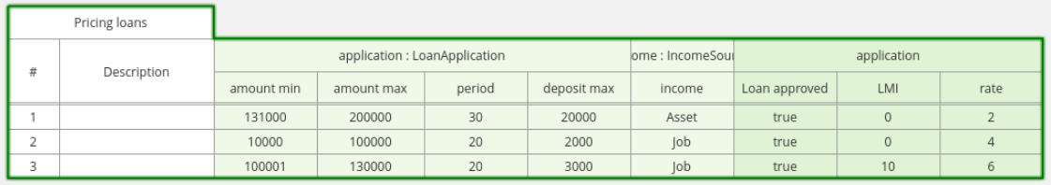
Decision Table
Rule attributes, meta-data, conditions and actions can be defined in a tabular format thus facilitating rapid entry of large sets of related rules.
Decision table rules are compiled into DRL.

Slide 38
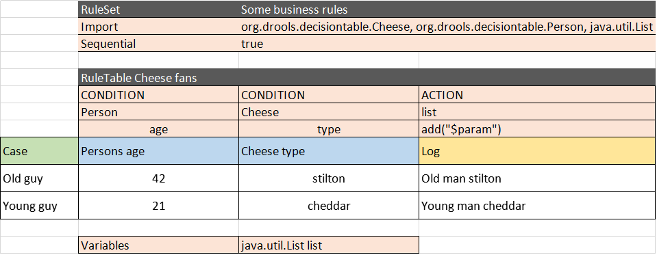
Decision Table

Slide 39
References
https://docs.jboss.org/drools/release/7.7.0.Final/drools-docs/html_single/index.html#_user_guide
https://docs.jboss.org/drools/release/7.7.0.Final/drools-docs/html_single/index.html#_droolslanguagereferencechapter
https://docs.jboss.org/drools/release/5.2.0.Final/drools-expert-docs/html/ch06.html

