Slide 1

MongoDB Tutorials
2023

Slide 2
MongoDB Installation
Install MongoDB Community on Local Machine
Install using Docker

Slide 3

Request
(username, password, commands)
Response
MongoDB client
(Compass, mongosh, NodeJS…)
MongoDB Server
(Local Machine, Cloud)

Slide 4

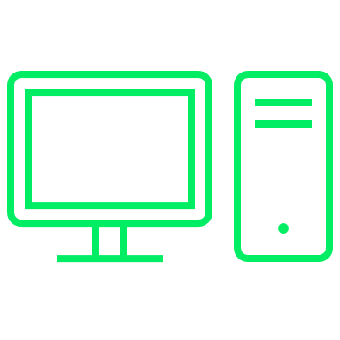
8082:8081
Mongo-Express
MongoDB Server: 8081
27018: 27017
Host(PC, laptop, cloud)
MongoDB Server:27017
Other services…
mongo-composer.yml

