Slide 1
PRESENTATION 1
OVERVIEW SD
SALES PROCESS
ORGANIZATION STRUCTURE
MENTOR: Mr. HIEU, Mr. BANG
PRESENTER: Mr. Vu

Slide 2
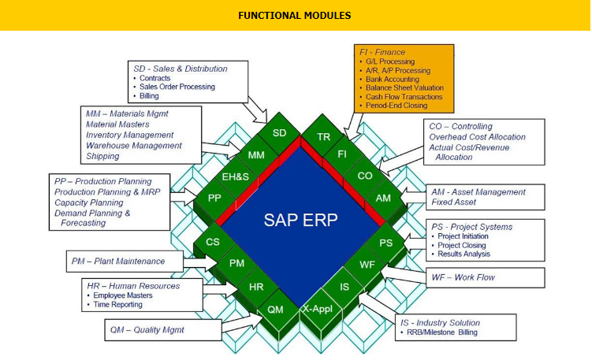
1. OVERVIEW SD

Slide 3
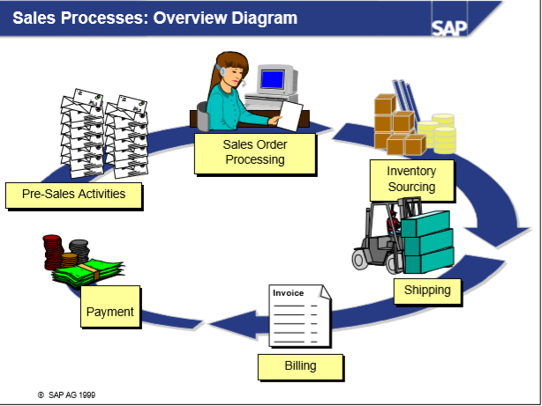
2. SALES PROCESS

Slide 4
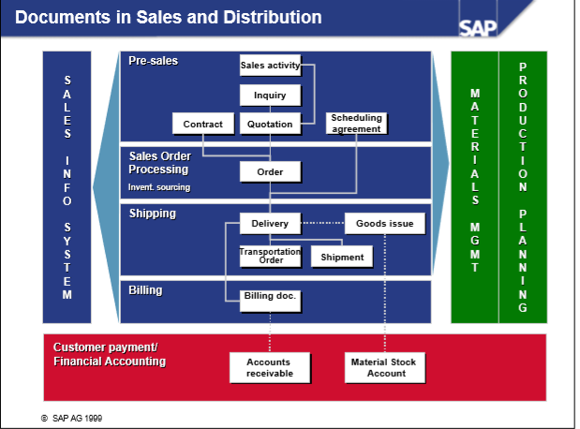

Slide 5
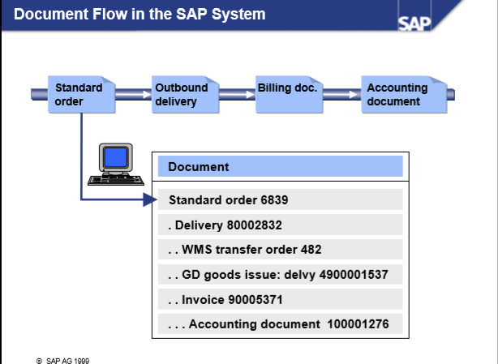

Slide 6
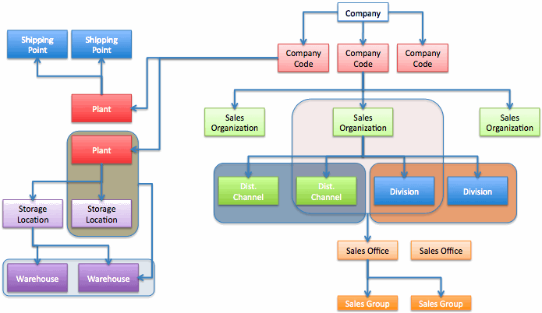
3. ORGANIZATION STRUCTURE

Slide 7
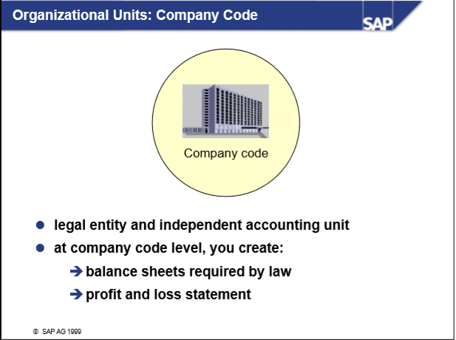

Slide 8
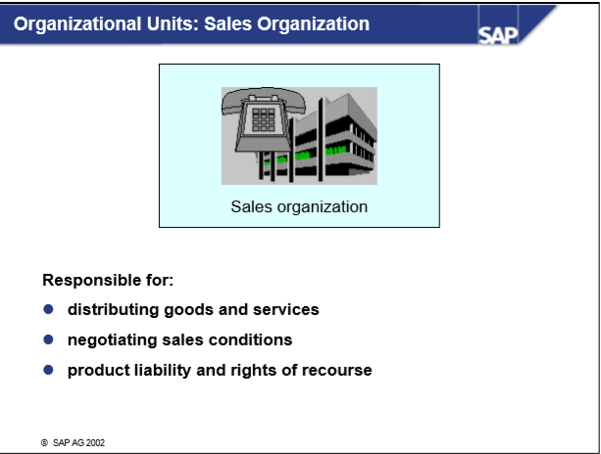

Slide 9
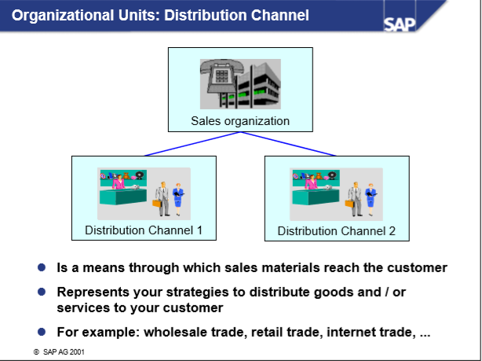

Slide 10
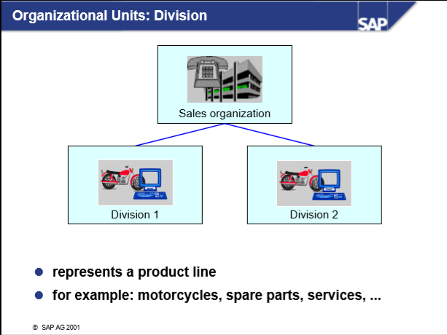

Slide 11
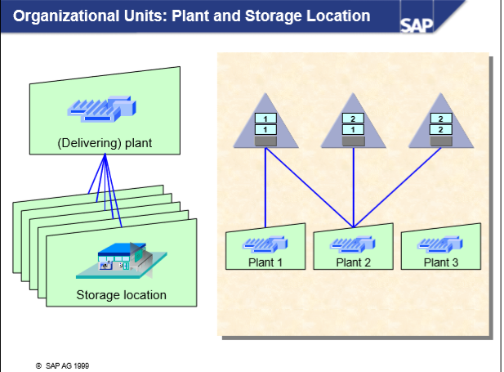

Slide 12
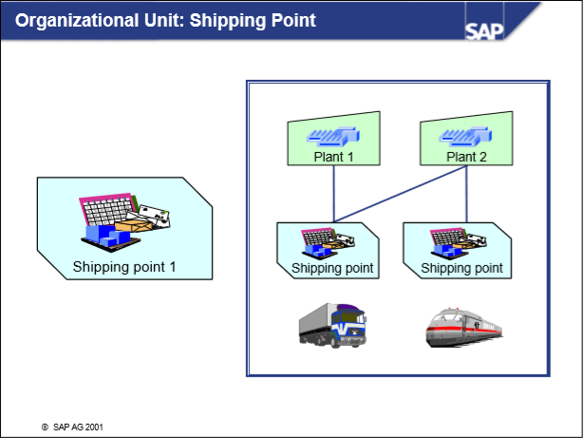

Slide 13
EXAMPLE
Company Vinfast specializing in car manufacture (Finished car + Spare part)
2 Branch in Ha Noi and HCM, 1 plant in Dong Nai
Distributor + sell directly from ABC's agency
2 Storage Location ( Nhon Trach IZ + Dong Nai IZ) , each of them has 2 warehouses, one for finished product + one for spare part
2 shipping point: north gate + south gate of Dong Nai Plant
2 sales office: Ha Noi, HCM
Sales office Ha Noi: Sales Group for Spare part, Sales Group for Finished car
Sales office HCM: Sales Group for Spare part, Sales Group for Finished car

Slide 14
THANK YOU

