Slide 1
COMPUTER STORE INFORMATION MANAGEMENT SYSTEM
OBJECTIVE
APPROACH
DATABASE
GUI
GROUP 5:
BA9-043 Nguyen Ngoc Minh
BI11-261 Ha Trung Tin
BI11-258 Le Phuong Thu
BI11-290 Nguyen Anh Vu
BI11-107 Truong Tuan Hung
BI11-157 Nguyen Hoang Long
COMPUTER STORE INFORMATION MANAGEMENT SYSTEM

Slide 2
DATABASE
OBJECTIVE AND APPROACH
TABLE OF CONTENTS
GUI
DEMO
OBJECTIVE
APPROACH
DATABASE
GUI
01
02
03
04
COMPUTER STORE INFORMATION MANAGEMENT SYSTEM

Slide 3

OBJECTIVE AND APPROACH
OBJECTIVE
APPROACH
DATABASE
GUI
01
COMPUTER STORE INFORMATION MANAGEMENT SYSTEM

Slide 4

OBJECTIVE
OBJECTIVE
APPROACH
DATABASE
GUI
Computer Store Information Management System
The system's goal is to give information about retailing computer products and office equipment, particularly data on:
+
+
COMPUTER STORE INFORMATION MANAGEMENT SYSTEM

Slide 5
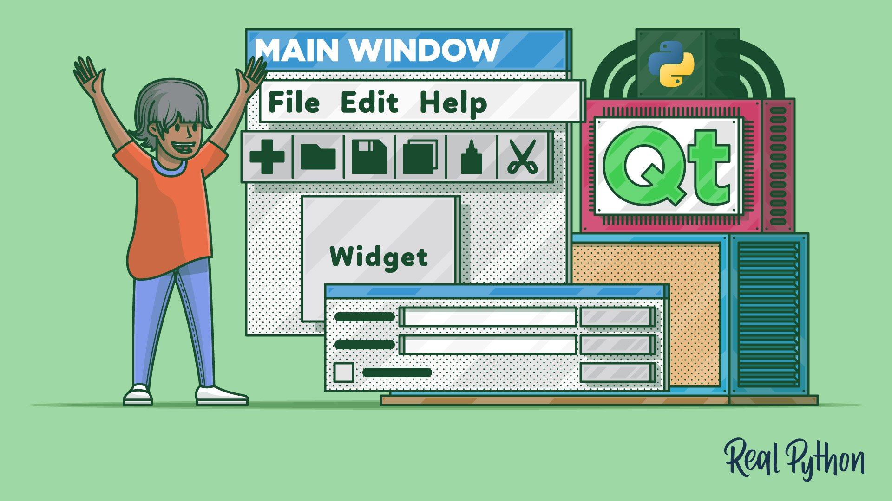

APPROACH
OBJECTIVE
APPROACH
DATABASE
GUI
Qt Python for GUI
MySQL for Database
COMPUTER STORE INFORMATION MANAGEMENT SYSTEM

Slide 6
DATABASE
OBJECTIVE
APPROACH
DATABASE
GUI
02
COMPUTER STORE INFORMATION MANAGEMENT SYSTEM

Slide 7
DATABASE
OBJECTIVE
APPROACH
DATABASE
GUI
COMPUTER STORE INFORMATION MANAGEMENT SYSTEM

Slide 8
DATABASE
OBJECTIVE
APPROACH
DATABASE
GUI
COMPUTER STORE INFORMATION MANAGEMENT SYSTEM

Slide 9
GUI
OBJECTIVE
APPROACH
DATABASE
GUI
PROJECT PROPOSAL

Slide 10
THANKS FOR LISTENING!
OBJECTIVE
APPROACH
DATABASE
GUI
Do you have any questions?
youremail@freepik.com
+91 620 421 838
yourcompany.com
https://github.com/hatrungt1n/Computer-Store-Information-Management-System.git
COMPUTER STORE INFORMATION MANAGEMENT SYSTEM

