Slide 1
COMPUTER STORE INFORMATION MANAGEMENT SYSTEM
OBJECTIVE
APPROACH
DATABASE
GUI
GROUP 5:
BA9-043 Nguyen Ngoc Minh
BI11-261 Ha Trung Tin
BI11-258 Le Phuong Thu
BI11-290 Nguyen Anh Vu
BI11-107 Truong Tuan Hung
BI11-157 Nguyen Hoang Long
COMPUTER STORE INFORMATION MANAGEMENT SYSTEM

Slide 2
DATABASE
OBJECTIVE AND APPROACH
TABLE OF CONTENTS
GUI
DEMO
OBJECTIVE
APPROACH
DATABASE
GUI
01
02
You can describe the topic of the section here
03
04
COMPUTER STORE INFORMATION MANAGEMENT SYSTEM

Slide 3

OBJECTIVE AND APPROACH
OBJECTIVE
APPROACH
DATABASE
GUI
01
COMPUTER STORE INFORMATION MANAGEMENT SYSTEM

Slide 4

OBJECTIVE
OBJECTIVE
APPROACH
DATABASE
GUI
Computer Store Information Management System
The system's goal is to give information about retailing computer products and office equipment, particularly data on:
+
+
COMPUTER STORE INFORMATION MANAGEMENT SYSTEM

Slide 5
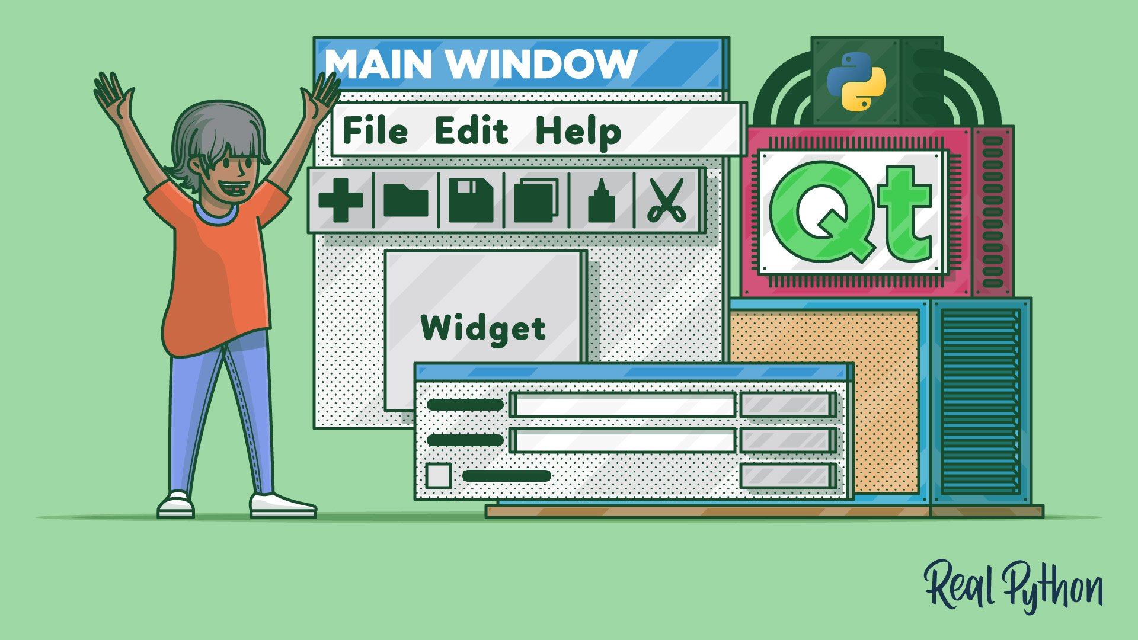

APPROACH
OBJECTIVE
APPROACH
DATABASE
GUI
Qt Python for GUI
MySQL for Database
COMPUTER STORE INFORMATION MANAGEMENT SYSTEM

Slide 6
DATABASE
OBJECTIVE
APPROACH
DATABASE
GUI
02
COMPUTER STORE INFORMATION MANAGEMENT SYSTEM

Slide 7
DATABASE
OBJECTIVE
APPROACH
DATABASE
GUI
COMPUTER STORE INFORMATION MANAGEMENT SYSTEM

Slide 8
DATABASE
OBJECTIVE
APPROACH
DATABASE
GUI
COMPUTER STORE INFORMATION MANAGEMENT SYSTEM

Slide 9
GUI
OBJECTIVE
APPROACH
DATABASE
GUI
PROJECT PROPOSAL

Slide 10
THANKS FOR LISTENING!
OBJECTIVE
APPROACH
DATABASE
GUI
Do you have any questions?
youremail@freepik.com
+91 620 421 838
yourcompany.com
https://github.com/hatrungt1n/Computer-Store-Information-Management-System.git
COMPUTER STORE INFORMATION MANAGEMENT SYSTEM

