Slide 1
LOCAL WEATHER MONITORING, FORECASTING SYSTEM USING NEURAL NETWORK AND LORA COMMUNICATION TECHNOLOGY
23/11/2018
Instructor: Ph.D Trinh Le Huy
Student 1: Nguyen Manh Thao Student ID: 14520853
Student 2: Quach The Hao Student ID: 14521124
Copyrights 2016 UIT-Khoa KTMT . All Rights Reserved.
Notes:
Hello everyone, I am Nguyen Manh Thao and this is Quach The Hao. We are about to give a presentation of our thesis progress report.

Slide 2
Contents
Remind of expected results
Achievement
Plan
Copyrights 2016 UIT-Khoa KTMT . All Rights Reserved.

Slide 3
Remind of expected results
Functioning system and packaged nodes to be able to work outdoor
Increase rain forecasting accuracy by 3% comparing to the system in 2016
Design the anti-collision algorithm to decrease packet collision rate
Copyrights 2016 UIT-Khoa KTMT . All Rights Reserved.
Notes:
First of all, we would like to remind you of the expected results in this project. Because nodes must work outdoor to collect environmental data, it needs to be packaged carefully so that it can work under the rain or even in the storm. Next, in 2016, there is a forecasting system that archived 60% of rain forecasting accuracy. So, we want to increase that accuracy to 63% by using the Neural Network. And finally, to decrease the packet collision in LoRa bandwidth, we want to design a separate anti-collision algorithm to decrease the packet collision rate.

Slide 4
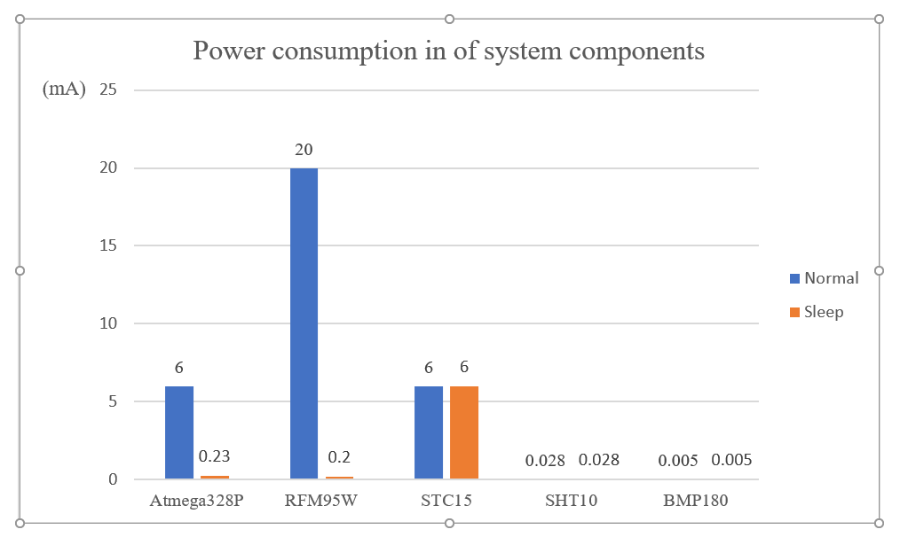
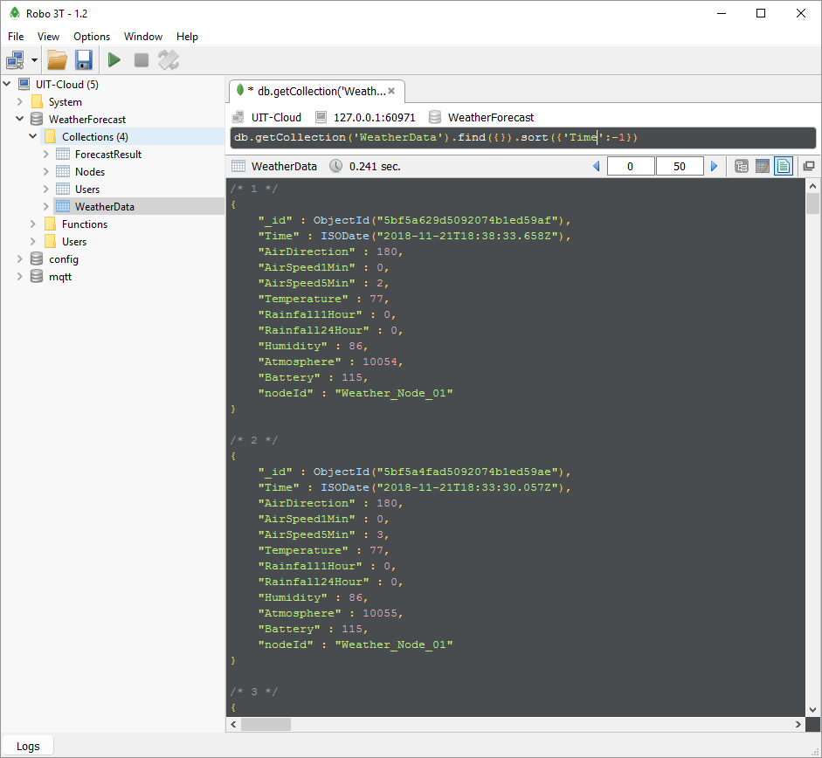
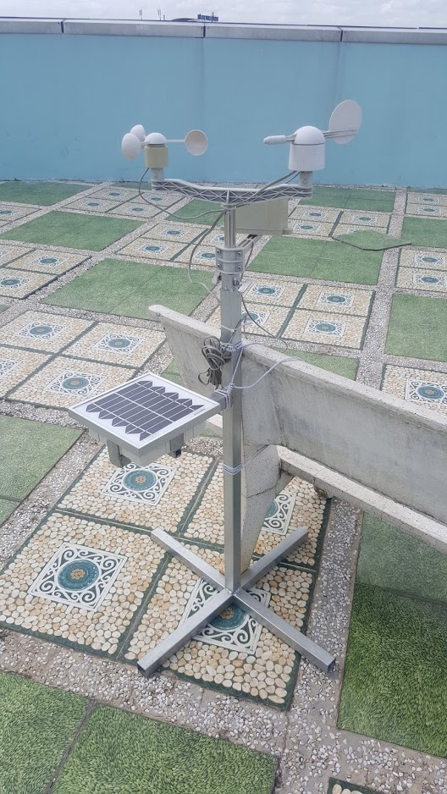
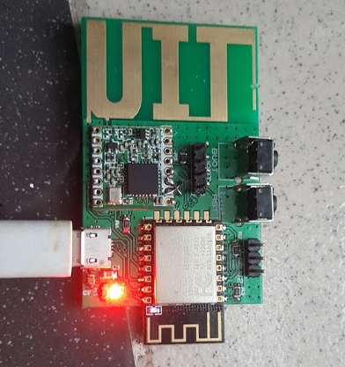
Achievement
Copyrights 2016 UIT-Khoa KTMT . All Rights Reserved.
Notes:
So what have we done until now? We have successfully rebuilt the system which is collecting the environmental data right now and save it to the database for analyzing and building the Neural Network models. The system including a node put on the roof of this building and a gateway put next to room E6.2. More than that, we have optimized the power consumption of the node up to 95% thanks to sleep mode on MCU & LoRa module. The detailed power consumption comparison to the last system is described in the summary report.

Slide 5
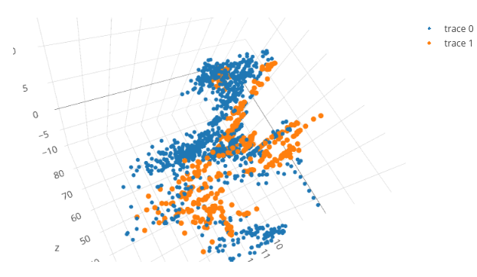
Achievement
Stage | Result | Modification
Aug 25th - Sep 19th | N/A | Multi-layer Perceptron and Back-propagation with 8 raw inputs
Sep 25th - Oct 10th | 45% | Changing input of the models: Wind speed, wind direction, hour in day, average temperature, average humidity, total pressure reduction. Using softmax regression transfer function at output layer.
Oct 10th - Present | 80% | Applying Dropout technique in learning
Copyrights 2016 UIT-Khoa KTMT . All Rights Reserved.
Notes:
About the Neural Network models, we have examined some popular ANN models and algorithms such as Naive Bayes, Binary Classifiers, K-nearest neighbors, Softmax Regression, Multi-layer Perceptron, and Back-propagation, Support Vector Machine, and Decision Trees; analyzed their pros and cons to our problem which is rain forecasting 2 hours in advance. You can see the result as a comparison table in the summary report. After that, we have decided to use Multi-layer Perceptron and Back-propagation to solve our problem base on the comparison table and the data analysis you see here. We have built this model in C++, went through 3 stages of modification until now and get about 80 percent of the accuracy. What a result!

Slide 6
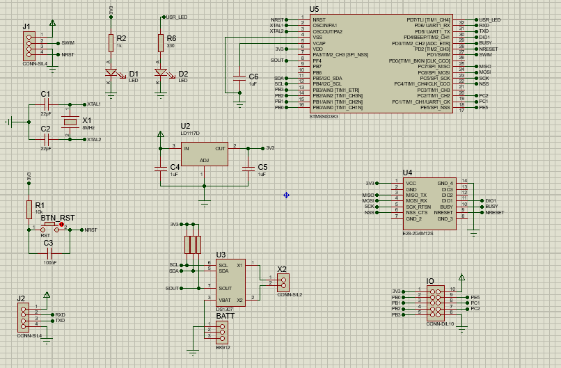
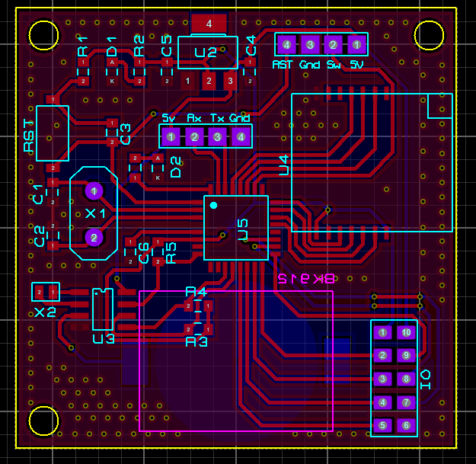
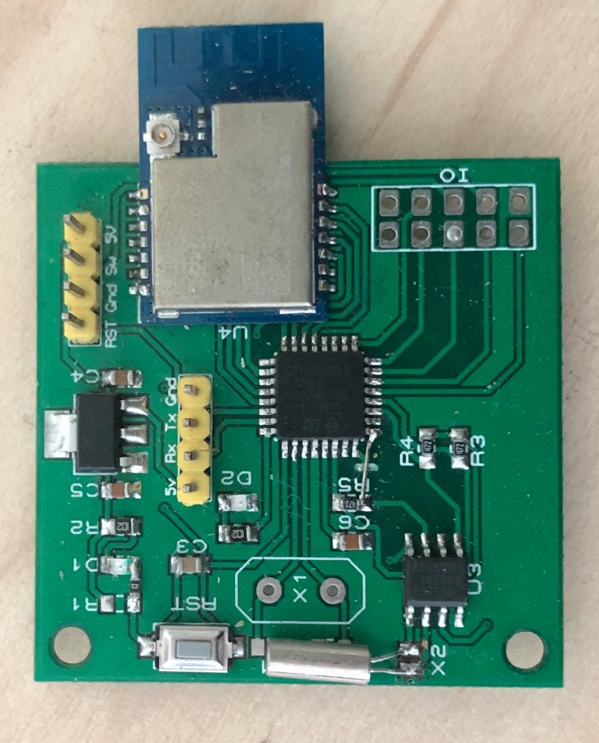
Achievement
Copyrights 2016 UIT-Khoa KTMT . All Rights Reserved.
Notes:
About the simulation of the anti-collision algorithm. We have completed the designing phase and soldered up to 30 nodes. Now, we are currently developing the firmware for this simulation system and expect to get the result in 2 more weeks. Our current setting for the simulation network is SF=8, BW=200kHz, CR=4/5, Explicit Header, Preamble=16.25syms, Header 8syms, Payload=253 bytes, CRC=16Bits, Transmit Power=12.5dBm. With this setting, Time on Air=434.1281ms. So that, every slot should be 1 second in length. Because we need to send the packet every 5 minutes, we will have 300 slots. The algorithm is very simple. Each transmission is done in one timeslot including an uplink and a downlink (or ACK) operations. When the transmission fails, the node will find the nearest Emergency slot to retransmit the packet with error information attached. The uplink operation doesn't start at the beginning of the timeslot, it has a random offset to avoid the failure in both collision nodes.

Slide 7
Plan
Integrate the forecasting module into the system
Examining the SVM models
Develop a web interface
Designing the gateway case
Examining the anti-collision algorithm
Copyrights 2016 UIT-Khoa KTMT . All Rights Reserved.
Notes:
In the remaining time of this thesis, we would like to complete following tasks. Integrate the forecasting module into the system and running the forecast in real time. Examine the SVM models and give the comparison of the forecasting accuracy. Develop a web interface for monitoring and managing the system. Examining the anti-collision algorithm, comparing to other anti-collision algorithm such as pure ALOHA and slotted ALOHA.

Slide 8
End
Thank you for your listening
Copyrights 2016 UIT-Khoa KTMT . All Rights Reserved.
Notes:
That’s all about our progress report. Thanks for your listening!

