Slide 1
LOCAL WEATHER MONITORING, FORECASTING SYSTEM USING NEURAL NETWORK AND LORA COMMUNICATION TECHNOLOGY
Instructor: Ph.D Trịnh Lê Huy
Nguyễn Mạnh Thảo - Student ID: 14520853
Quách Thế Hào - Student ID: 14521124

Slide 2
Agenda
Content 1: Thesis overview
Content 2: Neural Network model
Content 3: Anti-collision strategy
Content 4: Expected results

Slide 3
Content 1: Thesis overview
Research and implement a local weather monitoring and forecasting system
Using Artificial Neural Network to forecast rainfall to increase the accuracy of forecasting results along with system using time
Applying an anti-collision strategy on LoRa bandwidth

Slide 4
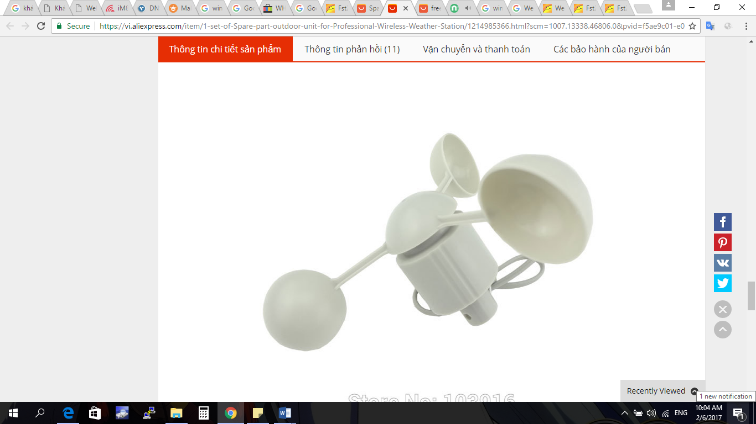
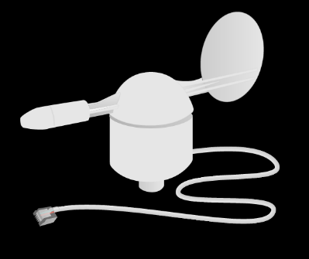
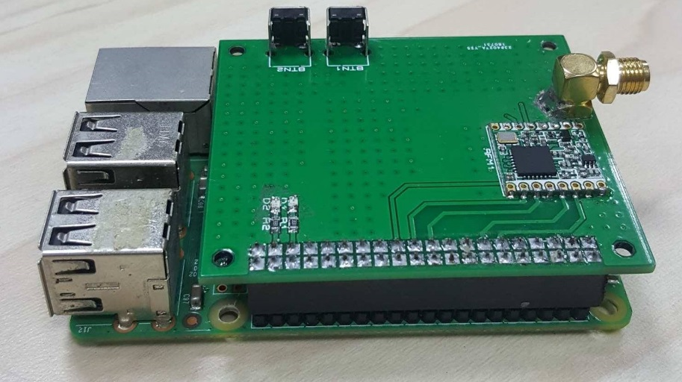



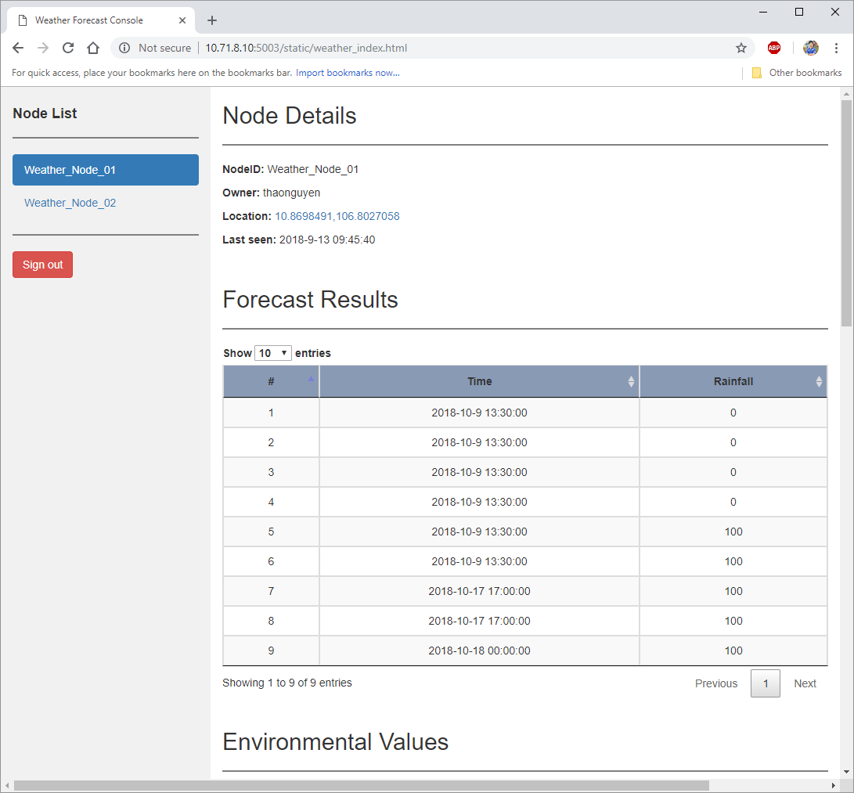
Content 1: Thesis overview
Design of the system
Nodes
Gateway
Web
Server

Slide 5
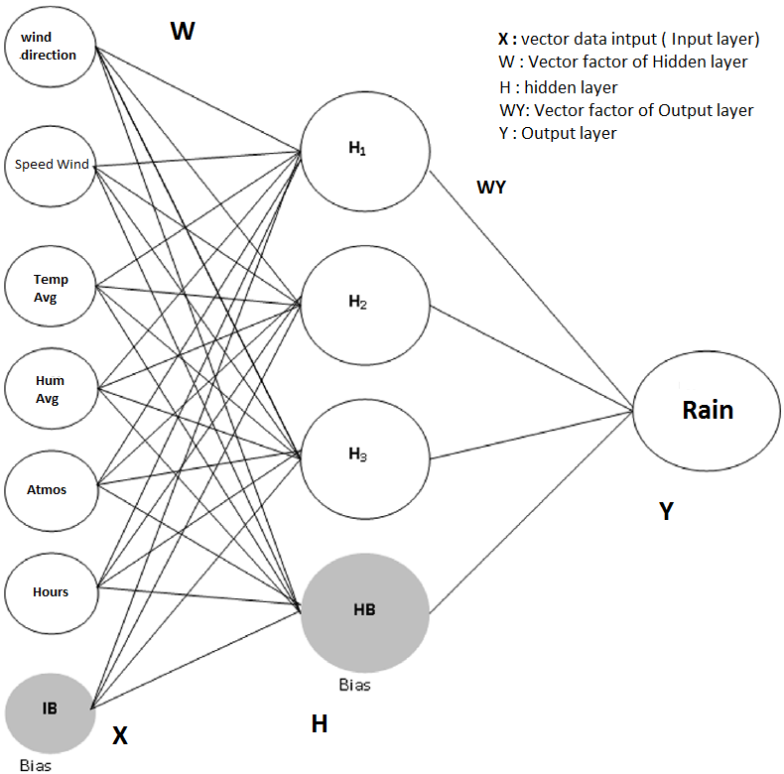
Content 2: Neural Network model
Model: Multi-layer
H = sigmoid(W,X)
Y = softmax(WY,H)
Utilized by Backpropagation

Slide 6
Content 2: Neural Network model
Backpropagation
Pros
High applicability
Compatible with many trigger and loss functions
Vector standardization is not required
Cons
Without a good initialization, the result can be unexpected because of local maximum value

Slide 7
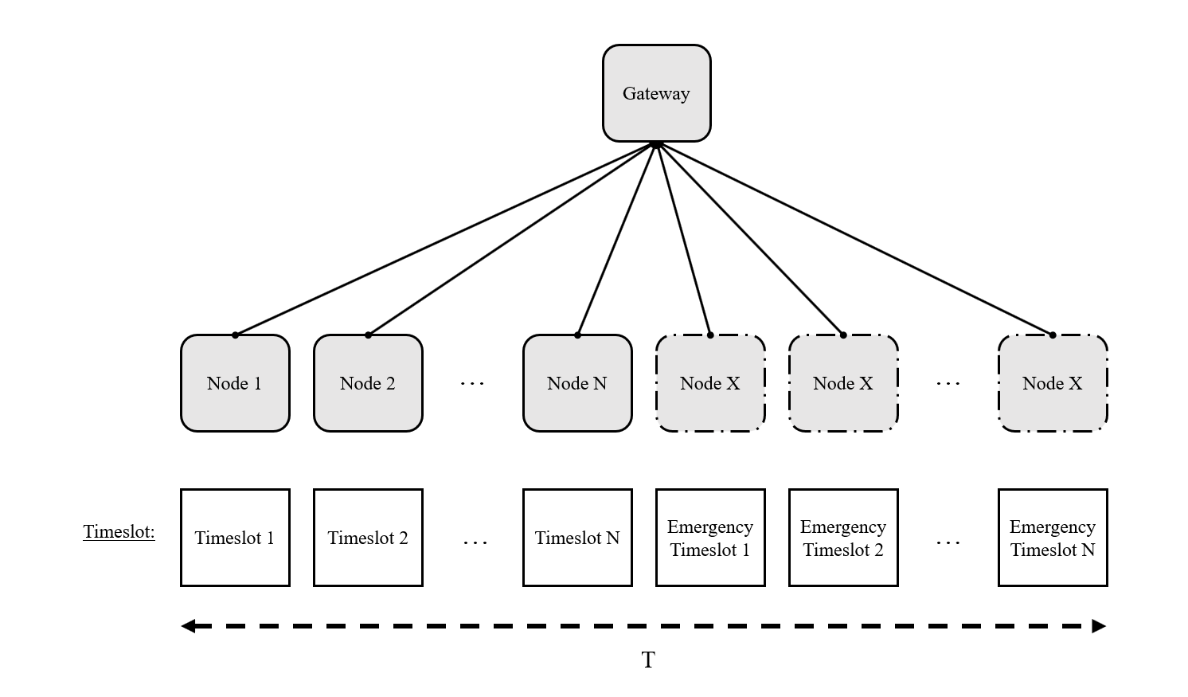
Content 3: Anti-collision strategy

Slide 8
Content 4: Expected results
Functioning system and packaged nodes to be able to work outdoor
Increase rainfall forecasting accuracy to 63%
Decrease packet collision rate to 1%
Notes:
The hardware system collects weather data independently and be able to work in windy weather environment.
The local weather forecasting application using Back-propagation Neural Network model. Increase rainfall forecasting accuracy to 63% comparing to 60% of the local weather forecasting application using Fuzzy Logic.
Solving the data collision problem with timeslot protocol

Slide 9
Q&A
Thank you for listening

