Slide 1
COMP258 · Neural Networks · Final Project
Student Success Prediction
A full-stack intelligent web app that forecasts
persistence, GPA, and at-risk status using deep learning.
Group: 5
Members:
Minh Doan Nguyen – 301413330
Presented in Week 14 · Centennial College

Slide 2
Agenda
What we will cover today
01
Problem & Motivation
02
Dataset & Preprocessing
03
System Architecture
04
Neural Network Models (×4)
05
Training Strategy
06
Results & Evaluation
07
Live Demo
08
Challenges & Future Work
COMP258 · Student Success Prediction · Full-Stack Intelligent App
2 / 20

Slide 3
Problem & Motivation
Why predicting student outcomes matters
The challenge
4
~1,400
• Post-secondary institutions lose a meaningful share of first-year students.
• Early identification of at-risk students enables timely intervention.
• Instructors need lightweight, data-driven tools, not black-box dashboards.
• Client asks for an admin-friendly app that turns existing data into action.
neural networks trained
student records
14-15
REST + React
features per model
full-stack delivery
COMP258 · Student Success Prediction · Full-Stack Intelligent App
3 / 20

Slide 4
Project Objectives
Four prediction tasks delivered as one intelligent app
01
First-Year Persistence
02
Second-Term GPA
Binary classification: will this student continue after year 1?
Regression from 1st-term GPA, HS marks and demographics.
03
At-Risk Detection
04
Stacked Academic Score
Flag students needing support (persistence = 0 OR GPA < 2.0).
Two-stage regression for an overall academic-performance score.
COMP258 · Student Success Prediction · Full-Stack Intelligent App
4 / 20

Slide 5
Dataset Overview
Centennial College student records (NDA-protected)
Input features (14-15 per model)
Dataset snapshot
• Academic: first / second term GPA, HS average, math score, English grade
• Program: school, funding, fast-track, coop, residency, prev. education
• Demographic: gender, age group, first language
• Target labels: first-year persistence (0/1), GPA (0.0-4.5), derived at-risk
~1,400
records
15
raw variables
Numeric + Categorical
mixed types
Imputed
median / mode per column
Standardized
StandardScaler on features
80 / 20
train / test split
COMP258 · Student Success Prediction · Full-Stack Intelligent App
5 / 20

Slide 6
Data Preparation Pipeline
From raw CSV to model-ready tensors
1
2
3
4
5
Ingest
→
Clean
→
Split
→
Scale
→
Train
Load CSV →
persist to SQLite
Drop rows w/o target
Impute features
80 / 20
stratified where possible
StandardScaler
fit on train only
Keras Sequential
early-stopping + LR decay
Why imputation?
• Dropping any missing value collapsed the dataset from ~1,400 rows to ~500 — too little signal.
• We only drop rows whose target label is missing, then impute feature NaNs (median for numeric, mode for categorical).
• This preserves variance while keeping labels honest.
COMP258 · Student Success Prediction · Full-Stack Intelligent App
6 / 20

Slide 7
System Architecture
React SPA → Flask REST API → TensorFlow models + SQLite
Frontend
Backend
ML Layer
Storage
React 18 SPA
Flask + Blueprints
TensorFlow / Keras
SQLite + CSV seed
• Dashboard, Data Explorer
• Prediction forms for each task
• Model-metrics panel, Admin panel
• Axios client · Chart.js
• MVC: routes / services / models
• /api/data · /api/predict
• /api/models · /api/admin
• CORS enabled for SPA
• 4 Sequential neural nets
• StandardScaler per model
• .keras + .pkl artefacts
• Retrain endpoint
• SQLAlchemy ORM
• Student + PredictionLog tables
• CSV re-import endpoint
• Docker-ready (compose)
HTTP / JSON · RESTful endpoints · stateless backend
COMP258 · Student Success Prediction · Full-Stack Intelligent App
7 / 20

Slide 8
Backend · Flask REST API
MVC blueprints with clear separation of concerns
Key endpoints
Design patterns
GET
/api/data/summary
dataset stats
• MVC: routes · services · models
• Blueprint: one per concern
• Repository: DB access via SQLAlchemy
• DI: prediction_service injected at startup
• Factory: create_app() builds the Flask app
GET
/api/data/students
paginated + filtered
GET
/api/data/correlation
feature correlation matrix
POST
/api/predict/persistence
classify persistence
POST
/api/predict/gpa
regress 2nd-term GPA
POST
/api/predict/atrisk
classify risk level
POST
/api/predict/pipeline
two-stage academic score
GET
/api/models/metrics
live evaluation metrics
POST
/api/admin/retrain
re-train all four models
COMP258 · Student Success Prediction · Full-Stack Intelligent App
8 / 20

Slide 9
Frontend · React SPA
Component-driven, feature-organised
Dashboard
DataExplorer
PersistencePrediction
GPAPrediction
home + KPIs
filter students
task form
task form
AtRiskPrediction
AcademicPipeline
ModelMetrics
AdminPanel
task form
two-stage demo
live metrics
retrain / reimport
Key frontend choices
• Single-Page App with react-router — no reloads between prediction screens.
• axios service module centralises API calls (src/services/api.js).
• Form inputs map directly to the backend feature contract for zero guesswork.
• Results cards reuse the same layout across all four models.
COMP258 · Student Success Prediction · Full-Stack Intelligent App
9 / 20

Slide 10
Neural Network Design — Shared Recipe
One proven architecture, four outputs
Input
14-15 features
Why this topology?
• Funnel widths: 128 → 64 → 32 compresses features gradually.
• BatchNorm: stabilises training, speeds convergence.
• Dropout: 0.3 / 0.2 / 0.1 fights overfitting on ~1k rows.
• L2 (1e-3): gentle weight decay on the two large layers.
• Head: sigmoid for classifiers, linear for regressors.
• Optimizer: Adam @ 1e-3 · reduced on plateau.
Dense 128 + BN + Drop 0.3
ReLU · L2(0.001)
Dense 64 + BN + Drop 0.3
ReLU · L2(0.001)
Dense 32 + Drop 0.2
ReLU
Dense 1
sigmoid / linear
COMP258 · Student Success Prediction · Full-Stack Intelligent App
10 / 20

Slide 11
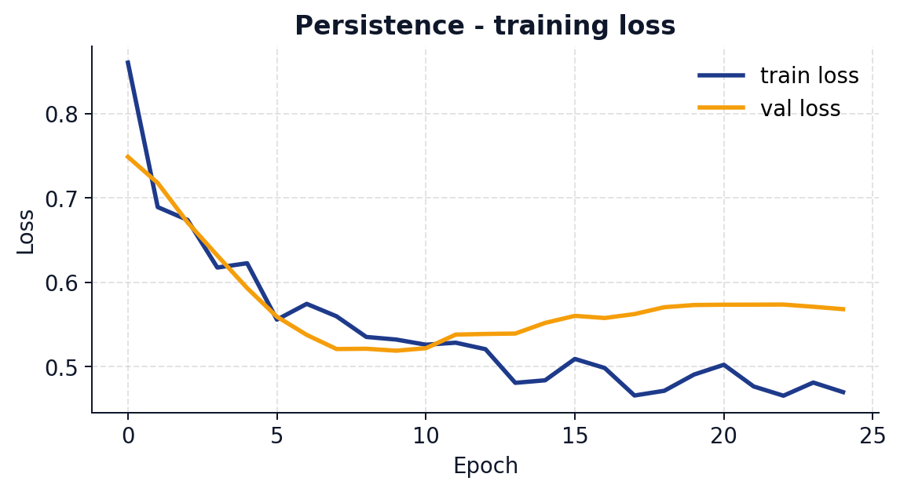
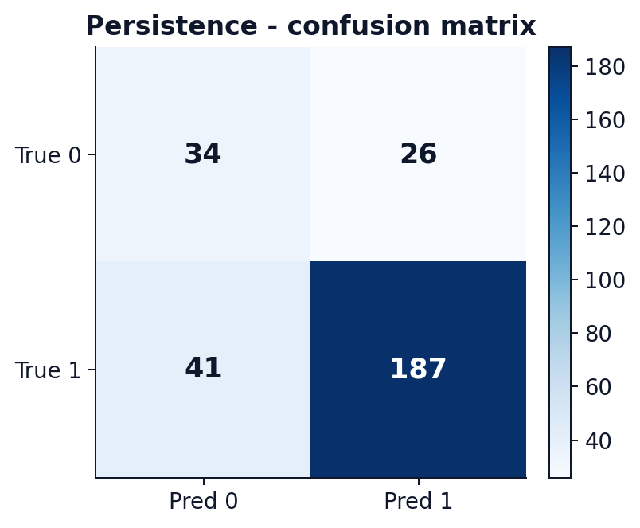
Model 1 · Persistence Classifier
Binary classification: will the student continue past year 1?
Accuracy
Precision
76.7%
87.8%
Recall
F1
82.0%
84.8%
Train / Test: 1149 / 288 samples · Epochs trained: 25
Inputs
1st & 2nd term GPA · HS avg · math · English · school · funding · residency · age · gender · first language · fast-track · coop · prev. education
COMP258 · Student Success Prediction · Full-Stack Intelligent App
11 / 20

Slide 12
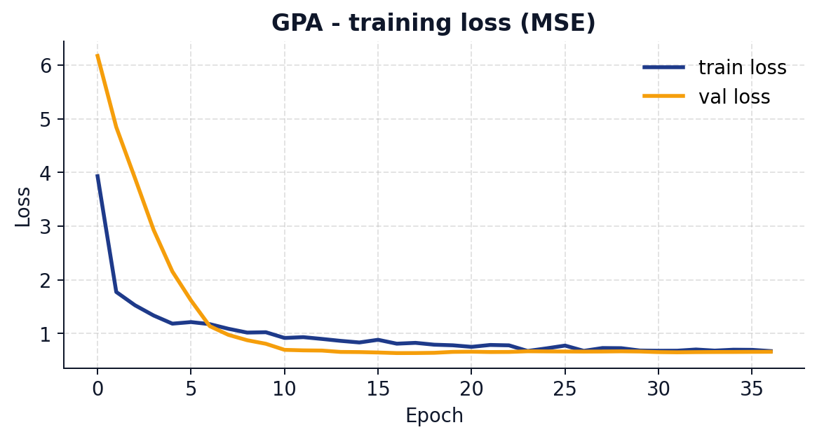
Model 2 · GPA Regressor
Regression: predict second-term GPA (0.0 - 4.5)
R²
MAE
0.605
0.516
RMSE
Epochs
0.660
37
Train / Test: 1021 / 256 samples · Epochs trained: 37
Inputs
1st term GPA · HS avg · math · English · school · funding · residency · age · gender · first language · fast-track · coop · prev. education
COMP258 · Student Success Prediction · Full-Stack Intelligent App
12 / 20

Slide 13
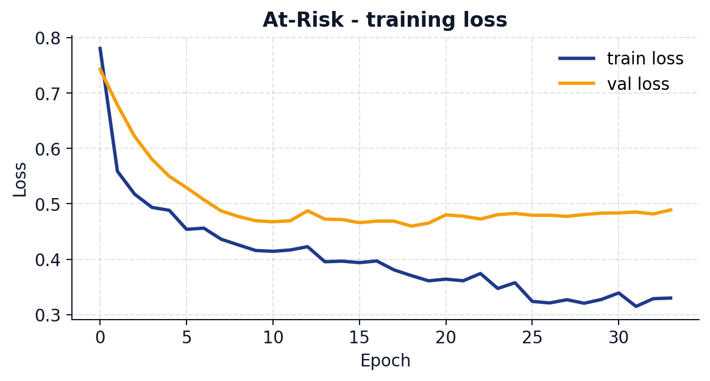
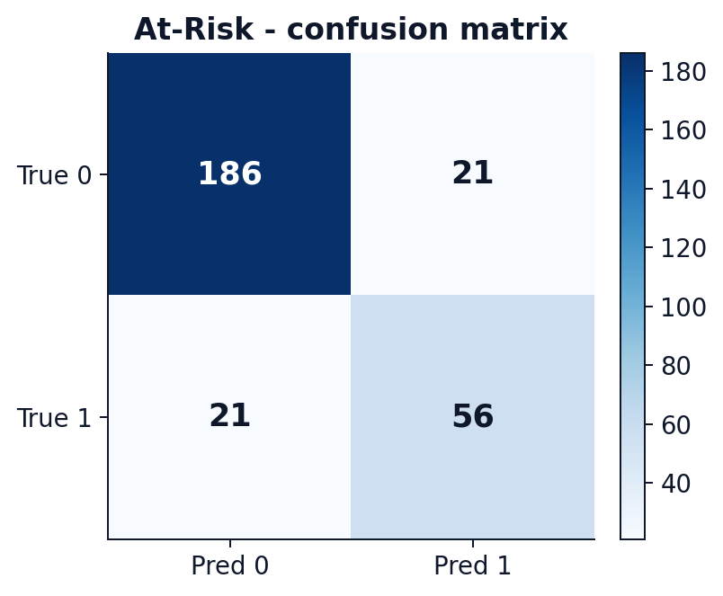
Model 3 · At-Risk Classifier
Flag students with persistence = 0 OR first-term GPA < 2.0
Accuracy
Precision
85.2%
72.7%
Recall
F1
72.7%
72.7%
Train / Test: 1136 / 284 samples · Epochs trained: 34
Inputs
1st term GPA · HS avg · math · English · school · funding · residency · age · gender · first language · fast-track · coop · prev. education
COMP258 · Student Success Prediction · Full-Stack Intelligent App
13 / 20

Slide 14
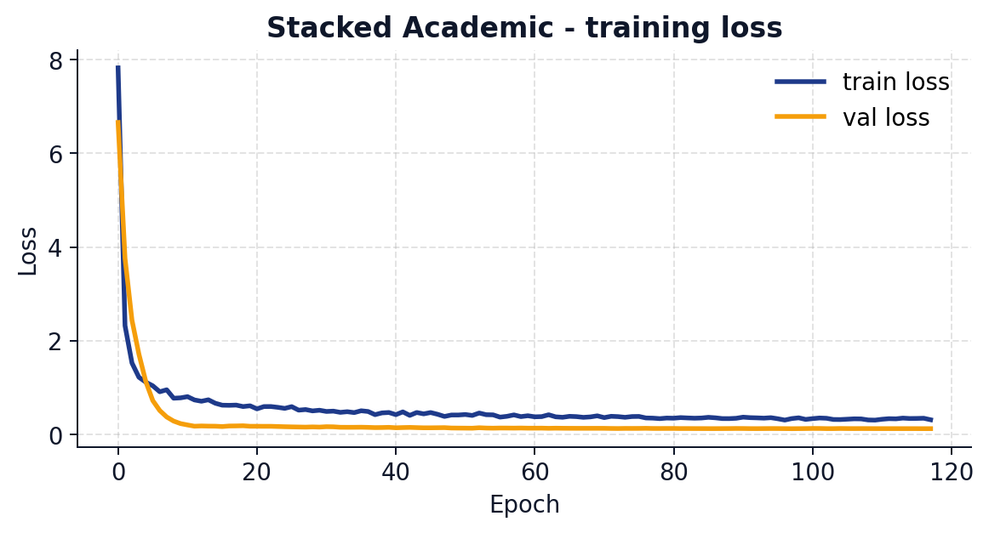
Model 4 · Stacked Academic Pipeline
Stage-2 regression: GPAs + HS + demographics → overall score
R²
MAE
0.958
0.139
RMSE
Epochs
0.190
118
Train / Test: 1021 / 256 samples · Epochs trained: 118
Inputs
1st + 2nd term GPA · HS avg · math · English · plus the full demographic set (14 features total)
COMP258 · Student Success Prediction · Full-Stack Intelligent App
14 / 20

Slide 15
Training Strategy
Robust training without overfitting the small dataset
EarlyStopping
patience 15-20 on val_loss, restore best weights
ReduceLROnPlateau
halve LR if val_loss stalls 5-7 epochs
Class weights
balance persistence/at-risk imbalance
StandardScaler
fit on train only, applied consistently at inference
Seeded RNGs
Python · NumPy · TensorFlow (SEED = 42) → reproducible runs
Dropout + L2
regularise the 128/64 layers against tiny-dataset overfit
COMP258 · Student Success Prediction · Full-Stack Intelligent App
15 / 20

Slide 16
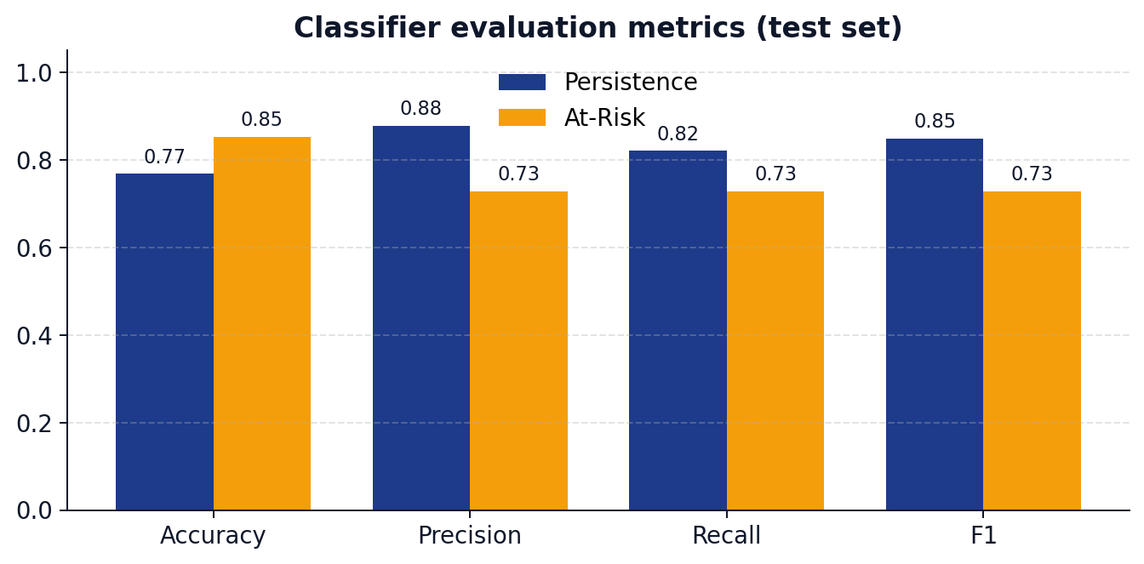
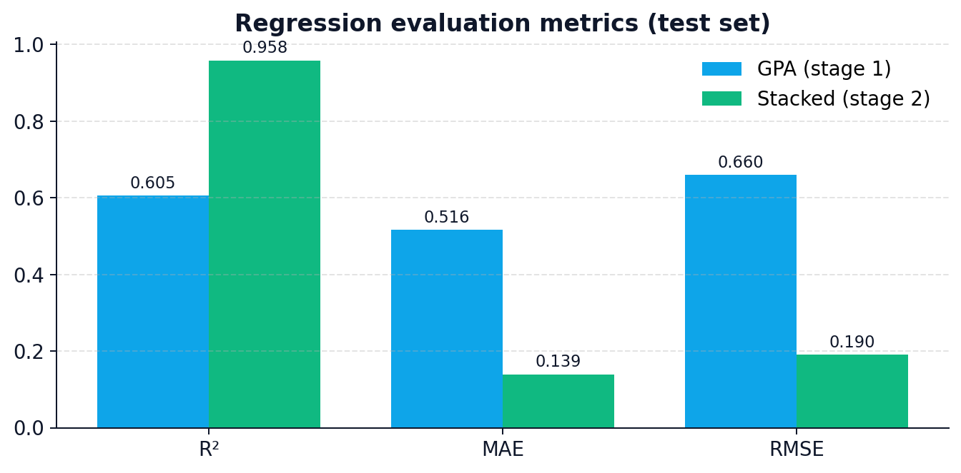
Results · Head-to-Head
Evaluation on the held-out 20 % test split
Persistence · F1
At-Risk · Accuracy
GPA · R²
Stacked · R²
84.8%
85.2%
0.605
0.958
COMP258 · Student Success Prediction · Full-Stack Intelligent App
16 / 20

Slide 17
Live Demo
React SPA talking to the Flask REST API in real time
01
Data Explorer
02
Predict Persistence
Filter by school/gender/persistence — hits /api/data/students.
Fill the form → POST /api/predict/persistence → probability + label.
03
Predict GPA
04
At-Risk Flag
Provide 1st-term GPA + HS scores → regression output.
Three-tier: Low / Medium / High risk.
05
Two-Stage Pipeline
06
Admin / Retrain
Stage 1 predicts 2nd-term GPA → fed into Stage 2 score.
POST /api/admin/retrain re-fits all 4 models end-to-end.
💡 Tip for presenters: bring a copy of saved_models/ so the demo
works even if the venue has no internet. Start backend first, then frontend.
COMP258 · Student Success Prediction · Full-Stack Intelligent App
17 / 20

Slide 18
Challenges & How We Solved Them
Small data, imbalanced labels, full-stack coordination
Challenge
Solution
Missing values dropped the dataset in half
Impute per-column (median / mode), keep all 1,400 rows.
Challenge
Solution
Class imbalance on persistence / at-risk
Compute class_weight on the fly during training.
Challenge
Solution
Overfitting a small dataset
L2, dropout, BatchNorm, EarlyStopping + ReduceLROnPlateau.
Challenge
Solution
Reproducible results for the demo
Seed Python / NumPy / TensorFlow, restore best weights.
Challenge
Solution
Front-end ↔ back-end contract drift
Single schema for each prediction form, mirrored in services.
COMP258 · Student Success Prediction · Full-Stack Intelligent App
18 / 20

Slide 19
Future Work
Where we would take the app next
Model upgrades
Explainability
Try TabTransformer / gradient-boosted trees for tabular baseline parity.
Per-prediction SHAP values in the UI so advisors see *why*.
Confidence calibration
Active learning loop
Temperature scaling for the two classifiers.
Log low-confidence cases → advisor labels them → retrain nightly.
Auth & auditing
Deployment
Role-based access for advisor vs. admin; immutable prediction log.
Docker Compose → cloud (Azure/GCP), HTTPS, CI/CD.
COMP258 · Student Success Prediction · Full-Stack Intelligent App
19 / 20

Slide 20
Thank you
Questions?
COMP258 · Student Success Prediction
Group: 5 · Week 14

