Slide 1
Recommender systems
Lecturer: Assoc.Prof. Nguyễn Phương Thái
VNU University of Engineering and Technology
Slide: from Assoc.Prof. Phan Xuân Hiếu, Updated: April 25, 2024
data understanding
1 / 106

Slide 2
What is a recommender system?
Definition from Nvidia
A recommendation system is an artificial intelligence algorithm, usually associated with machine learning, that uses big data to suggest or recommend additional products to consumers. These can be based on various criteria, including past purchases, search history, demographic information, and other factors. Recommender systems are highly useful as they help users discover products and services they might otherwise have not found on their own.
Definition from Wikipedia
A recommender system, or a recommendation system, is a subclass of information filtering
system that provide suggestions for items that are most pertinent to a particular user.
Definition from ChatGPT
A recommender system is a type of information filtering system that predicts and recommends items to users based on their past behavior, preferences, and interests. It is commonly used in e-commerce, social media, online content platforms, and other applications where personalized recommendations can improve the user experience.
recommender systems

Slide 3
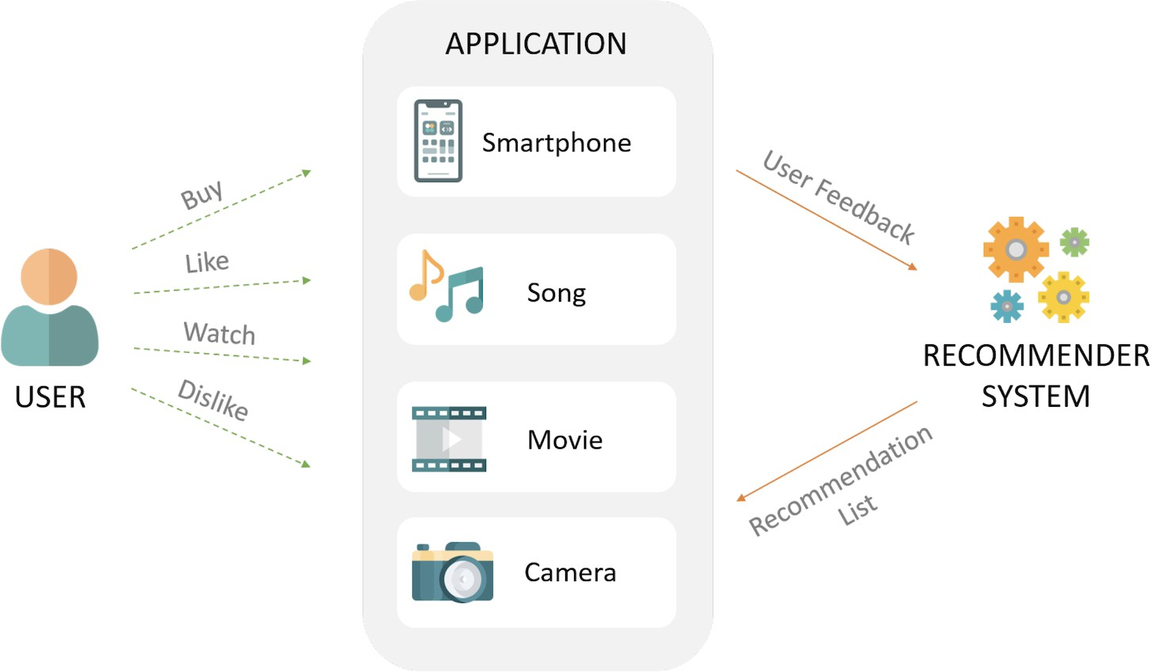
What is a recommender system? (cont’d)
[source: Internet]
recommender systems

Slide 4
Two primary approaches of recommender systems
Recommendation as a prediction problem
Recommendation as a ranking problem
recommender systems

Slide 5
Recommendation as a prediction problem
Predicting the rating value for a user–item combination.
Assuming that the training data is available, indicating user preferences for items. For m users and n items, the user ratings are an incomplete m × n matrix:
The observed (existing) values are used for training (e.g., a recommendation model). The unobserved (missing) values will be predicted using the model.
This problem is also referred to as the matrix completion problem.
recommender systems

Slide 6
Recommendation as a ranking problem
Not necessary to predict the missing ratings to make recommendations. Rather:
Recommend the top–k items for a particular user; or Determine the top–k users to target for a particular item.
Determining top–k items is more common than determining top–k users. This problem is also referred to as the top–k recommendation problem.
In this approach, the absolute values of the predicted ratings are not important.
The ranking can be based on the predicted values in the first approach. However, it is easier and more natural to solve the ranking problem directly.
recommender systems

Slide 7
Goals of recommender systems
Business–centric goals: the primary goals of a recommendation system are to
increase the user activities (view, watch, like, share, add to cart, etc.), user attention, user experience, and user engagement;
and finally, increase the sale volume, revenue and profit of the business service.
The operational and technical goals:
Relevance Novelty Serendipity Diversity Long–tail Fairness
Other business and domain–specific goals
1
2
3
4
5
6
7
recommender systems

Slide 8
Goals of recommender systems (cont’d)
Relevance: recommend items that are relevant to the user:
Users are more likely to consume items that they find interesting; or Or items that fit their need and intents (e.g., purchase intents).
Novelty: recommend items that the user has not seen in the past.
For example, popular movies of a preferred genre would rarely be novel to the user. Repeated suggestion of popular items can also lead to reduction in sales diversity.
Serendipity: the recommended items are truly surprising to the user.
Rather than simply something they did not know about before.
This means something “unknown unknown” whereas novelty is “unknown known’ ’.
Serendipity has the beneficial side effect of increasing sales diversity or beginning a new trend of interest in the user.
Serendipitous recommendations often tend to irrelevant items at the beginning.
recommender systems
10 / 202

Slide 9
Goals of recommender systems (cont’d)
Diversity: when all the recommended items are very similar, it increases the risk that the user might not like any of these items. Diversity help ensure that the user does not get bored by repeated recommendation of similar items.
Long–tail: recommender systems normally ignore unpopular or newly introduced items having only few ratings. Leveraging unpopular items at the long–tail of the distribution is important.
Fairness: this concept is related to groups of users based on race, gender, age, etc. For example, a job recommender system should have the fairness to suggest jobs to different races and genders.
Other business and domain–specific goals: this depends on the business applications. Some domains require explanation to the recommended items; Some need direct suggestions while some are indirect recommendation.
recommender systems

Slide 10
Some typical recommender systems
GroupLens recommender system:
A pioneering prototype recommender system (recommendation of Usenet news), later extended to book and movie recommendation like BookLens and MovieLens.
GroupLens is now a research lab at The University of Minnesota, and has made pioneering contributions to collaborative filtering research.
Have released important datasets in this field like MovieLens with different sizes (https://grouplens.org/datasets/movielens).
Amazon.com recommender system:
One of the pioneers in recommender systems, especially in e–commerce. Starting with book recommendation, and later expanded to virtually all forms of products.
Amazon recommendations are based on both implicit ratings (like browsing and buying behaviors) as well as explicit ratings (5–point scale, from 1–star to 5–star).
Recommendations are based on both (item–based) collaborative filtering and frequent patterns (e.g., frequently bought together, bought this also bought that ).
recommender systems

Slide 11
Some typical recommender systems (cont’d)
Netflix movie recommender system:
Recommendation is built based on 5–point scale ratings.
Providing meaningful explanations for the recommended items to users.
Netflix Prize contest: predicting ratings of particular user–item combinations.
Training data set: 100,480,507 ratings (480,189 users and 17,770 movies), including
Probe set: 1,408,395 ratings.
Qualifying data set: 2,817,131 ratings (hidden), consisting of:
Quiz set: 1,408,342 ratings; used to calculate leaderboard scores. Test set: 1,408,789 ratings; used to determine winners.
Data contain no information about users and movies except their IDs and ratings. Submitted predictions are scored against the true grades using RMSE.
The ranking is based on the improvement over the Netflix’s own algorithm Cinematch. The grand prize of US$1M given to the BellKor’s Pragmatic Chaos team in 2009.
recommender systems

Slide 12
Some typical recommender systems (cont’d)
Google news personalization system:
Recommend news to users based on their history of clicks.
News articles are treated as items. User clicking on a news article is a positive rating. Recommendations are based on collaborative filtering with these implicit ratings.
Facebook friend recommendations:
Recommend potential friends to users in order to increase the social connections. This has slightly different goals than a product recommendation.
This is also referred to as link prediction in the field of social network analysis. Recommendations are based on structural relationships rather than rating data.
recommender systems

Slide 13
Some typical recommender systems (cont’d)
System | Domain
MovieLens | Movies
Amazon.com | E-commerce (books and other products)
Netflix | DVDs and Streaming videos
Google News | Online news
Google Search | Advertising
Facebook | Friends and Advertising
Pinterest | Photos
Tiktok | Short video clips (various domains)
Youtube | Videos (various domains)
Pandora | Music
Spotify | Music
Tripadvisor | Travel products
IMDb | Movies
recommender systems

Slide 14
Major approaches to building recommender systems
Collaborative filtering recommender systems Content–based recommender systems Knowledge–based recommender systems
Hybrid and ensemble–based recommender systems
recommender systems

Slide 15
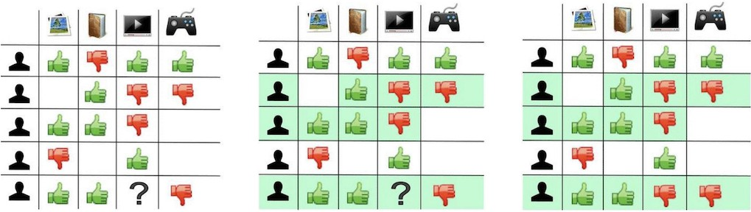
Collaborative filtering recommender systems
Collaborative filtering (CF) is an approach of making predictions about the interests of a user by collecting preferences or taste information from many users.
The underlying assumption of CF is that if a person u has the same opinion as a person v on an issue, u is more likely to have v’s opinion on another issue than that of a randomly chosen person.
Collaborative filtering models use the collaborative power of the ratings provided by multiple users to make recommendations.
[source: Internet]
recommender systems

Slide 16
Content–based recommender systems
The main idea of content–based recommendation is to suggest items similar to the items that the user interacted with in the past. Interacted means
User actions: browsing, reading, watching, add–to–cart, buying, sharing, etc. Or user explicit ratings to the items.
The recommendations for a particular user are based on the following information:
The descriptive attributes and the content of items.
The basic info of the user, e.g., demographic info (gender, age, etc.) if existing. The behaviors of the user in the past, i.e., the interaction history of the user.
There is no collaboration, i.e., recommendations for different users are independent. Content–based recommendation has its own pros and cons in comparison with CF.
recommender systems

Slide 17
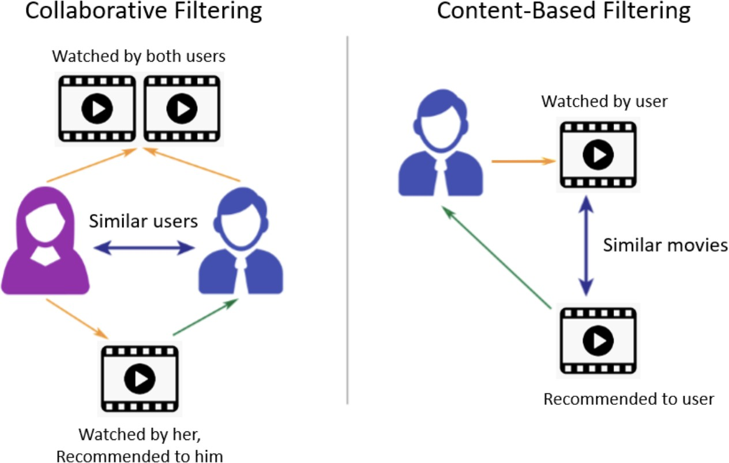
Content–based versus collaborative filtering
[source: Internet]
recommender systems

Slide 18
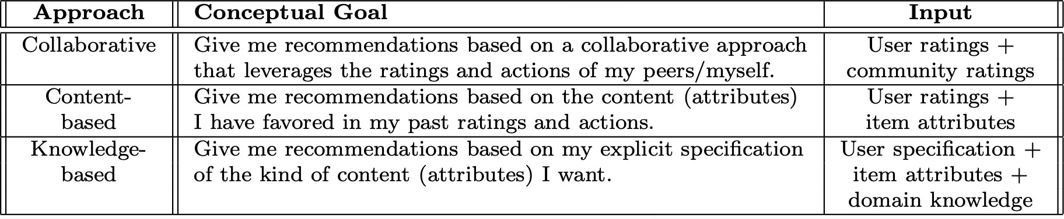
Knowledge–based recommender systems
Knowledge–based recommender systems are particularly useful for items that are
not purchased often, i.e., ratings may not be sufficient for recommendation.
Examples: real estate, automobiles, financial services, or expensive luxury goods. The nature of consumer preferences may evolve over time with such items.
The recommendations are based on the basis of similarities between customer requirements and item descriptions, or the use of customer constraints.
Knowledge-based systems allow the users to explicitly specify what they want. The explicit specification results in greater control of the recommendation process.
recommender systems

Slide 19
Hybrid and ensemble–based recommender systems
In many cases, a wide variety of inputs is available:
User demographic information: gender, age, location, prior preferences, etc. Item information: genre, description texts, tags, etc.
User ratings: implicit or explicit ratings, etc.
In such cases, a hybrid approach is appropriate to leverage all types of data.
Combining CF, content–based, knowledge–based, etc. Taking advantages of the strong points of those approaches.
Several scenarios to build hybrid recommender systems:
Adding content information to a CF system. Adding CF information to a content–based system.
Adding knowledge to a CF or content–based system. Etc.
recommender systems

Slide 20
Context and social factors in recommender systems
Status or condition information:
Context–ware: recommendations are also based on additional information (if existing). For example: user is single, just married, being pregnant, etc.
Temporal information:
Integrating temporal info: time in day, seasons, holidays, product life cycle, etc.
Location information:
Recommendations are also based on the current location of users or items (if available).
Recommending nearest hotels, restaurants, etc.
Social information:
Recommendations are also based on social tags, cues, viral info, social trending, etc.
recommender systems

Slide 21
Challenges and advanced topics in recommender systems
The sparse data problem
The cold–start problem in recommender systems The scalability in recommender systems Attack–resistant recommender systems
Group recommender systems Multi–criteria recommender systems Privacy in recommender systems
recommender systems

Slide 22
The sparse data problem
The user interaction and rating are limited, the rating matrices may be very sparse. Causing difficulty in computing similarity between users and between items.
Two very similar items may not be rated by same users.
Two users with similar taste (preferences) may not rate the same items.
Sparse data will lead to a low coverage (e.g., long–tail items). Solutions:
Using matrix factorization, topic analysis, dimensionality reduction, embeddings, etc. Graph–based methods.
Combining CF and content–based (content–boosted). Etc.
recommender systems

Slide 23
The cold–start problem in recommender systems
The new user problem:
Have not rated any items.
No history information (interactions, behaviors, etc.)
The new item problem:
Have not been rated by any users.
Even have not been seen or bought any time.
Solutions:
Recommending hot or popular items, or random recommendations at the beginning. The new item problem: computing the similarity using item informations.
The new user problem: computing the similarity using demographic info (if available). Combining CF and content–based in different ways.
recommender systems

Slide 24
The scalability in recommender systems
The rating matrices are normally very large (millions × millions). Computation on very large matrices is very time–consuming:
Computing the similarity between users or between items. Finding k nearest neighbors (k most similar users).
Etc.
Recommendations are normally real–time or near real–time. Solutions:
Dimensionality reduction using PCA, SVD, etc.
Item–based CF is normally faster and more stable than user–based CF. Building model–based systems (usually large training time).
recommender systems

Slide 25
Attack–resistant recommender systems
This normally happens in a platform having many different competitors.
Example: on an e–commerce market or platform: some sellers would submit inflated ratings of their own products to manipulate the recommendation ranking. and biased or negative reviews to products of their competitors.
Numerous sophisticated strategies developed for attacking recommender systems.
recommender systems

Slide 26
Group recommender systems
Recommendation to a group rather than a single user. Examples:
A family watching movies or television. A group of friends going to a restaurant. Travel recommendation to a family.
Recommendation for a group is more complicated than for a single user.
Simple combination of the taste or preferences of individuals is not really effective.
recommender systems

Slide 27
Multi–criteria recommender systems
Items in several domains have different aspects. Examples:
Hotel: room, view, breakfast, wifi, reception, close to the down town, etc. Movie: screenplay, acting, graphics, music, etc.
Smartphone: brand, display, battery, stability, software and apps, etc.
Two users having the same rating score may not have similar taste or preferences. Multi–criteria systems help to rank items when considering multiple aspects.
recommender systems

Slide 28
Privacy in recommender systems
Recommender systems are based heavily on feedback from the users, which might be implicit or explicit.
This feedback contains significant information about the interests of the user. For examples:
Personal perferences, Sexual orientations, Political opinions, Etc.
Such information can be highly sensitive, which leads to privacy concerns. Privacy preserving in recommendation is really important.
recommender systems

Slide 29
Types of collaborative filtering
Memory–based CF methods: also known as neighborhood–based CF. The ratings of user–item combinations are predicted on the basis of their neighborhoods. These neighborhoods can be defined in one of the two following ways:
User–based CF: recommendations are based on the similarity between users.
Item–based CF: recommendations are based on the similarity between items.
Memory–based methods are easy to implement.
The resulting recommendations are often easy to explain.
However, they do not work very well with sparse rating matrices.
Model–based CF methods: machine learning and data mining methods are used in the context of predictive models. Typical model–based methods: decision trees, Bayesian methods, or latent factor models.
Models are parameterized and optimized; more complicated to implement.
Handling sparse rating matrices better.
recommender systems

Slide 30
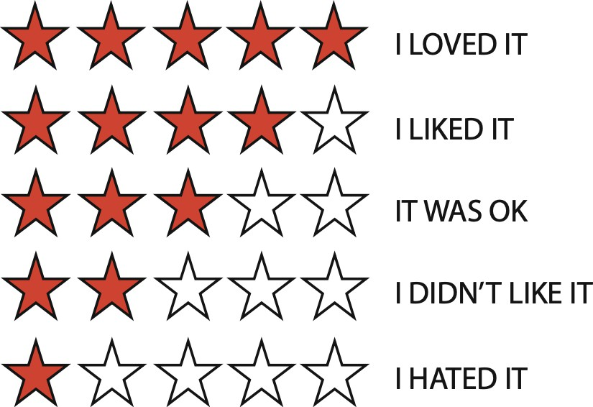
Types of user ratings
source: from book [8]
Unary rating: {like} (e.g., Facebook like button; no way to express a dislike) Binary rating: {like, dislike}
5–point rating scale (discrete): {1, 2, 3, 4, 5} or {−2, −1, 0, 1, 2}. – Some other options are 7–point or 10–point scale.
Continuous rating values: e.g., any real value in [−10, 10].
recommender systems

Slide 31
Explicit ratings versus implicit ratings
Explicit ratings: users rate items explicitly using rating scale like unary, binary, 5–point scale, etc.
Implicit ratings: users do not really rate items explicitly.
The rating values are inferred from the user actions like browsing, reading, watching, add–to–cart, buying, sharing, etc.
The rating values are based on types of actions, e.g., buying an item has a higher weight than just browsing it.
recommender systems

Slide 32
Rating matrices
Let I be the set of n items in a system, e.g., n products, n movies, etc. Let U be the set of m users of the system.
Let R = {r_{ui}}_{m×n} be the user–item rating matrix.
Where r_{ui} ∈ R is the rating value of the item i given by the user u. Normally, only a small fraction of ratings are specified (or observed ). Most of the ratings are missing (i.e., unspecified or unobserved ).
Thus, R is normally very sparse.
The rating matrix is also called the user–item matrix or the utility matrix. Two types of rating matrix:
Explicit rating matrix: the rating values are given explicitly by users. Implicit rating matrix: the rating values are inferred from the user actions.
recommender systems

Slide 33
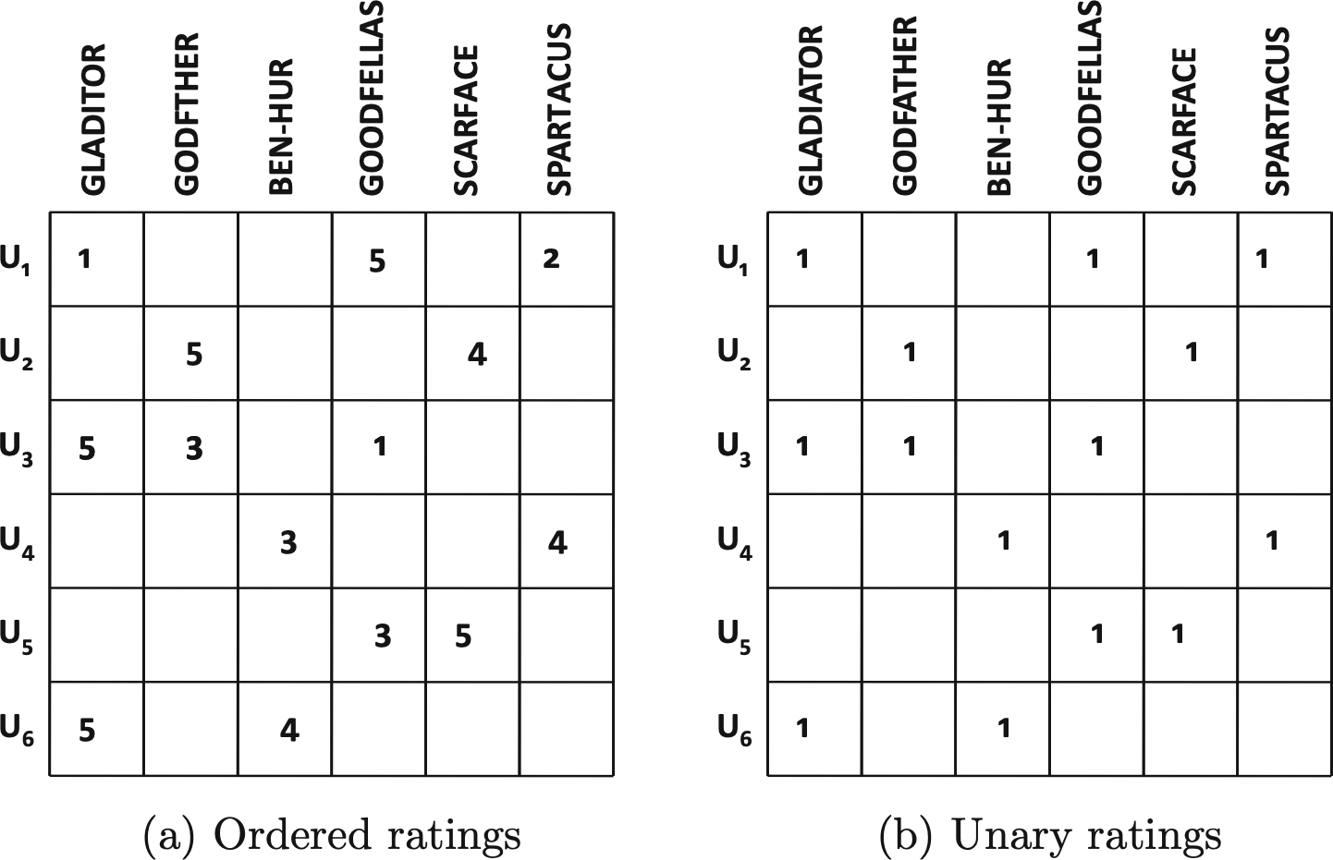
Examples of user–item rating matrices [8]
recommender systems

Slide 34
The long–tail of rating frequencies
Only a small fraction of the items are rated frequently. That are popular items.
A majority of items are rated rarely, leading to a highly skewed rating distribution.
High–frequency items tend to be relatively competitive items with little profit. Lower frequency items normally have larger profit margins.
Advantageous to the merchant to recommend lower frequency items. Amazon.com analysis: make most of their profit by selling items in the long tail.
In fact, many recommendation algorithms:
Tend to suggest popular items rather than infrequent items.
Having negative impact on diversity, and users may often become bored by receiving the same set of recommendations of popular items.
Need to consider the long–tail problem when designing recommendation algorithms.
recommender systems

Slide 35
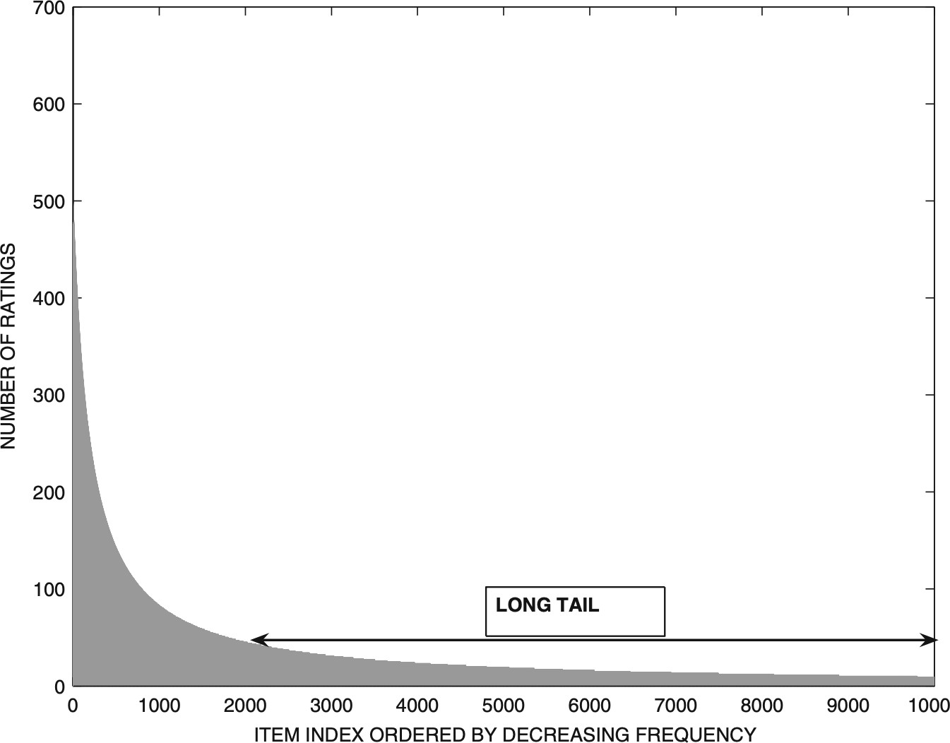
The long–tail of rating frequencies (cont’d)
source: from the textbook [8]
recommender systems

Slide 36
Neighborhood–based collaborative filtering
Predicting ratings with neighborhood–based methods
Clustering and neighborhood–based methods
Dimensionality reduction and neighborhood methods
Graph models for neighborhood–based methods
recommender systems

Slide 37
Neighborhood–based CF recommender systems
Predicting ratings with neighborhood–based methods
Clustering and neighborhood–based methods
Dimensionality reduction and neighborhood methods
Graph models for neighborhood–based methods
recommender systems

Slide 38
Predicting ratings with neighborhood–based methods
The idea in neighborhood–based methods is to make recommendations based on:
the user–user similarity, or
the item–item similarity computed from the rating matrix.
Neighborhood implies determining either similar users or similar items. Two basic principles used in neighborhood–based models:
User–based: Similar users have similar ratings on the same item. Therefore, if Alice and Bob have rated movies in a similar way in the past, then one can use Alice’s observed rating on Terminator to predict Bob’s unobserved rating on this movie.
Item–based: Similar items are rated in a similar way by the same user. Therefore, Bob’s ratings on similar science fiction movies like Alien and Predator can be used to predict his rating on Terminator.
recommender systems

Slide 39
User–based neighborhood methods
Let u, v ∈ U be two users, i.e., corresponding to two rows in the rating matrix.
Let I_{u} and I_{v} denote the sets of item indices (columns) for which ratings have been specified by the user u and the user v, respectively.
Then, I_{u} ∩ I_{v} is the set of item indices that are both rated by u and v. Example:
I_{u} = {1, 3, 5} means u only rated the first, third, and fifth items.
I_{v} = {1, 2, 3, 4} means v only rated the first, second, third, and fourth items.
I_{u} ∩ I_{v} = {1, 3} means the items 1 and 3 were commonly rated by both u and v.
It is quite common that I_{u} ∩ I_{v} = ∅ because rating matrices are generally sparse. How to compute the similarity (in terms of taste or preferences) between u and v?
recommender systems

Slide 40
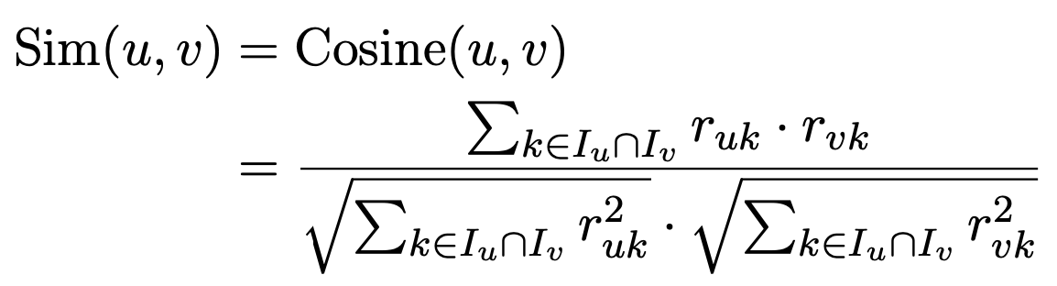
Computing user–user similarity using cosine
The cosine similarity between user u and user v is defined as follows:
(1)
where r_{uk} and r_{vk} are the rating values of user u and user v on item k, respectively.
What if different users may have different scales of ratings? For example, one user might be biased toward liking most items, whereas another user might be biased toward not liking most of the items.
Pearson correlation is one way to deal with different scales of ratings.
recommender systems

Slide 41
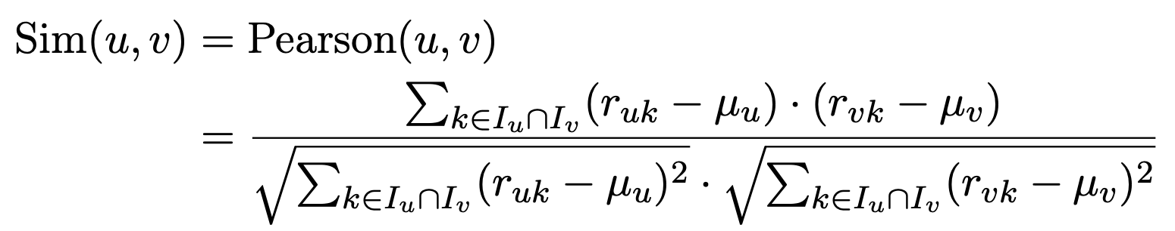
Computing user–user similarity using Pearson correlation
The Pearson correlation coefficient between user u and user v is defined as follows:
(2)
where µ_{u} and µ_{v} the mean values of ratings of u and v, respectively.
r_{uk} and r_{vk} are the rating values of user u and user v on item k, respectively.
recommender systems

Slide 42
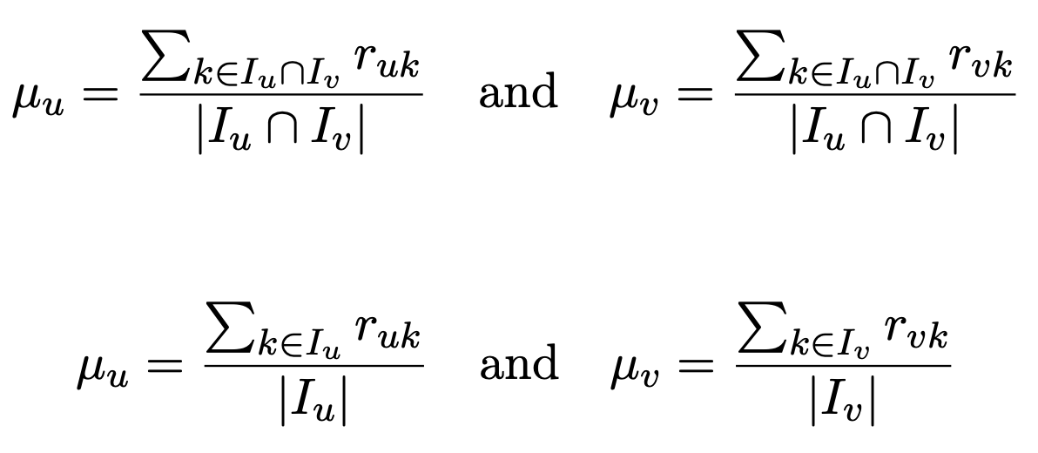
Computing user–user similarity using Pearson correlation (cont’d)
There are two ways to compute µ_{u} and µ_{v} :
(3)
or:
(4)
It is hard to argue that which way is better.
In extreme cases, if |I_{u} ∩ I_{v}| = 1 (only one common item), the first way is not
usable. Even if |I_{u} ∩ I_{v}| = 2 or 3 and those rating values of one user (u or v) are
identical, the similarity will also be zero.
The second way is more efficient in computation (computed once for each user). However, many implementations compute µ_{u} and µ_{v} in pairwise fashion.
recommender systems

Slide 43
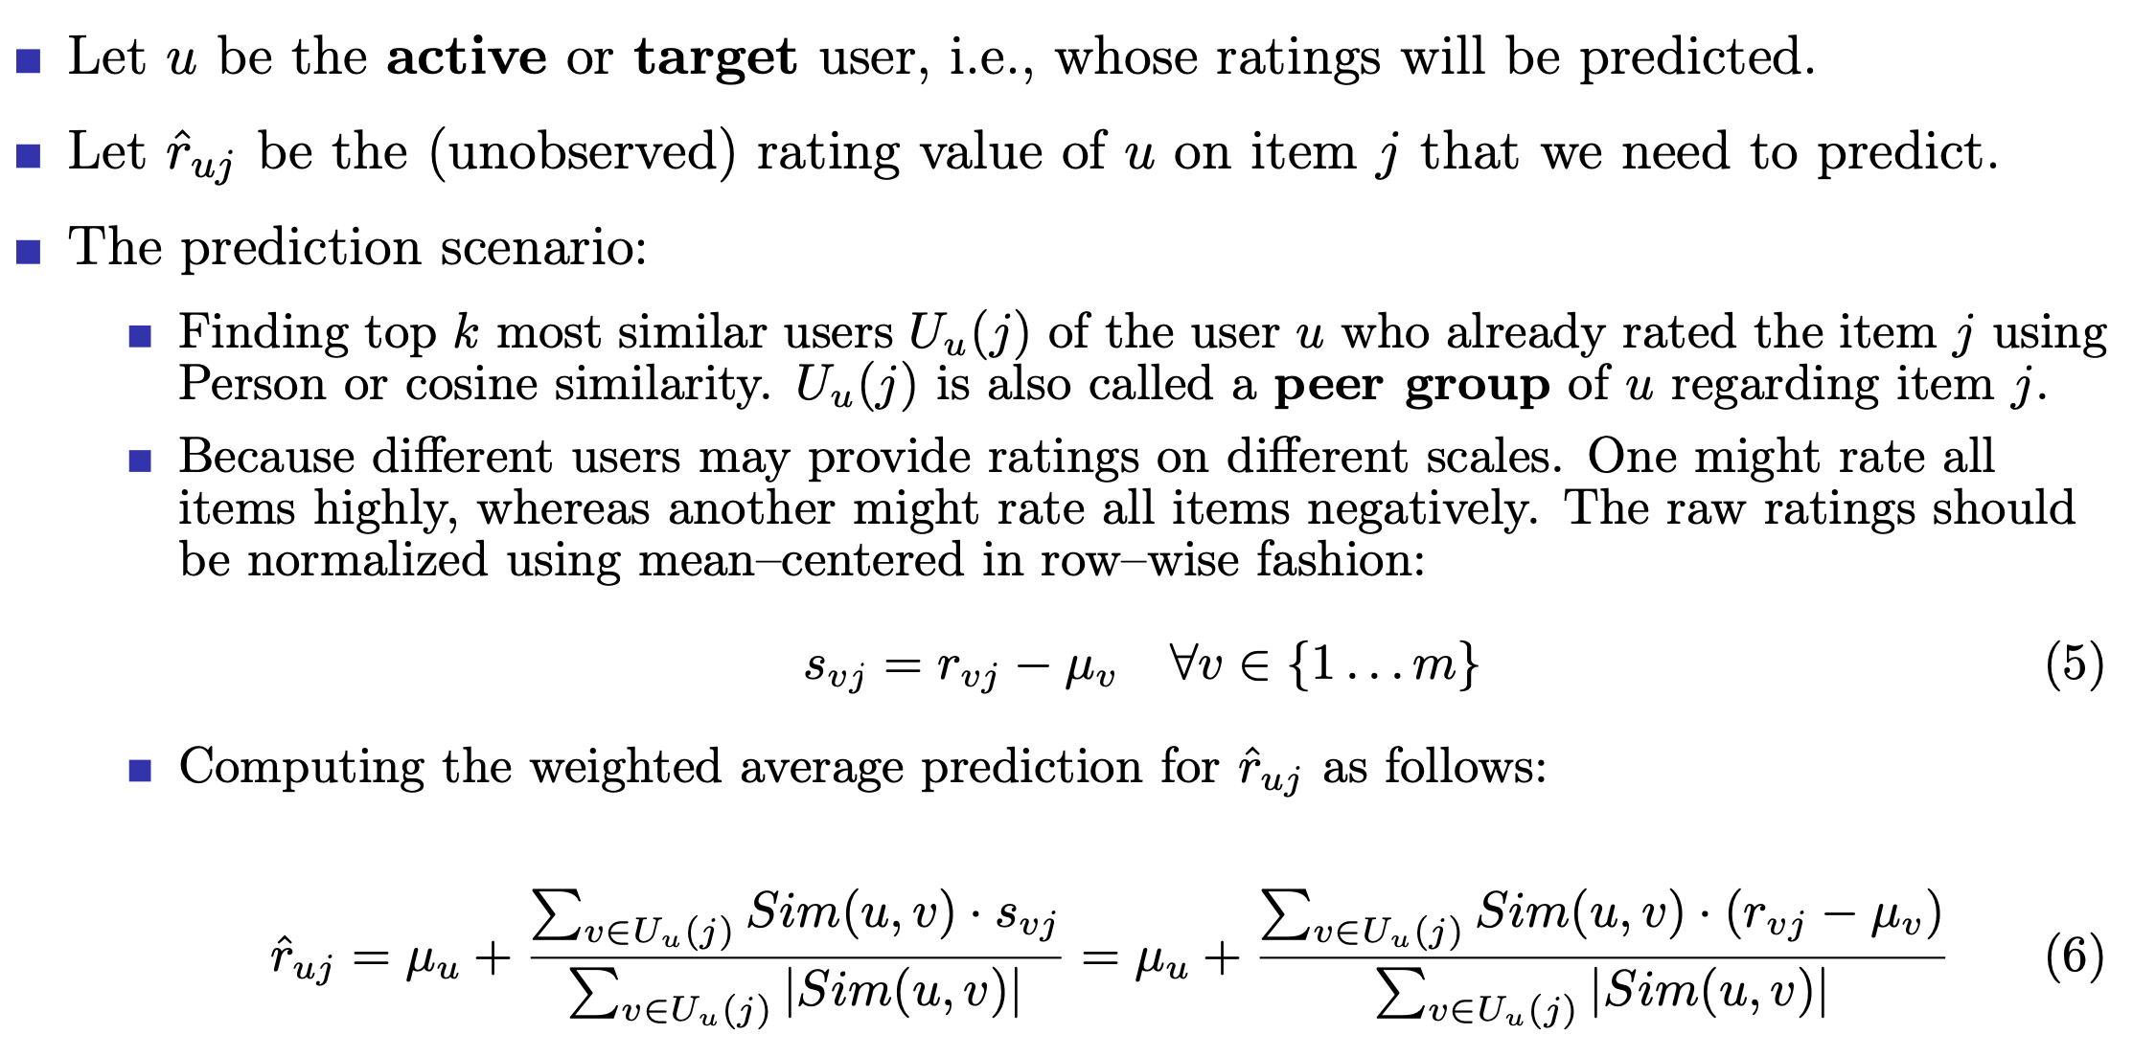
Prediction function: predicting user ratings using weighted average
recommender systems

Slide 44
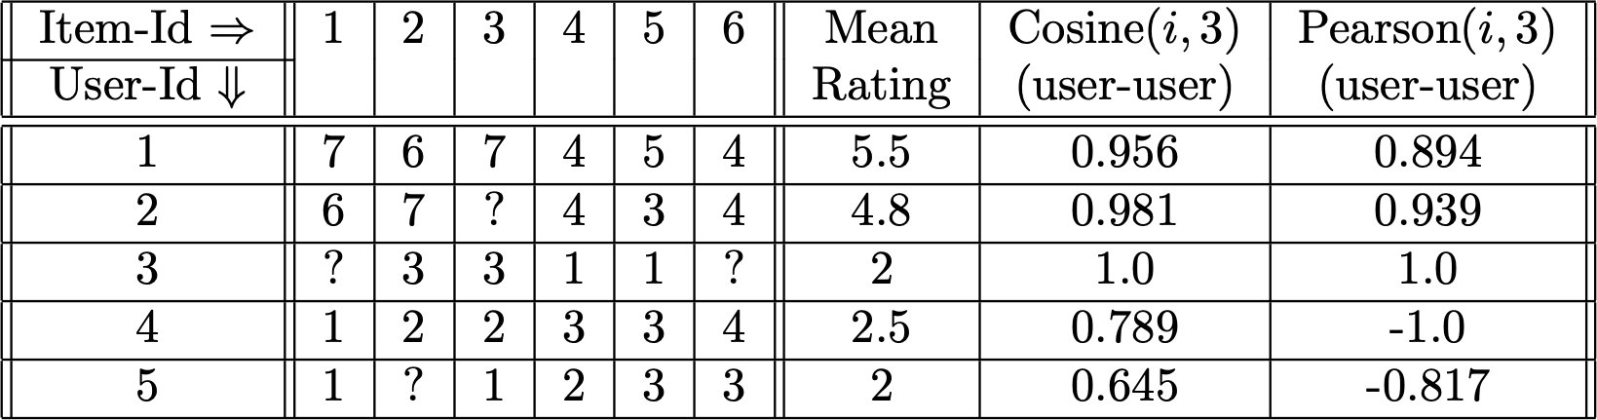
Example of predicting user ratings using weighted average
source: from the textbook [8]
The table shows the ratings of five user {1 . . . 5} on six items {1 . . . 6}. Each rating is drawn from the range {1 . . . 7}.
Consider the current or target user index is u = 3.
User–user similarity between the user u and other users using Cosine and Pearson.
recommender systems

Slide 45
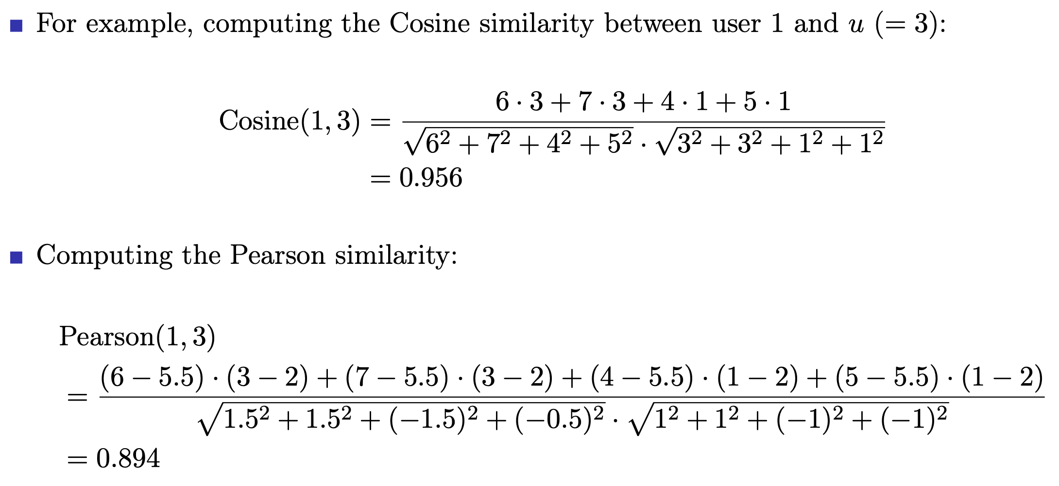
Example of predicting user ratings using weighted average (cont’d)
recommender systems

Slide 46
Example of predicting user ratings using weighted average (cont’d)
Let k = 2. The top–2 closest users of 3 are 1 and 2 according to both measures.
Using the Pearson–weighted average of the raw ratings of users 1 and 2 to predict the missing rating values rˆ₃₁ and rˆ₃₆ as follows:
7 · 0.894 + 6 · 0.939
0.894 + 0.939
rˆ =
≈ 6.49
31
4 · 0.894 + 4 · 0.939
rˆ = = 4.0
36
0.894 + 0.939
The corresponding predictions with mean–centered ratings:
1.5 · 0.894 + 1.2 · 0.939
rˆ = 2 +
≈ 3.35
31
0.894 + 0.939
−1.5 · 0.894 − 0.8 · 0.939
rˆ = 2 +
≈ 0.86
36
0.894 + 0.939
recommender systems

Slide 47
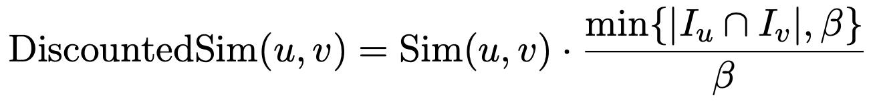
Discounted similarity between users
The reliability of the similarity function Sim(u, v) is often affected by the number of common ratings |I_{u} ∩ I_{v}| between users u and v.
When the number of common ratings between two users is too small, need to
de–emphasize the importance of that user pair.
Let β be a minimum threshold for the number of common ratings, the discounted similarity is defined as follows:
(7)
The discounted similarity is used both for the process of determining the peer group (i.e., the top–k closest users) and for computing the prediction.
recommender systems

Slide 48
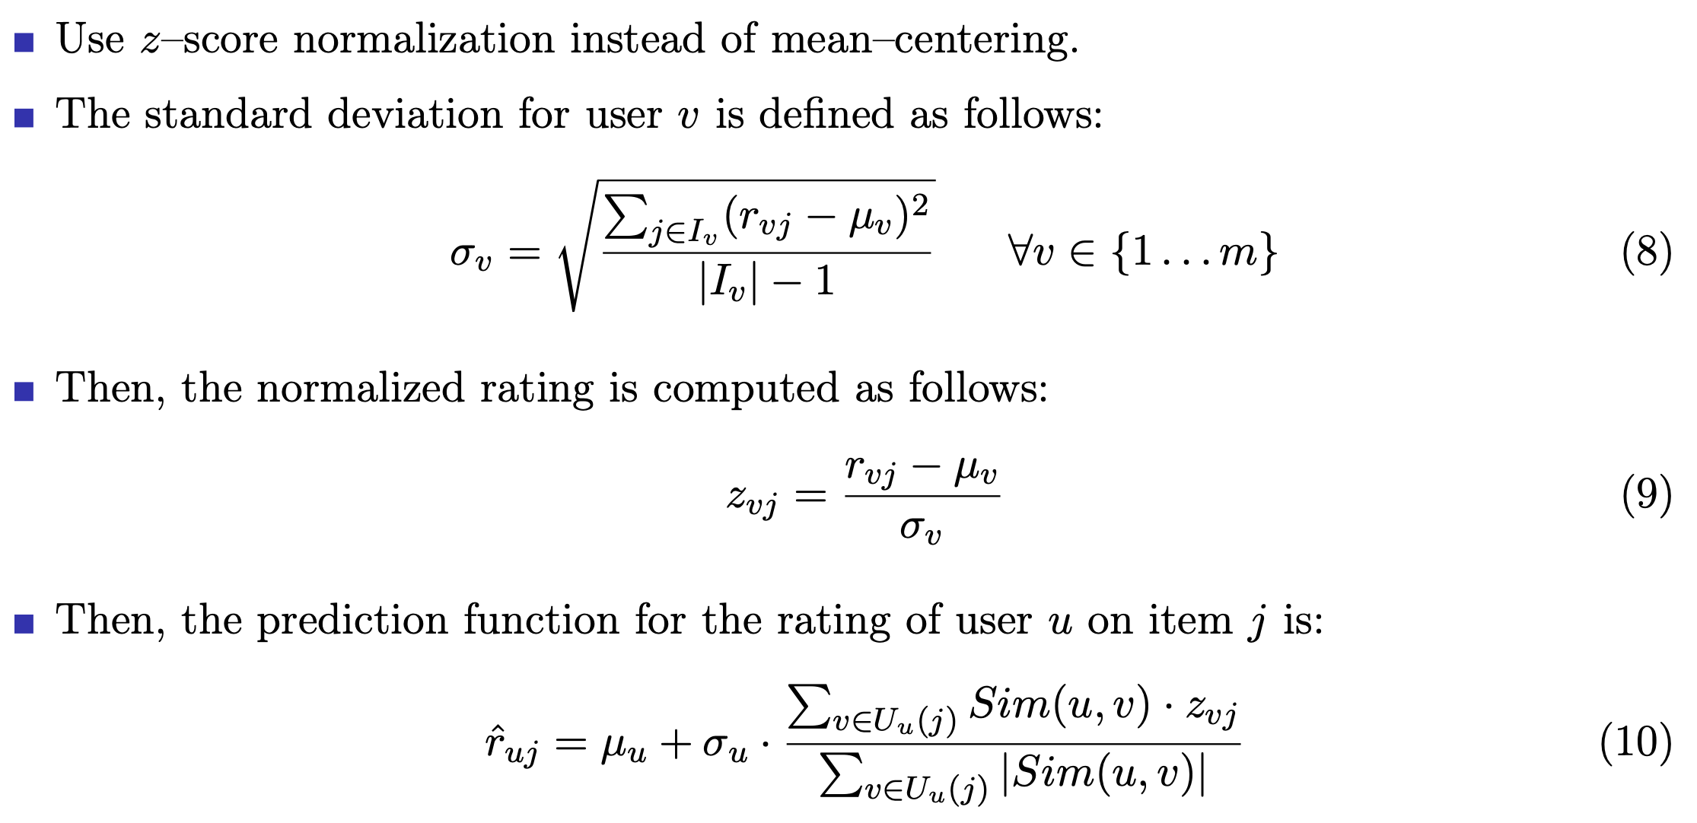
Variants of the prediction function
recommender systems

Slide 49
Finding top–k closest users (i.e., filtering the peer group)
Amplifying the similarity between users:
Sim(u, v) = Pearson(u, v)^{α}
Choosing α > 1 if we want to amplify the importance of the similarity.
(11)
We should remove weakly and negatively correlated users with the active user u from the top–k.
Weakly correlated users might add to the error in the prediction.
Negatively correlated ratings often do not have as much predictive value in terms of potential inversion of the ratings (although the prediction function technically allows the use of weak or negative ratings).
recommender systems

Slide 50
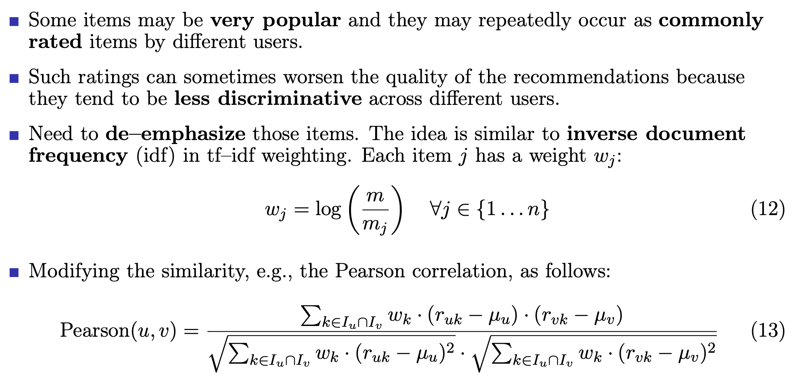
Impact of the long tail
recommender systems

Slide 51
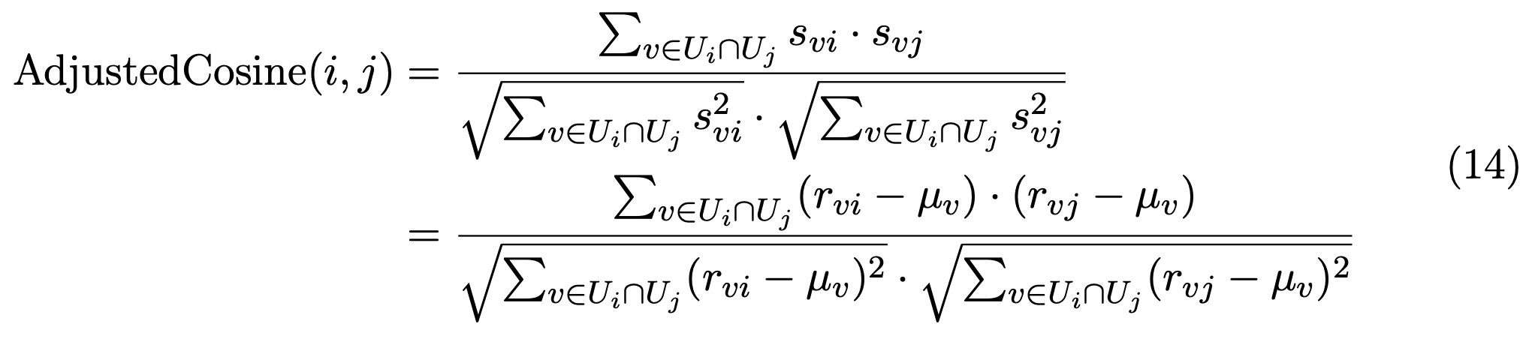
Item–based neighborhood methods
Peer groups are constructed in terms of items rather than users.
Similarities need to be computed between items (or columns in the ratings matrix). Before computing the similarities between columns, each row is mean–centered.
Let i be a user, U_{i} be the indices of the set of users who have specified ratings for item i. For example, if the first, third, and fourth users have rated item i, then U_{i} = {1, 3, 4}. U_{i} ∩ U_{j} is the set of user indices who rated both i and j.
To compute the similarity between items i and j, the adjusted cosine is defined as:
recommender systems

Slide 52
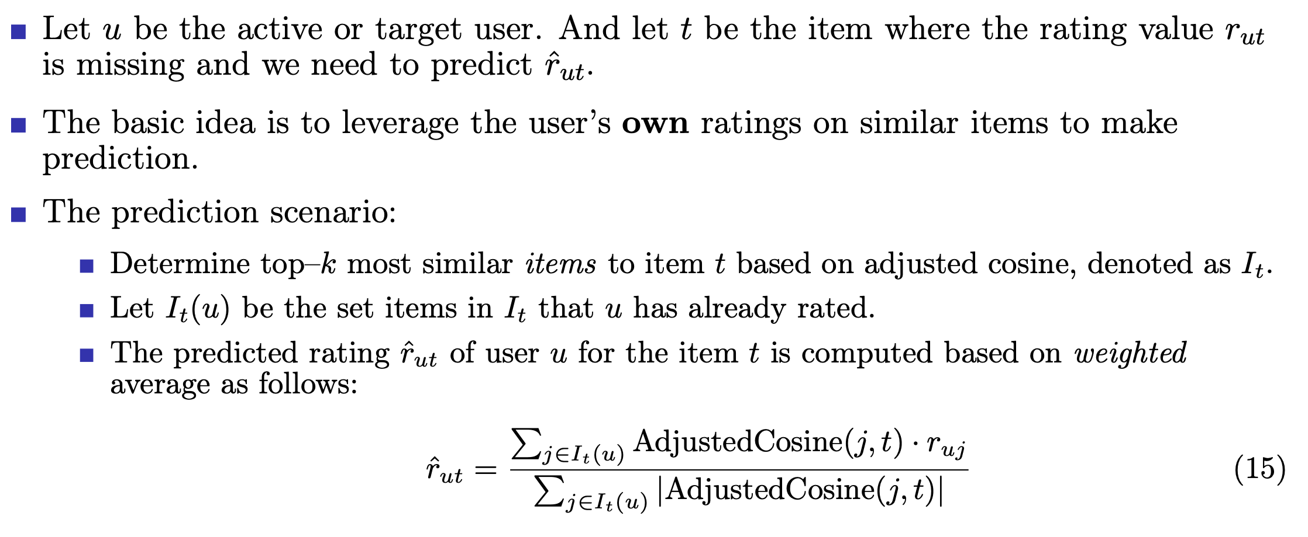
Item–item based prediction function
recommender systems

Slide 53
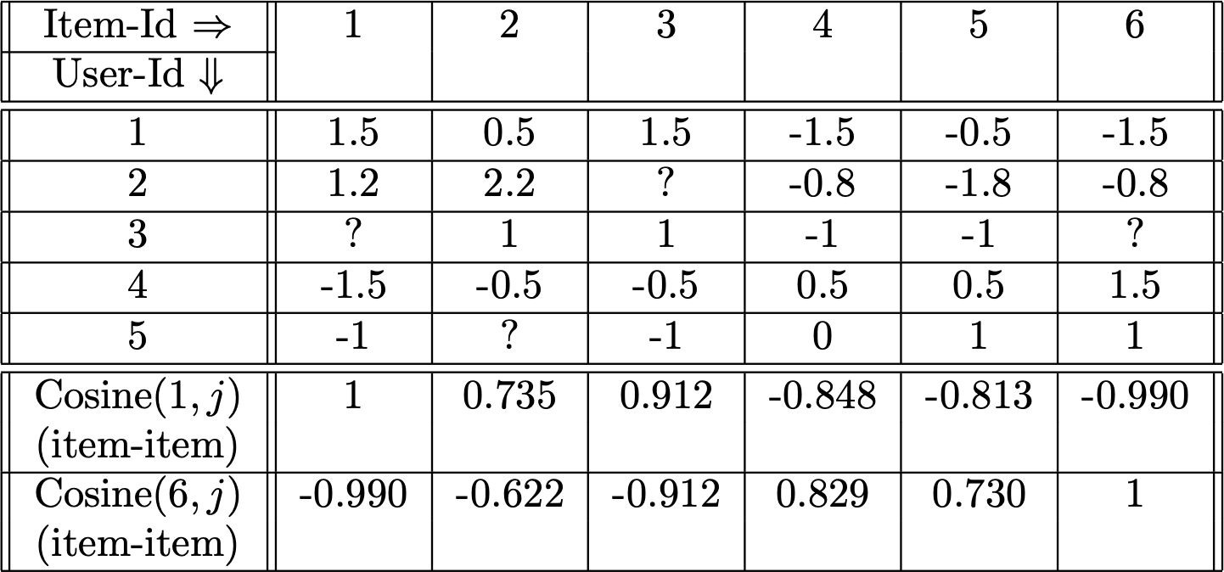
Row–normalized rating matrix for item–item similarity computation [8]
recommender systems

Slide 54
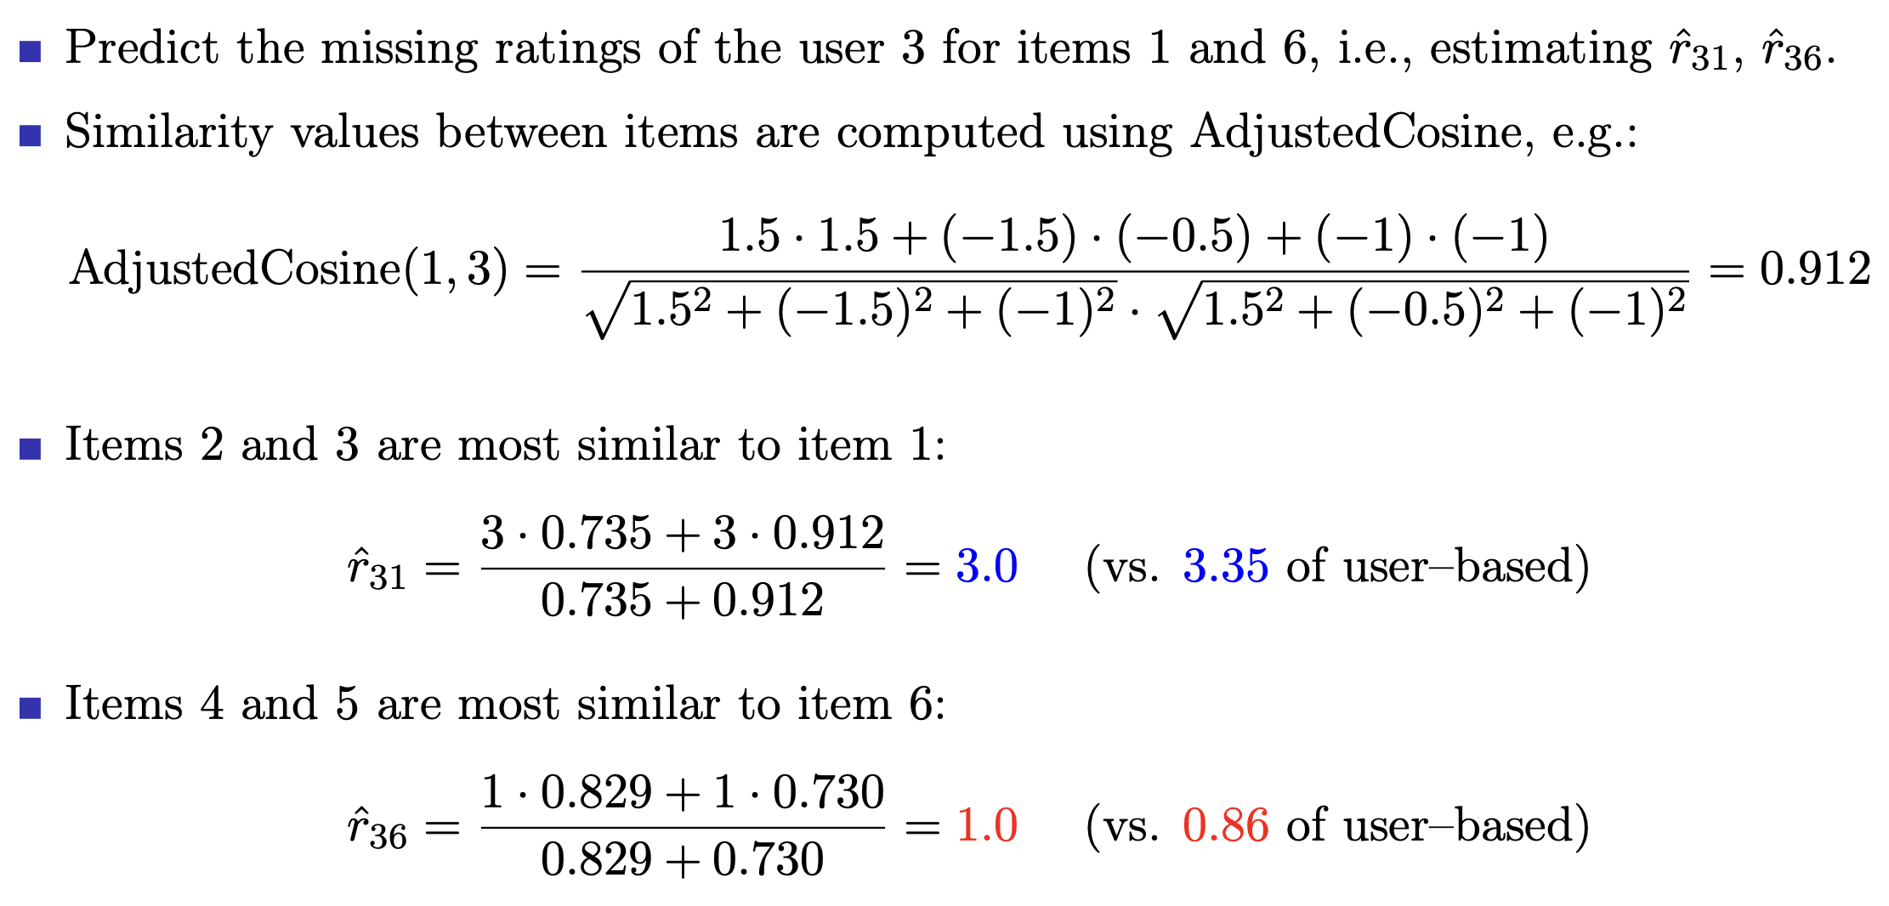
Example of item–item based prediction for rating values
recommender systems

Slide 55
Efficient implementation and computational complexity
Store intermediate computations for efficient ranking of recommendations. The recommendation process is divided into offline phase and online phase:
Offline: (a) user–user (item–item) similarity values and peer groups (of user/item) are computed; (b) for each user (or item), the relevant peer group is prestored.
Online: those prestored similarity values and peer groups are used to make prediction.
Let n′ (≪ n) be the maximum number of specified ratings of a user (row); and m′
(≪ m) be the maximum number of specified ratings of an item (column).
n′ is the maximum running time for computing the similarity between a pair of users. m′ is the maximum running time for computing the similarity between a pair of items. Identifying the peer group of an active/target user (user–based): O(m · n′).
Identifying the peer group of an active/target item (item–based): O(n · m′).
Computing the peer groups of all users is O(m² · n′). Computing the peer groups of all items is O(n² · m′).
recommender systems

Slide 56
Efficient implementation and computational complexity (cont’d)
Space complexity to store all pairs of similarities between pairs of users: O(m²). Space complexity to store all pairs of similarities between pairs of items: O(n²). Normally m > n, user–based methods need more space than item–based ones.
Online phase:
Let k be the size of the user/item neighborhood used for prediction.
Time complexity to rank all items for a target user: O(k · n) (user– or item–based). Time complexity to rank all users for a specific item: O(k · m).
Time complexity for the offline phase is much larger than that of the online phase.
In real implementation, various pre–computing and caching techniques should be used to accelerate both phase 1 and phase 2 (need near real–time recommendation).
recommender systems

Slide 57
Comparing user–based and item–based methods
Item–based methods often provide more relevant recommendations.
Because user’s own ratings are used directly to perform the recommendation. User–based: ratings are extrapolated from other users (may have different interests).
User–based methods may provide more diverse and novel recommendations.
Novelty, diversity, and serendipity mean more surprising, interesting, and discovery.
Item–based methods can provide concrete reasons for recommendations, e.g.:
Because you watched “Secrets of the Wings”, the recommendations are . . .
Item–based methods are more stable with changes to the ratings because
The number of users is generally much larger than the number of items: two users may have a very small number of mutually rated items while two items are likely to have a large number of users co–rating them. Thus, with user–based, adding a few ratings can change the similarity between users significantly.
New users are likely to be added more frequently in than new items. Thus, the similarity values between items are more stable than those between users. This also leads to less re–computation frequency for item–based methods.
recommender systems

Slide 58
Pros and cons of neighborhood–based methods
Strengths:
Simplicity: easy to implement and debug.
An intuitive approach: easy to justify why a specific item is recommended. Relatively stable with the addition of new items and users.
Incremental: easy to expand.
Weaknesses:
Computation is expensive with large–scale settings, especially for the offline phase. Likely low coverage due to the data sparsity.
recommender systems

Slide 59
Neighborhood–based CF recommender systems
Predicting ratings with neighborhood–based methods
Clustering and neighborhood–based methods
Dimensionality reduction and neighborhood methods
Graph models for neighborhood–based methods
recommender systems

Slide 60
Clustering and neighborhood–based methods
Main problem of neighborhood–based: the huge complexity of the offline phase:
O(m² · n′) is impractical if the number of users m is a few hundred million. E.g.: m = 10⁸ and n′ = 100, O(m² · n′) = O(10¹⁸).
Idea: replacing the offline neighborhood computation with an offline clustering.
Problem: offline nearest–neighbor phase creates a large number of peer groups. Solution: clustering process creates a smaller number of peer groups.
Clustering is much more efficient than the O(m² · n′).
After clustering: top–k closest peers within the same cluster are used for prediction.
Pros and cons of combining clustering with neighborhood–based:
Cluster size is much smaller than m (or n), finding top–k closest peers is efficient. Some loss of accuracy due to locality (i.e., only searching peers within cluster).
Clusters are more fine–grained, the efficiency improves, but the accuracy is reduced. In many cases, very large gains in efficiency only pay a small reduction in accuracy.
recommender systems

Slide 61
Clustering on the rating matrix
Challenge: the rating matrix is incomplete.
Clustering methods need to be adapted to work with massively incomplete data sets.
Clustering methods like k–means can be easily adapted to incomplete data.
Problem: the m × n rating matrix is incomplete.
Computation of the mean and the distance values becomes undefined. Solution: compute the means using only the observed values within a cluster.
The distance values are computed using only the subset of dimensions, which are specified both for the data point and cluster representative.
Manhattan distance is more appropriate than the Euclidean or other distances.
Clustering can be performed for both users (rows) and items (columns).
recommender systems

Slide 62
Neighborhood–based CF recommender systems
Predicting ratings with neighborhood–based methods
Clustering and neighborhood–based methods
Dimensionality reduction and neighborhood methods
Graph models for neighborhood–based methods
recommender systems

Slide 63
Dimensionality reduction and neighborhood methods
Dimensionality reduction (DR) can improve both quality and efficiency.
DR provides a dense low–dimensional representation in terms of latent factors. Computing similarity between dense low–dimensional vectors is easier and efficient. Thus, able to find more relevant neighbors with less time.
There are two ways of applying DR for recommender systems.
First way: DR is applied for either users (row–wise) or items (column–wise):
A reduced representation will either compress the item dimensionality or the user dimensionality into latent factors.
This reduced representation can be used to alleviate the sparsity problem for neighborhood–based models.
Second way: DR is applied for both users and items simultaneously:
This belongs to the model–based CF approach. Will be discussed later.
recommender systems

Slide 64
Dimensionality reduction for user–based collaborative filtering
Idea: transform the m × n rating matrix R into a lower–dimensional space
using dimensionality reduction techniques.
The resulting matrix R′ of size m × d where d ≪ n.
Each n–dimensional rating vector of a user is transformed into a d–dimensional vector. Unlike the their original vectors, d–dimensional vectors are dense.
Computing similarity between d–dimensional vectors are more accurate and efficient.
Typical dimensionality reduction techniques are:
Principal component analysis (PCA), Singular value decomposition (SVD), Etc.
recommender systems

Slide 65
Neighborhood–based CF recommender systems
Predicting ratings with neighborhood–based methods
Clustering and neighborhood–based methods
Dimensionality reduction and neighborhood methods
Graph models for neighborhood–based methods
recommender systems

Slide 66
Graph models for neighborhood–based methods
The sparsity of observed ratings causes a major problem in similarity computation. Graph–based is an approach to define similarity in neighborhood–based methods. The general idea is the use of structural transitivity on graphs to:
infer and estimate the relationships among users and/or items, and ranking recommendations.
Graphs can be constructed on the users, on the items, or on both.
A variety of algorithms on graphs, e.g., random walk or shortest path, etc.
recommender systems

Slide 67
User–item graphs
The user–item graph is an undirected and bipartite graph: G = (N_{u} ∪ N_{i}, A).
N_{u} is the set of nodes representing users.
N_{i} is the set of nodes representing items.
All edges in the graph exist only between users and items.
An undirected edge exists in A between user i and item j iff user i has rated item j. Therefore, |A| = the number of observed entries in the rating matrix.
Advantage: two users do not need to have rated many of the same items to be considered neighbors as long as many short paths exist between the two users.
Neighborhoods can be defined via indirect connectivity between nodes.
Of course, direct or shorter paths have stronger weights when computing similarity. Different ways of defining neighborhoods on graphs to deal with sparse data problem.
recommender systems

Slide 68
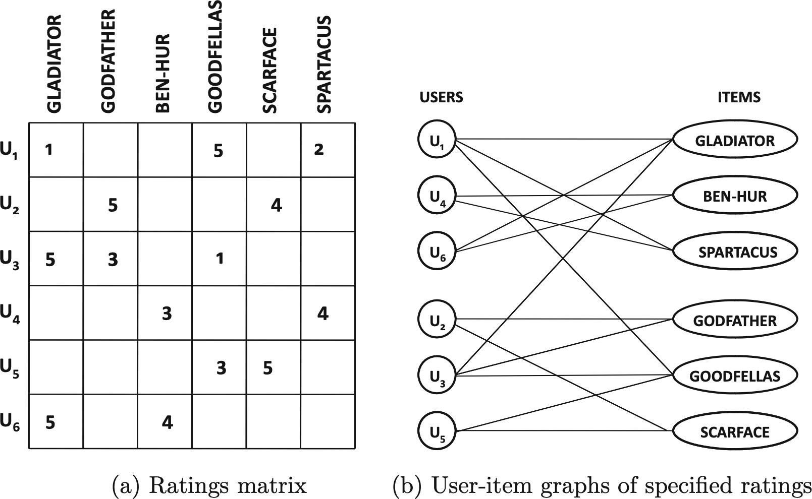
User–item graphs (cont’d)
source: from the textbook [8]
recommender systems

Slide 69
Defining neighborhoods with random walks
The neighborhood of a user is defined by the set of users that are encountered frequently in a random walk starting at that user.
How can the expected frequency of such random walks be measured?
Using personalized PageRank or the SimRank methods
to determine the k most similar users to a given user for user-based CF, or
to determine the k most similar items to a given item by starting the random walk at a given item.
Why is this approach more effective for sparse matrices?
When computing Pearson correlation: two users need to be connected directly to a set of common items.
In sparse user–item graphs, such direct connectivity may not exist for many nodes. A random–walk method also considers indirect connectivity to overcome sparsity.
recommender systems

Slide 70
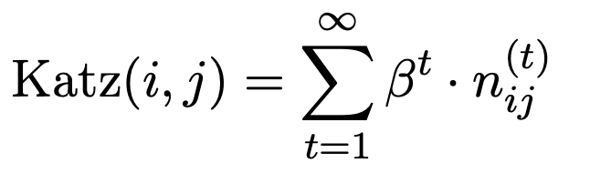
Defining neighborhoods with the Katz measure
Based on the weighted number of walks between a pair of nodes.
The weight of each walk is in (0, 1), which is a decreasing function of its length. The weighted number of walks between a pair of nodes is the Katz measure.
Intuition: if two users belong to the same neighborhood based on walk–based connectivity, then there is a propensity for a link to be formed between them.
Katz measure: Let n^{(t)} be the number of walks of length t between nodes i and j.
ij
Then, for a user–defined parameter β < 1, the Katz measure between i and j is:
(26)
The value of β is a discount factor that de–emphasizes walks of longer lengths. For small enough values of β, the infinite summation of Equation (26) will converge.
recommender systems

Slide 71
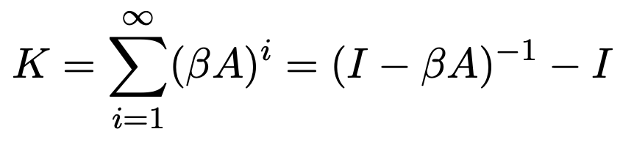
Defining neighborhoods with the Katz measure (cont’d)
Let K be the m × m matrix of Katz coefficients between pairs of users.
If A is the symmetric adjacency matrix of an undirected network, then the pairwise Katz coefficient matrix K can be computed as follows:
(27)
The value of β should always be selected to be smaller than the inverse of the largest eigenvalue of A to ensure convergence of the infinite summation.
A can be replaced with the weight matrix of the graph. This is to weight the edges in the user–item graph with the corresponding rating.
Should apply a threshold for the maximum path length for less computation.
recommender systems

Slide 72
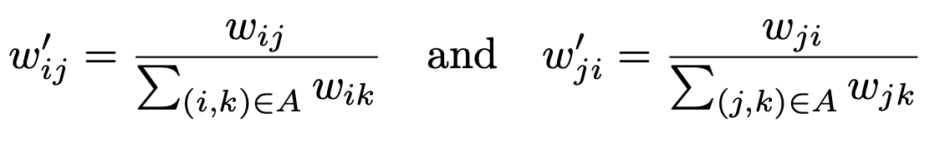
Item–item graphs
An item–item graph is called a correlation graph.
An item–item graph is a weighted and directed network G = (N, A):
Each node in N is an item.
Each edge (i, j) in A is a relationship between items i and j; and having a weight w_{ij} .
If i and j are rated by at least one common user, both edges (i, j) and (j, i) exist in G.
Computing the weight w_{ij} of the edge (i, j):
Let U_{i} and U_{j} be the sets of users who have rated item i and item j, respectively. Initialize w_{ij} = |U_{i} ∩ U_{j}|. At this point, w_{ij} = w_{ji}, i.e., symmetric.
Weight normalization: the sum of weights of outgoing edges of a node is equal to 1.
(28)
Now, the weights of edges in G correspond to random–walk probabilities.
recommender systems

Slide 73
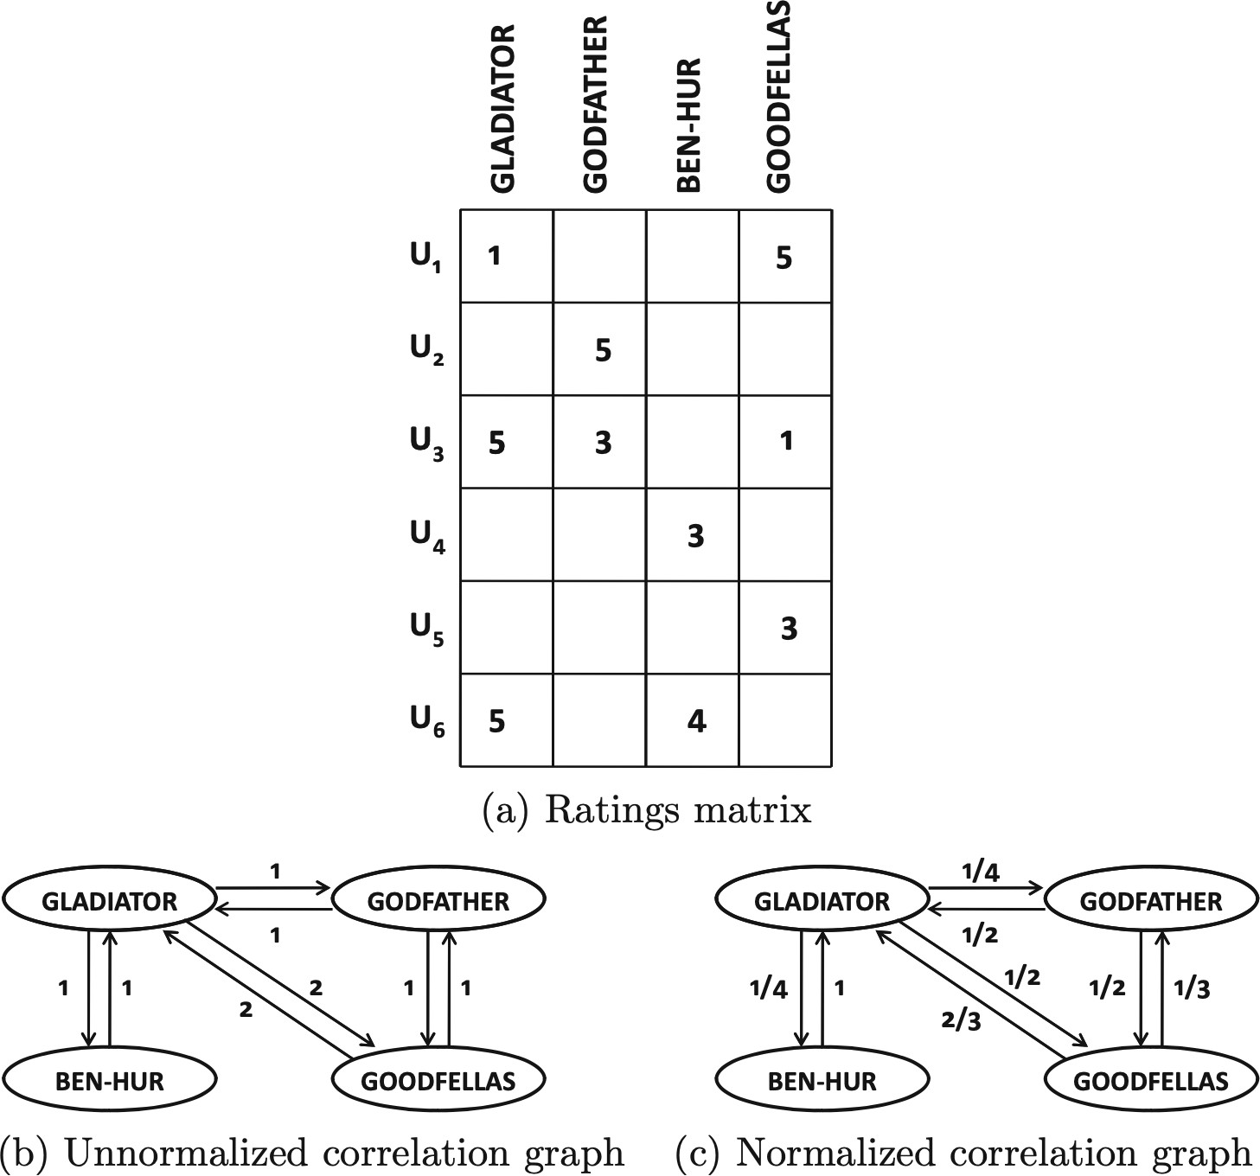
Example of item–item graph [8]
recommender systems

Slide 74
Item–item graphs (cont’d)
The weights on the normalized correlation graph are not symmetric.
Weights can be defined by using cosine between the rating vectors of the two items. Random–walk methods can be used to determine the neighborhood of a given item. This graph is can be used in item–based collaborative filtering.
recommender systems

Slide 75
References
J. Han, M. Kamber, and J. Pei. Data Mining: Concepts and Techniques. Morgan Kaufmann, Elsevier, 2012 [Book1].
C. Aggarwal. Data Mining: The Textbook. Springer, 2015 [Book2].
J. Leskovec, A. Rajaraman, and J. D. Ullman. Mining of Massive Datasets. Cambridge University Press, 2014 [Book3].
M. J. Zaki and W. M. Jr. Data Mining and Analysis: Fundamental Concepts and Algorithms. Cambridge University Press, 2013 [Book4].
D. Easley and J. Kleinberg. Networks, Crowds, and Markets: Reasoning About a Highly Connected World. Cambridge University Press, 2010 [Book5].
J. VanderPlas. Python Data Science Handbook: Essential Tools for Working with Data. O’Reilly, 2017 [Book6].
J. Grus. Data Science from Scratch: First Principles with Python. O’Reilly, 2015 [Book7].
C. Aggarwal. Recommender Systems: The Textbook. Springer, 2016 [Book8].
recommender systems

Slide 76
Summary
Recommendation: prediction/ranking, goals, approaches, challenges, applications. Rating matrices, rating scales, explicit/implicit ratings, sparsity, long–tail, etc.
Neighborhood–based CF:
Rating prediction: user–based, item–based, target/active user, peer groups, etc. Pearson correlation, adjust cosine for user–user, item–item similarity computation. User bias, rating normalization, mean–centering, etc.
Clustering–based neighborhood CF
Dimensionality reduction: SVD, Compact SVD, Truncated SVD, etc.
Graph models: structural transitivity, random walk, user–item and item–item graphs.
recommender systems

