Slide 1

Hello everyone ☺
Team : MY GIUN
SUBJECT: C/C++ PROGRAMMING IN UNIX
Class: ITIT16IU11
https://github.com/nguyenminhthong0208/snakegame

Slide 2
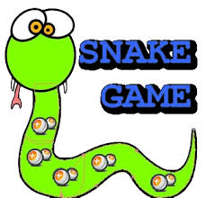
PROJECT LABORATERY C/C++ DEMO GAME SNAKE

Slide 3
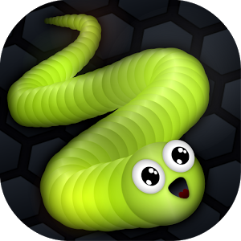
MEMBER ‘MY GIUN’ TEAM

Slide 4
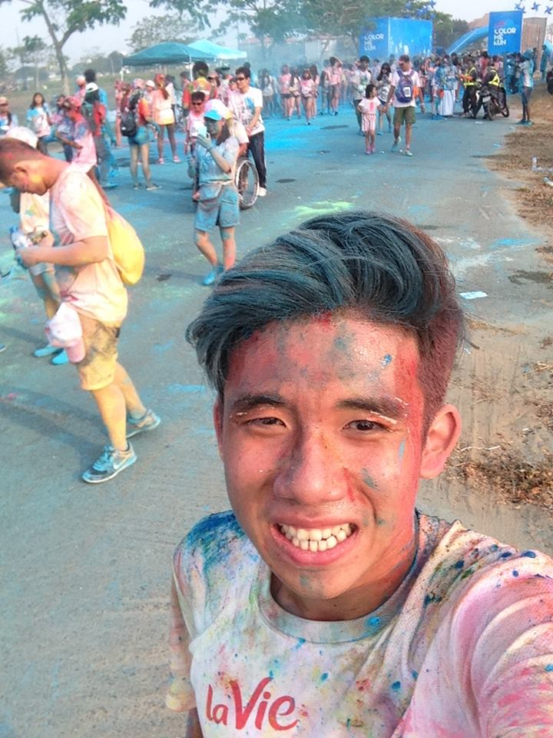
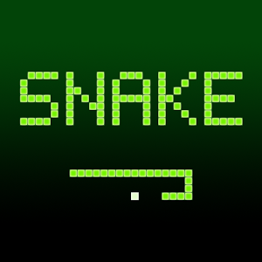
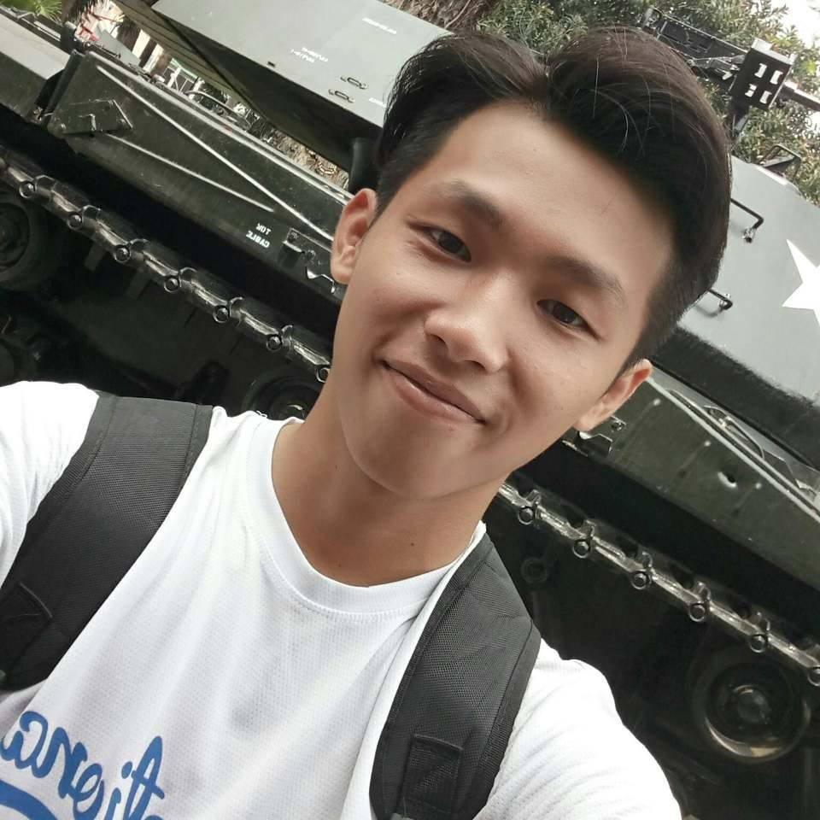
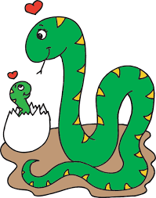
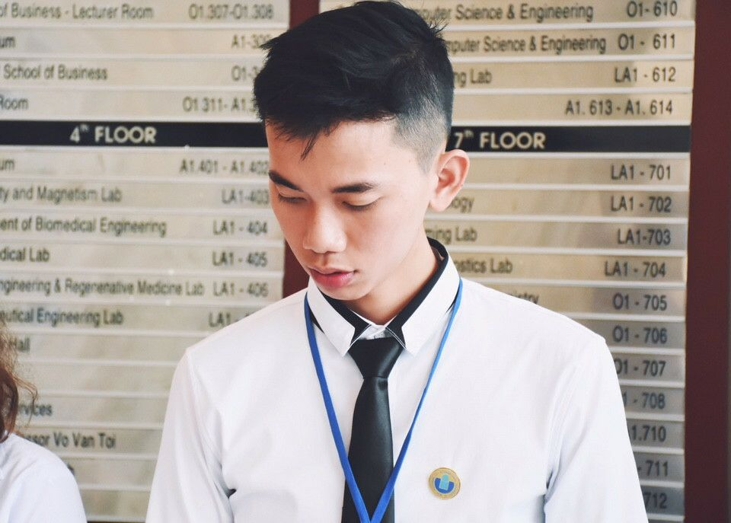
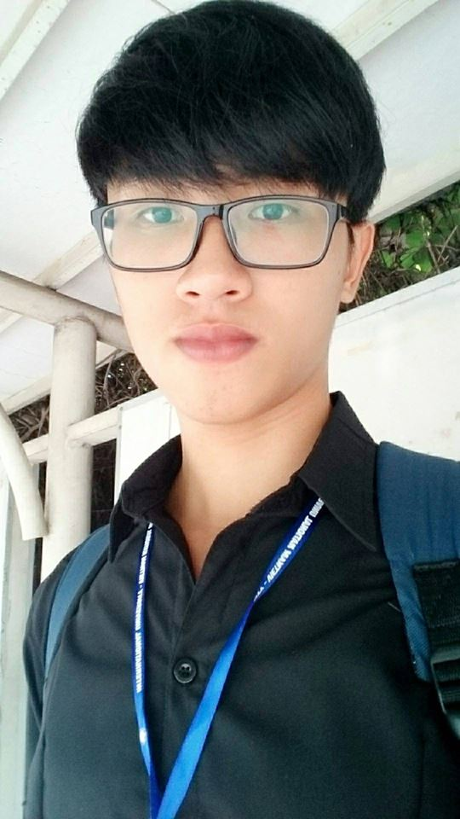
MEMBER MY GIUN TEAM
Leader: NGUYỄN MINH THÔNG
ID: ITITIU16126
Member:NGUYỄN TRẦN HOÀNG NAM
ID:
Member: BÙI TIẾN ĐẠT
ID: ITITUN16003
Member: NGUYỄN KIM KHA
ID: ITITIU16033

Slide 5
CONSTITUTE SNAKE GAME
Based on the traditional snake game
Use language C

Slide 6

HOW TO PLAY
Press these keys to move the snake to left, right, up, down.
If the snake eat the food, the snake will be longer.
When the snake touch the wall, the game is over.

Slide 7
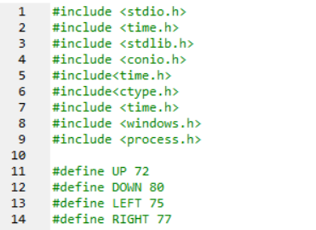
Library declaration

Slide 8
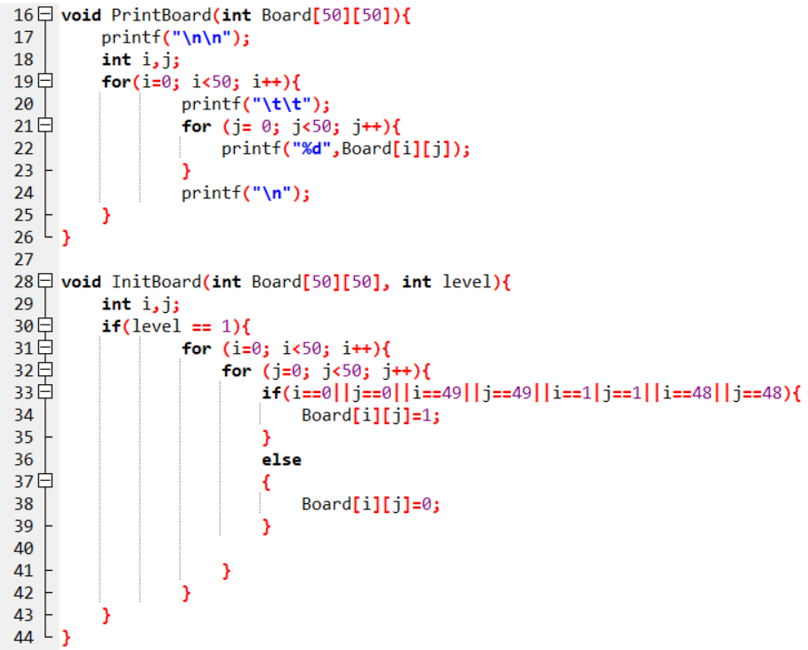

Slide 9
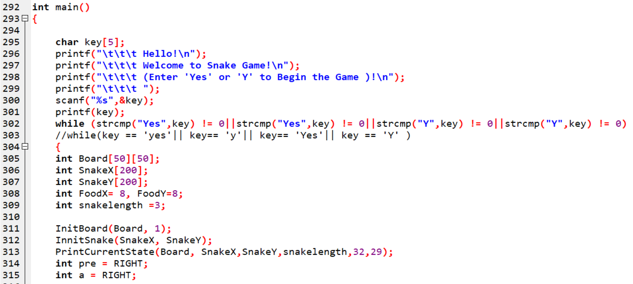

Slide 10
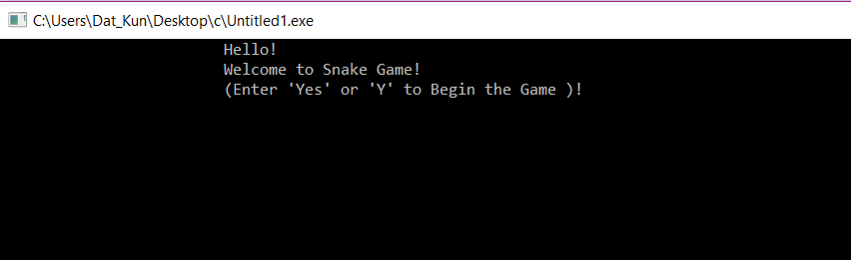

Slide 11
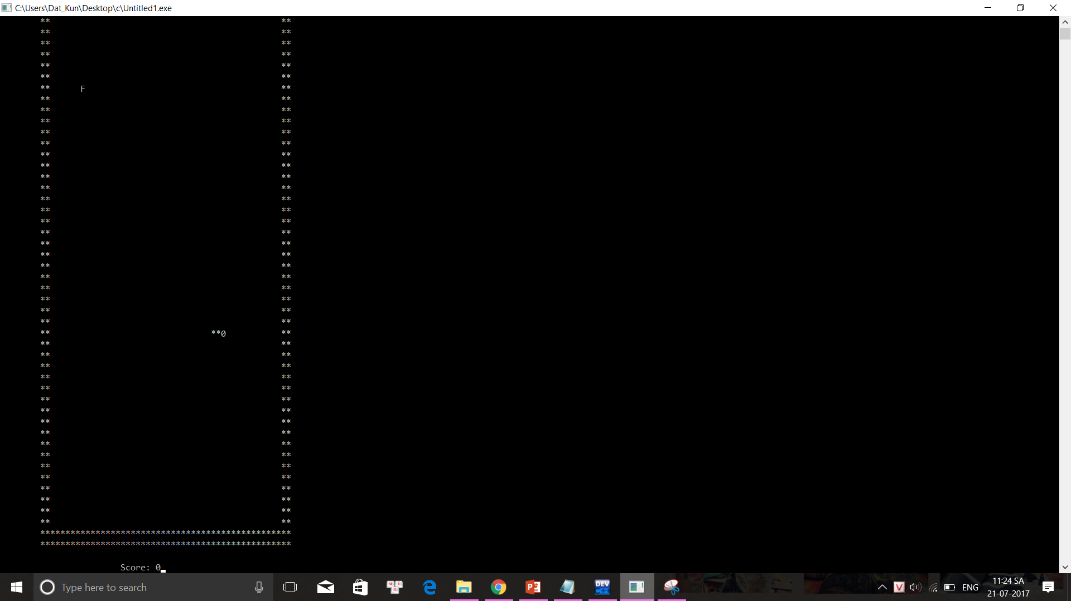

Slide 12
THANK FOR WATCHING
https://github.com/nguyenminhthong0208/snakegame

