Slide 1

Author: Nguyen Minh Tien
Email: nguyenminhtiend@gmail.com
React.js

Slide 2
Agenda
Introduce React
React Core Concept
React Life Cycle
React Event
React Form
React with Flux

Slide 3
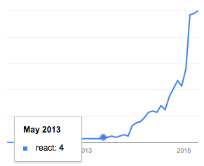
Introduce React
Google search trends for React in programming category
Notes:
React.js isn’t a complete framework, so it doesn’t provide all the components you’ll find in other projects like Ember or AngularJS.
An important difference with frameworks like AngularJS – which uses a two-way data binding model – is that React features a one-way data binding model.

Slide 4
Introduce React
React is a UI library developed at Facebook.
Allow to create UI components
Interactive
Stateful
Reusable
Client site and server side
React is the "View" in the application
Notes:
React.js isn’t a complete framework, so it doesn’t provide all the components you’ll find in other projects like Ember or AngularJS.
An important difference with frameworks like AngularJS – which uses a two-way data binding model – is that React features a one-way data binding model.

Slide 5
Introduce React
Using Virtual DOM → enables high performance for the rendering the UI.
Building large applications with data that changes over time.
Using with Flux for scaling front-end apps, that provide data flows in a single direction.
Notes:
React.js isn’t a complete framework, so it doesn’t provide all the components you’ll find in other projects like Ember or AngularJS.
An important difference with frameworks like AngularJS – which uses a two-way data binding model – is that React features a one-way data binding model.

Slide 6




Introduce React

Slide 7
React Core Concept
JSX
React Elements
React Components
Props
State
Virtual DOM
Mixins
Composition

Slide 8
JSX
It is a Javascript XML syntax transform.
Let us write HTML tags in Javascript.
Less effort to read and write.
Not supported in browsers by default.
Need to transformed into JS before running in the browser.
JSX and HTML syntax are similar but it’s different at some point
class → className, for → htmlFor

Slide 9

JSX Friendly Editor

Slide 10
React Elements
The primary type in React.
It is a virtual DOM.
A virtual representation of a DOM Element:
Light
Stateless
Immutable
Pass to ReactDom.render to render a new tree into the DOM.

Slide 11


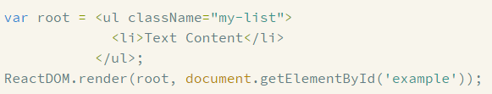
React Elements
Ex:
Notes:
https://facebook.github.io/react/docs/tags-and-attributes.html

Slide 12
React Components
React Component is stateful.
At least a render method on it.
The render method must return a single React Element.
The React Component is converted to the React Element when rendering.
Notes:
You can use React using only ReactElements but to really take advantage of React, you'll want to use ReactComponents to create encapsulations with embedded state.

Slide 13
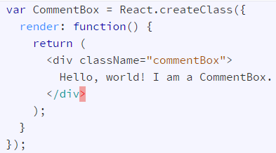

React Components
Notes:
You can use React using only ReactElements but to really take advantage of React, you'll want to use ReactComponents to create encapsulations with embedded state.

Slide 14
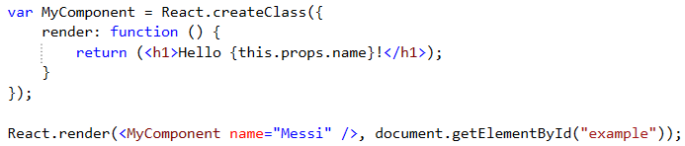
Props
Props are supplied as attributes
These attributes are available in our component as this.props
A Component cannot change its props
Notes:
When we use our defined components, we can add attributes called props.

Slide 15
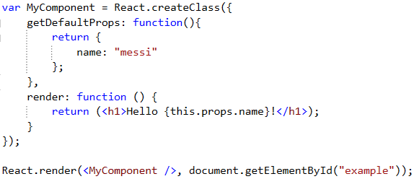
Props - getDefaultProps
Specify property values to use if they are not explicitly supplied.

Slide 16
State
A Component manages its own state internally.
Using setState method to change state.
Re-render component when setState is called.
Using getInitialState method to provide the default value
Notes:
In React each component is well encapsulated and maintains its own state (if stateful). A stateful component can store a value in its state and pass it to its child components via props. This ensures that whenever a component’s state changes, the props also change. As a result the child components that depend on these props re-render themselves automatically.
You could say the state is private.

Slide 17
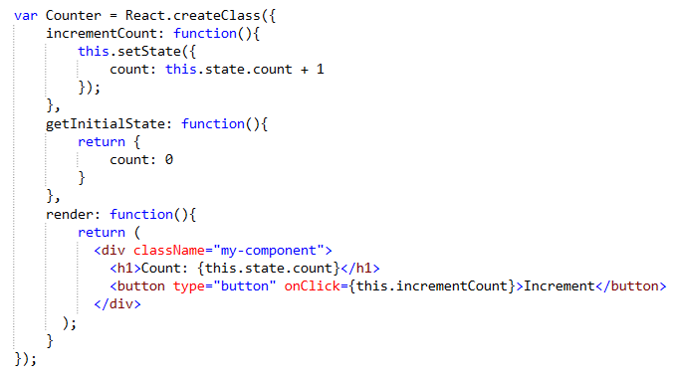
State
Notes:
In React each component is well encapsulated and maintains its own state (if stateful). A stateful component can store a value in its state and pass it to its child components via props. This ensures that whenever a component’s state changes, the props also change. As a result the child components that depend on these props re-render themselves automatically.
You could say the state is private.

Slide 18
Virtual DOM
Not invented by React.
It's pure JavaScript, in-memory representation of the DOM.
Model
Render
Virtual DOM
DOM
Notes:
PROS
Fast and efficient "diffing" algorithm
Multiple frontends (JSX, hyperscript)
Lightweight enough to run on mobile devices
Lots of traction and mindshare
Can be used without React (i.e. as an independent engine)
CONS
Full in-memory copy of the DOM (higher memory use)
No differentiation between static and dynamic elements *

Slide 19
When and how re-render?
Model
Diff algorithm
Batch
DOM
Virtual DOM
Notes:
In React each component is well encapsulated and maintains its own state (if stateful). A stateful component can store a value in its state and pass it to its child components via props. This ensures that whenever a component’s state changes, the props also change. As a result the child components that depend on these props re-render themselves automatically.
You could say the state is private.

Slide 20
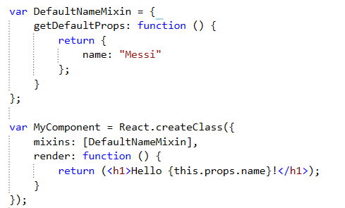
Mixins
An array of objects
Using to extend the current component’s functionality.
Notes:
Notes:
There are some conflict when using mixins:
getDefaultProps: the same prop name
getDefaultState: the same prop name
The same method name

Slide 21
Composition

