Slide 1

Author: Nguyen Minh Tien
Email: nguyenminhtiend@gmail.com
React.js

Slide 2
Agenda
Introduce React
React Core Concept
React Life Cycle
React Event
React Form
React Router
React with Flux

Slide 3
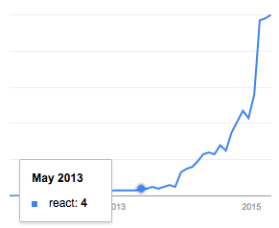
Introduce React
Google search trends for React in programming category
Notes:
React.js isn’t a complete framework, so it doesn’t provide all the components you’ll find in other projects like Ember or AngularJS.
An important difference with frameworks like AngularJS – which uses a two-way data binding model – is that React features a one-way data binding model.

Slide 4
Introduce React
React is a UI library developed at Facebook.
Allow to create UI components
Interactive
Stateful
Reusable
Client site and server side
React is the "View" in the application
Notes:
React.js isn’t a complete framework, so it doesn’t provide all the components you’ll find in other projects like Ember or AngularJS.
An important difference with frameworks like AngularJS – which uses a two-way data binding model – is that React features a one-way data binding model.

Slide 5
Introduce React
Using Virtual DOM → enables high performance for the rendering the UI.
Using with Flux for scaling front-end apps, that provide data flows in a single direction.
Notes:
React.js isn’t a complete framework, so it doesn’t provide all the components you’ll find in other projects like Ember or AngularJS.
An important difference with frameworks like AngularJS – which uses a two-way data binding model – is that React features a one-way data binding model.

Slide 6




Introduce React

Slide 7
React Core Concept
JSX
React Elements
Components
Props
State
Virtual Dom
Mixins
Composition

Slide 8
JSX
It is a Javascript XML syntax transform

