Slide 1
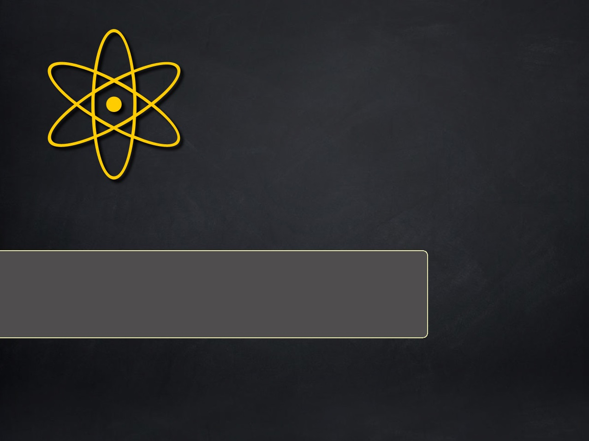
React.js
Author: Tien Nguyen

Slide 2
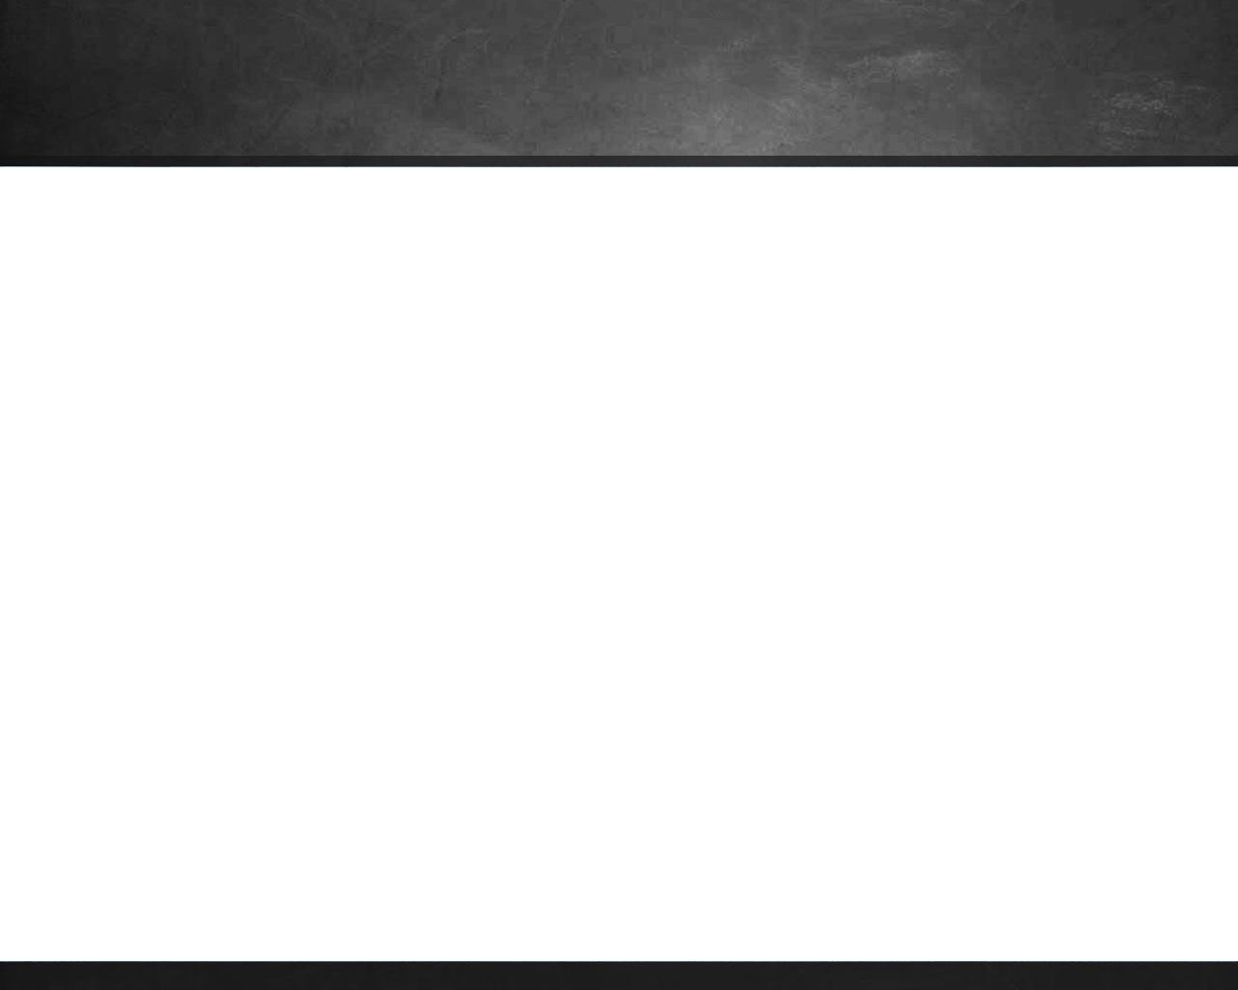
Agenda
Introduce React
React Components
Composition
React Life Cycle
React Form
React Router
React with Flux

Slide 3
Introduce React
React is a UI library developed at Facebook
Allow to create interactive, stateful and reusable UI components

