Slide 1

Author: Nguyen Minh Tien
Email: nguyenminhtiend@gmail.com
React.js

Slide 2
Agenda
Introduce React
React Core Concept
React Life Cycle
React with Flux

Slide 3
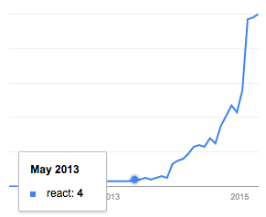
Introduce React
Google search trends for React in programming category
Notes:
React.js isn’t a complete framework, so it doesn’t provide all the components you’ll find in other projects like Ember or AngularJS.
An important difference with frameworks like AngularJS – which uses a two-way data binding model – is that React features a one-way data binding model.

Slide 4
Introduce React
React is a UI library developed at Facebook.
Allow to create UI components
Interactive
Stateful
Reusable
Client site and server side
React is the "View" in the application
Notes:
React.js isn’t a complete framework, so it doesn’t provide all the components you’ll find in other projects like Ember or AngularJS.
An important difference with frameworks like AngularJS – which uses a two-way data binding model – is that React features a one-way data binding model.

Slide 5
Introduce React
Using Virtual DOM → enables high performance for the rendering the UI.
Building large applications with data that changes over time.
Using with Flux for scaling front-end apps, that provide data flows in a single direction.
Notes:
React.js isn’t a complete framework, so it doesn’t provide all the components you’ll find in other projects like Ember or AngularJS.
An important difference with frameworks like AngularJS – which uses a two-way data binding model – is that React features a one-way data binding model.

Slide 6




Introduce React

Slide 7
React Core Concept
JSX
React Elements
React Components
Props
State
Virtual DOM
Mixins
Composition

Slide 8
JSX
It is a Javascript XML syntax transform.
Let us write HTML tags in Javascript.
Less effort to read and write.
Not supported in browsers by default.
Need to transformed into JS before running in the browser.
JSX and HTML syntax are similar but it’s different at some point
class → className, for → htmlFor

Slide 9

JSX Friendly Editor

Slide 10
React Elements
The primary type in React.
It is a virtual DOM.
A virtual representation of a DOM Element:
Light
Stateless
Immutable
Pass to ReactDom.render to render a new tree into the DOM.

Slide 11


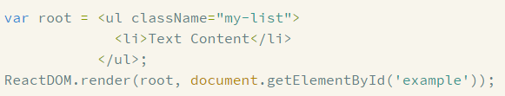
React Elements
Ex:
Notes:
https://facebook.github.io/react/docs/tags-and-attributes.html

Slide 12
React Components
React Component is stateful.
At least a render method on it.
The render method must return a single React Element.
The React Component is converted to the React Element when rendering.
Notes:
You can use React using only ReactElements but to really take advantage of React, you'll want to use ReactComponents to create encapsulations with embedded state.

Slide 13
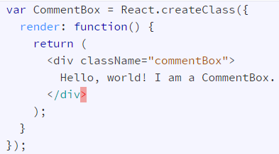

React Components
Notes:
You can use React using only ReactElements but to really take advantage of React, you'll want to use ReactComponents to create encapsulations with embedded state.

Slide 14
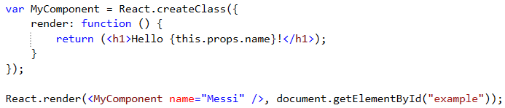
Props
Props are supplied as attributes
These attributes are available in our component as this.props
A Component cannot change its props
Notes:
When we use our defined components, we can add attributes called props.

Slide 15
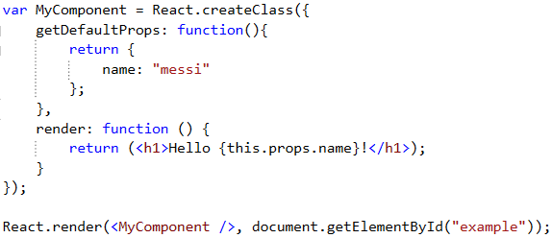
Props - getDefaultProps
Specify property values to use if they are not explicitly supplied.

Slide 16
State
A Component manages its own state internally.
Using setState method to change state.
Re-render component when setState is called.
Using getInitialState method to provide the default value
Notes:
In React each component is well encapsulated and maintains its own state (if stateful). A stateful component can store a value in its state and pass it to its child components via props. This ensures that whenever a component’s state changes, the props also change. As a result the child components that depend on these props re-render themselves automatically.
You could say the state is private.

Slide 17
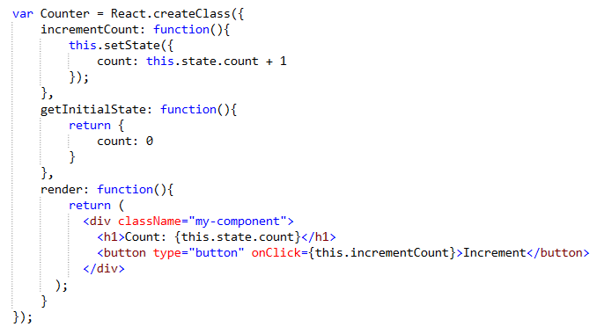
State
Notes:
In React each component is well encapsulated and maintains its own state (if stateful). A stateful component can store a value in its state and pass it to its child components via props. This ensures that whenever a component’s state changes, the props also change. As a result the child components that depend on these props re-render themselves automatically.
You could say the state is private.

Slide 18
Virtual DOM
Not invented by React.
It's pure JavaScript, in-memory representation of the DOM.
Model
Render
Virtual DOM
DOM
Notes:
PROS
Fast and efficient "diffing" algorithm
Multiple frontends (JSX, hyperscript)
Lightweight enough to run on mobile devices
Lots of traction and mindshare
Can be used without React (i.e. as an independent engine)
CONS
Full in-memory copy of the DOM (higher memory use)
No differentiation between static and dynamic elements *

Slide 19
When and how re-render?
Model
Diff algorithm
Batch
DOM
Virtual DOM
Notes:
In React each component is well encapsulated and maintains its own state (if stateful). A stateful component can store a value in its state and pass it to its child components via props. This ensures that whenever a component’s state changes, the props also change. As a result the child components that depend on these props re-render themselves automatically.
You could say the state is private.

Slide 20
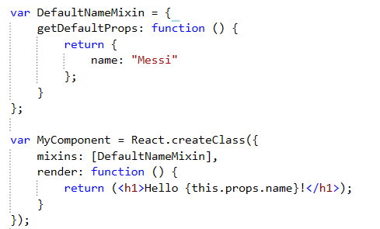
Mixins
An array of objects
Using to extend the current component’s functionality.
Notes:
Notes:
There are some conflict when using mixins:
getDefaultProps: the same prop name
getDefaultState: the same prop name
The same method name

Slide 21
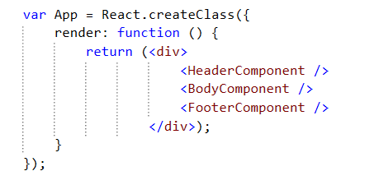
Composition
Combining smaller components inside a component

Slide 22
React Life Cycle
Initialization
State Changes
Props Changes
Unmounting
Notes:
https://facebook.github.io/react/docs/component-specs.html

Slide 23
Initialization
getDefaultProps
getInitialState
componentWillMount
render
componentDidMount
Notes:
Any changes on the props object will also trigger the lifecycle and is almost identical to the state change with one additional method being called.
componentWillReceiveProps is only called when the props have changed and when this is not an initial rendering.componentWillReceiveProps enables to update the state depending on the existing and upcoming props, without triggering another rendering. One interesting thing to remember here is that there is no equivalent method for the state as state changes should never trigger any props changes.
componentWillReceiveProps: function(nextProps) { this.setState({ // set something }); }
The rest of the lifecycle reveals nothing new here and is identical to the state change triggered cycle.

Slide 24
State Changes
shouldComponentUpdate
componentWillUpdate
render
componentDidUpdate
Notes:
From looking at the image above we can see that the first two methods being called are getDefaultProps and getInitialState. Both methods are only called once when initially rendering the component.
The getInitialState method enables to set the initial state value, that is accessible inside the component via this.state.
getInitialState: function(){ return { /* something here */}; }
Analogously getDefaultProps can be used to define any default props which can be accessed via this.props.
getDefaultProps: function(){ return { /* something here */}; }
Another two methods that only get called when initializing a component are componentWillMount and componentDidMount.
componentWillMount is called before the render method is executed. It is important to note that setting the state in this phase will not trigger a re-rendering.
The render method returns the needed component markup, which can be a single child component or null or false (in case you don't want any rendering).
This is the part of the lifecycle where props and state values are interpreted to create the correct output. Neither props nor state should should be modified inside this function. This is important to remember, as by definition the render function has to be pure, meaning that the same result is returned every time the method is invoked.
As soon as the render method has been executed the componentDidMount function is called. The DOM can be accessed in this method, enabling to define DOM manipulations or data fetching operations. Any DOM interactions should always happen in this phase not inside therender method.

Slide 25
Props Changes
componentWillRecieveProps
shouldComponentUpdate
componentWillUpdate
render
componentDidUpdate
Notes:
From looking at the image above we can see that the first two methods being called are getDefaultProps and getInitialState. Both methods are only called once when initially rendering the component.
The getInitialState method enables to set the initial state value, that is accessible inside the component via this.state.
getInitialState: function(){ return { /* something here */}; }
Analogously getDefaultProps can be used to define any default props which can be accessed via this.props.
getDefaultProps: function(){ return { /* something here */}; }
Another two methods that only get called when initializing a component are componentWillMount and componentDidMount.
componentWillMount is called before the render method is executed. It is important to note that setting the state in this phase will not trigger a re-rendering.
The render method returns the needed component markup, which can be a single child component or null or false (in case you don't want any rendering).
This is the part of the lifecycle where props and state values are interpreted to create the correct output. Neither props nor state should should be modified inside this function. This is important to remember, as by definition the render function has to be pure, meaning that the same result is returned every time the method is invoked.
As soon as the render method has been executed the componentDidMount function is called. The DOM can be accessed in this method, enabling to define DOM manipulations or data fetching operations. Any DOM interactions should always happen in this phase not inside therender method.

Slide 26
Unmounting
componentWillUnmount
Notes:
The only method we haven't touched yet is the componentWillUnmount which gets called before the component is removed from the DOM. This method can be beneficial when needing to perform clean up operations, f.e. removing any timers defined in componentDidMount.
Check the code example for a more detailed insight.

Slide 27
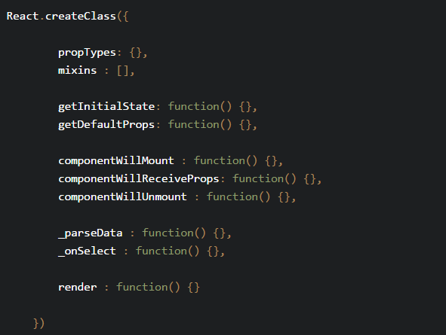
Best practices
Component organisation
Notes:
The only method we haven't touched yet is the componentWillUnmount which gets called before the component is removed from the DOM. This method can be beneficial when needing to perform clean up operations, f.e. removing any timers defined in componentDidMount.

Slide 28
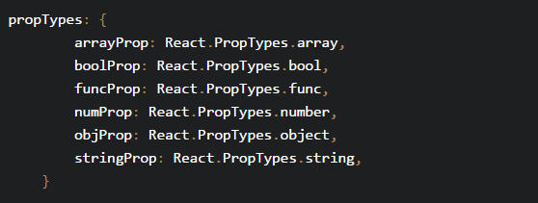
Best practices
Always set propTypes for validation and self-documentation.
Notes:
The only method we haven't touched yet is the componentWillUnmount which gets called before the component is removed from the DOM. This method can be beneficial when needing to perform clean up operations, f.e. removing any timers defined in componentDidMount.

Slide 29
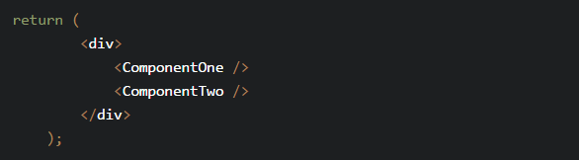
Best practices
Using JSX for more readable
Multi-line JSX
Rather than …
Notes:
The only method we haven't touched yet is the componentWillUnmount which gets called before the component is removed from the DOM. This method can be beneficial when needing to perform clean up operations, f.e. removing any timers defined in componentDidMount.

Slide 30
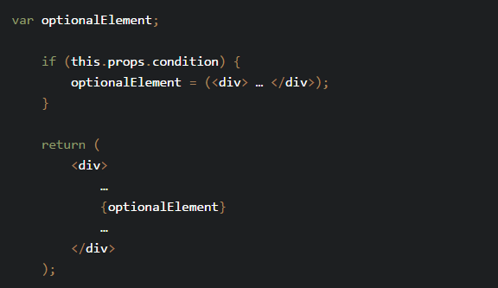
Best practices
Conditional JSX
Notes:
The only method we haven't touched yet is the componentWillUnmount which gets called before the component is removed from the DOM. This method can be beneficial when needing to perform clean up operations, f.e. removing any timers defined in componentDidMount.

Slide 31
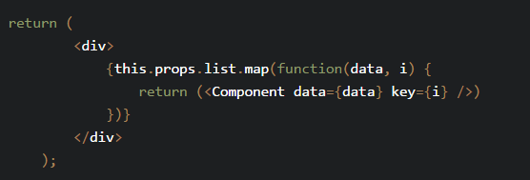
Best practices
In-line list iteration
Notes:
The only method we haven't touched yet is the componentWillUnmount which gets called before the component is removed from the DOM. This method can be beneficial when needing to perform clean up operations, f.e. removing any timers defined in componentDidMount.

Slide 32
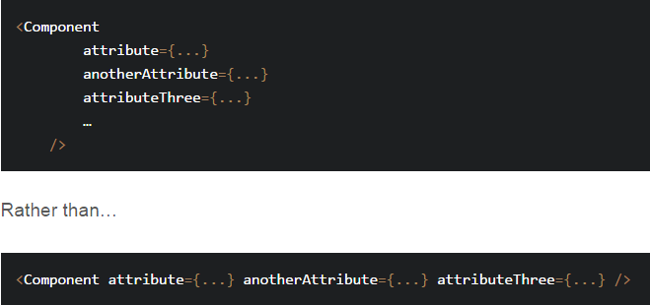
Best practices
Indentation and new line for component attributes
Notes:
The only method we haven't touched yet is the componentWillUnmount which gets called before the component is removed from the DOM. This method can be beneficial when needing to perform clean up operations, f.e. removing any timers defined in componentDidMount.

Slide 33
React with Flux
Flux is the application architecture
Unidirectional data flow
Is a pattern and not a technology or framework.
Some major parts:
Dispatcher
Stores
Views (React Components)
Action
Notes:
The only method we haven't touched yet is the componentWillUnmount which gets called before the component is removed from the DOM. This method can be beneficial when needing to perform clean up operations, f.e. removing any timers defined in componentDidMount.

Slide 34
React with Flux
Dispatcher:
The central hub that manage all flow in application
Receives new data and passes it to the Stores
Stores:
Contain the application data
When a Store changes its data, it notifies the Views.
Views
Are React component
Rendering interfaces and handling user events
Their data is obtained from the Stores
Notes:
The only method we haven't touched yet is the componentWillUnmount which gets called before the component is removed from the DOM. This method can be beneficial when needing to perform clean up operations, f.e. removing any timers defined in componentDidMount.

Slide 35
React with Flux
Action:
The dispatcher exposes a method to trigger a dispatch to the stores
Contain Action Type and data
Notes:
The only method we haven't touched yet is the componentWillUnmount which gets called before the component is removed from the DOM. This method can be beneficial when needing to perform clean up operations, f.e. removing any timers defined in componentDidMount.

Slide 36
React with Flux
Dispatcher
Dispatch action
Store
Call dispatch
Notify
Action
Call
View
Request
Data
API
Notes:
The only method we haven't touched yet is the componentWillUnmount which gets called before the component is removed from the DOM. This method can be beneficial when needing to perform clean up operations, f.e. removing any timers defined in componentDidMount.

Slide 37
Example
Build Todo List using
React
Flux
Gulp
Browserify
Notes:
The only method we haven't touched yet is the componentWillUnmount which gets called before the component is removed from the DOM. This method can be beneficial when needing to perform clean up operations, f.e. removing any timers defined in componentDidMount.

