Slide 1

Author: Nguyen Minh Tien
Email: nguyenminhtiend@gmail.com
React.js

Slide 2
Agenda
1
Introduce React
2
React Core Concept
3
React Life Cycle
4
Best Practices and Demo

Slide 3
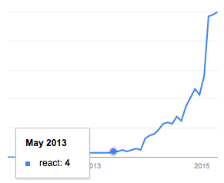
Introduce React
Google search trends for React in programming category

Slide 4
Introduce React
React is a UI library developed at Facebook.
Allow to create UI components
Interactive
Stateful
Reusable
Client site and server side
React is the "View" in the application
Notes:
React.js isn’t a complete framework, so it doesn’t provide all the components you’ll find in other projects like Ember or AngularJS.
An important difference with frameworks like AngularJS – which uses a two-way data binding model – is that React features a one-way data binding model.

Slide 5
Introduce React
Using Virtual DOM → high performance
Suitable with building:
Large applications
Application with data change over time.
Using with Flux for scaling front-end apps.
One way data binding.

Slide 6




Introduce React

Slide 7
React Core Concept
Virtual DOM
JSX
React Elements
React Components
Props
State
PropTypes
Mixins
Composition

Slide 8
DOM
Document Object Model.
Representing a structured document via objects.
Traverse and modify by DOM API
DOM Problems:
Never optimized for creating dynamic UI
Performance issues when working in huge page
Solutions
Shadow DOM.
Virtual DOM.
Notes:
DOM
It is cross-platform and language-independent convention for representing and interacting with data in HTML, XML and others.
Web browsers handle the DOM implementation details, so we can interact with it using JavaScript and CSS.
We can search for nodes and change their details, remove one and insert a new one.
This days DOM API is almost cross-platform and cross-browser.
DOM Problems
The HTML DOM is always tree-structured
Think about modern social networks like Twitter, Facebook or Pinterest. After scrolling a little bit, user will have tens of thousands of nodes. Interact with them efficiently is a huge problem.
Solution
Currently W3C group is working on new Shadow DOM.
Shadow DOM - A W3C working draft standard. This specification describes a method of combining multiple DOM trees into one hierarchy and how these trees interact with each other within a document, thus enabling better composition of the DOM.
Another option is Virtual DOM - Not a standard. Virtual DOM solutions are built on top of standard DOM. They still utilize DOM eventually — they just do it as little as possible and very efficiently.

Slide 9
Virtual DOM
Built on top of standard DOM
Not invented by React.
It's pure JavaScript, in-memory representation of the DOM.
Model
Render
Virtual DOM
DOM
Notes:
PROS
Fast and efficient "diffing" algorithm
Multiple frontends (JSX, hyperscript)
Lightweight enough to run on mobile devices
Lots of traction and mindshare
Can be used without React (i.e. as an independent engine)
CONS
Full in-memory copy of the DOM (higher memory use)
No differentiation between static and dynamic elements *

Slide 10
When and how re-render?
Model
Diff algorithm
Batch
DOM
Virtual DOM

Slide 11
JSX
It is a Javascript XML syntax transform.
HTML tags in Javascript.
Not supported in browsers by default.
JSX and HTML syntax are similar but it’s different at some point
class → className
for → htmlFor
Notes:
Less effort to read and write
Need to transformed into JS before running in the browser.

Slide 12

JSX Friendly Editor

Slide 13
React Elements
The primary type in React.
It is a virtual DOM.
A virtual representation of a DOM Element:
Light
Stateless
Immutable
Pass to ReactDom.render to render a new tree into the DOM.

Slide 14


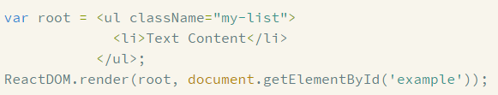
React Elements
Notes:
https://facebook.github.io/react/docs/tags-and-attributes.html

Slide 15
React Components
Stateful.
At least a render method on it.
The render method must return a single React Element.
The React Component is converted to the React Element when rendering.
Notes:
You can use React using only ReactElements but to really take advantage of React, you'll want to use ReactComponents to create encapsulations with embedded state.

Slide 16
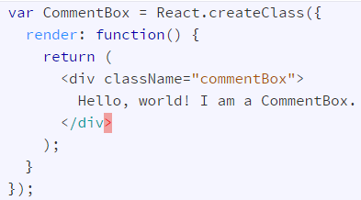

React Components

Slide 17
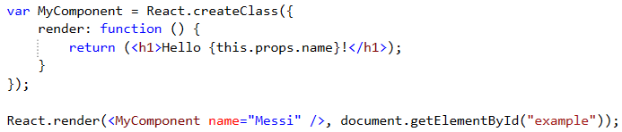
Props
Props are supplied as attributes
These attributes are available in our component as this.props
A Component cannot change its props
Notes:
When we use our defined components, we can add attributes called props.

Slide 18
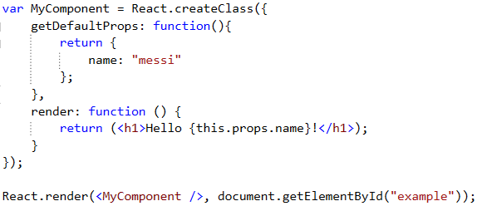
Props - getDefaultProps
Specify property values to use if they are not explicitly supplied.

Slide 19
State
A Component manages its own state internally.
Using setState method to change state.
Re-render component when setState is called.
Using getInitialState method to provide the default value
Notes:
In React each component is well encapsulated and maintains its own state (if stateful). A stateful component can store a value in its state and pass it to its child components via props. This ensures that whenever a component’s state changes, the props also change. As a result the child components that depend on these props re-render themselves automatically.
You could say the state is private.

Slide 20
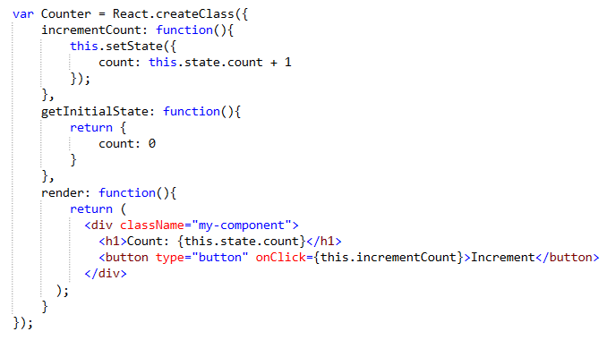
State

Slide 21
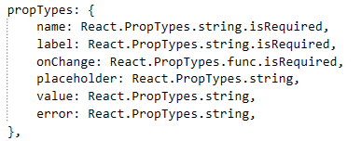
PropTypes
Use to validate props pass to component
Isn’t run in production (minified) version.
Notes:
When application is bigger and bigger, We use component properly

Slide 22
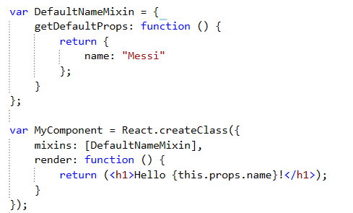
Mixins
An array of objects
Using to extend the current component’s functionality.
Notes:
Notes:
There are some conflict when using mixins:
getDefaultProps: the same prop name
getDefaultState: the same prop name
The same method name

Slide 23
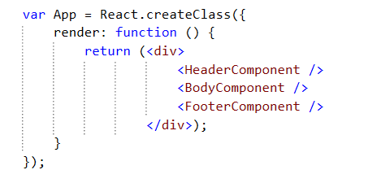
Composition
Combining smaller components inside a component

Slide 24
React Life Cycle
Initialization
State Changes
Props Changes
Unmounting
Notes:
https://facebook.github.io/react/docs/component-specs.html

Slide 25
Initialization
getDefaultProps
getInitialState
componentWillMount
render
componentDidMount
Notes:
Any changes on the props object will also trigger the lifecycle and is almost identical to the state change with one additional method being called.
componentWillReceiveProps is only called when the props have changed and when this is not an initial rendering.componentWillReceiveProps enables to update the state depending on the existing and upcoming props, without triggering another rendering. One interesting thing to remember here is that there is no equivalent method for the state as state changes should never trigger any props changes.
componentWillReceiveProps: function(nextProps) { this.setState({ // set something }); }
The rest of the lifecycle reveals nothing new here and is identical to the state change triggered cycle.

Slide 26
State Changes
shouldComponentUpdate
componentWillUpdate
render
componentDidUpdate
Notes:
From looking at the image above we can see that the first two methods being called are getDefaultProps and getInitialState. Both methods are only called once when initially rendering the component.
The getInitialState method enables to set the initial state value, that is accessible inside the component via this.state.
getInitialState: function(){ return { /* something here */}; }
Analogously getDefaultProps can be used to define any default props which can be accessed via this.props.
getDefaultProps: function(){ return { /* something here */}; }
Another two methods that only get called when initializing a component are componentWillMount and componentDidMount.
componentWillMount is called before the render method is executed. It is important to note that setting the state in this phase will not trigger a re-rendering.
The render method returns the needed component markup, which can be a single child component or null or false (in case you don't want any rendering).
This is the part of the lifecycle where props and state values are interpreted to create the correct output. Neither props nor state should should be modified inside this function. This is important to remember, as by definition the render function has to be pure, meaning that the same result is returned every time the method is invoked.
As soon as the render method has been executed the componentDidMount function is called. The DOM can be accessed in this method, enabling to define DOM manipulations or data fetching operations. Any DOM interactions should always happen in this phase not inside therender method.

Slide 27
Props Changes
componentWillRecieveProps
shouldComponentUpdate
componentWillUpdate
render
componentDidUpdate
Notes:
From looking at the image above we can see that the first two methods being called are getDefaultProps and getInitialState. Both methods are only called once when initially rendering the component.
The getInitialState method enables to set the initial state value, that is accessible inside the component via this.state.
getInitialState: function(){ return { /* something here */}; }
Analogously getDefaultProps can be used to define any default props which can be accessed via this.props.
getDefaultProps: function(){ return { /* something here */}; }
Another two methods that only get called when initializing a component are componentWillMount and componentDidMount.
componentWillMount is called before the render method is executed. It is important to note that setting the state in this phase will not trigger a re-rendering.
The render method returns the needed component markup, which can be a single child component or null or false (in case you don't want any rendering).
This is the part of the lifecycle where props and state values are interpreted to create the correct output. Neither props nor state should should be modified inside this function. This is important to remember, as by definition the render function has to be pure, meaning that the same result is returned every time the method is invoked.
As soon as the render method has been executed the componentDidMount function is called. The DOM can be accessed in this method, enabling to define DOM manipulations or data fetching operations. Any DOM interactions should always happen in this phase not inside therender method.

Slide 28
Unmounting
componentWillUnmount
Notes:
The only method we haven't touched yet is the componentWillUnmount which gets called before the component is removed from the DOM. This method can be beneficial when needing to perform clean up operations, f.e. removing any timers defined in componentDidMount.
Check the code example for a more detailed insight.

Slide 29
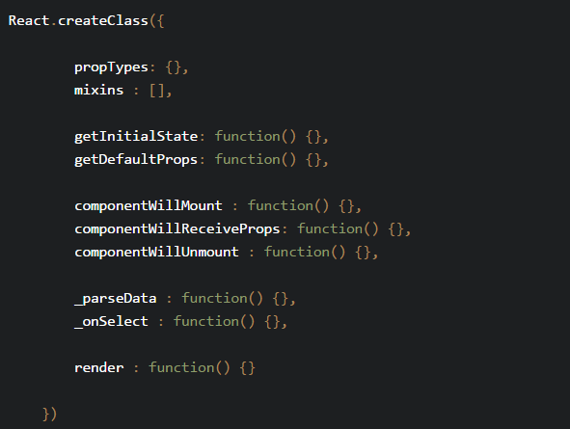
Best practices
Component organisation

Slide 30
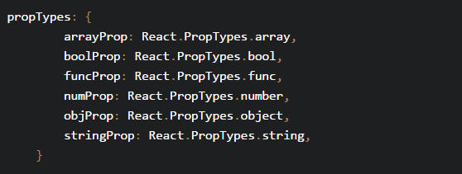
Best practices
Always set propTypes for validation and self-documentation.

Slide 31
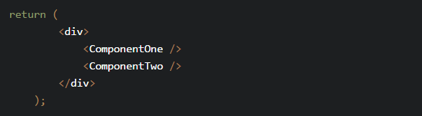
Best practices
Using JSX for more readable
Multi-line JSX
Rather than …

Slide 32
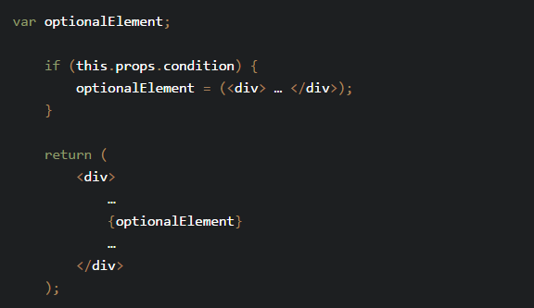
Best practices
Conditional JSX

Slide 33
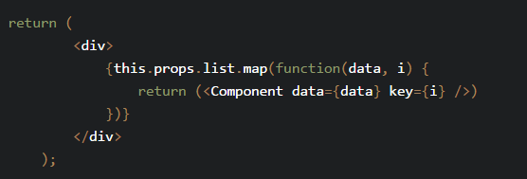
Best practices
In-line list iteration

Slide 34
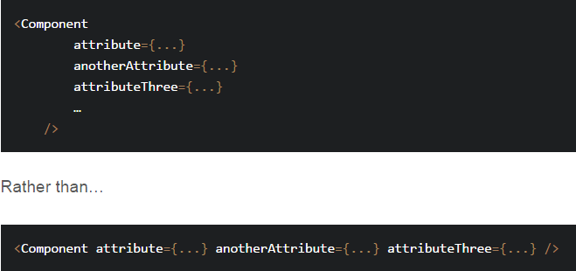
Best practices
Indentation and new line for component attributes

Slide 35
DEMO
Build Todo List using
React
React DOM
Reactify
Gulp
Browserify
Notes:
The only method we haven't touched yet is the componentWillUnmount which gets called before the component is removed from the DOM. This method can be beneficial when needing to perform clean up operations, f.e. removing any timers defined in componentDidMount.

Slide 36

Questions & answers

