Slide 1
ECE6130 Project HW III
Group 14
Fall 2016

Slide 2
Part 1-A System Design

Slide 3
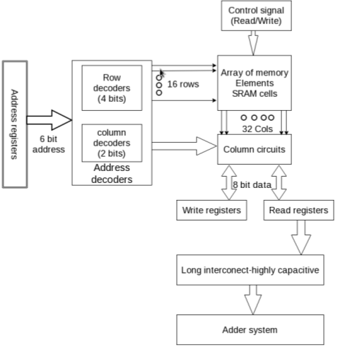
Overall System Design

Slide 4
Intended Operation
Write a set of data to an SRAM array
The control signal tells SRAM to work on write mode.
For each cycle, address decoder with decodes the address,
Then the data is read from write register and written to the respective SRAM cell
Read data sequentially from the array
The control signal tells SRAM to work on read mode.
For each cycle, the address decoder decodes the address, then data is read from respective SRAM cells and write to READ registers. Address is increased by one after each cycle.

Slide 5
Intended Operation
Driven through a long-interconnect and add them sequentially for n cycle
The data in read registers of SRAM is read by the long-interconnect
The data is driven to the input registers of the adder system.
Then the data is added to the already computed partial sum.

Slide 6
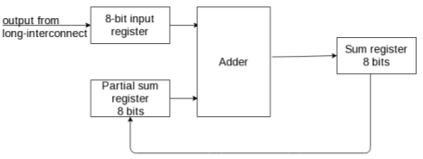
Sequential Sum Implementation

Slide 7
Sequential Sum Implementation
Adder gets one input from an 8-bit input register whose data is the new data fetched from SRAM via the long-interconnect, and another input from the partial sum register.
Then addition is executed and the output is written to the sum register output. In the next cycle, the partial sum register is updated the newly calculated partial sum from the sum register.
Then the adder get inputs from the 8-bit input register and partial sum register and repeat the same process.

Slide 8
Brief description of the system functionality
We utilized pipeline to speed up the system.

Slide 9
Brief description of the system functionality
High-level functionality
Write the entire array in the initialize cycles
Perform 3 cycle of read, driven and partial sum updated, and addition operation (pipelined)
+ One cycle is read data from SRAM
+ The second cycle is driven data from SRAM’s read register to adder’s input register. At the same time, the value of the partial sum register is updated from the sum register.
+ Add data in the third cycle

Slide 10
Part 1-B Decoder

Slide 11
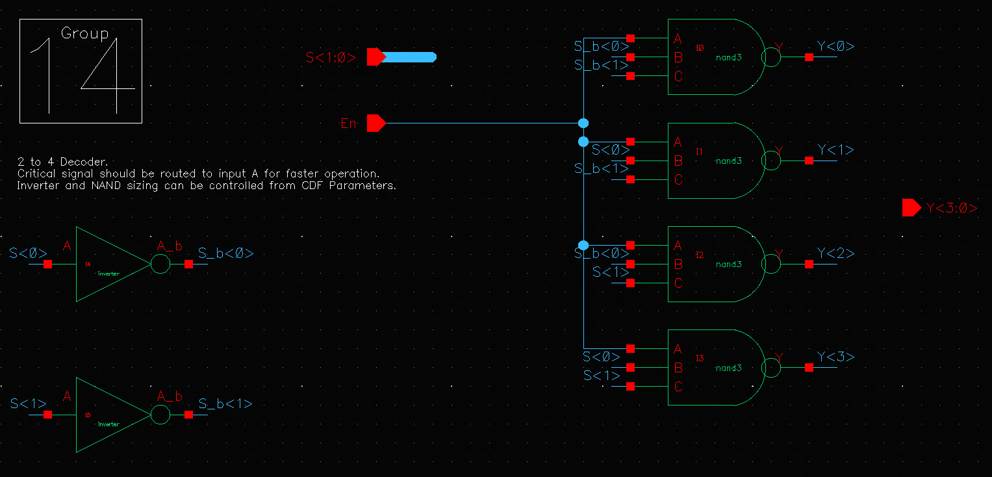
2 to 4 Decoder

Slide 12
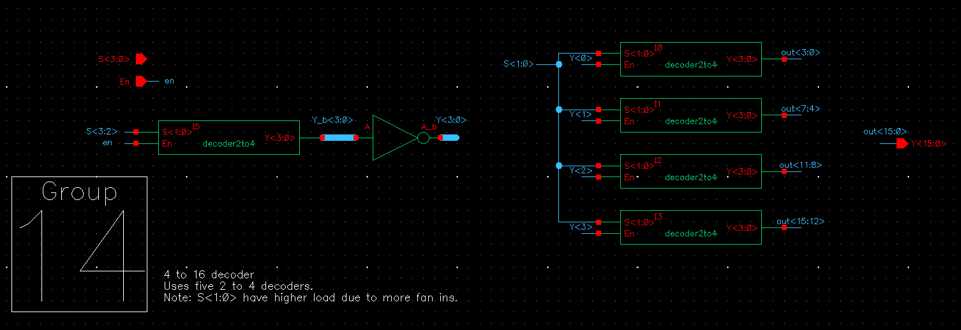
4 to 16 Decoder

Slide 13
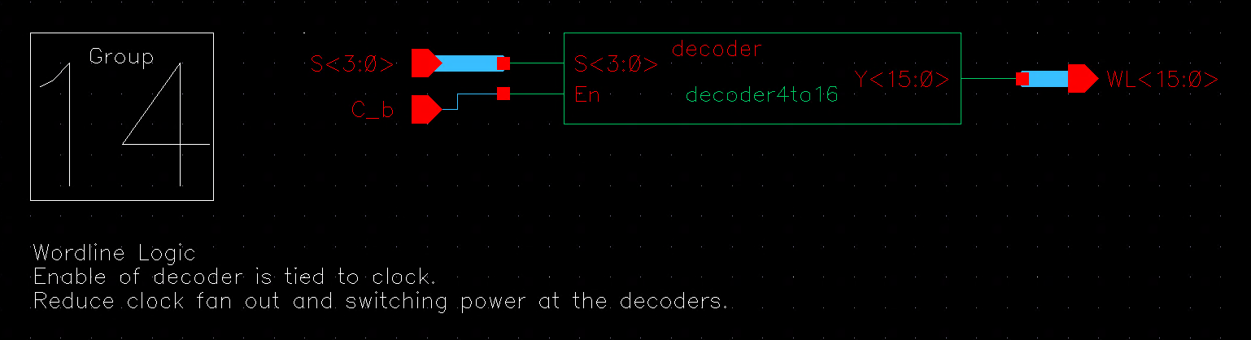
WL logic schematic

Slide 14
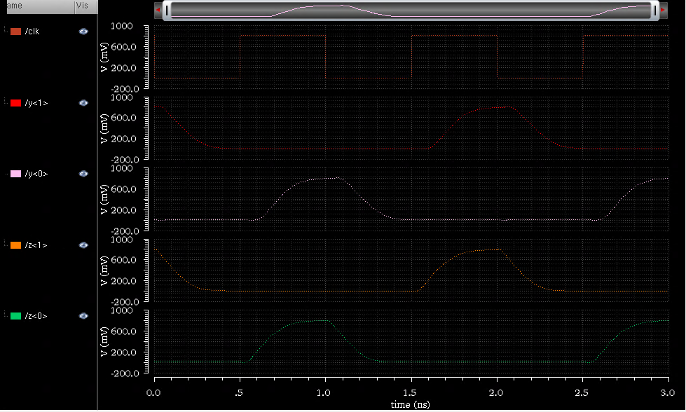
WL Logic waveform of operation
Clock
000000
000101
Row decoder output 1
Row decoder output 0
Column decoder output 1
Column decoder output 0

Slide 15
Delay @ nominal voltage: 225.5 ps
Delay (s)
Power (W)

Slide 16
Part 1-C Registers Circuits for Long-Capacitive Interconnect

Slide 17
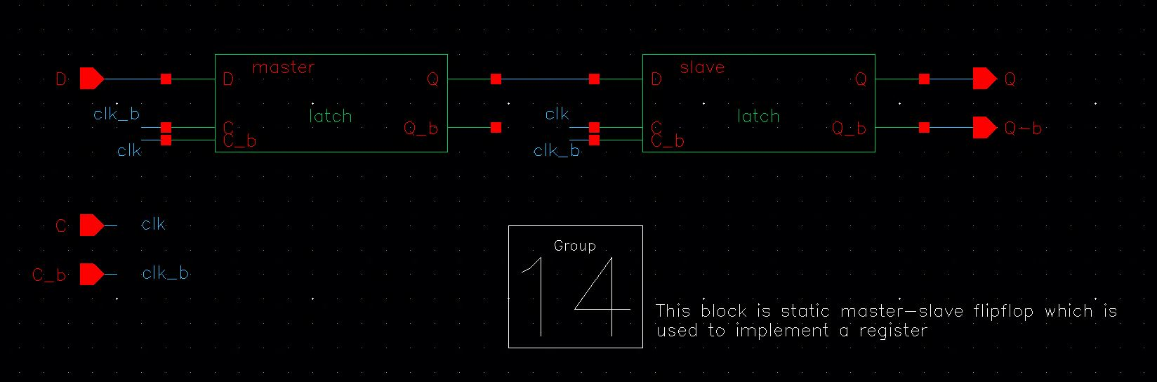
Schematic of the single flip-flop

Slide 18
Design Style Used
Register is made by 6 parallel flip-flops
We used latches, one master latch and one slave latch to design register.
Latch is designed by two transmission gates

Slide 19
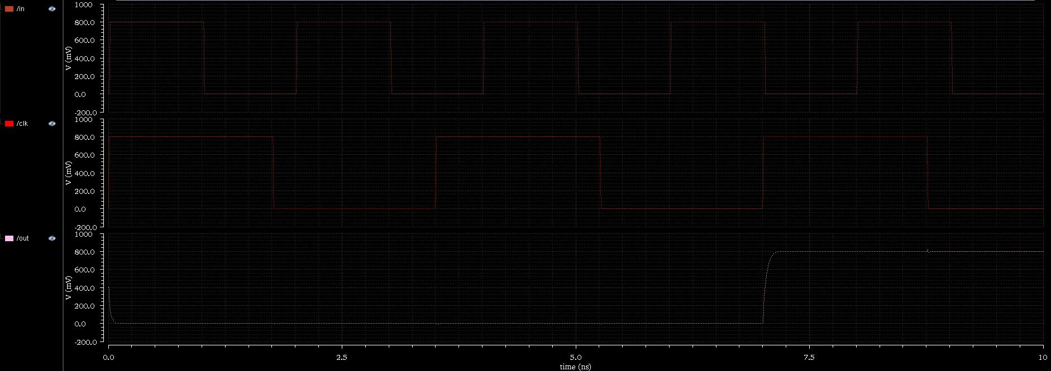
Waveform of operation for flip-flop

Slide 20
At normal supply voltage
Clk-Q delay: 19.8 ps
Hold time: 0
Set-up time: 11 ps

Slide 21
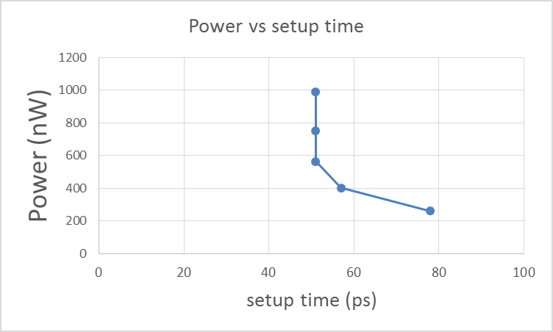
Power vs setup time when varying Vdd

Slide 22
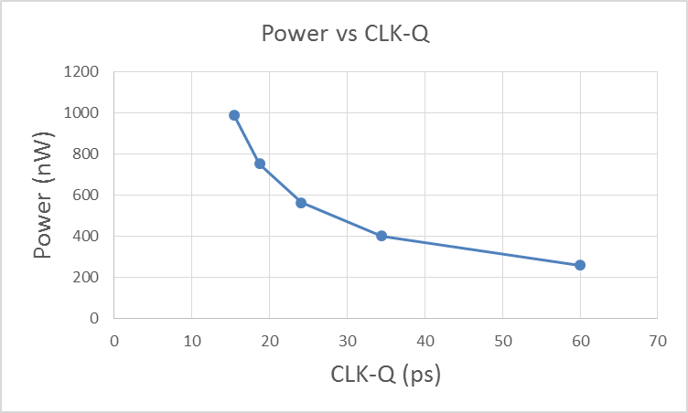
Power vs CLK-Q when varying Vdd

Slide 23
Long interconnect design
We using chain of inverters and sizing to design the long interconnect
By optimize the delay, we found that using a chain of 2 inverters gives
the optimal design.
The relative size of inverter is 3.1 .
The upsizing factor is 2 and 8 for each inverter, respectively

Slide 24
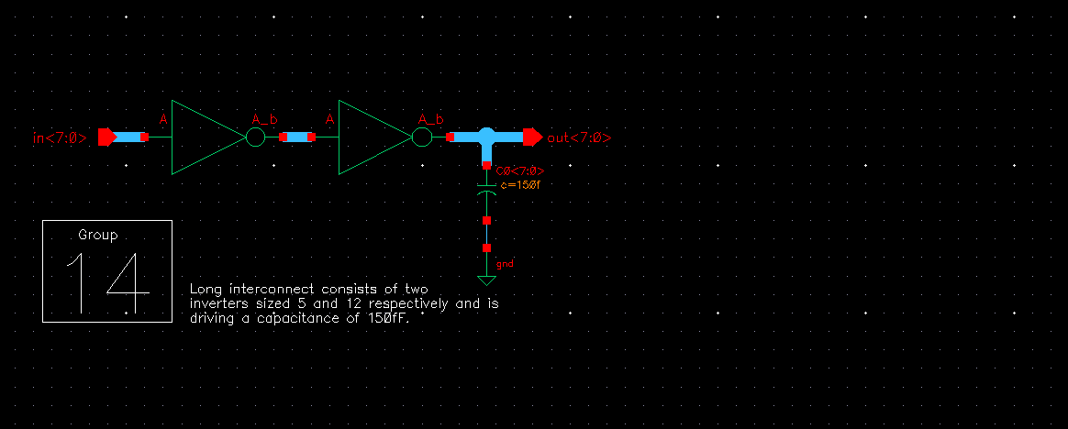
Long interconnect design schematic

Slide 25
At normal voltage: 0.8V
The delay through the chain: 326.36 ps
The power dissipation: 686.638 microW

Slide 26
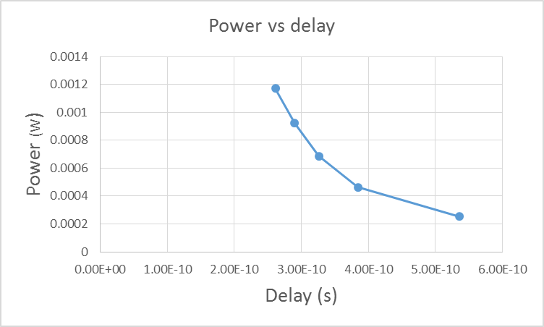
Power of the driver chain vs delay

Slide 27
The minimum supply voltage
The minimum supply voltage is 1.6v
If we want to use lower supply voltage, we can reduce the setup time

Slide 28
Part 1-D Integration of the blocks

Slide 29
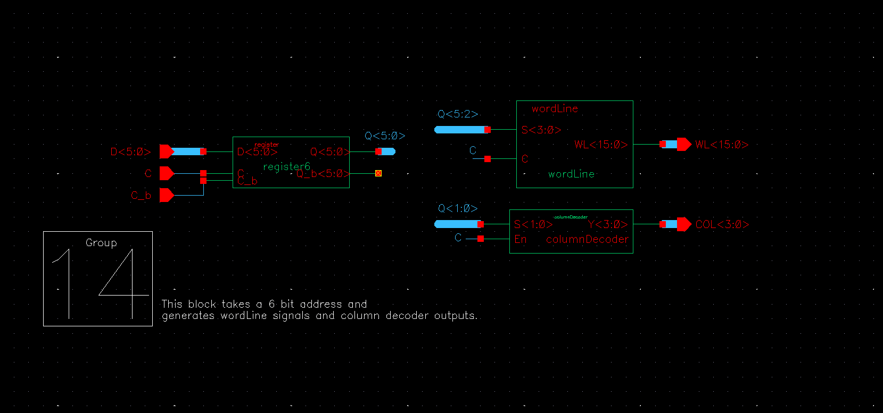
Integrated circuit schematic of Integration 1

Slide 30
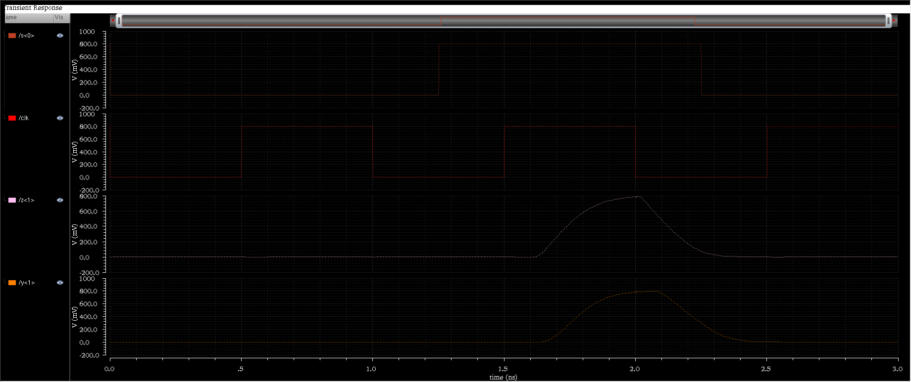
Waveform for operation
Input<0>
Input<2>
Clock
Column decoder<0>
Row
WL<0>

Slide 31
Clk edge to WL transition delay: 278.9ps
Delay (s)
Power (W)

Slide 32
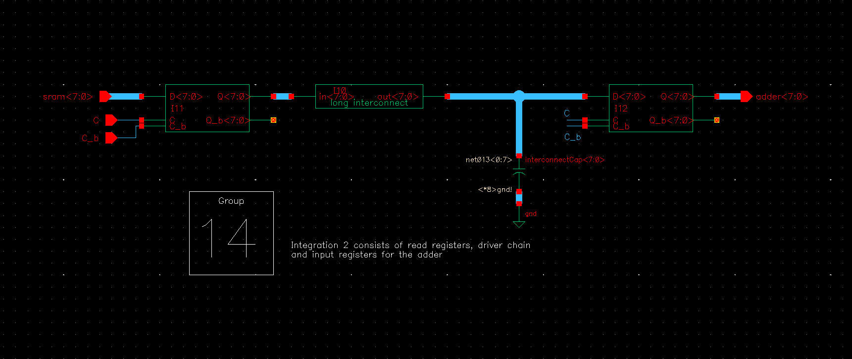
Integration 2’s schematic

Slide 33
Integration 2’s waveform for operation

Slide 34
Delay responding adder’s input transition
The delay from positive CLK-edge to transition at the input of the “input registers for the adder” (@ nominal voltage) : 347 ps

Slide 35
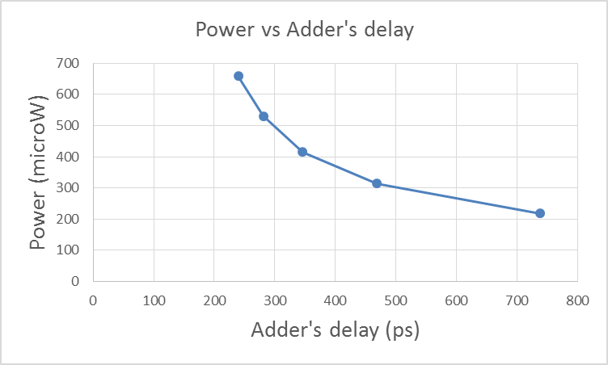
System Power vs Adder’s delay

