Slide 1
ECE6130 Project HW III
Group 14
Fall 2016

Slide 2
Part 1-B Decoder

Slide 3
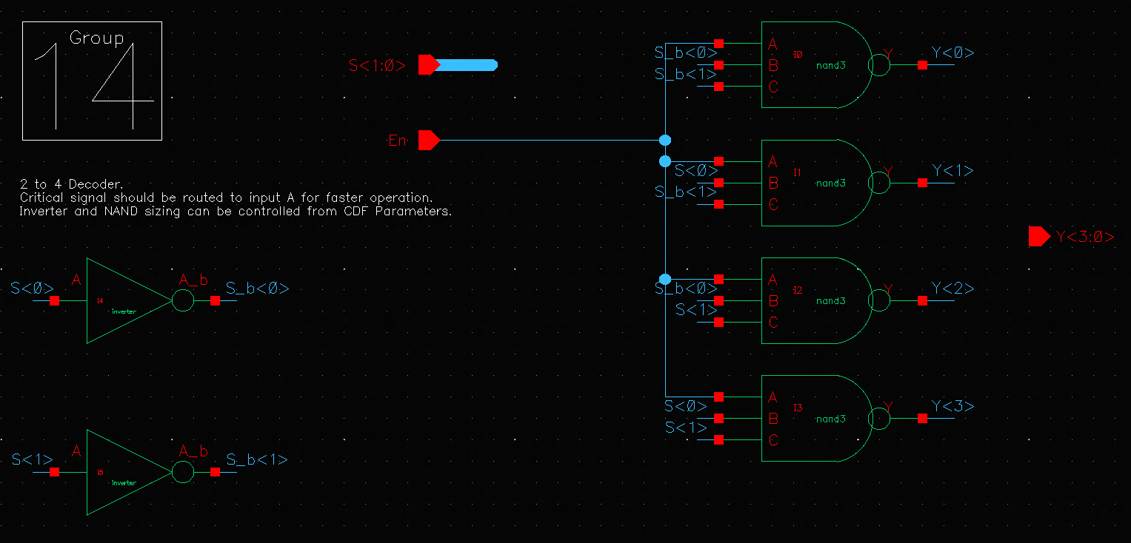
2 to 4 Decoder

Slide 4
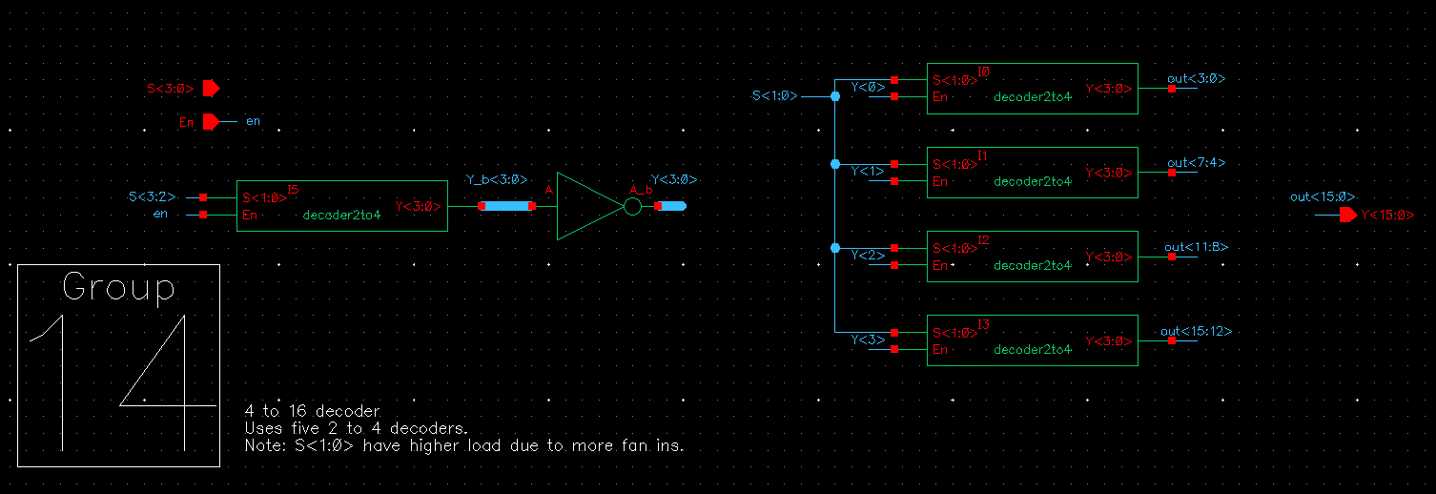
4 to 16 Decoder

Slide 5
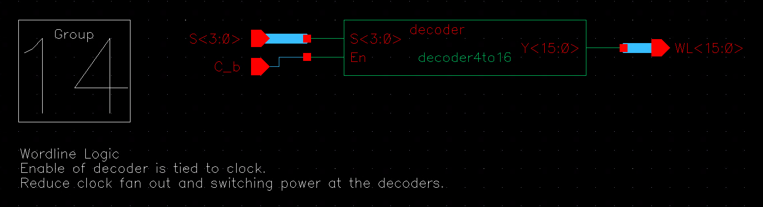
WL logic schematic

Slide 6
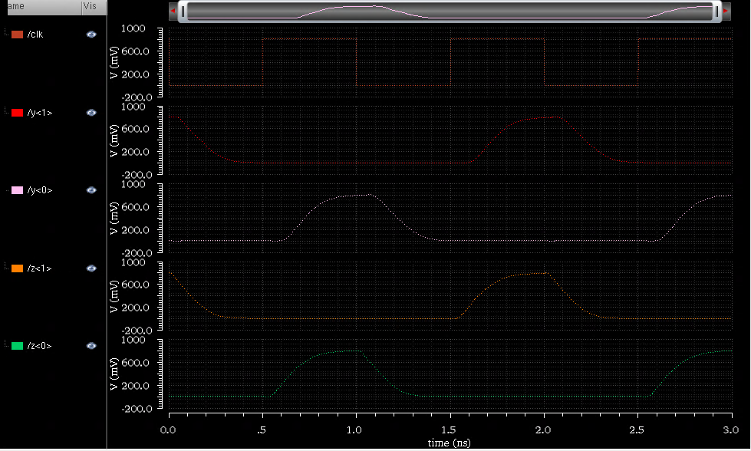
WL Logic waveform of operation
Clock
000000
000101
Row decoder output 1
Row decoder output 0
Column decoder output 1
Column decoder output 0

Slide 7
Delay @ nominal voltage: 225.5 ps
Delay (s)
Power (W)

Slide 8
Part 1-D Integration of the blocks

Slide 9
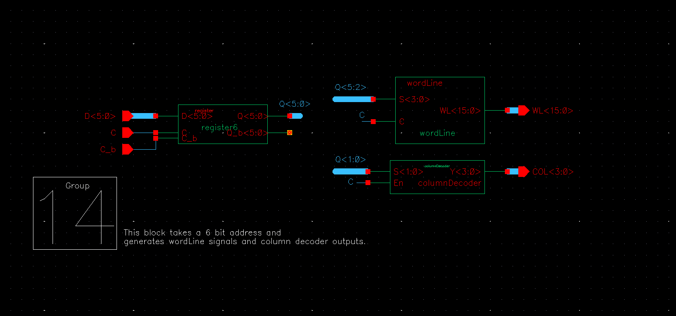
Integrated circuit schematic

Slide 10
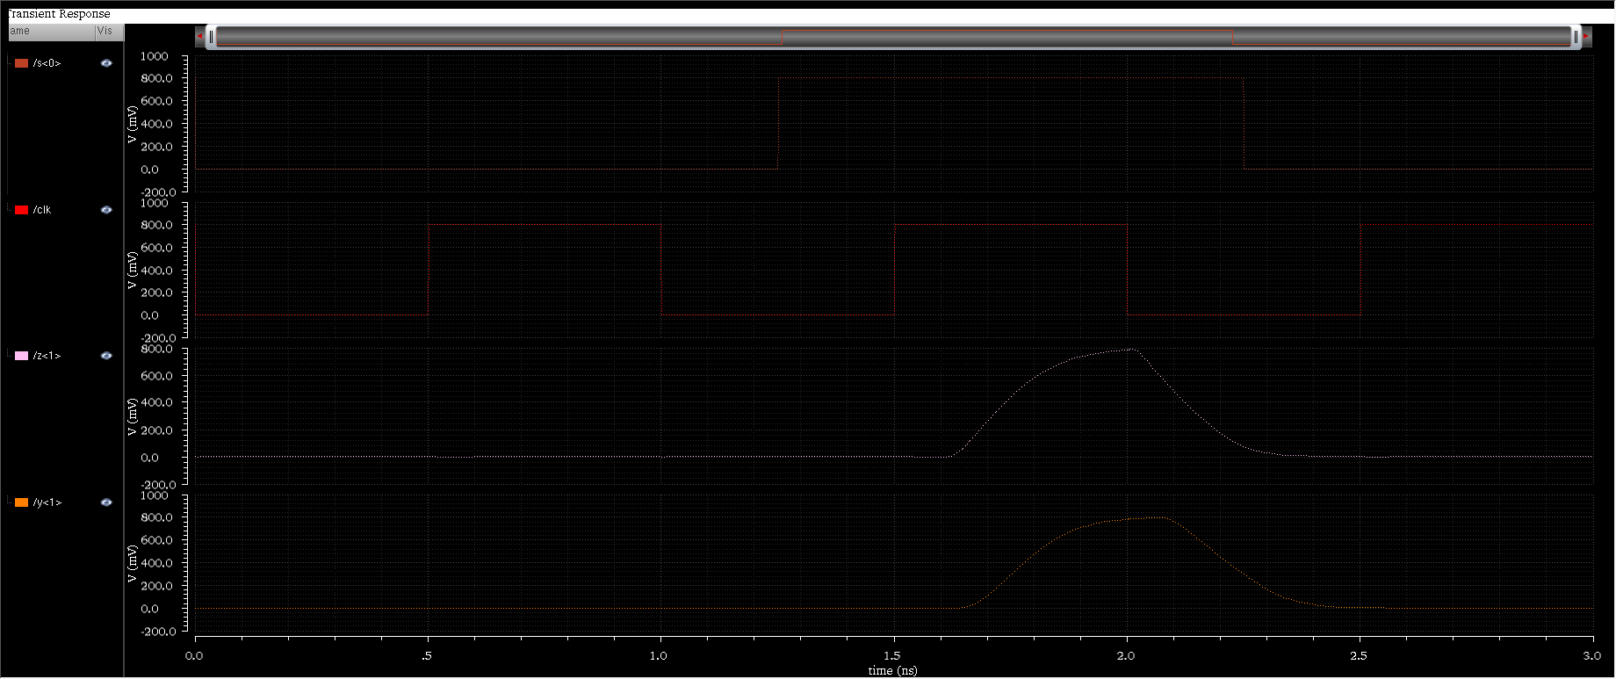
Waveform for operation
Input<0>
Input<2>
Clock
Column decoder<0>
Row
WL<0>

Slide 11
Clk edge to WL transition delay: 278.9ps
Delay (s)
Power (W)

Slide 12
Misc. addendum

