Slide 1
ECE6130 Project HW4
Group 14

Slide 2
Part II-A

Slide 3
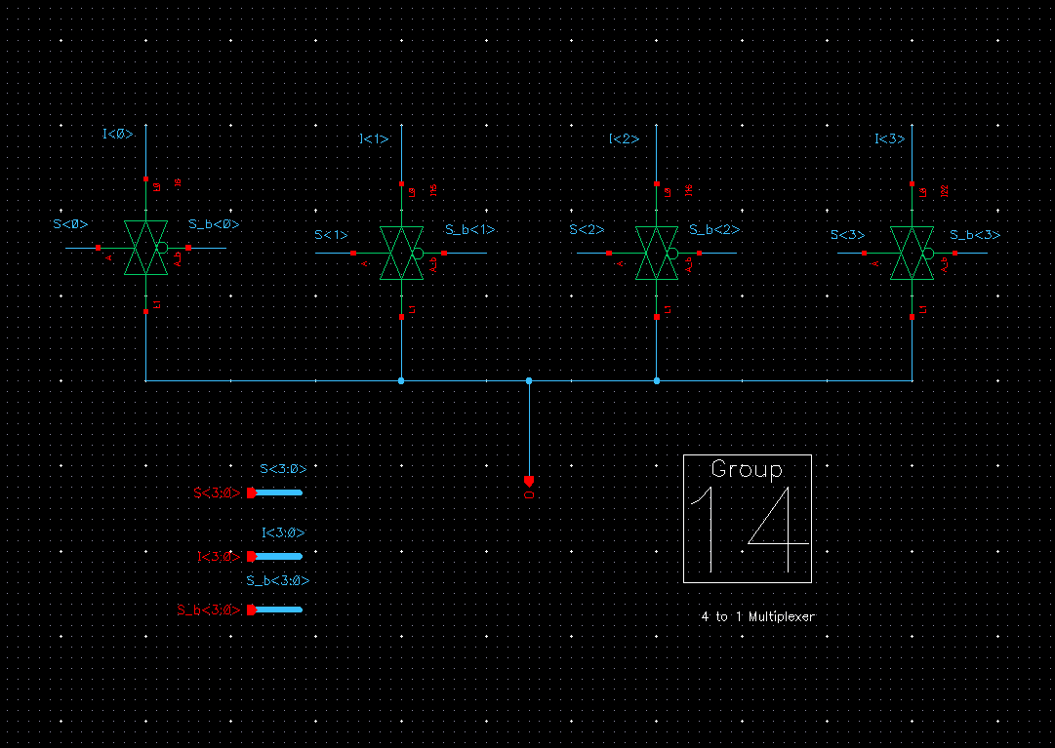
4:1 Column Mux

Slide 4
Waveform of operation

Slide 5
Specs
Critical delay:
Delay of nominal VDD:

Slide 6
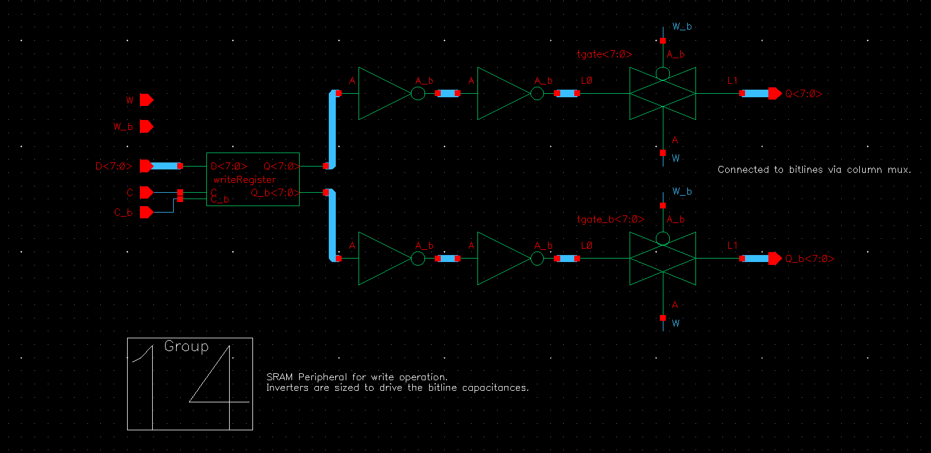
Write circuit
Schematic

Slide 7
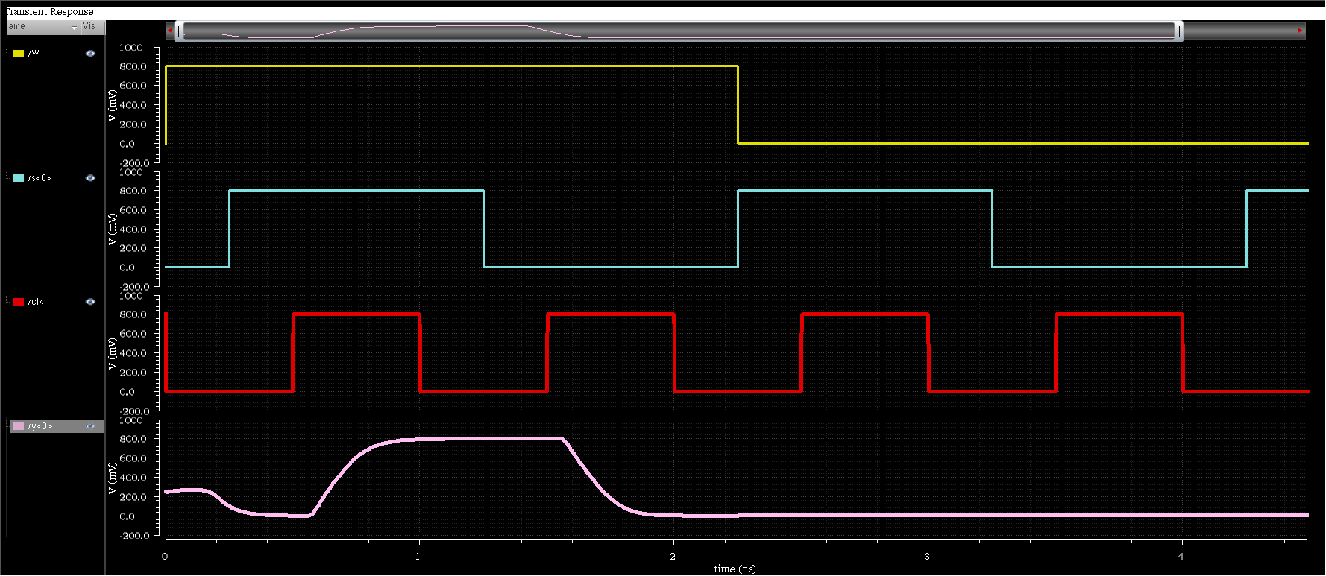
Waveform of operation
Write enable
write data (bit 0)
Clock
Bit line output

Slide 8
Specs
Critical delay: Clk – bitline output delay
Delay of nominal VDD: 178 ps
Power dissipation at nominal Vdd: 118.8uW

Slide 9
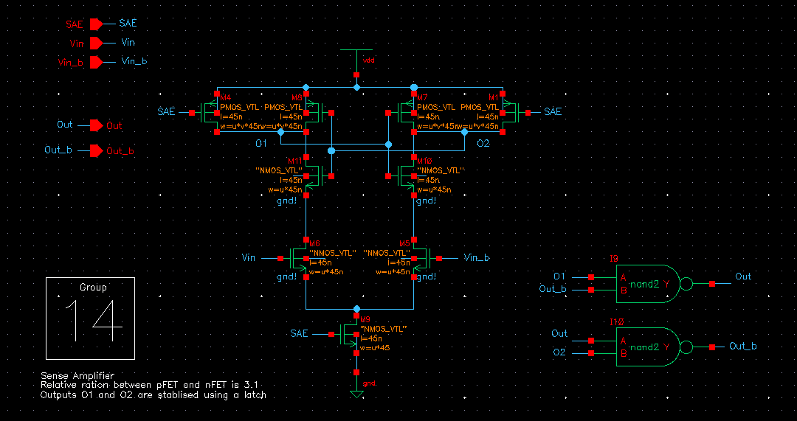
Read circuit - Sense Amplifier schematic

Slide 10
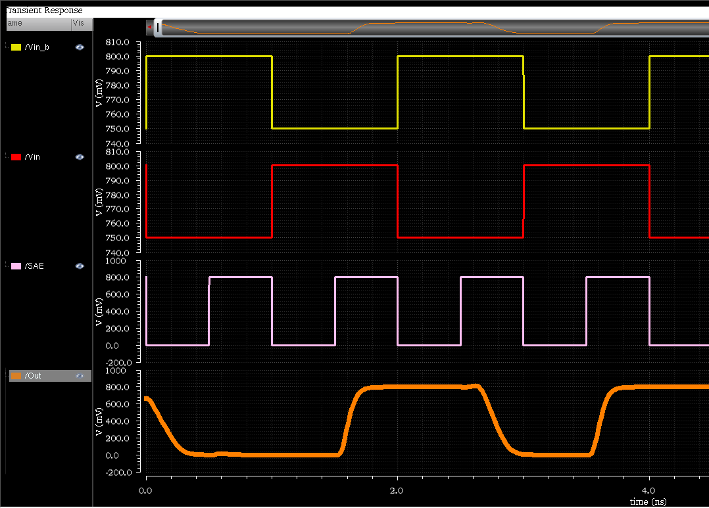
Waveform of operation
Delta = 50mV
Delta = -50mV
Sense amp enable
Sense amp output

Slide 11
Specs
Critical delay: Sense enable (SAE) to output delay
Delay at nominal VDD: 190 ps
Delta bit (DB) for the sense amplifier: 30mV

Slide 12
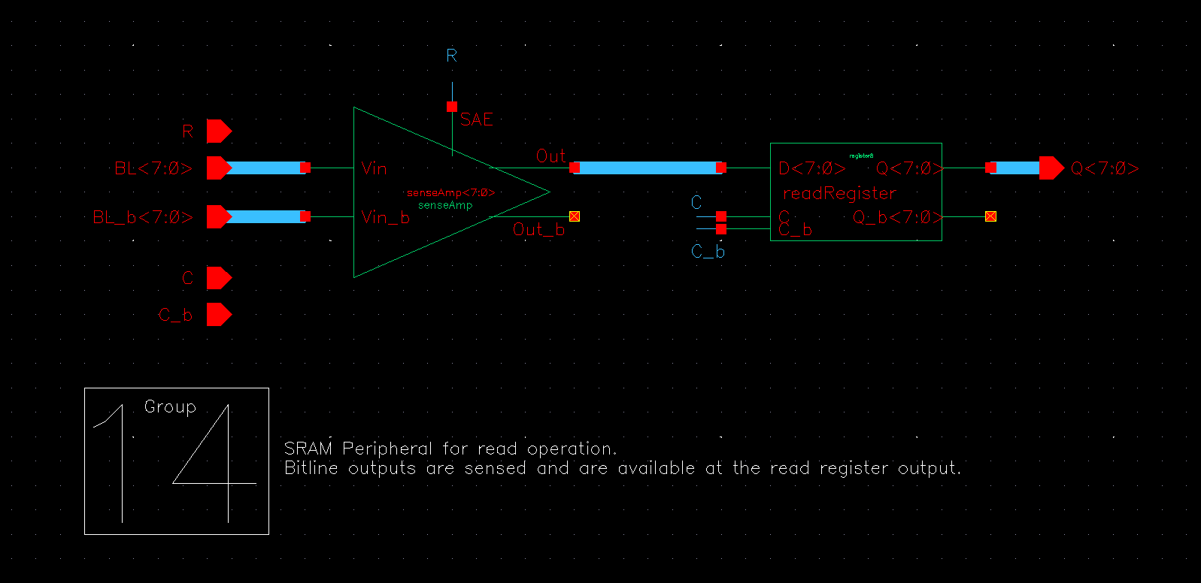
Read circuit

Slide 13
Specs
Waveform is a trivial extension of the waveform of sense amplifier output. Hence omitted.
Critical delay: Delay between bitline voltages and sense amplifier outputs.
Power at nominal voltage: 30.9uW
Power vs delay curve
(delay at the output register):

Slide 14
Part II-B: SRAM Cell

Slide 15
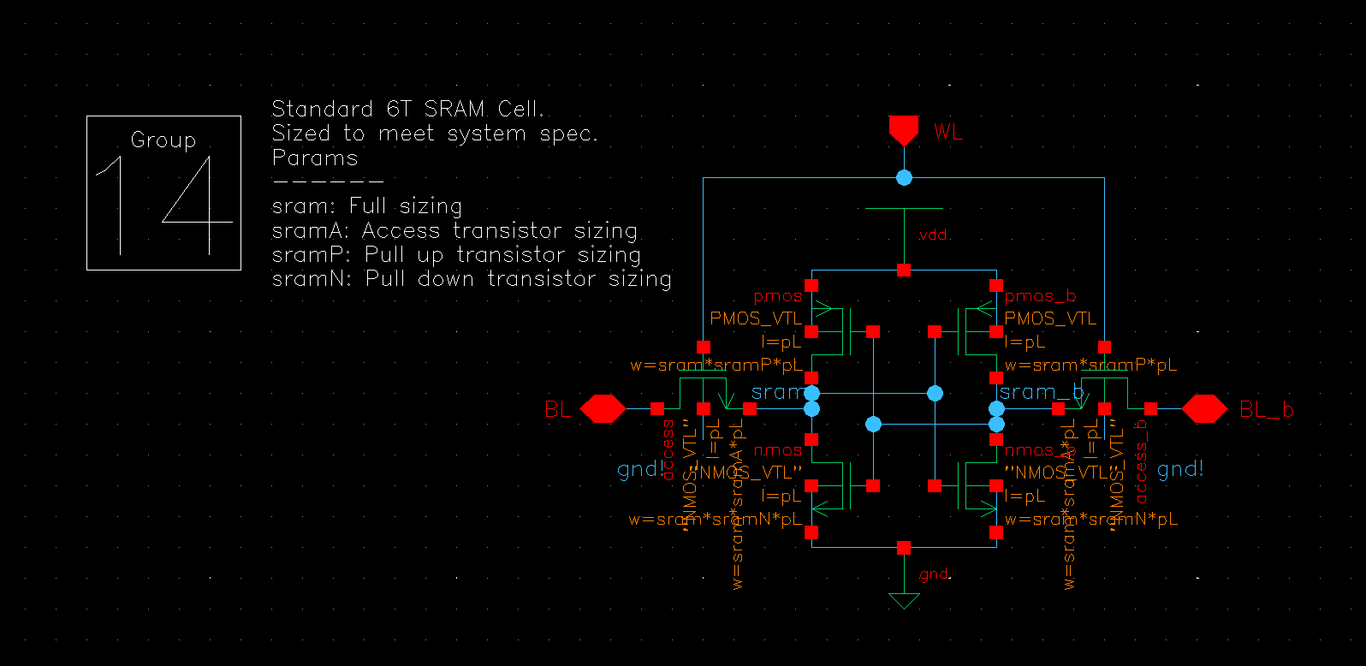
Schematic

Slide 16
Layout Cell area:

Slide 17
LVS and DRC Reports

Slide 18
Specs
Sizing:
A sample of many combinations tried.
Sizing (Wp:Waccess:Wpull-down) | Read margin | Read Speed (Cell access time) | Write margin | Comments
1:1.5:2 | 230mV(28%) | 68ps | 260mV(32.6%) | Starting point. Read margin not met. Write margin at the borders. Increase pull-down and check.
1:1.5:2.6 | 243mV(30.3%) | 61ps | 260mV(32.6%) | Specifications met. Improve write margin if possible. Read speed not affected much. Try higher pull-down.
1:1.5:2.8 | 247mV(30.8%) | 60ps | 260mV(32.6%) | Almost same specs, but with increased area. Reduce access.
1:1.3:2.6 | 255mV (31.8%) | 68ps | 240mV (30%) | Approaching sweet-spot. Size pull-up to see if read margin can met with reduced area.
1.2:1.3:2.4, 1.2:1.3:2.6 | 261.1mV (32.6%) | 68.5ps | 260mV(32.6%) | Degrades write margin and area. Reverting to previous sizing. Run parametric analyses to hit the sweet spot.
1:1.4:2.6 | 249.5mV (31.1%) | 64 ps | 280 mV (35%) | Write margin improved by 5%. Minor hit in read margin taken. Final sizing.
2:2.8:5.2 | 248mV (31%) | 32ps | 280mV(35%) | Scaled up to meet layout rules (min. poly as 90nm)

Slide 19
Sizing plots

Slide 20
Access time variations

Slide 21
Variation with VDD

