Slide 1
GUI AI Learning Platform Design
TSDV
2021 年 02月 18 日

Slide 2

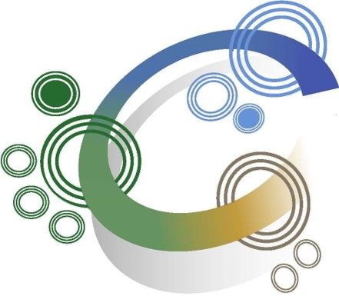



Main window
AI Learning Platform
Transfer Learning
Dataset Management

Slide 3
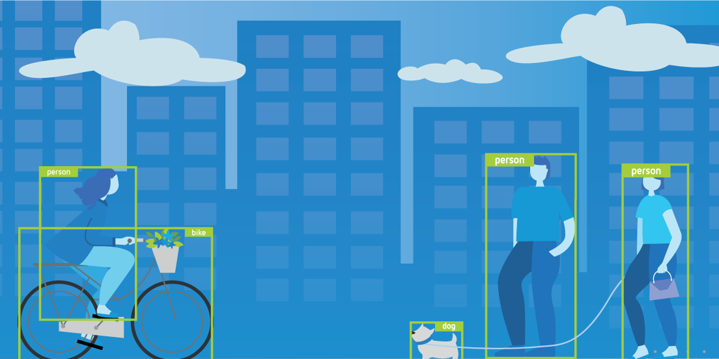
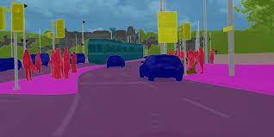
Transfer Learning window
ObjectDetection Segmentation
Object Detection
Segmentation
Object detection combines classification and localization to determine what objects are in the image or video and specify where they are in the image. It applies classification to distinct objects and uses bounding boxes.
Segmentation identifies parts of the image and understanding what object they belong to. Segmentation lays the basis for performing object detection and classification.

Slide 4
Transfer Learning window
ObjectDetection Segmentation
Train
Evaluate
Interference
Prune
Object Detection
Segmentation
Object detection combines classification and localization to determine what objects are in the image or video and specify where they are in the image. It applies classification to distinct objects and uses bounding boxes.
Segmentation identifies parts of the image and understanding what object they belong to. Segmentation lays the basis for performing object detection and classification.

Slide 5
Transfer Learning - Segmentation
Train Function
First way design for train function. Specification file of MaskRCNN is configured by user configuration file.
ObjectDetection Segmentation
Network Configuration
Architectures Model
MaskRCNN
Specification File
MaskRCNN
U-Net
Deep Lab
./MaskRCNN.cfg
Output Folder
./model
Output Model Name
MaskRCNN
Pretrained Model
MaskRCNN.pth
Number GPUS
2
The Transfer Learning Toolkit for Intelligent Video Analytics Guide provides instruction on using transfer learning for video and image analysis.
From research to production. An open source machine learning framework that accelerates the path from research prototyping to production deployment.
After click ok, Model is trained
Model is training

Slide 6
Transfer Learning - Segmentation
Train Function
Second way design for train function. Create a new window for configure MaskRNN by GUI.
ObjectDetection Segmentation
ObjectDetection Segmentation
Architectures Model
MaskRCNN configuration
MaskRCNN
MaskRCNN
U-Net
Deep Lab
Number layers
20
Output Folder
./model
Architechture
Resnet
Output Model Name
MaskRCNN
Mask size
112
Pretrained Model
The Transfer Learning Toolkit for Intelligent Video Analytics Guide provides instruction on using transfer learning for video and image analysis.
Batch size
The Transfer Learning Toolkit for Intelligent Video Analytics Guide provides instruction on using transfer learning for video and image analysis.
MaskRCNN.pth
256
epochs
Number GPUS
2
100
Model is training
After click ok, a new window MaskRCNN configuration display

Slide 7
Dataset Management Window
Clone Checkout Push Convert
Dataset information
Name | Date modified
VOCdevkit/VOC2012 | 2021/02/18
VOCdevkit/VOC2013 | 2021/02/18

Slide 8
Dataset Management
Clone function
Clone Checkout Push Convert
Git Repository
User
Password
Git repositoy is cloning

Slide 9
Dataset Management
Checkout function
Clone Checkout Push Convert
Git Branch
User
Password
Git branch is checkouting

Slide 10
Dataset Management
Push function
Clone Checkout Push Convert
Dataset
Git Branch
User
Password
Dataset is pushing to server

Slide 11
Dataset Management
Convert function
Clone Checkout Push Convert
Input Dataset
Output forder
Dataset is converting

Slide 12
Trained Model Management Window
Clone Checkout Push
Model information
Name | Date modified
fasterrcnn.pth | 2021/02/18
detectnet_v2.pth | 2021/02/18

Slide 13
Trained Model Management
Clone function
Clone Checkout Push
Git Repository
User
Password
Git repositoy is cloning

Slide 14
Trained Model Management
Checkout function
Clone Checkout Push
Git Branch
User
Password
Git branch is checkouting

Slide 15
Trained Model Management
Push function
Clone Checkout Push
Trained Model
Git Branch
User
Password
Trained Model is pushing to server

