Slide 1
Quality Commit Tool
Scope of Disclosure | within TSDV
Head of Information Owner Section | Head of Engineering Dept 2.

Slide 2
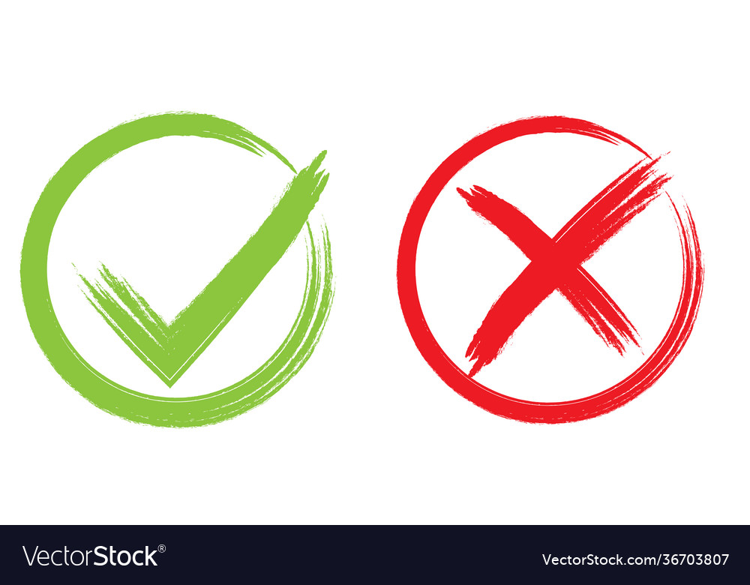
Basic Idea of GUI
Product types
Dash Board
Source Code
Document
HW Design
…
Source Code Quality
XXX Quality
Document Quality
YYY Quality
HW Design Quality
ZZZ Quality
… Quality
OK
Cancel
The button is only available when all items are marked “Quality”

Slide 3
Item to investigate
Create simple GUI app (just 1 panel is OK) in C#.
  Investigate what is entry function (as “main”) of GUI to receive argument from caller.
  Test with SVN hook by receiving argument and display argument values to GUI.
2. Investigate how GUI can return with value to caller.
Normally, in “C” code, return of an application is done in “main”.
Investigate how it’s done with C# GUI.
  Apply to SVN hook.
  Return “0” (=normal) with message.
  Return “#0” (=abnormal with error message. It is expected that SVN will show the error message.

Slide 4
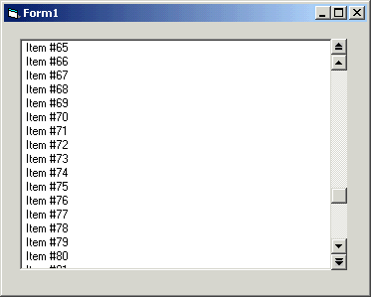
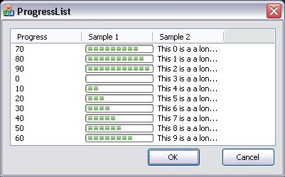
Item to investigate
Investigate how to create a List with scroll feature.
This is for showing items of each product category.
Point to investigate.
  Which UI Control Type should be used for list.
  How to add/remove item to list.
  How to enable scroll.
  When need, how to create list with several fields as image below.

