Slide 1

NETFILTER/ IPTABLES
GROUP 17

Slide 2


Members:
1. Tran Thuy Hien Mai_ MSSV: 21522323
2. Nguyen Ngoc Thanh Thuy_ MSSV: 21522659

Slide 3
TABLE OF CONTENTS
01
02
03
04
INTRODUCTION
NETFILTER
IPTABLES
DEMO

Slide 4
INTRODUCTION
01

Slide 5
FIREWALL

Slide 6

INTRODUCTION FIREWALL
Fundamental guardians of network security, a combination of hardware and software that monitors and control network traffic.

Slide 7
INTRODUCTION FIREWALL
Linux-based firewall solutions: Netfilter -> a strong framework for packet filtering, address translation, and manipulation
Linux built-in firewall, based on Netfilter: Iptables -> a flexible user-space utility to configure rules, control traffic flow, and fortify network defenses

Slide 8
NETFILTER
02

Slide 9
NETFILTER
A "Free and Open Source" (FOSS) project, for Linux systems since kernel version 2.4
Key functionalities:
Stateless and stateful packet filtering for IPv4 and IPv6
Network address translations NAT
Connection track
Additional packet manipulation tools

Slide 10
NETFILTER
A custom loadable kernel module using C Netfilter macros
Provides a set of hooks that allow kernel modules to register callback functions with the network stack

Slide 11
NETFILTER
NETFILTER HOOKS
NETFILTER ACTIONS

Slide 12
NETFILTER
NETFILTER HOOKS

Slide 13
NETFILTER HOOKS
Entry points within the kernel's networking processing flow
Implement by registering callback functions or modules to execute at these specific interception points within the networking stack

Slide 14
NETFILTER HOOKS
When a packet traverses the networking stack, it encounters these hooks, which trigger the execution of registered functions or modules.

Slide 15
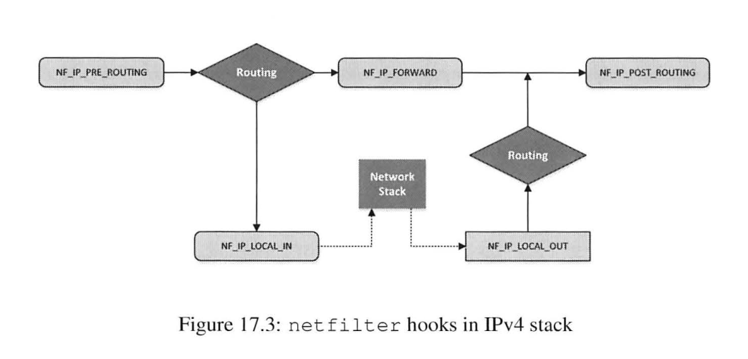
NETFILTER HOOKS

Slide 16
NETFILTER HOOKS
NF_INET_PRE_ROUTING: Is called before any routing decision is made
NF_INET_LOCAL_IN: Decides whether the packet which goes through routing, is for other machines or for the host itself
NF_INET_FORWARD: Packets that are forwarded to other hosts reach this hook

Slide 17
NETFILTER HOOKS
NF_INET_LOCAL_OUT: Packets generated by the local host reach this hook. This is the first hook for the packets on their way out of the host
NF_INET_POST_ROUTING: Triggers when outgoing or forwarded traffic after routing has taken place

Slide 18
NETFILTER
NETFILTER ACTIONS

Slide 19
NETFILTER ACTIONS
Is provided after the return functions have completed their processing of packets

Slide 20
NETFILTER ACTIONS
NF_ACCEPT: Let the packet flow through the stack
NF_DROP: Discard the packet
NF_STOLEN: Temporarily removes the packet from regular processing but retains it within the kernel's resources

Slide 21
NETFILTER ACTIONS
NF_QUEUE: Directed into a queue for further processing by user-space applications or firewall software
NF_REPEAT: Request the Netfilter framework to call this module again
NF_STOP: Hold the current hook, stop further processing or passing through additional hooks

Slide 22
IPTABLES
03

Slide 23
IPTABLES
A widely used firewall tool which uses the command-line interface (CLI) in Linux
Interact with the Netfilter packet handling of the Linux kernel
Operate by interfacing with hooks within the Linux kernel's network stack

Slide 24
IPTABLES
Include 3 core components:
Tables
Chains
Targets

Slide 25
IPTABLES
IPTABLES TABLES
IPTABLES CHAINS
IPTABLES TARGETS

Slide 26
IPTABLES
IPTABLES TABLES

Slide 27
IPTABLES TABLES
Iptables firewall uses tables to organize its rules:
Filter:
Chains: INPUT, OUTPUT, FORWARD
Functionality: Packet filtering

Slide 28
IPTABLES TABLES
NAT:
Chains: PREROUTING, POSTROUTING, INPUT, OUTPUT
Functionality: Modifying source or destination network address
Mangle:
Chains: PREROUTING, INPUT, FORWARD, OUTPUT
Functionality: Packet content and headers modification

Slide 29
IPTABLES
IPTABLES CHAINS

Slide 30
IPTABLES CHAINS
PREROUTING:
Netfilter hook: NF_IP_PRE_ROUTING
Triggers when a packet arrives at the network interface and before any routing decisions are made.
INPUT:
Netfilter hook: NF_IP_LOCAL_IN
Manages incoming packets destined for the local system

Slide 31
IPTABLES CHAINS
OUTPUT:
Netfilter hook: NF_IP_LOCAL_OUT
Handles outgoing packets generated by the local system
FORWARD:
Netfilter hook: NF_IP_FORWARD
Handles outgoing packets generated by the local system

Slide 32
IPTABLES CHAINS
POSTROUTING:
Netfilter hook: NF_IP_POST_ROUTING
Triggers when packet is leaving the local system

Slide 33
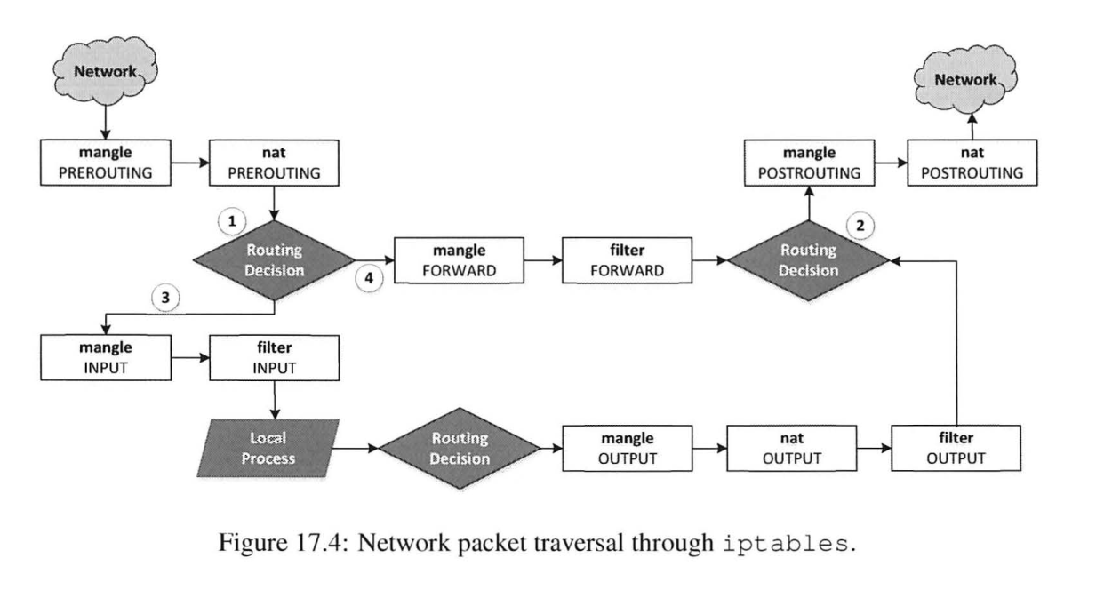
IPTABLES CHAINS
Corresponds to specific Netfilter hooks they link to

Slide 34
IPTABLES
IPTABLES TARGETS

Slide 35
IPTABLES TARGETS
Actions specified within rules that determine what happens to packets that match specific criteria:
ACCEPT: Permit packets to continue through firewall
DROP: Discard packets without notification

Slide 36
IPTABLES TARGETS
REJECT: Discard packets and send an error message to notify
LOG: Logs the packet information to the system log files
RETURN: Exit a specific chain and return to the calling chain for further processing

Slide 37
IPTABLES COMMAND STRUCTURE
sudo iptables -t <table> -<action with chains/rules> <chain name> -p <protocol> -i <input interface> -o <output interface> -s <IP source> -d <IP destination> --sport <source port number> --dport <destination port number.> -j <target>

Slide 38
DEMO
04

Slide 39
DEMO
Platform used for implementing: Ubuntu version 20.04 on VMWare

Slide 40
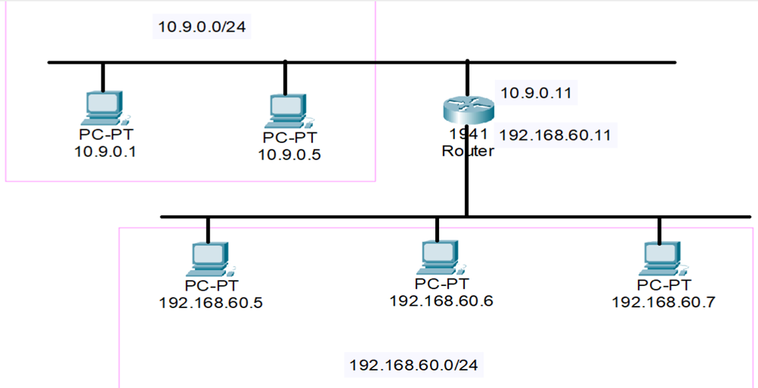
DEMO
Setup topology:

Slide 41
DEMO
2 scenarios:
Protect the VM machine: Write a Netfilter kernel module to prevent other machines from pinging the VM, and to telnet into the VM
Protect the internal network 192.168.60.0/24: Implement iptables rules on the router, following some restrictions

Slide 42
LIST OF REFERENCES
https://tonylixu.medium.com/linux-networking-netfilter-5b378db9e33b
https://www.digitalocean.com/community/tutorials/a-deep-dive-into-iptables-and-netfilter-architecture
https://seedsecuritylabs.org/Labs_20.04/Networking/Firewall/
“Computer and Internet Security - A Hands-on Approach” Book of Professor Wenliang Du

Slide 43


THANK FOR YOUR LISTENING!
GROUP 17

