Slide 1
Future Airborne Capability Environment
@nguyennd5
CHDK-T7/2023

Slide 2
Agenda
Concept
Standard and Guide

Slide 3
Concept
FACETM
FACETM Consortium
FACETM conformance

Slide 4
Concept/FACETM
Is open, vendor-neutral technology standar, and certification
Develop by The Open Group
Provide standardized approaches for using open standards with avionic* system

Slide 5
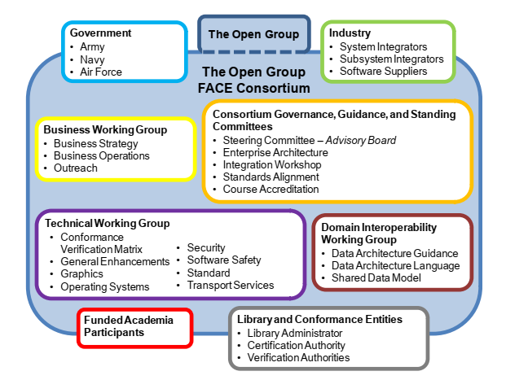
Concept/FACETM Consortium
A government and industry partnership group
Is responsible for proposing, developing, implementing conformance software onto Department of Defense (DoD) aircraft and other environments.
Notes:
Stakeholders:
The open group: work with customer, suppliers (system, solutions, tools, integrator, academia, consultant) to develop software standard, and certification program
The Open Group Face consortium (US Government, Industry, Academia): promote, utilize technology, business practice to provide portable, reusable, and interoperable software across the aviation community
Industry: contribute technology and business expert
Government:
Army: responsible for require of Aviation-Real time, Safety-Critical, Embedded (RTSCE) computing environment
Army and navy: related to unmanned system project
Funded Academia participants: prototype, research, validate
Working group:
Business working group
Technical working group: conformance verification matrix, general enhancement, graphic, operating system, security, software safety, security, standard, transport
Domain interoperability working group: data architechture guide, data architechture language, shared data model

Slide 6
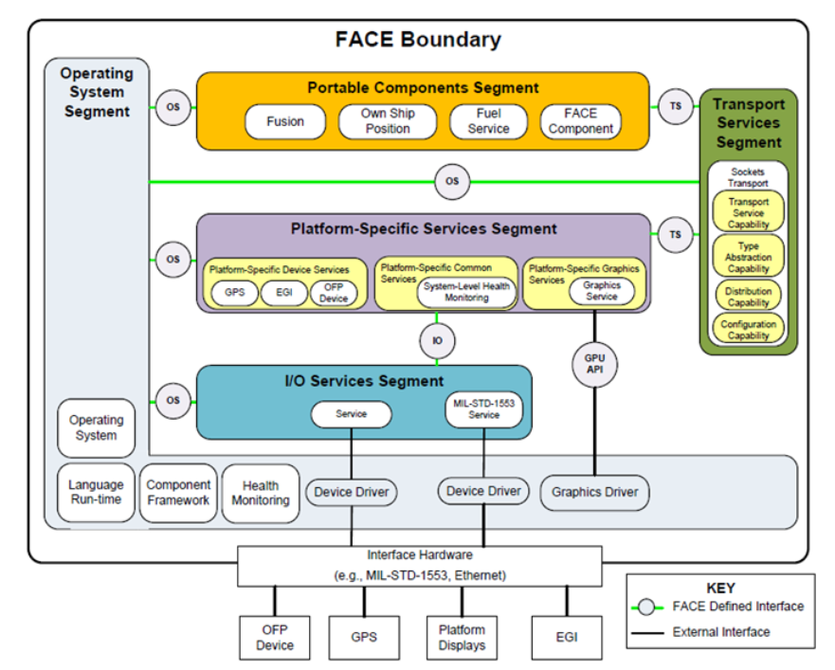
Concept/FACETM Consortium
Product & process
Technical Standard
Architecture (5 segments):
OSS: computing platform for other
IOSS: normalize hardware interface
PSSS: PSDS (specific device), PSCS (common), PSGS (graphic)
TSS: communication between PSSS, TSS
PCS: mission level, business logic
Key Interface (3)
OSS Interface OS
I/O Service Interface IS
Transport Service Interface TS
Notes:
Stakeholders:
The open group: work with customer, suppliers (system, solutions, tools, integrator, academia, consultant) to develop software standard, and certification program
The Open Group Face consortium (US Government, Industry, Academia): promote, utilize technology, business practice to provide portable, reusable, and interoperable software across the aviation community
Industry: contribute technology and business expert
Government:
Army: responsible for require of Aviation-Real time, Safety-Critical, Embedded (RTSCE) computing environment
Army and navy: related to unmanned system project
Funded Academia participants: prototype, research, validate
Working group:
Business working group
Technical working group: conformance verification matrix, general enhancement, graphic, operating system, security, software safety, security, standard, transport
Domain interoperability working group: data architechture guide, data architechture language, shared data model

Slide 7
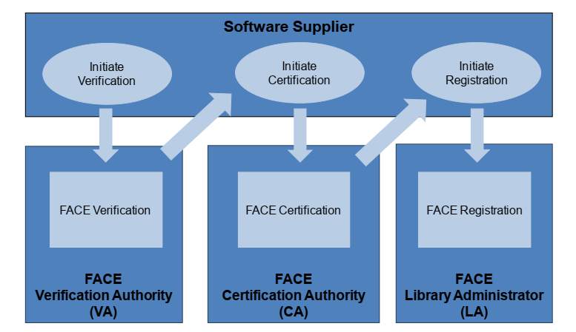
Concept/FACETM Consortium
Product & process
Conformance program: to verify and certify conformance to the technical standard
Verification
Certification
Registration

Slide 8
Concept/FACETM Conformance
Role:
Software supplier (developer, integrator, …): provide software to be certified.
FACE Verification Authority VA: several committees evaluate software against standard
FACE Certification Authority CA: provide certification
FACE Library Administrator LA: list the certified UoC

Slide 9
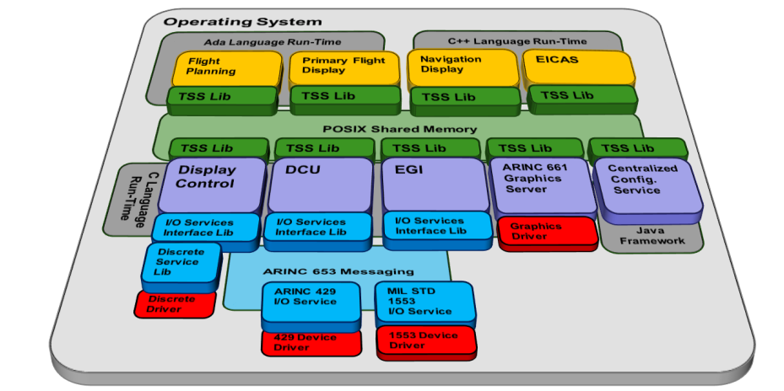
Concept/FACETM Conformance
Process:
Preparation:
Unit of Conformance, Software Repository
Technical standard, conformation verification matrix, test suite
UoC (is a single unit of Unit of Portability, a I/O Service, an Operation System) definition
Profile: security > safety base > safety extended > general purpose
Segment: an UoC can only exist in one segment
…
Verification, Certification, Registration processs

Slide 10
Standard and Guide
Approach
FACE Technical Standard
Software Supplier Guide

Slide 11
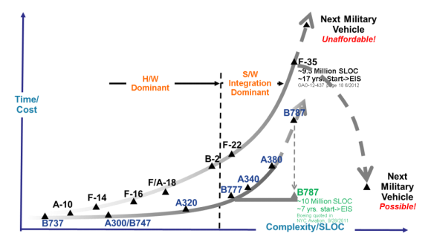
Standard and Guide/Approach
Business goal
Increase affordability
Improve time-to-field
Attribute to archive the goal
Accelerate innovation and new technology
Enable cross platform, modularity, portability, reuse
Create software marketplace
Align with other open architecture, and industry standard

Slide 12
Standard and Guide/Approach
Satisfy MOSA principles
Establish an enabling environment: FACE document, tool, infrastructure, …
Employ modular design: FACE reference architecture, and data Architecture
Design key interface: FACE interface
Use open standard: ARINIC 653, 661, POSIX, OpenGL,..
Certify conformance: FACE Conformance program

Slide 13
Standard and Guide/FACE Technical Standard
Detail in technical document:
FACE Technical Standard edition 3.1
FACE Software Supplier Stated guide version 3x
FACE Reference Implantation guide edition 3.0 (volume 1,2,3)
FACE Integrator guide for edition 3.1

