Slide 1
WebArena Dataset
Json format
Tasks
Evaluation (rule-based evaluation):
string_match
exact_match
must_include
fuzzy_match
Combined
url_match
program_html

Slide 2
string_match (exact_match)
"eval": {
"eval_types": [
"string_match"
],
"reference_answers": {
"exact_match": "emma.lopez@gmail.com"
},
"reference_url": "",
"program_html": [],
"string_note": "",
"reference_answer_raw_annotation": "emma.lopez@gmail.com"
},

Slide 3
string_match (must_include)
"eval": {
"eval_types": [
"string_match"
],
"reference_answers": {
"must_include": [
"148"
]
},
"reference_url": "",
"program_html": [],
"string_note": "",
"reference_answer_raw_annotation": "$148"
},

Slide 4
string_match (fuzzy_match)
"eval": {
"eval_types": [
"string_match"
],
"reference_answers": {
"fuzzy_match": "N/A"
},
"reference_url": "",
"program_html": [],
"string_note": "There is no phone number in the website",
"reference_answer_raw_annotation": "N/A"
},

Slide 5
string_match (combined)
"eval": {
"eval_types": [
"string_match"
],
"reference_answers": {
"must_include": [
"Acadia National Park"
],
"fuzzy_match": [
"10hour 33minute"
]
},
"reference_url": "",
"program_html": [],
"string_note": "",
"reference_answer_raw_annotation": "Acadia National Park\n10h 33min“
},

Slide 6
url_match
"eval": {
"eval_types": [
"url_match"
],
"reference_answers": null,
"reference_url": "__SHOPPING__/catalogsearch/result/index/?product_list_order=price&q=chairs&product_list_dir=asc",
"program_html": [],
"url_note": "GOLD in PRED"
},

Slide 7
program_html
"eval": {
"eval_types": [
"program_html"
],
"reference_answers": null,
"reference_url": "",
"program_html": [
{
"url": "__SHOPPING_ADMIN__/sales/order/view/order_id/304/",
"locator": "document.querySelector(\"#order_history_block\").querySelector(\".note-list\").firstElementChild.querySelector(\".note-list-comment\").outerText",
"required_contents": {
"exact_match": "Yo, your order will be shipped soon!"
}
}
]
},

Slide 8
Call LLM
generate_from_openai_chat_completion
generate_from_openai_completion
generate_from_huggingface_completion

Slide 9
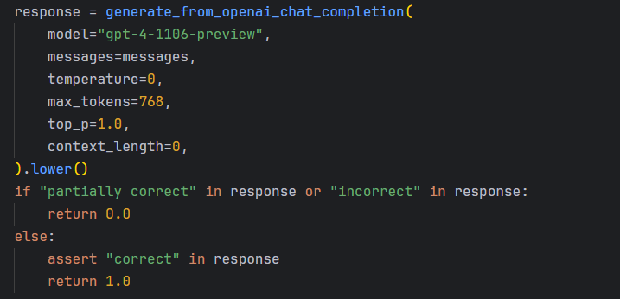
string_match (fuzzy_match) – Call LLM

Slide 10
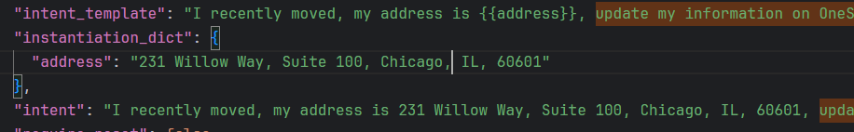
WebArena - Input data
WebArena uses the input data provided within the task.
No new data is generated to perform the task.

Slide 11
Improvement – Evaluation types
Types of Comparison Targets:
Raw text
URL
HTML element
Form Input – Generated Data
Evaluation types :
Exact match
Must include
Fuzzy match
Regex match
Sematic match (?Call LLM)

Slide 12
Improvement – Evaluation types Regex match
Uses patterns (regular expressions) to check format
Validate emails, phone numbers, password or codes.
{
"task_id": "task_002",
"match_type": "regex",
"fields": {
"price": "\\$?\\d+\\.\\d{2}",
"email": "^[\\w.-]+@[\\w.-]+\\.\\w{2,}$",
"zipcode": "^\\d{5}(-\\d{4})?$"
}
}

Slide 13
Updates
eval_type | description | match_type
string_match | string comparision | exact | contains | semantic
regex_match | pattern
url_match | url | exact | contains
dom_match | dom value | exact | contains
list_match | list
multiset_match | multiset

Slide 14
Work Progress Report
Environments (Magento, ERP, LMS, Redmine, Wordpress, Joomla, Drupal, Forums ) - Done
Script to convert Excel to Json (Done)
Dataset (100 tasks) --- Done
Evaluation function –--- Done
Run agents --- (Browser Use / HxAgent with Open LLMs).
Add more tasks – 300 tasks (planning)
LLMs (Gemini, Huggingface)

Slide 15
Challenges
Result (include extra data)
LLMs (Capability) (gemini-2.0-flash, gemini-2.0-flash-lite, gemini-1.5-flash)

Slide 16
Evaluator WebArena
Task Success Rate / Exact match (10/17) ? / prefix match ?
Human Performance (~2 people) / Webarena reference
Chain of thought (CoT) and No CoT in Prompting
Early Stop Error Rate : Unachievable hint (Yes / no) in Prompting
Action Accuracy (?)
Seeclick + Hxagent

Slide 17
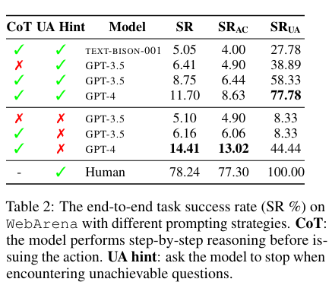
Evaluator WebArena

Slide 18
Evaluator Online-Mind2Web
WebJudge
1. Key Point Identification
2. Key Screenshot Identification
3. Outcome Judgement
O = Evaluator(T, A, I)
T: Task
A: Actions (a_0, a_1, ..., a_n)
I: images (i_1, i_2, ..., i_n)

Slide 19
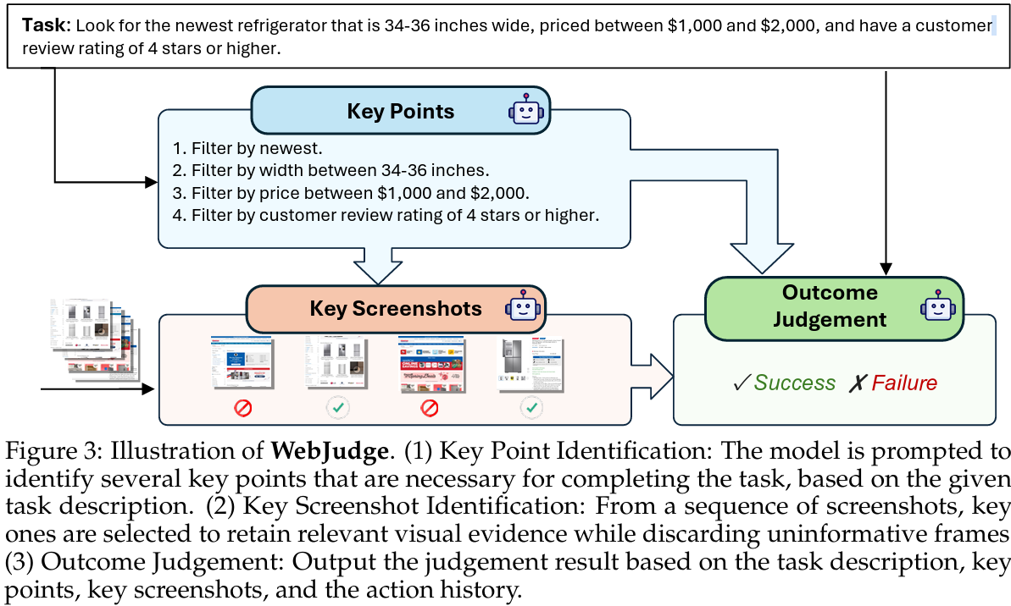
Evaluator Online-Mind2Web

