Slide 1
DEVELOPER TRAINING
S1E3 – BEM, SCSS
NEXT

Slide 2
TIMELINE.
START TIMELINE
SASS
OOCSS 1 , SMACSS 2 , ITCSS 3 , and BEM 4

Slide 3
AN
Q&As
END TIMELINE

Slide 4
WHAT IS Sass?
Sass is a stylesheet language that is an extension of CSS
Sass, also known as the indented syntax
SCSS, or Sassy CSS, a CSS-like syntax
You can program CSS with Sass
Sass is a preprocessor.

Slide 5
GETTING START
Install
sudo apt-get install ruby-full
gem install sass
Using Sass
sass input.scss output.css
sass --watch input.scss output.css
sass --watch sass/:stylesheet/.
Install
npm install node-sass –g
Using Sass
node-sass input.scss output.css
node-sass --watch input.scss output.css
node-sass --watch sass/ --output stylesheets/

Slide 6
VARIABLES
// Variable assignment
$my-variable: 42px;
// Variable usage
.foo {
width: $my-variable;
}
Dashes + Underscores = Same

Slide 7
Data Types
string (e.g. "Hello world", kittens)
number (e.g. 42, 1337px)
color (e.g. hotpink, rgb(1, 33, 7), #BADA55)
list (e.g. (a, b, c), a b c)
map (e.g. (a: 1, b: 2))
bool (true or false) null (null)

Slide 8
Some Notes
Avoid Color Keywords
$brand-color: #BADA55;
.logo {
color: $brand-color;
}
$gold: hsl(42, 78%, 54%); $dark-blue: rgb(13, 33, 70); $primary-theme-color: $gold; $secondary-theme-color: $dark-blue;
// Yep
$brand-color: #BADA55;
// Nope
$brand_color: #BADA55;
// Definitely nope
$brandColor: #BADA55;
// Stop it
$BrandColor: #BADA55;

Slide 9
Functions and Mixins
// Using the `darken(..)` built-in Sass function .foo { color: darken(#BADA55, 4.2%); // #B3D643 }
// The `get-base-url()` function has no parameter @function get-base-url() { @return '/assets/'; } // Usage .module { background-image: url(get-base-url() + 'unicorn.png'); }

Slide 10
Functions and Mixins – Parameters
@function multiply($a, $b) { @return ($a * $b); } // `$a` is mandatory and `$b` is optional (default value being 2) @function multiply($a, $b: 2) { @return ($a * $b); } // Throws an error: // > `Required argument $b must come before any optional arguments.` @function multiply($a: 2, $b) { @return ($a * $b); }

Slide 11
Case study - Asset Management
/// CDN URL where all assets are served from @type String $base-url: 'http://cdn.example.com/assets/'; /// Native `url(..)` function wrapper /// @param {String} $base - base URL for the asset /// @param {String} $type - asset type folder (e.g. `fonts/`) /// @param {String} $path - asset path /// @return {Url} @function asset($base, $type, $path) { @return url($base + $type + $path); }
/// Returns URL to an image based on its path
/// @param {String} $path - image path /// @param {String} $base [$base-url] - base URL /// @return {Url} @function image($path, $base: $base-url) { @return asset($base, 'images/', $path); } /// Returns URL to a font based on its path /// @param {String} $path - font path /// @param {String} $base [$base-url] - base URL /// @return {Url} @function font($path, $base: $base-url) { @return asset($base, 'fonts/', $path); }

Slide 12
Mixxins
To put it very simply, a mixin is a function that can output code rather than return a result.
@mixin center { width: 100%; max-width: 1180px; margin-left: auto; margin-right: auto; }
.container { @include center; }
.container { width: 100%; max-width: 1180px; margin-left: auto; margin-right: auto; }

Slide 13
Mixxins
/// @param {Length} $height [$width] - element height @mixin size($width, $height: $width) { width: $width; height: $height; } // Usage .foo { @include size(100%, 42px); }
@mixin on-event { &:hover, &:active, &:focus { @content; } } .foo { color: blue; @include on-event { color: red; } }
.foo {color: blue; } .foo:hover, .foo:active, .foo:focus {color: red; }

Slide 14
Mixxins – Wrap up
@mixin message($color, $background-color: lighten($color, 20%)) { color: $color; background-color: $background-color; }
.message { padding: 10px; border: 1px solid currentcolor; } .message-info { @include message(blue); } .message-danger { @include message(red); } .message-confirm { @include message(green); }

Slide 15
Loop
@for $i from 1 through 10 { .item:nth-child(#{$i}) { animation-delay: ($i - 1) * 0.1s; } } .item:nth-child(1) { animation-delay: 0.0s; } .item:nth-child(2) { animation-delay: 0.1s; } .item:nth-child(3) { animation-delay: 0.2s; } .item:nth-child(4) { animation-delay: 0.3s; } .item:nth-child(5) { animation-delay: 0.4s; } .item:nth-child(6) { animation-delay: 0.5s; } .item:nth-child(7) { animation-delay: 0.6s; } .item:nth-child(8) { animation-delay: 0.7s; } .item:nth-child(9) { animation-delay: 0.8s; } .item:nth-child(10) { animation-delay: 0.9s; }

Slide 16
Nesting
.container { margin: 0 auto; max-width: 42em; padding: 0 1em; p, li { text-indent: 1em; } }
.container { margin: 0 auto; max-width: 42em; padding: 0 1em; } .container p, .container li {text-indent: 1em; }

Slide 17
The Ampersand Selector
.navigation li {
display: block; @media screen and (min-width: 42em) { display: inline-block; } } .navigation li { display: block; } @media screen and (min-width: 42em) { .navigation li { display: inline-block; } }
a { color: deeppink; &:hover, &:active { color: hotpink } } a { color: deeppink; } a:hover, a:active { color: hotpink; }

Slide 18
Best Practices
.block { &__element { &--is-hidden { display: none; } } } <div class="block"> <span class="block__element block__element—is-hidden">…</span> </div>

Slide 19
@extend
// Extends Input .clearfix::after { content: ''; display: table; clear: both; } .emory { @extend .clearfix; } .gracie { @extend .clearfix; }
.clearfix::after, .emory::after, .gracie::after { content: ''; display: table; clear: both; }

Slide 20
Architecture
@import 'relative/styles.css'; @import 'http://absolute.com/styles.css'; @import url('landscape.css') screen and (orientation: landscape);
.latte { @import 'espresso'; }

Slide 21
Architecture
_base.scss _layout.scss _components.scss main.scss

Slide 22
Architecture
sass/ | |– abstracts/ (or utilities/) | |– _variables.scss // Sass Variables | |– _functions.scss // Sass Functions | |– _mixins.scss // Sass Mixins | |– base/ | |– _reset.scss // Reset/normalize | |– _typography.scss // Typography rules | |– components/ (or modules/) | |– _buttons.scss // Buttons | |– _carousel.scss // Carousel | |– _slider.scss // Slider | |– layout/ | |– _navigation.scss // Navigation | |– _grid.scss // Grid system | |– _header.scss // Header | |– _footer.scss // Footer | |– _sidebar.scss // Sidebar | |– _forms.scss // Forms
| |– pages/ | |– _home.scss // Home specific styles | |– _about.scss // About specific styles | |– _contact.scss // Contact specific styles | |– themes/ | |– _theme.scss // Default theme | |– _admin.scss // Admin theme | |– vendors/ | |– _bootstrap.scss // Bootstrap | |– _jquery-ui.scss // jQuery UI | `– main.scss // Main Sass file

Slide 23
Architecture
Main.scss: This file should only contain your imports
@import 'abstracts/variables'; @import 'abstracts/functions'; @import 'abstracts/mixins'; @import 'vendors/bootstrap'; @import 'vendors/jquery-ui'; @import 'base/reset'; @import 'base/typography'; @import 'layout/navigation'; @import 'layout/grid'; @import 'layout/header'; @import 'layout/footer'; @import 'layout/sidebar'; @import 'layout/forms';
@import 'components/buttons'; @import 'components/carousel'; @import 'components/slider'; @import 'pages/home'; @import 'pages/about'; @import 'pages/contact'; @import 'themes/theme'; @import 'themes/admin';

Slide 24
Object-oriented CSS (OOCSS)
Separate structure and skin.
Separate container and content.

Slide 25
Atomic Design
According to Atomic Design, atoms can be abstract information such as color palettes, fonts, and typographic scales; they can also be default styles for tags such as form labels, buttons, and paragraphs. S

Slide 26
Block, Element, Modifier (BEM)
BEM 16 is a system developed by the Yandex 17 team. This is a much more extensive system, with its fingers in every aspect of your code—from JSON data structures, to templates, as well as CSS.
Blocks are components of any size, and can be nested inside each other.
Elements are the constituent parts that belong to a specific block.
Modifiers are flags on blocks or elements that change their appearance, behavior, or state.

Slide 27
Block, Element, Modifier (BEM)
.form { border: 1px solid black; } .form__submit { background-color: green; } .form__submit_disabled { background-color: gray; }
.form { border: 1px solid black; &__submit { background-color: green; &_disabled { background-color: gray; } } }

Slide 28
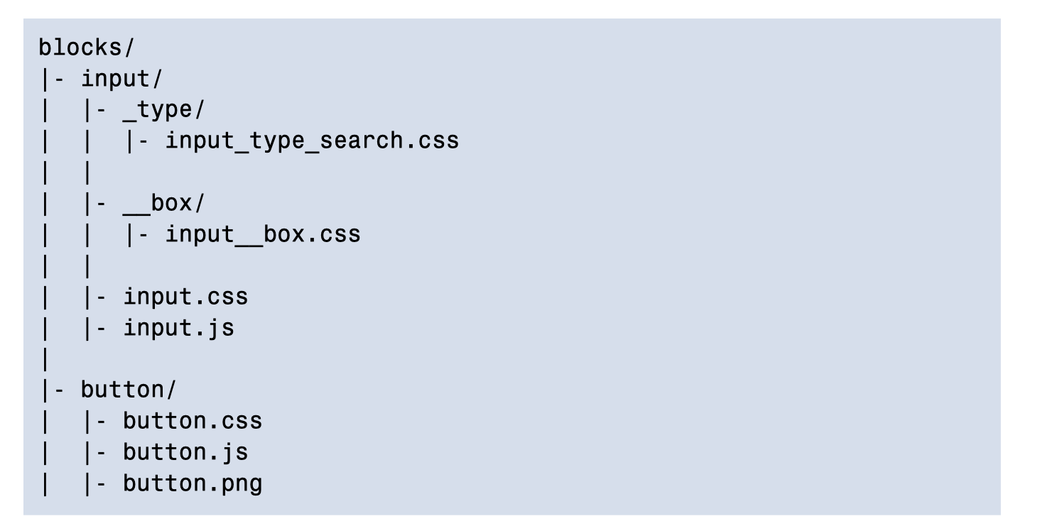
Block, Element, Modifier (BEM)

Slide 29
Scalable and Modular Architecture for CSS (SMACSS)
SMACSS 18 is a book, workshop, and philosophy by Jonathan Snook 1

Slide 30
THANK YOU.

