Slide 1


OMEDIANS
PROJECT NAME : MODEL MANAGEMENT
MEmBER: NGUYEN tHAnh NHAT QUANG HOANG TIEN DUNG
PHAN NGUYEN HOANG MINH HO TAN GIANG
NGUYEN VIET SANG PHUNG TAN LOI

Slide 2

Reasons
Model’s schedule management.
Provide suitable models to customer.
Make a passion of people become a model come true.
Save time, quick search.
Multichoice.

Slide 3

USING
Eclipse IDE, VS code.
MariaDB.
Java, Spring MVC, jsp, maven, mybatis, bootstrap, jquery, gitlab,…

Slide 4

PLAN
Design ERD, database, sitemap (4 days)
Frontend (1 weeks)
Backend (2 weeks)
Debug, Release (~2 days)

Slide 5

TASK
NAME | TASK
QUANG (main),DUNG, LOI | Model Modeltalent Rankmodel
GIANG(main), SANG, MINH | Account Role Contact
SANG | Staff Salary
DUNG | User
LOI, MINH | Contract – ContractDetail
MINH | Comment Social

Slide 6
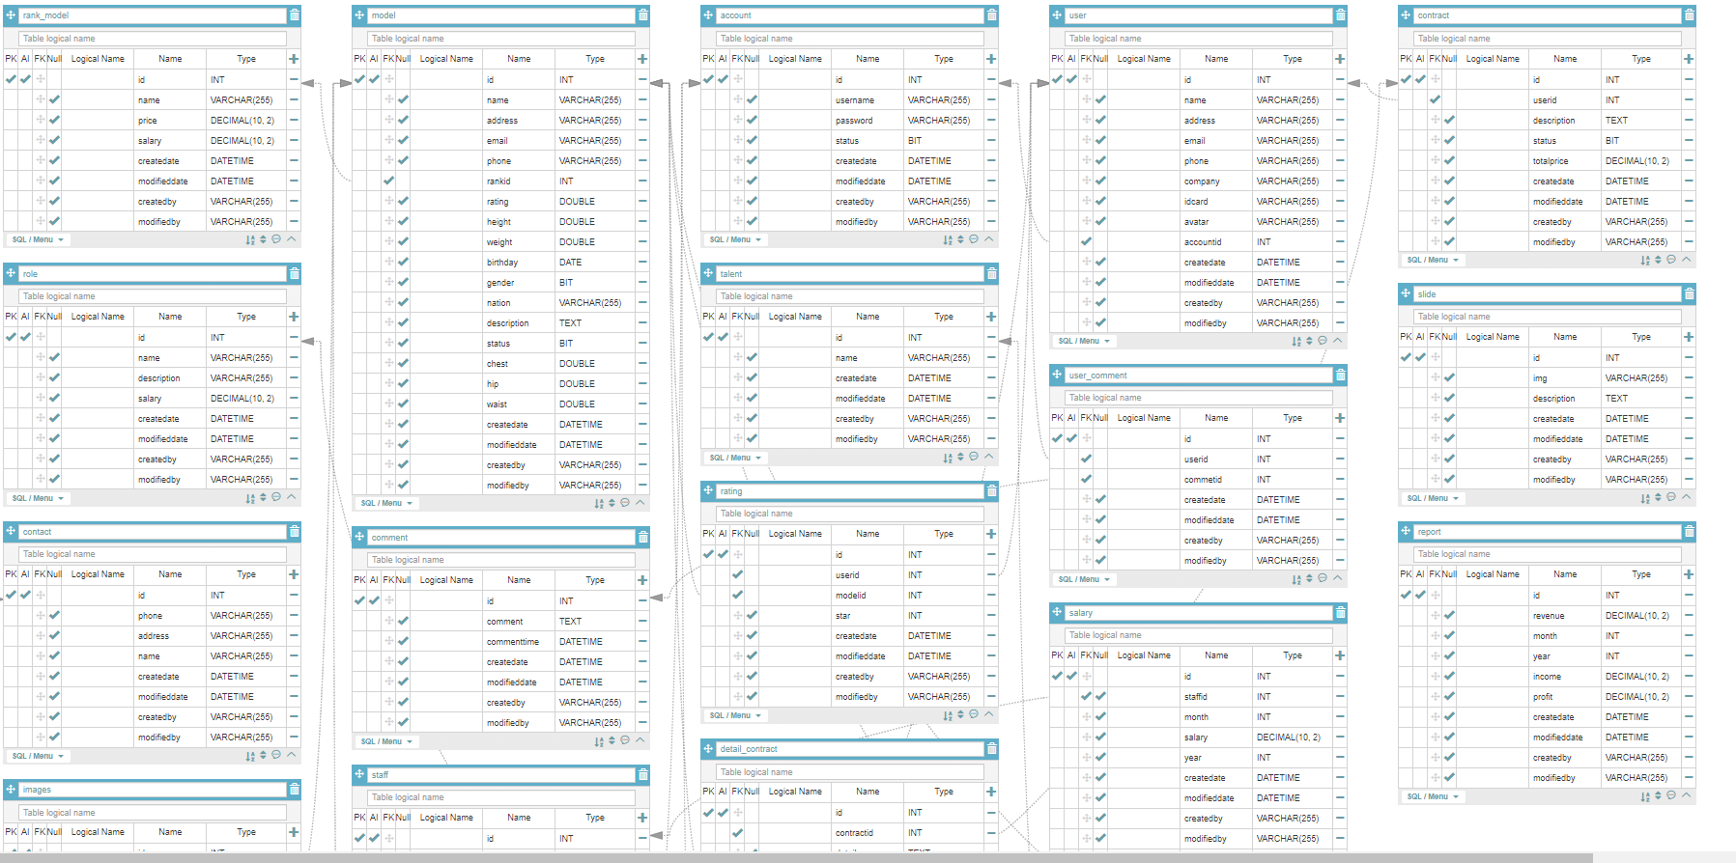
PLANNING DETAIL
WEEK 1:
Discuss about main functions, features in model project
Design, Fix ERD by Aquerytool, sitemap
Find a Template

Slide 7
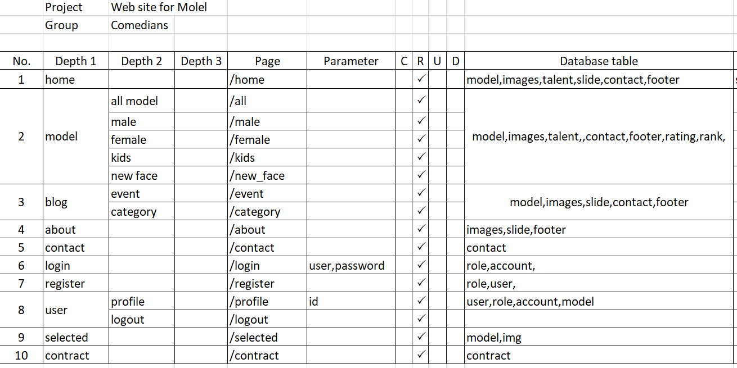

Slide 8
PLANNING DETAIL
WEEK 2:
Set up maven project
Build structure
Discuss Tasks to members.
Start coding.
WEEK 3:
Continue coding.
Test.
WEEK 4:
Debug.
Release.

Slide 9
THANK YOU

