Slide 1
Thiết kế môi trường mô phỏng UVM kiểm tra thiết kế bộ nén và giải mã AES-128
Nhóm: SimEnvB1

Slide 2
AGENDA
Moinitor
Scoreboard

Slide 3
I. Monitor
Tasks need perform in run_phase
virtual task run_phase (uvm_phase phase);
super.run_phase(phase);
fork
collect_send_data();
check_busy_cycle();
check_ready1();
check_ready2();
check_ready3();
check_chain_en1();
check_chain_en2();
check_cipher_en_decipher_en1();
check_cipher_en_decipher_en2();
check_cipher_decipher_mode();
join
endtask

Slide 4
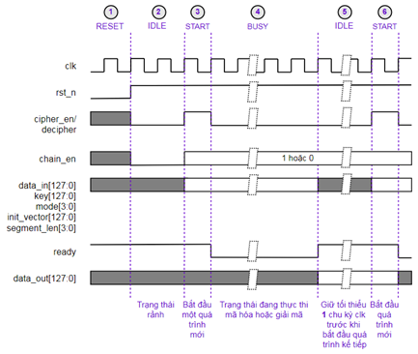
I. Monitor
1. Task collect_send_data()
Collect and send input valid data to scoreboard when ready equal 1 and cipher_en or decipher_en equal 1.
Collect and send output valid data to scoreboard when having posedge ready

Slide 5
I. Monitor
1. Task collect_send_data()
//Collect and send valid data to scoreboard when ready equal 1 and cipher_en or decipher_en equal 1
virtual task collect_send_data();
while(1) begin
wait@(vifAes.rst_n=1);
@(posedge vifAes.clk);
if(vifAes.ready==1) begin
if(vifAes.cipher_en==1 || vifAes.decipher_en==1) begin
//Get transaction on interface
if(vifAes.cipher_en==1) begin
coAesTransaction.aes_cipher_en <= 1;
end
if(vifAes.decipher_en==1) begin
coAesTransaction.aes_cipher_en <= 0;
end
coAesTransaction.aes_chain_en <= vifAes.aes_chain_en;
coAesTransaction.aes_data_in[127:0] <= vifAes.aes_data_in[127:0];
coAesTransaction.aes_key[127:0] <= vifAes.aes_key[127:0];
coAesTransaction.aes_mode[3:0] <= vifAes.aes_mode[3:0];
coAesTransaction.aes_init_vector[127:0] <= vifAes.aes_init_vector[127:0];
coAesTransaction.aes_segment_len[3:0] <= vifAes.aes_segment_len[3:0];
@(posedge vifAes.clk);
wait@(posedge vifAes.ready);
//Get transaction on interface
coAesTransaction.aes_data_out[127:0] <= vifAes.aes_data_out[127:0];
//Send the ouput valid data to analysis port which is connected to Scoreboard
ap_toScoreboard.write(coApbTransaction);
end
end
end
endtask

Slide 6
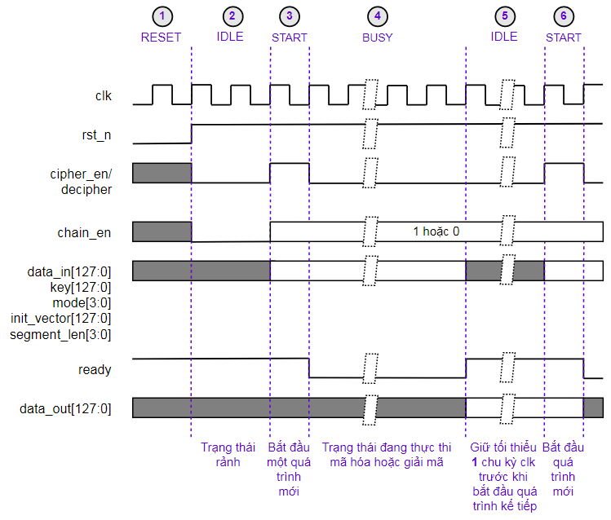
I. Monitor
2. Task check_busy_cycle()
-Number of busy cycle cipher process is 11 cycles
-Number of busy cycle decipher process is 22 cycles
-In BUSY process:
+ Ready signal level always equal zero and it will equal one after ending busy cycle.
+ Cipher_en and decipher_en signal level didn’t equal one in busy process.

Slide 7
I. Monitor
2. Task check_busy_cycle()
//check number of cipher and decipher busy cycle
bit count;
virtual task check_busy_cycle();
while(1) begin
wait@(vifAes.rst_n=1);
@(posedge vifAes.clk);
count<=0;
fork
while(count<11) begin
@(posedge vifAes.clk);
if(vifAes.cipher_en==0) begin
if(vifAes.ready==0) begin
count=count+1;
end
else begin
`uvm_error("cAesMonitor", "Total number of busy cycles cipher_en is less than number of cycles to perform");
end
else begin
`uvm_error("cAesMonitor", "Cipher_en shouldn't equal 1 when ready equal 0");
end
end
if(vifAes.ready==0) begin
`uvm_error("cAesMonitor", "Total number of busy cycles cipher_en is more than number of cycles to perform");
end

Slide 8
I. Monitor
2. Task check_busy_cycle()
while(count<22) begin
@(posedge vifAes.clk);
if(vifAes.decipher_en==0) begin
if(vifAes.ready==0) begin
count=count+1;
end
else begin
`uvm_error("cAesMonitor", "Total number of busy cycles decipher_en is less than number of cycles to perform");
end
else begin
`uvm_error("cAesMonitor", "Decipher_en shouldn't equal 1 when ready equal 0");
end
end
if(vifAes.ready==0) begin
`uvm_error("cAesMonitor", "Total number of busy cycles decipher_en is more than number of cycles to perform");
end
join

Slide 9
I. Monitor
3. Task check_ready()
- Check: ready signal holds the least one clock cycle before starting the next cipher or decipher process
-Check: ready != {x,z}
- Check: ready=1 immediately after reset

Slide 10
I. Monitor
3. Task check_ready()
//check ready signal
//check ready=1 immediately after reset
virtual task check_ready1();
while(1) begin
wait@(vifAes.rst_n=0);
if (vifAes.ready == 0) begin
`uvm_error("cAesMonitor", "Ready signal doesn't equal 1 when starting simulation");
end
end
endtask
//check ready != {x,z}
virtual task check_ready2();
while(1) begin
wait@(vifAes.rst_n=1);
case(vifAes.ready)
1'bx:`uvm_error("cAesMonitor", "Valid of ready shouldn't equal x");
1'bz:`uvm_error("cAesMonitor", "Valid of ready shouldn't equal z");
endcase
end
endtask
//check ready signal holds the least one clock cycle before starting the next cipher or decipher process
virtual task check_ready3();
while(1) begin
wait@(vifAes.rst_n=1);
wait@(posedge vifAes.clk);
wait@(posedge vifAes.ready);
wait@(posedge vifAes.clk);
if (vifAes.ready==0) begin
`uvm_error("cAesMonitor", "Ready signal holds one level less than 1 clock cycle");
end
end
endtask

Slide 11
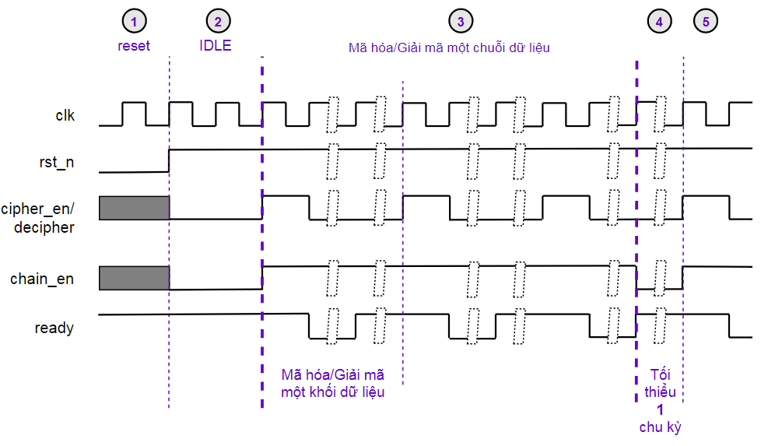
I. Monitor
4. Task check_chain_en()
- Check: chain_en signal holds the least one clock cycle before starting the next cipher or decipher process
-Check: chain_en != {x,z}

Slide 12
I. Monitor
4. Task check_chain_en()
//check chain_en signal
//check chain_en != {x,z}
virtual task check_chain_en1();
while(1) begin
wait@(vifAes.rst_n=1);
case(vifAes.chain_en)
1'bx:`uvm_error("cAesMonitor", "Valid of chain_en shouldn't equal x");
1'bz:`uvm_error("cAesMonitor", "Valid of chain_en shouldn't equal z");
endcase
end
endtask
//check chain_en signal holds the least one clock cycle before starting the next cipher or decipher process
virtual task check_chain_en2();
while(1) begin
wait@(vifAes.rst_n=1);
wait@(posedge vifAes.clk);
wait@(posedge vifAes.chain_en);
wait@(posedge vifAes.clk);
if (vifAes.chain_en==1) begin
`uvm_error("cAesMonitor", "Chain_en signal holds zero level less than 1 clock cycle");
end
end
endtask

Slide 13
I. Monitor
5. Task check_cipher_decipher_en()
- Check: cipher_en signal is just positive in one clock cycle.
-Check: cipher_en != {x,z}

Slide 14
I. Monitor
5. Task check_cipher_decipher_en()
//check cipher_en and decipher_en signals
//check: cipher_en != {x,z} and check: decipher_en != {x,z}
virtual task check_cipher_decipher_en1();
while(1) begin
wait@(vifAes.rst_n=1);
case@(vifAes.cipher_en)
1'bx:`uvm_error("cAesMonitor", "Valid of cipher_en shouldn't equal x");
1'bz:`uvm_error("cAesMonitor", "Valid of cipher_en shouldn't equal z");
endcase
case@(vifAes.decipher_en)
1'bx:`uvm_error("cAesMonitor", "Valid of decipher_en shouldn't equal x");
1'bz:`uvm_error("cAesMonitor", "Valid of decipher_en shouldn't equal z");
endcase
end
endtask
//check: cipher_en and decipher_en signals are just positive in one clock cycle.
virtual task check_cipher_decipher_en2();
while(1) begin
wait@(vifAes.rst_n=1);
wait@(posedge vifAes.clk);
fork
begin
wait@(posedge vifAes.cipher_en);
end
begin
wait@(posedge vifAes.decipher_en);
end
join
wait@(posedge vifAes.clk);
if (vifAes.cipher_en==0) begin
`uvm_error("cAesMonitor", "Cipher_en signal didn't equal 0 after 1 clock cycle");
end
if (vifAes.decipher_en==0) begin
`uvm_error("cAesMonitor", "Decipher_en signal didn't equal 0 after 1 clock cycle");
end
end
endtask

Slide 15
I. Monitor
8. Task check_cipher_decipher_mode()
- Check: cipher_en and decipher_en signal didn’t equal 1 at the same time.

Slide 16
I. Monitor
8. Task check_cipher_decipher_mode()
//check: cipher_en and decipher_en signal didn’t equal 1 at the same time.
virtual task check_cipher_decipher_mode();
while(1) begin
wait@(vifAes.rst_n=1);
wait@(posedge vifAes.clk);
if (vifAes.cipher_en==1 && vifAes.decipher_en==1) begin
`uvm_error("cAesMonitor", "Cipher_en and decipher_en equal 1 at the same time");
end
end
endtask

