Slide 1
MBIST - LBIST Introduction
Viet Truong

Slide 2
Agenda
Overview and definition
Why we use MBIST
Build-in self repair
Logic BIST
Reference

Slide 3
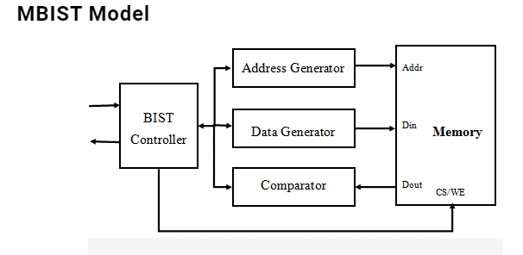
Overview and definition
- MBIST (Memory built-in self test) is a mechanism of self-testing and repair for memory
- Extra circuits would be added around memories,
The circuit uses pattern shifted pattern from tester to execute testing and send response back.
- Tester observed analyzed pass/fail data from comparator

Slide 4
Why is mbist used
Scan design/scan chain is not comprehensive to detect all memories’ faults due to difference in structure and memory function
MBIST provides self-repair mechanism and faulty cells analysis

Slide 5
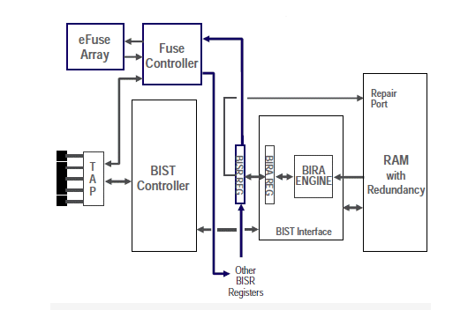
Build-in self repair
Soft-repair stores repair configuration in violate element (FF, scan register ...). BIST, BIRA and repair process must be executed every time the devide is power-up. Disavantages of this method is that unable to irritate hard corner in operation such as high voltage and temprature
Hard repair stores repair configuration in fuse box, there’s two kinds of fuse
Laser-fused hard repair configure repair setting by laser-trimming which blows diffusion fuses but this requires extra manufactoring step to blow fuse and put the devide back to the tester.
Electrical fuse repair doesn’t require extra manufactoring step, after BIST testing process, information from BISA tester determines properfuse to repair, the tester supply a programing voltage to blow the eFuse

Slide 6
Logic build-in self test
A form of logic self testing in which logic in a chip could be tested on-chip itself.
Purpose
is to detect latent fault which may not apperant or detectable during manufactoring testing but may cause failure after a period of time under environmental conditions. Automotive and military applications in particular are worst affected.
Feature
For need of performing routine tests on itself
Doesn’t require tester, test vector can’t be control externally
Cirtuitry is embeded in the chip(on-chip pattern generator, on-chip result compressor) that perform scan based structural test
Test can be trigger by hardware everytime the device is on(offline testing) or application allows the test to run(online testing)

Slide 7
QA
What is protocol between mbist controller and TAP ?
There’s no specific protocol between interface of TAP/WTAP and mbist controller. The signals between TAP/WTAP and controller are defined and divided into three category as memory bist signal description of Tessent TAP/WTAP port for BIST control and mus be connected to TAP/WTAP, Status Signals – indicate ooperational operation status, Serial Interface Signals – for serial data interaction
Reference
Non-programmable mbist controller
https://docs.sw.siemens.com/en-US/product/852852118/doc/DC201702035.docs.ethardwarereference.en_us/html/MemoryBIST06
https://docs.sw.siemens.com/en-US/product/852852118/doc/DC201702035.docs.ethardwarereference.en_us/html/MemoryBIST05
Programable mbist controller
https://docs.sw.siemens.com/en-US/product/852852118/doc/DC201702035.docs.ethardwarereference.en_us/html/MemoryBIST09
https://docs.sw.siemens.com/en-US/product/852852118/doc/DC201702035.docs.ethardwarereference.en_us/html/MemoryBIST10-684179

Slide 8
Reference
https://www.einfochips.com/blog/memory-testing-an-insight-into-algorithms-and-self-repair-mechanism/
http://razzkamal.blogspot.com/2014/09/fuse-makes-repairable-memory-testing.html
https://static.aminer.org/pdf/PDF/000/282/891/dynamic_data_bit_memory_built_in_self_repair.pdf
https://vlsiuniverse.blogspot.com/2014/11/lbist.html
https://www.design-reuse.com/articles/38290/lbist-a-technique-for-infield-safety.html
https://www.design-reuse.com/articles/38290/lbist-a-technique-for-infield-safety.html
https://vlsitutorials.com/logic-built-in-self-test-lbist/

Slide 9
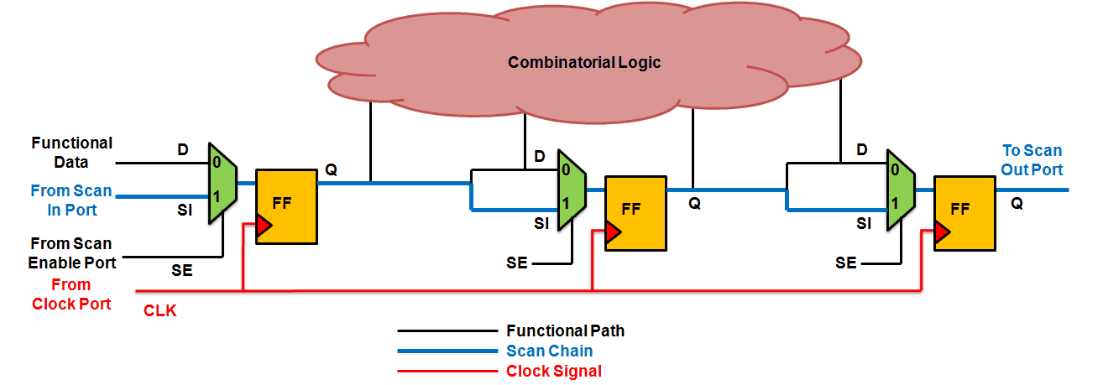
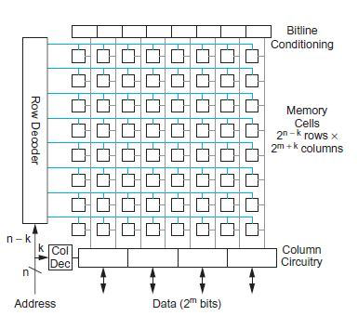
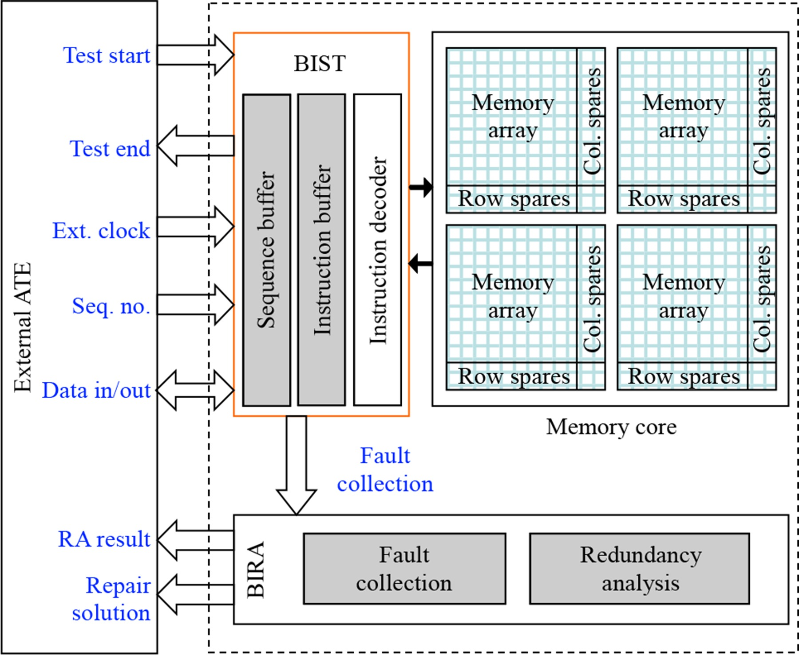

Slide 10
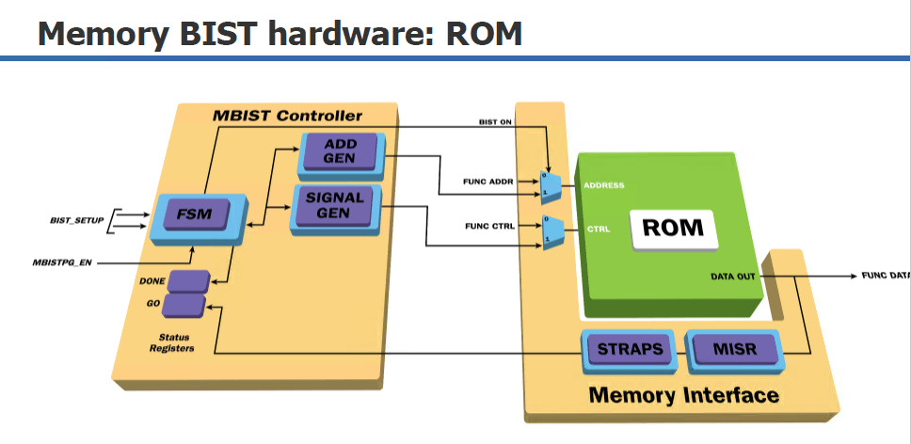
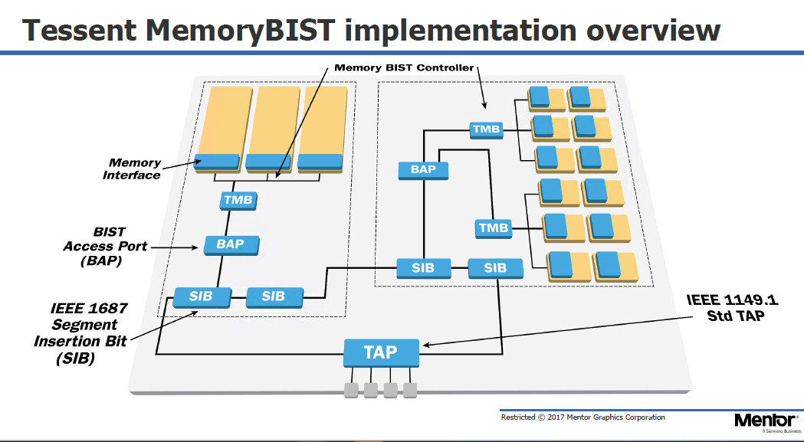
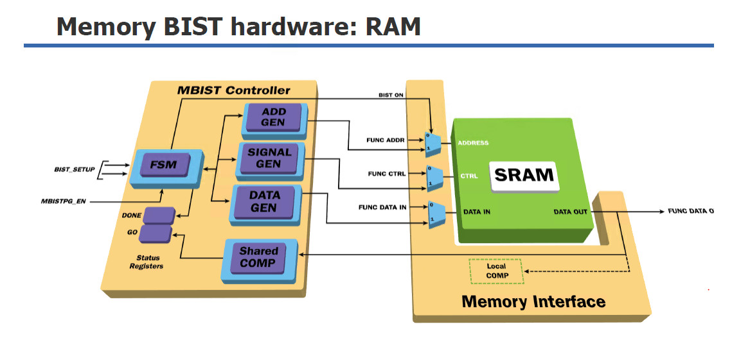
Application
All type of memories: ROM, DRAM, SRAM, AsyncRAM

