Slide 1
Chapter 13:
SIMPLE LINEAR REGRESSION

Slide 2
SIMPLE LINEAR REGRESSION
Simple Regression
Linear Regression

Slide 3
Simple Regression
Definition
A regression model is a mathematical equation that describes the relationship between two or more variables. A simple regression model includes only two variables: one independent and one dependent. The dependent variable is the one being explained, and the independent variable is the one used to explain the variation in the dependent variable.

Slide 4
Linear Regression
Definition
A (simple) regression model that gives a straight-line relationship between two variables is called a linear regression model.

Slide 5
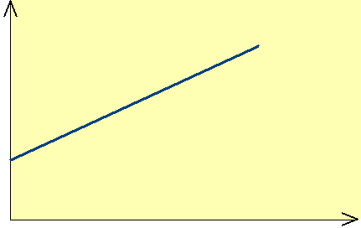
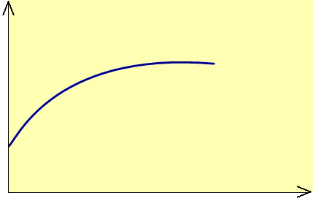
Figure 13.1 Relationship between food expenditure and income. (a) Linear relationship. (b) Nonlinear relationship.
Linear
Food Expenditure
Food Expenditure
Nonlinear
Income
Income
(a)
(b)

Slide 6
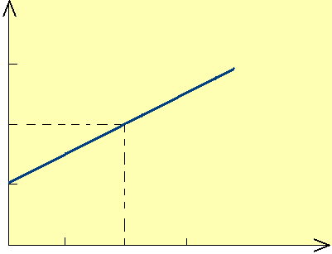
Figure 13.2 Plotting a linear equation.
y
y = 50 + 5x
150
100
x = 10
y = 100
50
x = 0
y = 50
5
10
15
x

Slide 7
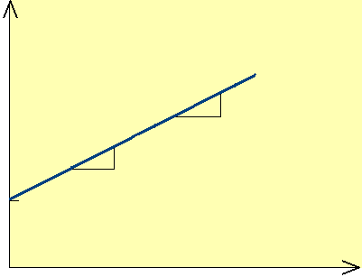
Figure 13.3 y-intercept and slope of a line.
y
5
1
5
Change in y
1
50
Change in x
y-intercept
x

Slide 8
SIMPLE LINEAR REGRESSION ANALYSIS
Scatter Diagram
Least Square Line
Interpretation of a and b
Assumptions of the Regression Model

Slide 9
SIMPLE LINEAR REGRESSION ANALYSIS cont.
y = A + Bx
Constant term or y-intercept
Slope
Dependent variable
Independent variable

Slide 10
SIMPLE LINEAR REGRESSION ANALYSIS cont.
Definition
In the regression model y = A + Bx + Є, A is called the y-intercept or constant term, B is the slope, and Є is the random error term. The dependent and independent variables are y and x, respectively.

Slide 11
SIMPLE LINEAR REGRESSION ANALYSIS
Definition
In the model ŷ = a + bx, a and b, which are calculated using sample data, are called the estimates of A and B.

Slide 12
Table 13.1 Incomes (in hundreds of dollars) and Food Expenditures of Seven Households
Income | Food Expenditure
35 49 21 39 15 28 25 | 9 15 7 11 5 8 9

Slide 13
Scatter Diagram
Definition
A plot of paired observations is called a scatter diagram.

Slide 14
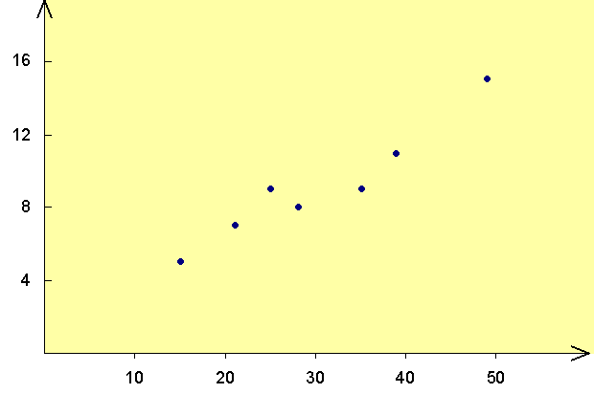
Figure 13.4 Scatter diagram.
First household
Seventh household
Food expenditure
Income

Slide 15
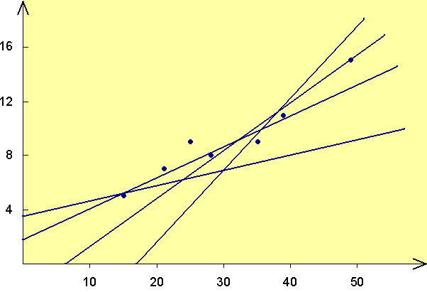
Figure 13.5 Scatter diagram and straight lines.
Food expenditure
Income

Slide 16
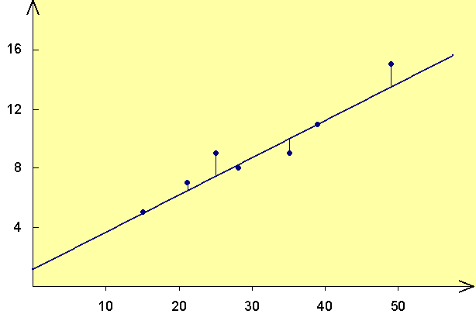
Least Squares Line
Figure 13.6 Regression line and random errors.
e
Food expenditure
Regression line
Income

Slide 17
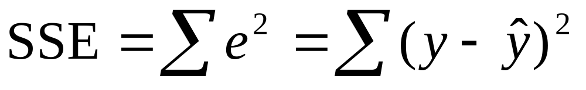
Error Sum of Squares (SSE)
The error sum of squares, denoted SSE, is
The values of a and b that give the minimum SSE are called the least square estimates of A and B, and the regression line obtained with these estimates is called the least square line.

Slide 18
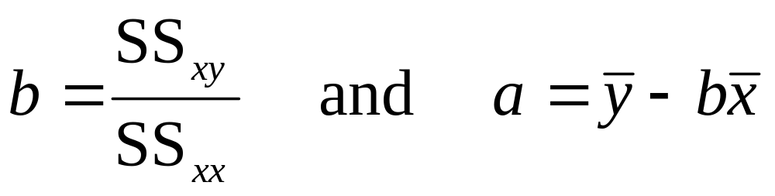
The Least Squares Line
For the least squares regression line ŷ = a + bx,

Slide 19
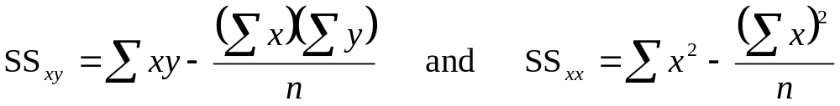
The Least Squares Line cont.
where
and SS stands for “sum of squares”. The least squares regression line ŷ = a + bx us also called the regression of y on x.

Slide 20
Example 13-1
Find the least squares regression line for the data on incomes and food expenditure on the seven households given in the Table 13.1. Use income as an independent variable and food expenditure as a dependent variable.

Slide 21
Table 13.2
Income x | Food Expenditure y |  | xy | x²
35 49 21 39 15 28 25 |  | 9 15 7 11 5 8 9 | 315 735 147 429 75 224 225 | 1225 2401 441 1521 225 784 625
Σx = 212 |  | Σy = 64 | Σxy = 2150 | Σx² = 7222

Slide 22
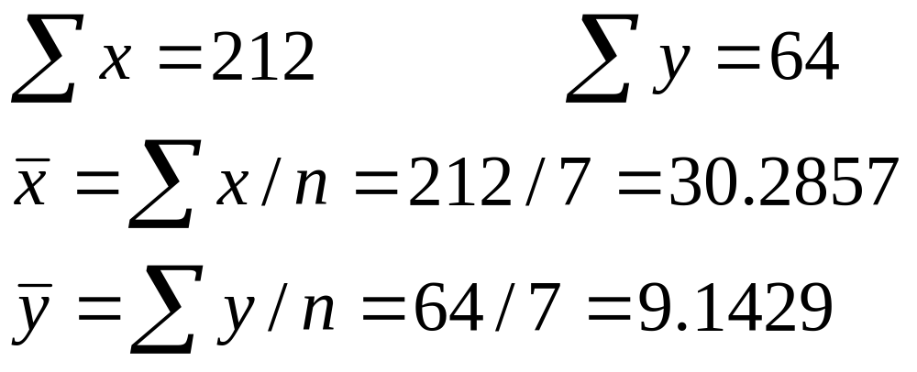
Solution 13-1

Slide 23
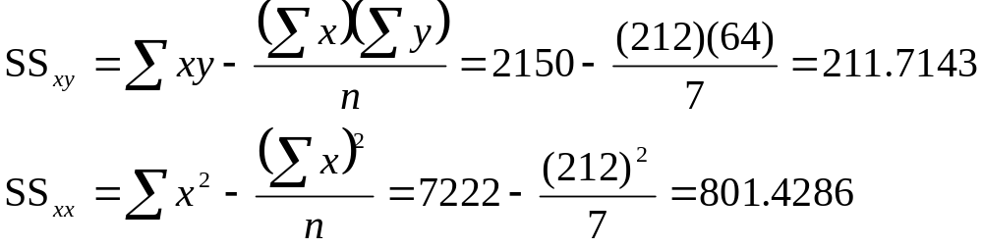
Solution 13-1

Slide 24
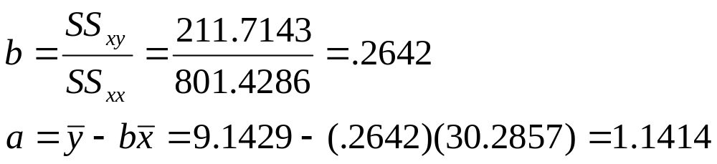
Solution 13-1
Thus,
ŷ = 1.1414 + .2642x

Slide 25
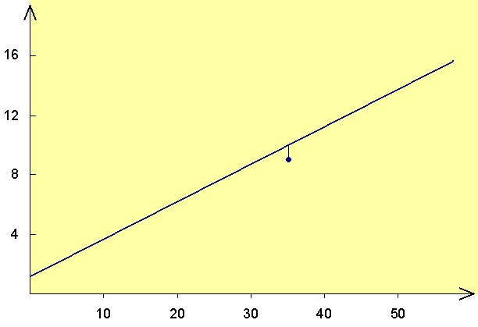
Figure 13.7 Error of prediction.
ŷ = 1.1414 + .2642x
Predicted = $1038.84
Food expenditure
e
Error = -$138.84
Actual = $900
Income

Slide 26
Interpretation of a and b
Interpretation of a
Consider the household with zero income
  ŷ = 1.1414 + .2642(0) = $1.1414 hundred
Thus, we can state that households with no income is expected to spend $114.14 per month on food
The regression line is valid only for the values of x between 15 and 49

Slide 27
Interpretation of a and b cont.
Interpretation of b
The value of b in the regression model gives the change in y due to change of one unit in x
We can state that, on average, a $1 increase in income of a household will increase the food expenditure by $.2642

Slide 28
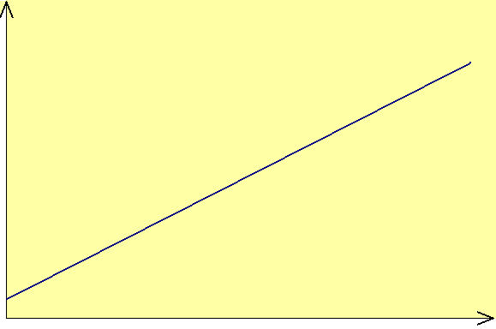
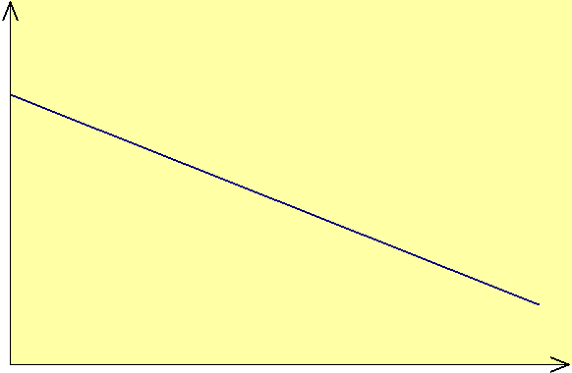
Figure 13.8 Positive and negative linear relationships between x and y.
y
y
b < 0
b > 0
x
x
(a) Positive linear
relationship.
(b) Negative linear
relationship.

Slide 29
Assumptions of the Regression Model
Assumption 1:
The random error term Є has a mean equal to zero for each x

Slide 30
Assumptions of the Regression Model cont.
Assumption 2:
The errors associated with different observations are independent

Slide 31
Assumptions of the Regression Model cont.
Assumption 3:
For any given x, the distribution of errors is normal

Slide 32
Assumptions of the Regression Model cont.
Assumption 4:
The distribution of population errors for each x has the same (constant) standard deviation, which is denoted σ_{Є}.

Slide 33
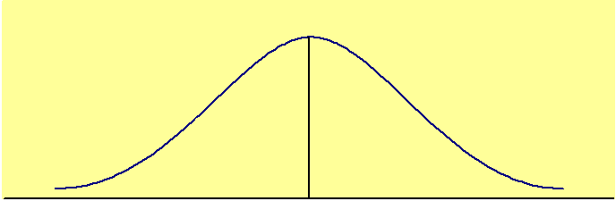
Figure 13.11 (a) Errors for households with an income of $2000 per month.
Normal distribution with (constant) standard deviation σ_{Є}
E(ε) = 0
Errors for households with income = $2000
(a)

Slide 34
Figure 13.11 (b) Errors for households with an income of $ 3500 per month.
Normal distribution with (constant) standard deviation σ_{Є}
E(ε) = 0
Errors for households with income = $3500
(b)

Slide 35
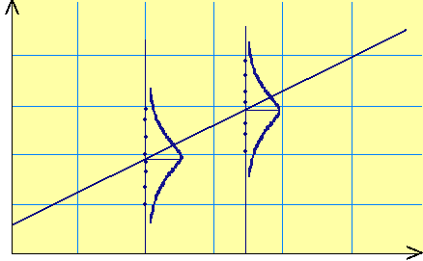
Figure 13.12 Distribution of errors around the population regression line.
16
Food expenditure
12
Population regression line
8
4
10
x = 20
30
x = 35
40
50
Income

Slide 36
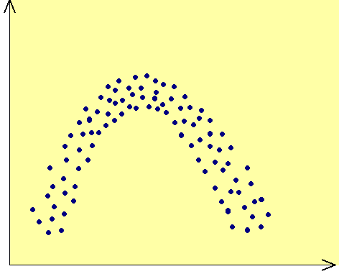
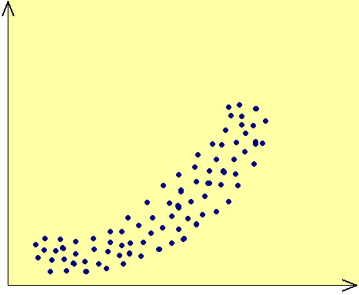
Figure 13.13 Nonlinear relations between x and y.
y
y
x
x
(a) (b)

Slide 37
Figure 13.14 Spread of errors for x = 20 and x = 35.
16
Food expenditure
12
Population regression line
8
4
10
x = 20
30
x = 35
40
50
Income

Slide 38
STANDARD DEVIATION OF RANDOM ERRORS
Degrees of Freedom for a Simple Linear Regression Model
The degrees of freedom for a simple linear regression model are
df = n – 2

Slide 39
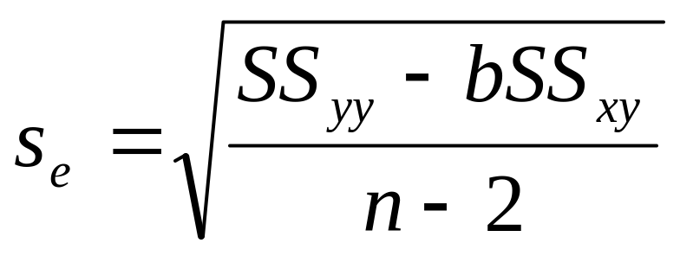
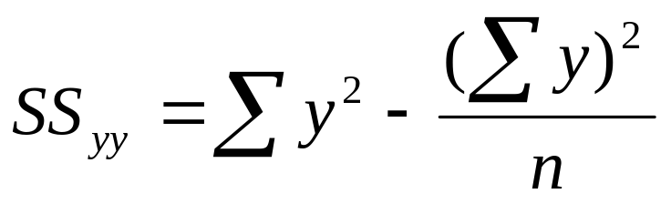
STANDARD DEVIATION OF RANDOM ERRORS cont.
The standard deviation of errors is calculated as
where

Slide 40
Example 13-2
Compute the standard deviation of errors s_{e} for the data on monthly incomes and food expenditures of the seven households given in Table 13.1.

Slide 41
Table 13.3
Income x | Food Expenditure y | y²
35 49 21 39 15 28 25 | 9 15 7 11 5 8 9 | 81 225 49 121 25 64 81
Σx = 212 | Σy = 64 | Σy² =646

Slide 42
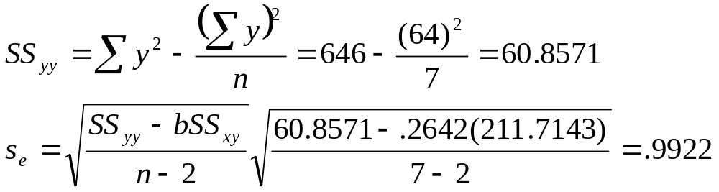
Solution 13-2

Slide 43
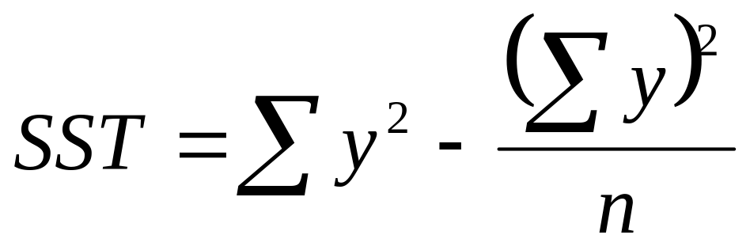
COEFFICIENT OF DETERMINATION
Total Sum of Squares (SST)
The total sum of squares, denoted by SST, is calculated as

Slide 44
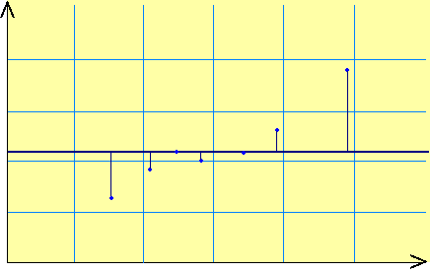

Figure 13.15 Total errors.
16
12
Food expenditure
8
4
10
20
30
40
50
Income

Slide 45
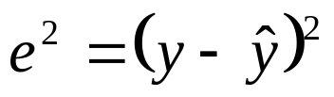

Table 13.4
x | y | ŷ = 1.1414 + .2642x | e = y – ŷ
35 49 21 39 15 28 25 | 9 15 7 11 5 8 9 | 10.3884 14.0872 6.6896 11.4452 5.1044 8.5390 7.7464 | -1.3884 .9128 .3104 -.4452 -.1044 -.5390 1.2536 | 1.9277 .8332 .0963 .1982 .0109 .2905 1.5715

Slide 46
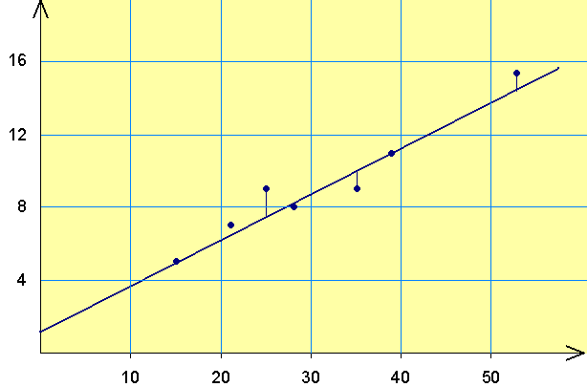
Figure 13.16 Errors of prediction when regression model is used.
ŷ = 1.1414 + .2642x
Food expenditure
Income

Slide 47
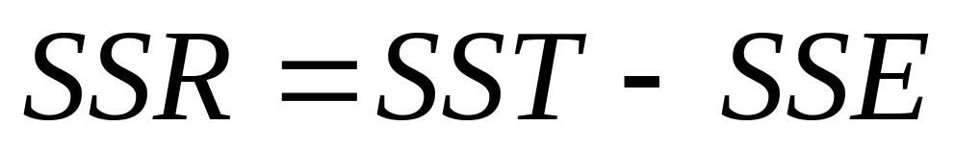
COEFFICIENT OF DETERMINATION cont.
Regression Sum of Squares (SSR)
The regression sum of squares , denoted by SSR, is

Slide 48
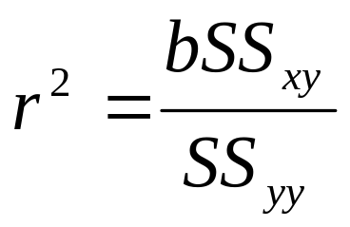
COEFFICIENT OF DETERMINATION cont.
Coefficient of Determination
The coefficient of determination, denoted by r², represents the proportion of SST that is explained by the use of the regression model. The computational formula for r² is
and 0 ≤ r² ≤ 1

Slide 49
Example 13-3
For the data of Table 13.1 on monthly incomes and food expenditures of seven households, calculate the coefficient of determination.

Slide 50
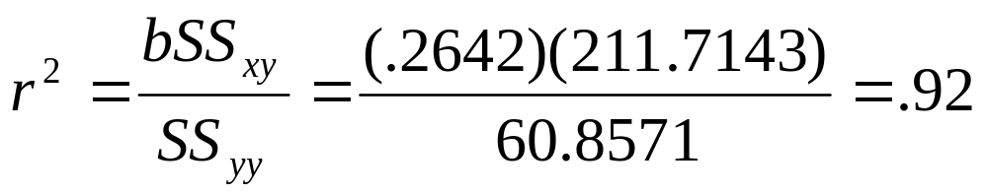
Solution 13-3
From earlier calculations
b = .2642, SS_{xx} = 211.7143, and SS_{yy} = 60.8571

Slide 51
INFERENCES ABOUT B
Sampling Distribution of b
Estimation of B
Hypothesis Testing About B

Slide 52
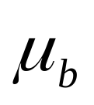
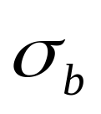
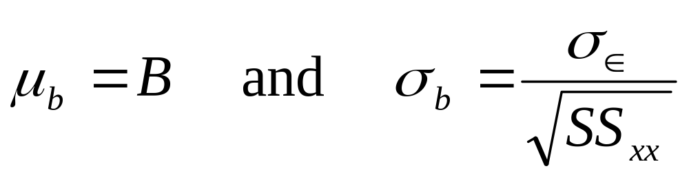
Sampling Distribution of b
Mean, Standard Deviation, and Sampling Distribution of b
The mean and standard deviation of b, denoted by and , respectively, are

Slide 53
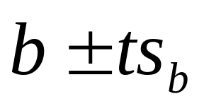
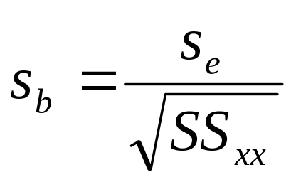
Estimation of B
Confidence Interval for B
The (1 – α)100% confidence interval for B is given by
where

Slide 54
Example 13-4
Construct a 95% confidence interval for B for the data on incomes and food expenditures of seven households given in Table 13.1.

Slide 55
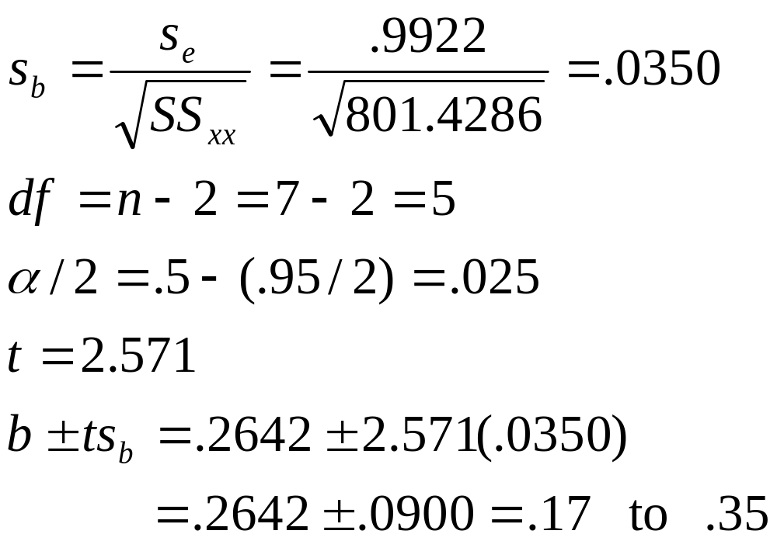
Solution 13-4

Slide 56
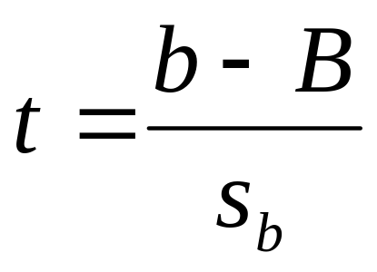
Hypothesis Testing About B
Test Statistic for b
The value of the test statistic t for b is calculated as
The value of B is substituted from the null hypothesis.

Slide 57
Example 13-5
Test at the 1% significance level whether the slope of the regression line for the example on incomes and food expenditures of seven households is positive.

Slide 58
Solution 13-5
H₀: B = 0
  The slope is zero
H₁: B > 0
  The slope is positive

Slide 59
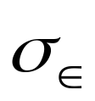
Solution 13-5
n = 7 < 30
is not known
Hence, we will use the t distribution to make the test about B
Area in the right tail = α = .01
df = n – 2 = 7 – 2 = 5
The critical value of t is 3.365

Slide 60

Figure 13.17
Do not reject H₀
Reject H₀
α = .01
0
3.365
t
Critical value of t

Slide 61
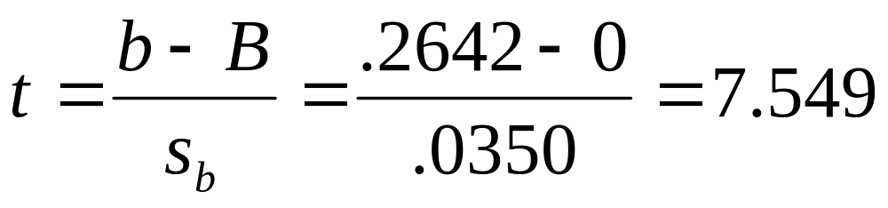
Solution 13-5
From H₀

Slide 62
Solution 13-5
The value of the test statistic t = 7.549
  It is greater than the critical value of t
  It falls in the rejection region
Hence, we reject the null hypothesis

Slide 63
LINEAR CORRELATION
Linear Correlation Coefficient
Hypothesis Testing About the Linear Correlation Coefficient

Slide 64
Linear Correlation Coefficient
Value of the Correlation Coefficient
The value of the correlation coefficient always lies in the range of –1 to 1; that is,
-1 ≤ ρ ≤ 1 and -1 ≤ r ≤ 1

Slide 65
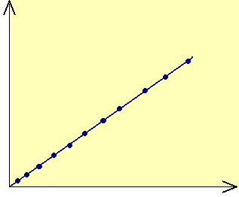
Figure 13.18 Linear correlation between two variables.
(a) Perfect positive linear correlation, r = 1
y
r = 1
x

Slide 66
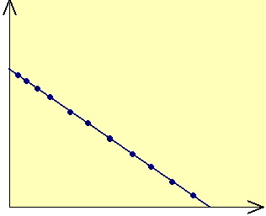
Figure 13.18 Linear correlation between two variables.
(b) Perfect negative linear correlation, r = -1
y
r = -1
x

Slide 67
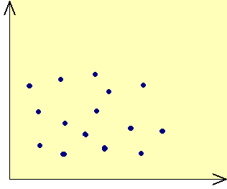
Figure 13.18 Linear correlation between two variables.
(c) No linear correlation, , r ≈ 0
y
r ≈ 0
x

Slide 68
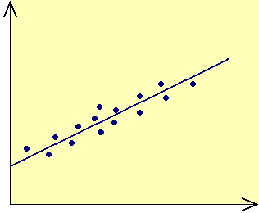
Figure 13.19 Linear correlation between variables.
(a) Strong positive linear correlation (r is close to 1)
y
x

Slide 69
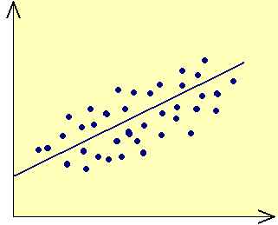
Figure 13.19 Linear correlation between variables.
(b) Weak positive linear correlation (r is positive but close to 0)
y
x

Slide 70
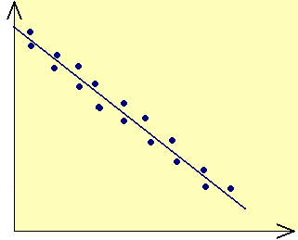
Figure 13.19 Linear correlation between variables.
(c) Strong negative linear correlation (r is close to -1)
y
x

Slide 71
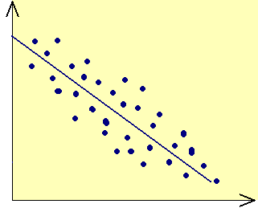
Figure 13.19 Linear correlation between variables.
(d) Weak negative linear correlation (r is negative and close to 0)
y
x

Slide 72
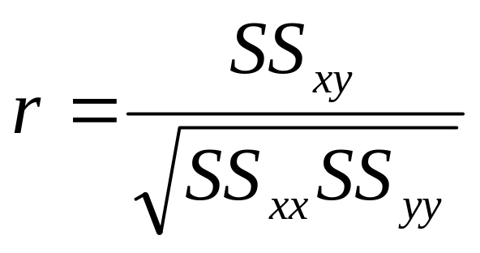
Linear Correlation Coefficient cont.
Linear Correlation Coefficient
The simple linear correlation, denoted by r, measures the strength of the linear relationship between two variables for a sample and is calculated as

Slide 73
Example 13-6
Calculate the correlation coefficient for the example on incomes and food expenditures of seven households.

Slide 74
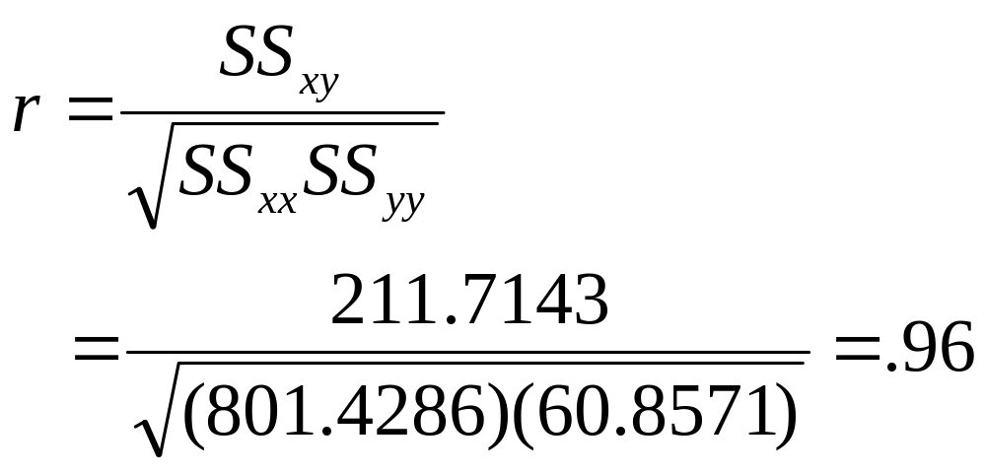
Solution 13-6

Slide 75
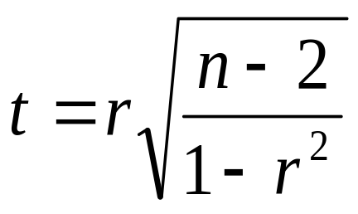
Hypothesis Testing About the Linear Correlation Coefficient
Test Statistic for r
If both variables are normally distributed and the null hypothesis is H₀: ρ = 0, then the value of the test statistic t is calculated as
Here n – 2 are the degrees of freedom.

Slide 76
Example 13-7
Using the 1% level of significance and the data from Example 13-1, test whether the linear correlation coefficient between incomes and food expenditures is positive. Assume that the populations of both variables are normally distributed.

Slide 77
Solution 13-7
H₀: ρ = 0
  The linear correlation coefficient is zero
H₁: ρ > 0
  The linear correlation coefficient is positive

Slide 78
Solution 13-7
Area in the right tail = .01
df = n – 2 = 7 – 2 = 5
The critical value of t = 3.365

Slide 79
Figure 13.20
Do not reject H₀
Reject H₀
α = .01
0
3.365
t
Critical value of t

Slide 80
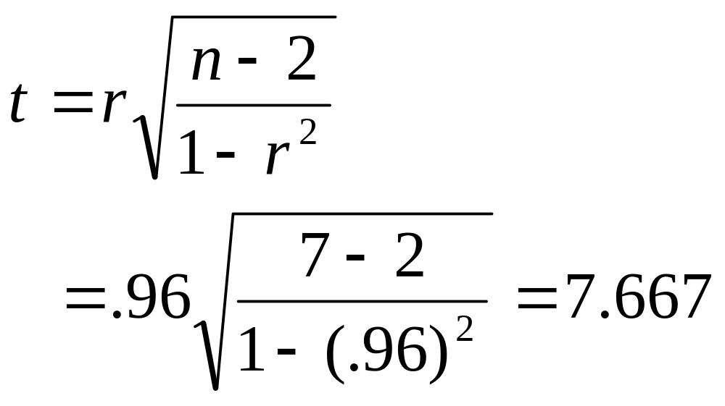
Solution 13-7

Slide 81
Solution 13-7
The value of the test statistic t = 7.667
  It is greater than the critical value of t
  It falls in the rejection region
Hence, we reject the null hypothesis

Slide 82
REGRESSION ANALYSIS: COMPLETE EXAMPLE
Example 13-8
A random sample of eight drivers insured with a company and having similar auto insurance policies was selected. The following table lists their driving experience (in years) and monthly auto insurance premiums.

Slide 83
Example 13-8
Driving Experience (years) | Monthly Auto Insurance Premium
5 2 12 9 15 6 25 16 | $64 87 50 71 44 56 42 60

Slide 84
Example 13-8
Does the insurance premium depend on the driving experience or does the driving experience depend on the insurance premium? Do you expect a positive or a negative relationship between these two variables?

Slide 85
Solution 13-8
The insurance premium depends on driving experience
  The insurance premium is the dependent variable
  The driving experience is the independent variable

Slide 86
Example 13-8
Compute SS_{xx}, SS_{yy}, and SS_{xy}.

Slide 87
Table 13.5
Experience x | Premium y | xy | x ² | y²
5 2 12 9 15 6 25 16 | 64 87 50 71 44 56 42 60 | 320 174 600 639 660 336 1050 960 | 25 4 144 81 225 36 625 256 | 4096 7569 2500 5041 1936 3136 1764 3600
Σx = 90 | Σy = 474 | Σxy = 4739 | Σx² = 1396 | Σy² = 29,642

Slide 88


Solution 13-8

Slide 89
Example 13-8
Find the least squares regression line by choosing appropriate dependent and independent variables based on your answer in part a.

Slide 90


Solution 13-8

Slide 91
Example 13-8
Interpret the meaning of the values of a and b calculated in part c.

Slide 92
Solution 13-8
The value of a = 76.6605 gives the value of ŷ for x = 0
Here, b = -1.5476 indicates that, on average, for every extra year of driving experience, the monthly auto insurance premium decreases by $1.55.

Slide 93
Example 13-8
Plot the scatter diagram and the regression line.

Slide 94


Figure 13.21 Scatter diagram and the regression line.
Insurance premium
Experience

Slide 95
Example 13-8
Calculate r and r² and explain what they mean.

Slide 96

Solution 13-8
f)

Slide 97
Solution 13-8
The value of r = -0.77 indicates that the driving experience
  Monthly auto insurance premium are negatively related
  The (linear) relationship is strong but not very strong
The value of r² = 0.59 states that 59% of the total variation in insurance premiums is explained by years of driving experience and 41% is not

Slide 98
Example 13-8
Predict the monthly auto insurance for a driver with 10 years of driving experience.

Slide 99
Solution 13-8
The predict value of y for x = 10 is
ŷ = 76.6605 – 1.5476(10) = $61.18

Slide 100
Example 13-8
Compute the standard deviation of errors.

Slide 101

Solution 13-8

Slide 102
Example 13-8
Construct a 90% confidence interval for B.

Slide 103

Solution 13-8

Slide 104
Example 13-8
Test at the 5% significance level whether B is negative.

Slide 105
Solution 13-8
H₀: B = 0
  B is not negative
H₁: B < 0
  B is negative

Slide 106
Solution 13-5
Area in the left tail = α = .05
df = n – 2 = 8 – 2 = 6
The critical value of t is -1.943

Slide 107

Figure 13.22
Reject H₀
Do not reject H₀
α = .01
-1.943 0
t
Critical value of t

Slide 108

Solution 13-8
From H₀

Slide 109
Solution 13-8
The value of the test statistic t = -2.937
  It falls in the rejection region
Hence, we reject the null hypothesis and conclude that B is negative

Slide 110
Example 13-8
Using α = .05, test whether ρ is difference from zero.

Slide 111
Solution 13-8
H₀: ρ = 0
  The linear correlation coefficient is zero
H₁: ρ ≠ 0
  The linear correlation coefficient is different from zero

Slide 112
Solution 13-8
Area in each tail = .05/2 = .025
df = n – 2 = 8 – 2 = 6
The critical values of t are -2.447 and 2.447

Slide 113

Figure 13.23
Reject H₀
Do not reject H₀
Reject H₀
α/2 = .025
α/2 = .025
-2.447 0 2.447 t
Two critical values of t

Slide 114

Solution 13-8

Slide 115
Solution 13-8
The value of the test statistic t = -2.956
  It falls in the rejection region
Hence, we reject the null hypothesis

Slide 116
USING THE REGRESSION MODEL
Using the Regression Model for Estimating the Mean Value of y
Using the Regression Model for Predicting a Particular Value of y

Slide 117


Figure 13.24 Population and sample regression lines.
y
Population regression line
Regression lines ŷ = a +bx estimated from different samples
x

Slide 118

Using the Regression Model for Estimating the Mean Value of y
Confidence Interval for μ_{y|x}
The (1 – α)100% confidence interval for μ_{y|x} for x = x₀ is

Slide 119


Confidence Interval for μ_{y|x}
Where the value of t is obtained from the t distribution table for α/2 area in the right tail of the t distribution curve and df = n – 2. The value of is calculated as follows:

Slide 120
Example 13-9
Refer to Example 13-1 on incomes and food expenditures. Find a 99% confidence interval for the mean food expenditure for all households with a monthly income of $3500.

Slide 121
Solution 13-9
Using the regression line, we find the point estimate of the mean food expenditure for x = 35
  ŷ = 1.1414 + .2642(35) = $10.3884 hundred
Area in each tail = α/2 = .5 – (.99/2) = .005
df = n – 2 = 7 – 2 = 5
t = 4.032

Slide 122

Solution 13-9

Slide 123

Solution 13-9

Slide 124

Using the Regression Model for Predicting a Particular Value of y
Prediction Interval for y_{p}
The (1 – α)100% prediction interval for the predicted value of y, denoted by y_{p}, for x = x₀ is

Slide 125


Prediction Interval for y_{p}
The value of is calculated as follows:

Slide 126
Example 13-10
Refer to Example 13-1 on incomes and food expenditures. Find a 99% prediction interval for the predicted food expenditure for a randomly selected household with a monthly income of $3500.

Slide 127
Solution 13-10
Using the regression line, we find the point estimate of the predicted food expenditure for x = 35
  ŷ = 1.1414 + .2642(35) = $10.3884 hundred
Area in each tail = α/2 = .5 – (.99/2) = .005
df = n – 2 = 7 – 2 = 5
t = 4.032

Slide 128

Solution 13-10

Slide 129

Solution 13-10

