Slide 1
Student Record Management
Nguyễn Quí Vinh Quang – ITIT19252
Nguyễn Ái Vương – ITDSIU19060
Nguyễn Duy Minh Thông – ITDSIU19017
Trương Công Trung – ITITIU19059
Lê Đỗ Minh Đăng – ITITIU20177

Slide 2
Introduction
1
Our aim is to build an effective database system that saves a student record at the university

Slide 3
Functionalities
Add user
Add course
Add teacher
Edit information
Assign teacher and course
Register course
Keep track student record
Delete student
Delete course
Delete teacher
Delete class
…

Slide 4
System and Design Specification
2
Our Student Record Database is based on third normal form

Slide 5
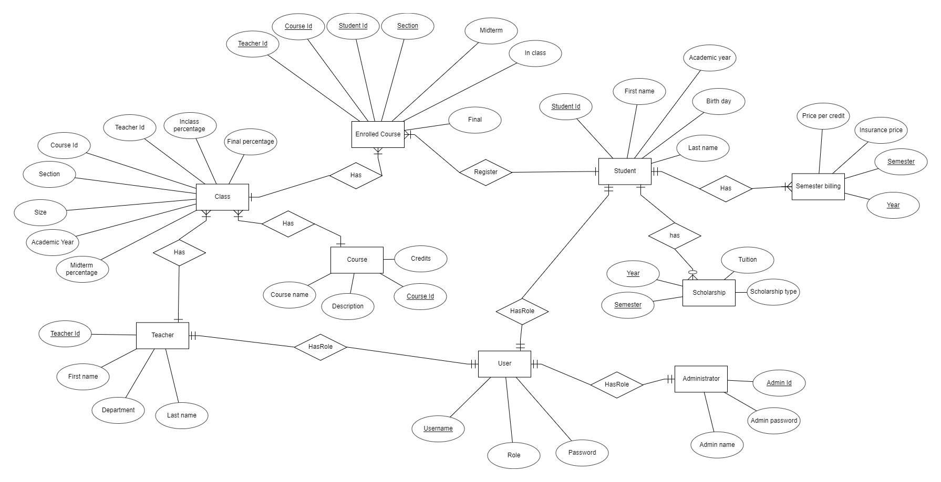
Diagram

Slide 6
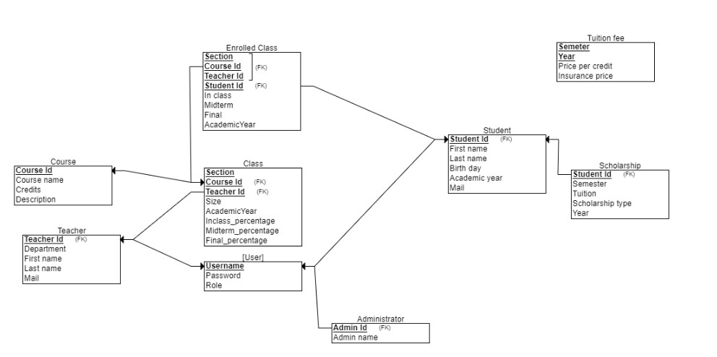
Relationship Diagram

Slide 7
Project Implementation
3
Database
Microsoft SQL Server
Application
Java

Slide 8
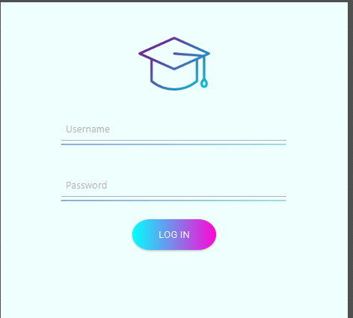
Login screen

Slide 9
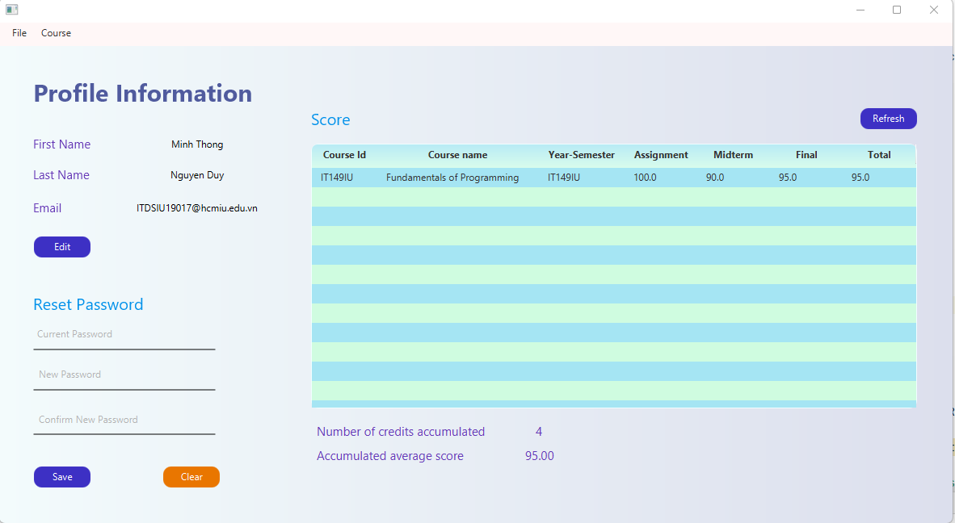
Student Information

Slide 10
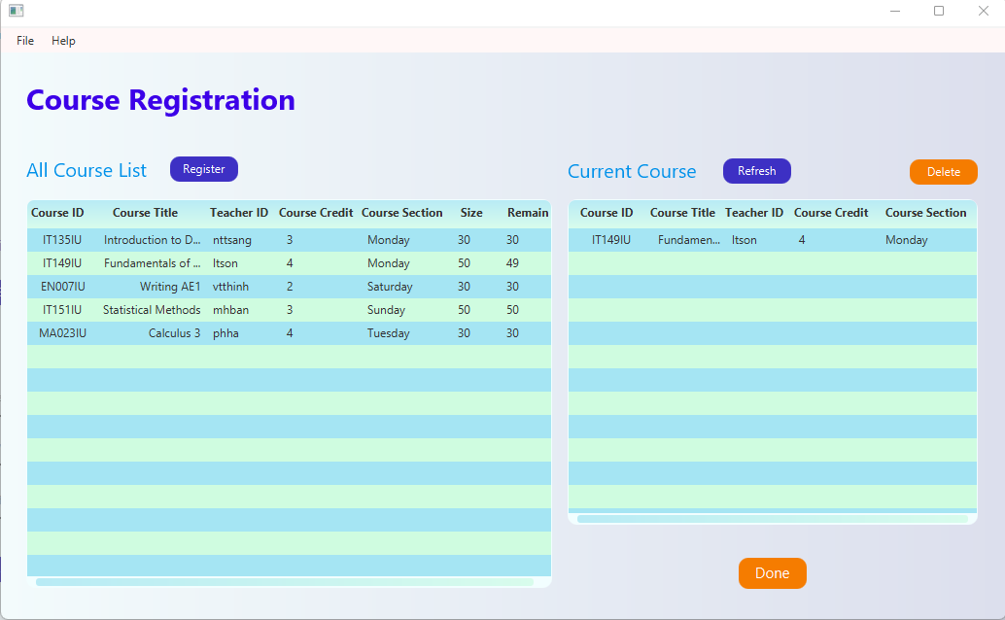
Course Registration

Slide 11
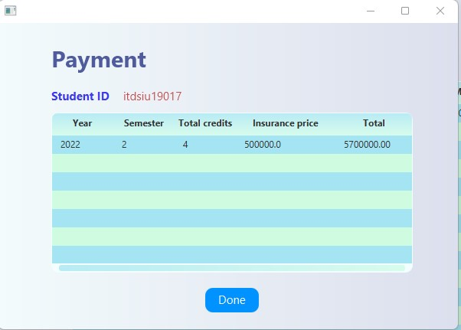
Student Payment

Slide 12
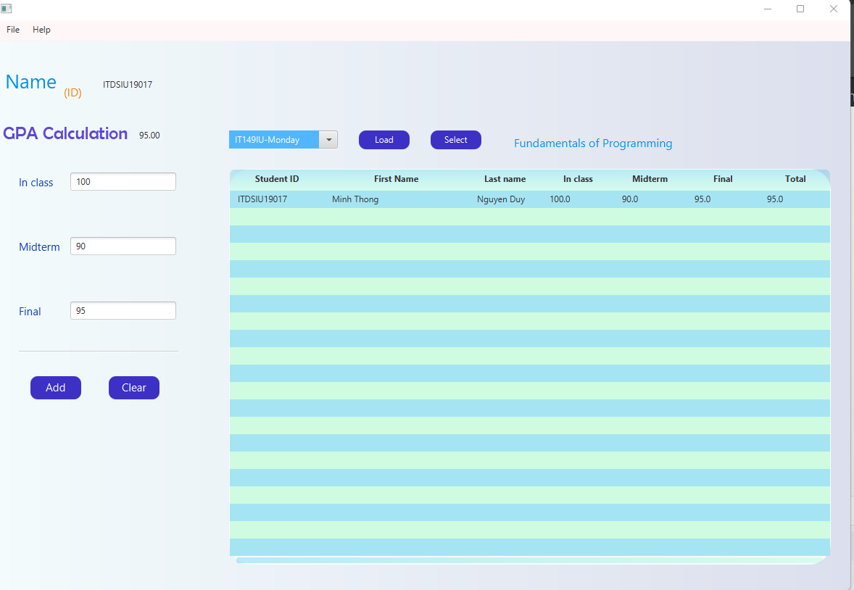
Teacher Dashboard

Slide 13
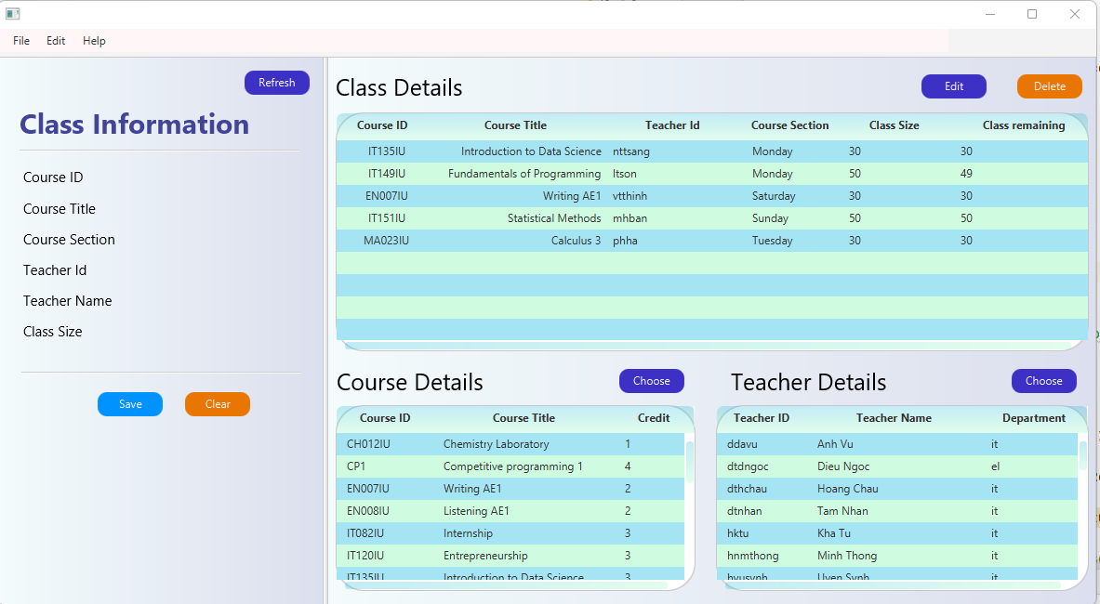
Admin Dashboard

Slide 14
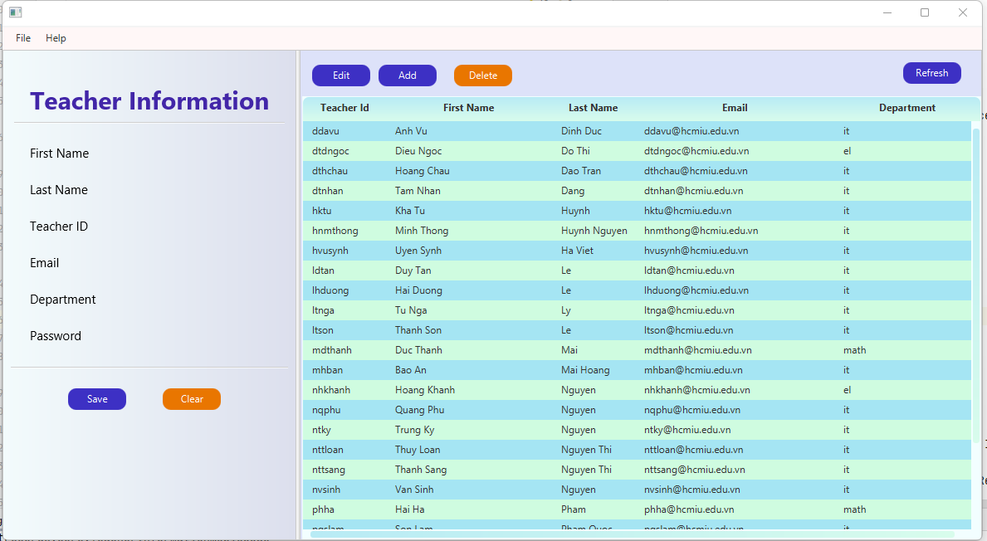
Admin Dashboard

Slide 15
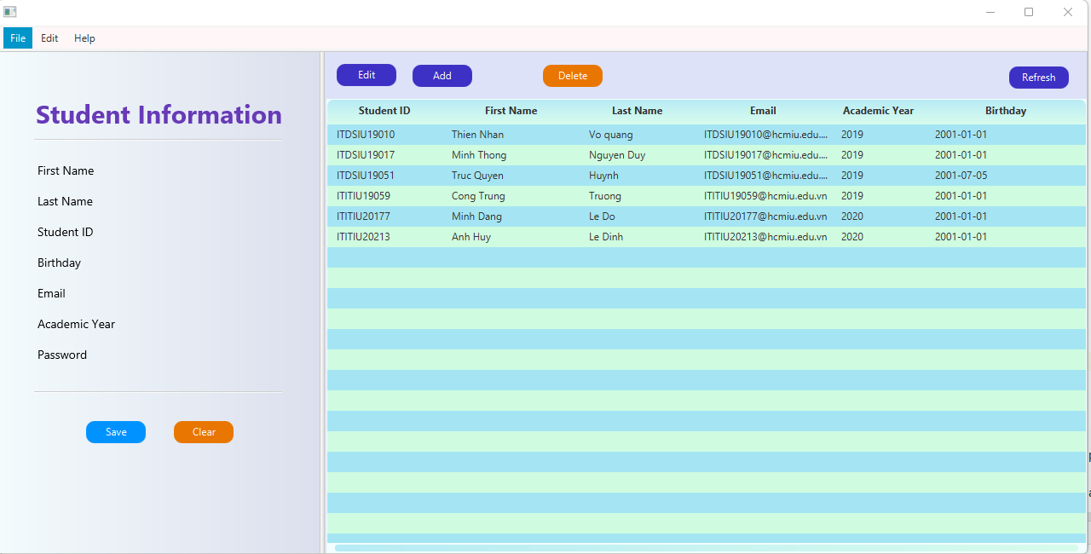
Admin Dashboard

Slide 16
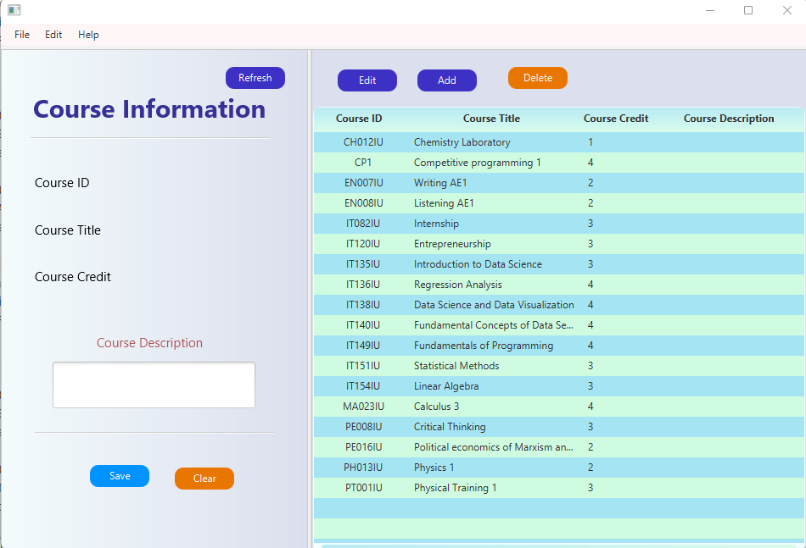
Admin Dashboard

Slide 17
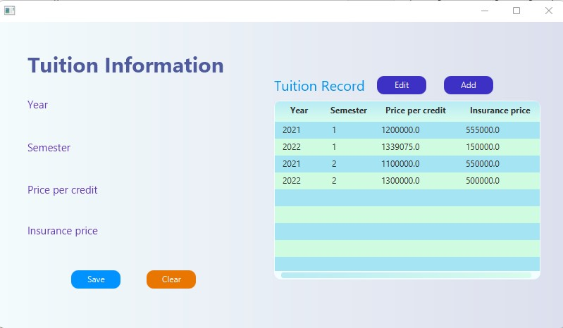
Admin Dashboard

Slide 18
Conclusion
Through this project, our group has achieved deeper understanding of:
Building an application from scratch
Designing and optimizing the database
How to connect an application with the database

Slide 19
Future plan
Develop this into an online application
Focus more on database security such as preventing SQL Injection attack

Slide 20
THANKS!
Any questions?

