Slide 1
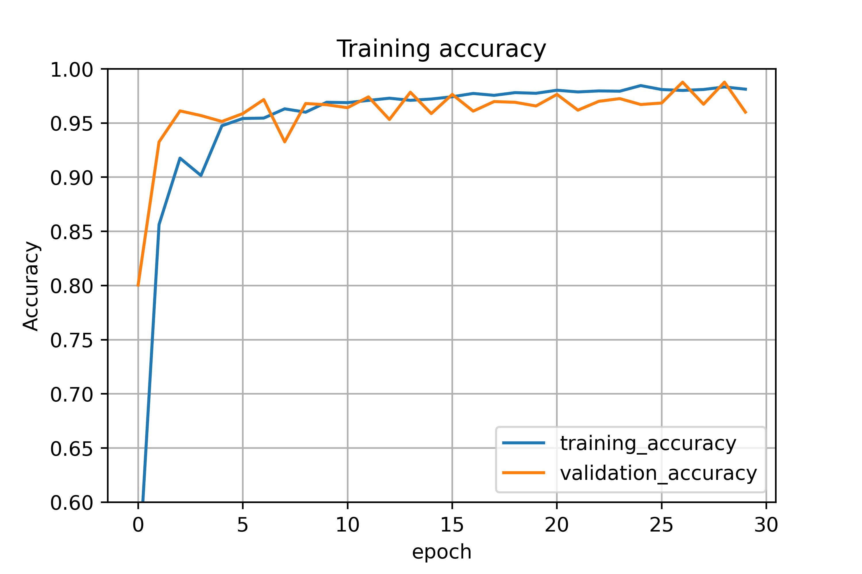
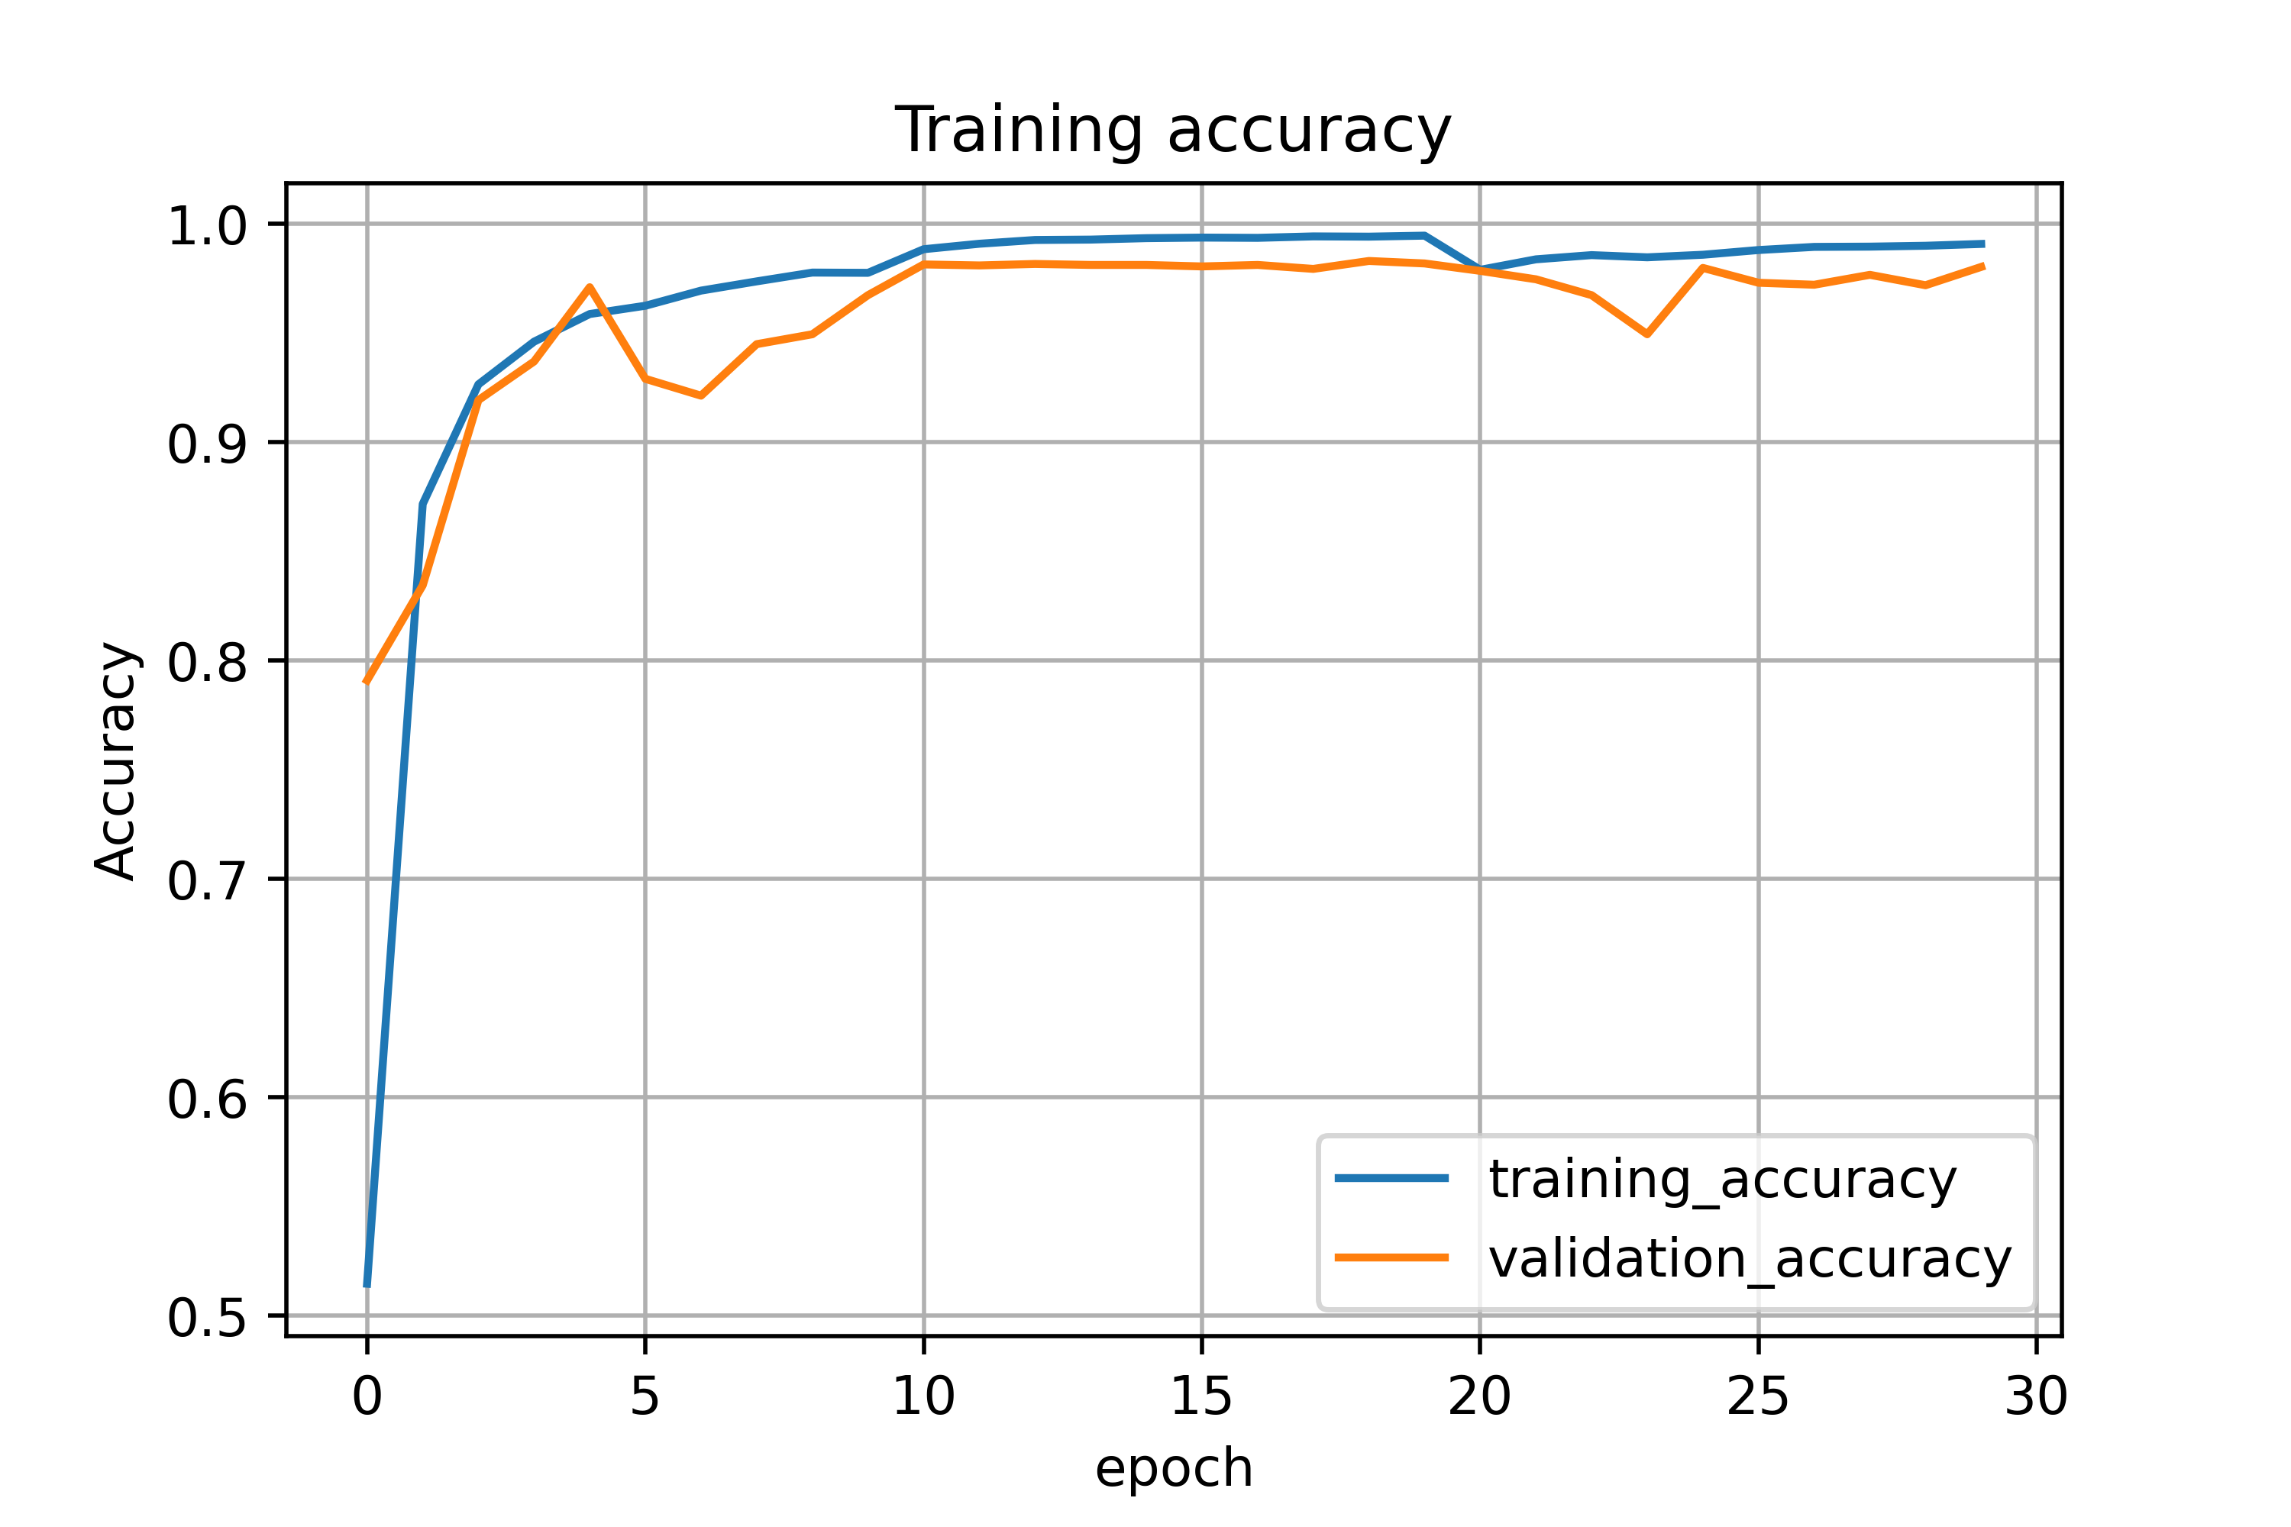
Epoch 28/30
1087/1087 - 61s 56ms/step - loss: 0.0593 - accuracy: 0.9823 - val_loss: 0.1926 - val_accuracy: 0.9653
Epoch 29/30
1087/1087 - 61s 56ms/step - loss: 0.0603 - accuracy: 0.9821 - val_loss: 0.1563 - val_accuracy: 0.9732
Epoch 30/30
1087/1087 - 66s 61ms/step - loss: 0.0592 - accuracy: 0.9829 - val_loss: 0.1186 - val_accuracy: 0.9719 LeNet improved
Epoch 28/30
1087/1087 - 721s 664ms/step - loss: 0.0801 - accuracy: 0.9810 - val_loss: 0.1617 - val_accuracy: 0.9673
Epoch 29/30
1087/1087 - 721s 663ms/step - loss: 0.0756 - accuracy: 0.9833 - val_loss: 0.0720 - val_accuracy: 0.9878
Epoch 30/30
1087/1087 - 724s 666ms/step - loss: 0.0878 - accuracy: 0.9813 - val_loss: 0.3008 - val_accuracy: 0.9601 GoogLeNet improved
Epoch 8/10
1087/1087 - 602s 554ms/step - loss: 0.0351 - accuracy: 0.9896 - val_loss: 0.0829 - val_accuracy: 0.9766
Epoch 9/10
1087/1087 - 602s 553ms/step - loss: 0.0333 - accuracy: 0.9900 - val_loss: 0.1067 - val_accuracy: 0.9719
Epoch 10/10
1087/1087 - 603s 554ms/step - loss: 0.0300 - accuracy: 0.9908 - val_loss: 0.0772 - val_accuracy: 0.9803 ResNet improved
Prediction accuracy on test dataset
loss: 0.2170 - accuracy: 0.9547
Prediction accuracy on test dataset
loss: 0.2711 - accuracy: 0.9458
Prediction accuracy on test dataset
loss: 0.2003 - accuracy: 0.9576

