Slide 1
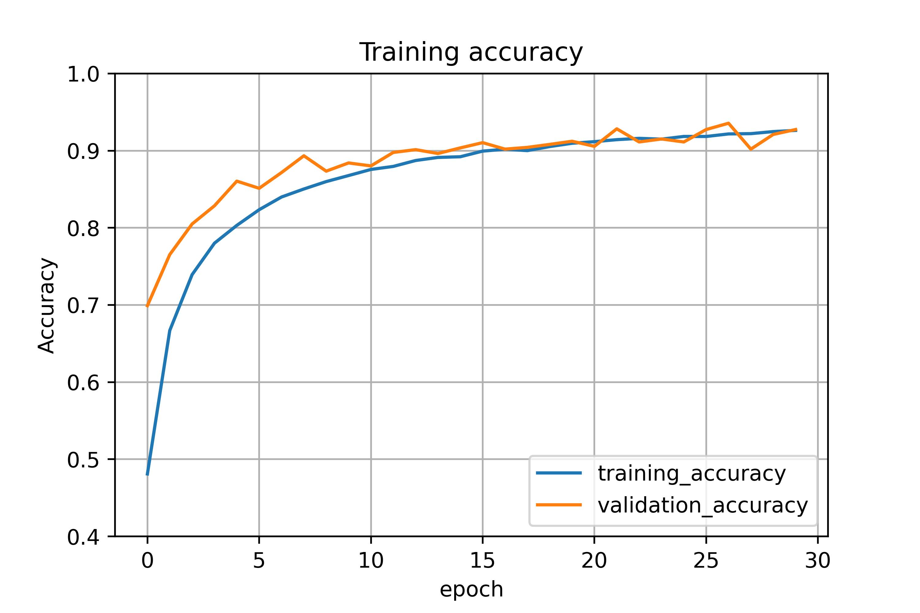
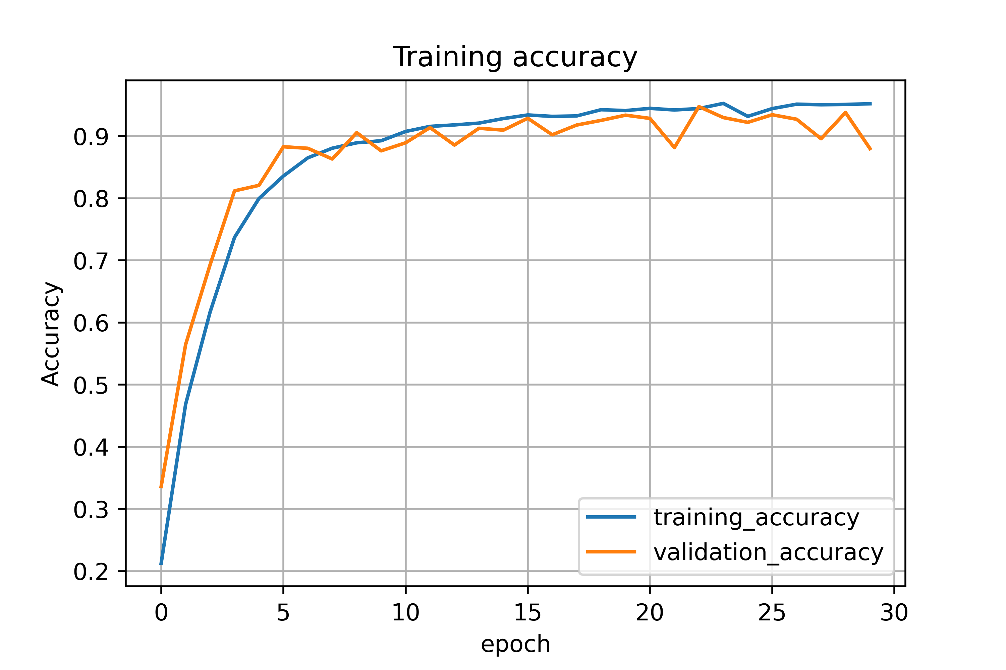
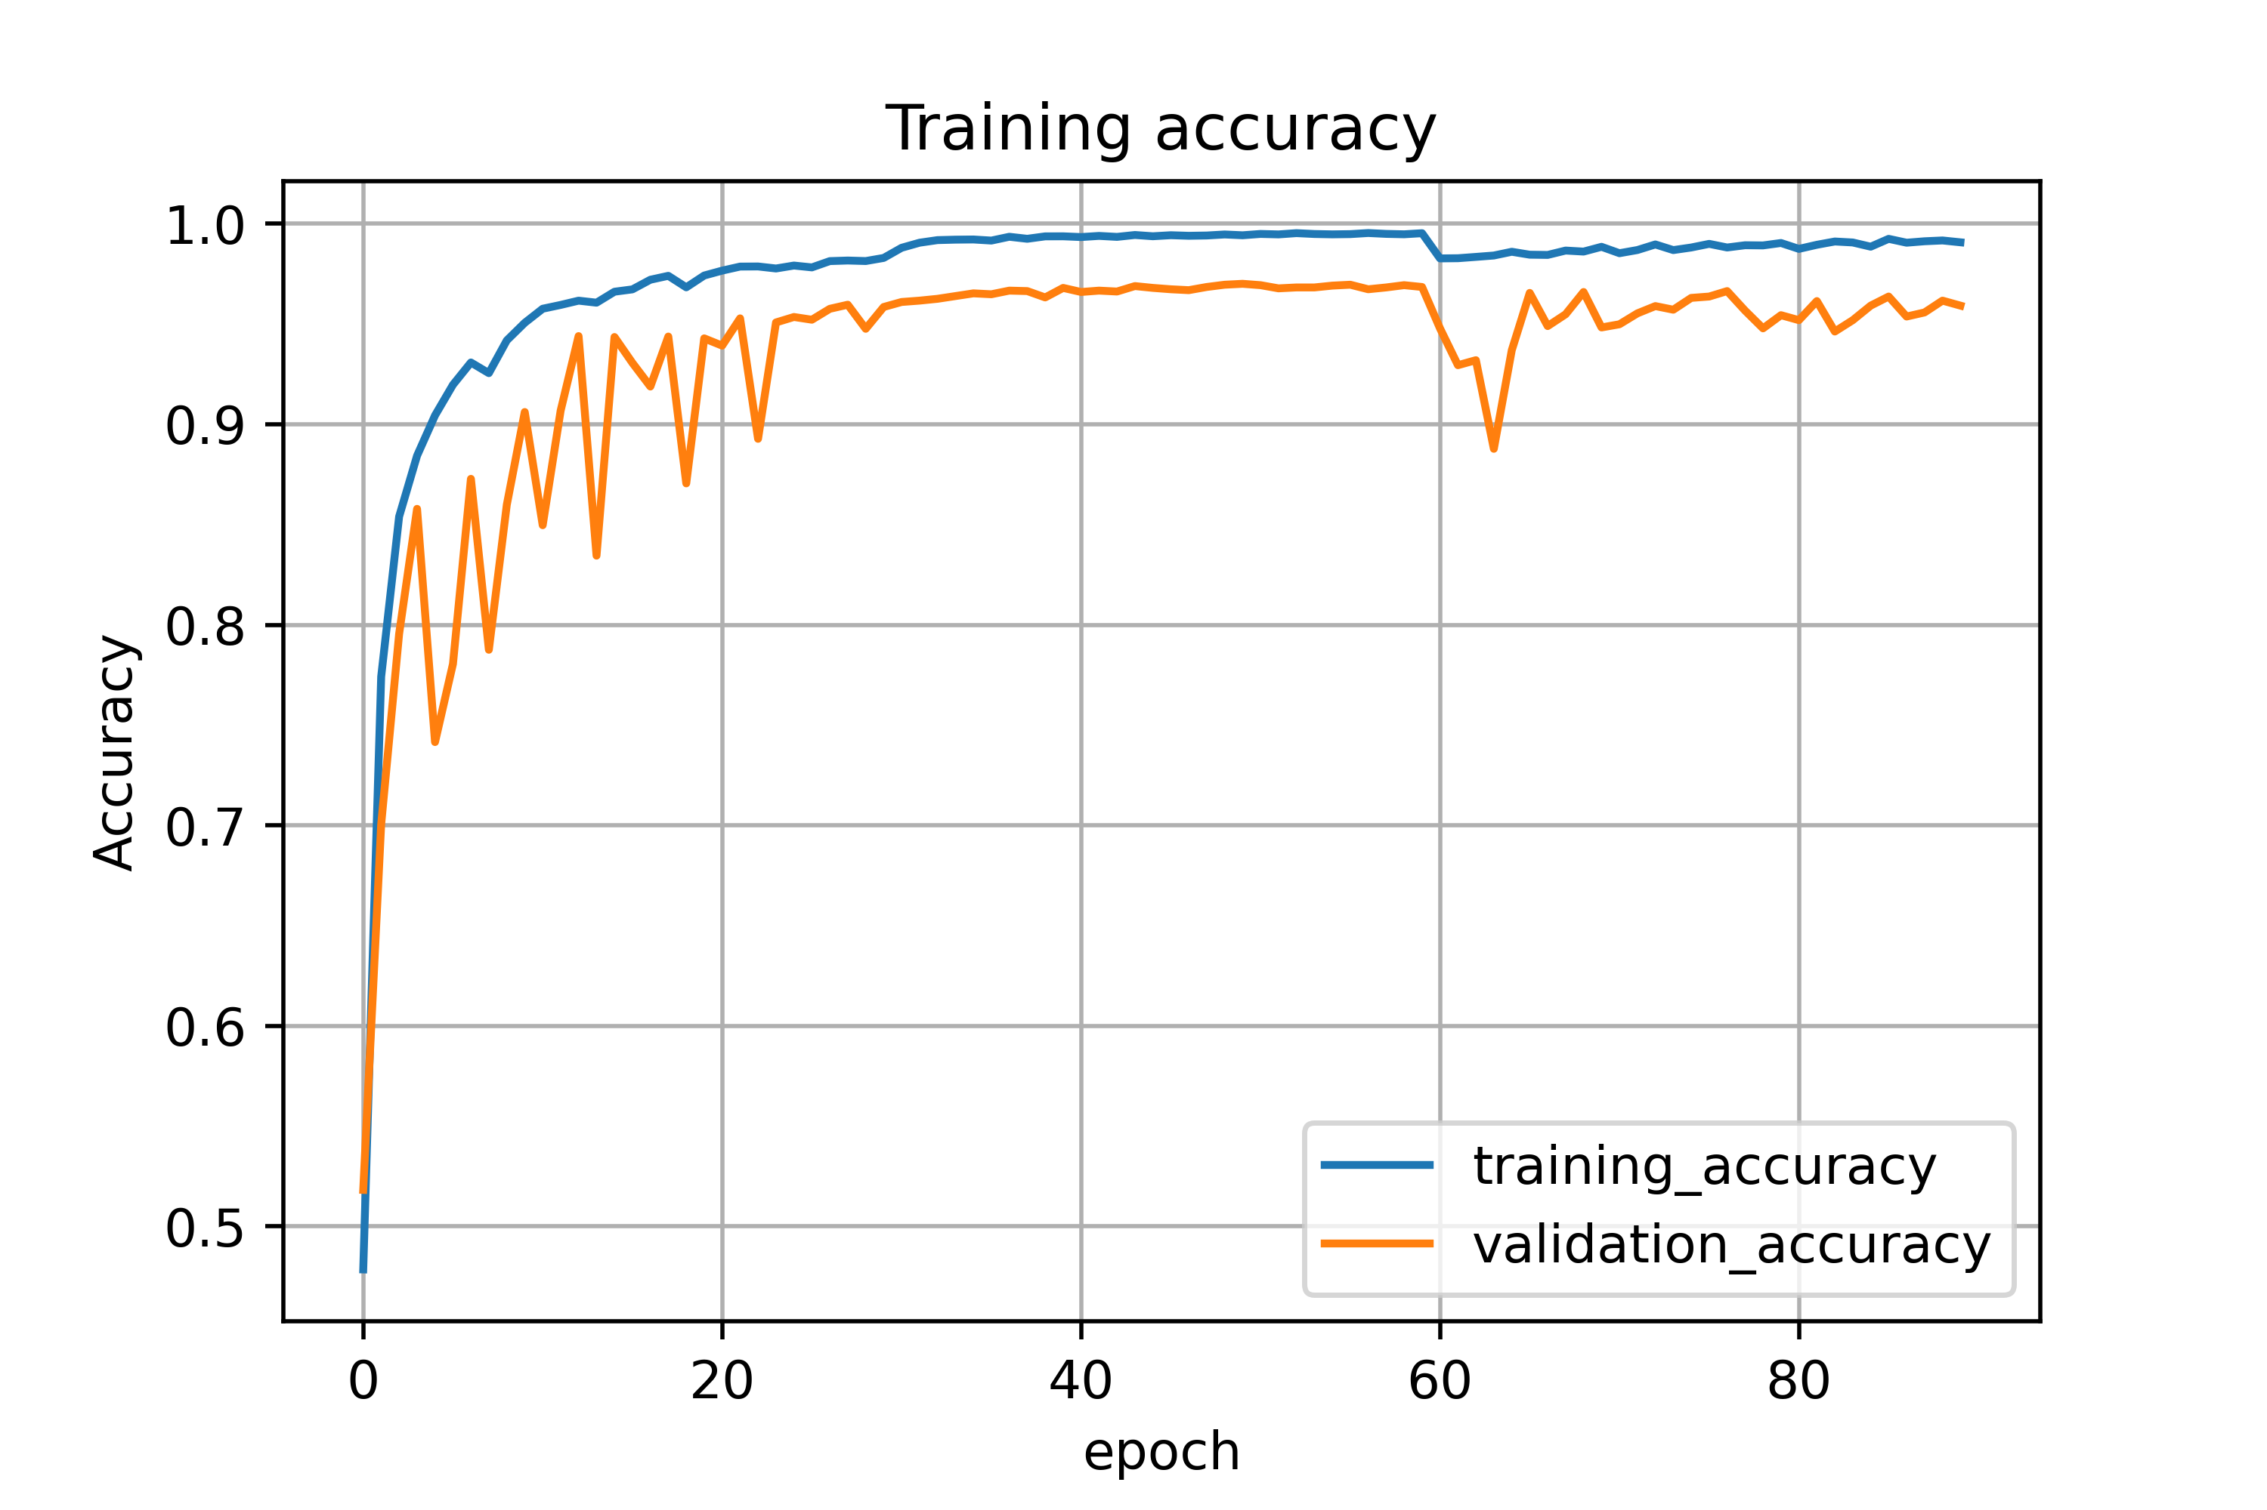
Epoch 28/30
1087/1087 - 140s 129ms/step - loss: 0.2607 - accuracy: 0.9221 - val_loss: 0.5261 - val_accuracy: 0.9020
Epoch 29/30
1087/1087 - 124s 114ms/step - loss: 0.2516 - accuracy: 0.9248 - val_loss: 0.3459 - val_accuracy: 0.9211
Epoch 30/30
1087/1087 - 123s 113ms/step - loss: 0.2500 - accuracy: 0.9263 - val_loss: 0.2719 - val_accuracy: 0.9274 LeNet original
Epoch 28/30
1087/1087 - 135s 124ms/step - loss: 0.1902 - accuracy: 0.9501 - val_loss: 0.3084 - val_accuracy: 0.9122
Epoch 29/30
1087/1087 - 136s 125ms/step - loss: 0.1586 - accuracy: 0.9568 - val_loss: 0.3126 - val_accuracy: 0.9200
Epoch 30/30
1087/1087 - 138s 127ms/step - loss: 0.1703 - accuracy: 0.9555 - val_loss: 0.2706 - val_accuracy: 0.9460 GoogLeNet original
Epoch 28/30
1087/1087 - 365s 336ms/step - loss: 0.0253 - accuracy: 0.9913 - val_loss: 0.1874 - val_accuracy: 0.9558
Epoch 29/30
1087/1087 - 368s 339ms/step - loss: 0.0270 - accuracy: 0.9917 - val_loss: 0.1906 - val_accuracy: 0.9617
Epoch 30/30
1087/1087 - 357s 329ms/step - loss: 0.0291 - accuracy: 0.9908 - val_loss: 0.1849 - val_accuracy: 0.9592 ResNet original
Prediction accuracy on test dataset
loss: 0.3913 - accuracy: 0.9103
Prediction accuracy on test dataset
loss: 0.3807 - accuracy: 0.9246
Prediction accuracy on test dataset
loss: 0.2908 - accuracy: 0.9398

