Slide 1
human does computer vision
Test data
Training data
Choose
operations, logical conditions and thresholds
Label
Problem Analyze
Analyze Outputs then improve if necessary
deep learning does computer vision
Training data + label
Testing data + label
Validation data + label
Initialize Model’s weights
Training
Back propagation
Model’s weights
updated
Testing
Problem Analyze
-Human chooses model Architecture
-Weights are randomly initialized
= finding good
operations + logical conditions + thresholds
in human does computer vision
Analyze Accuracy then improve if necessary

Slide 2
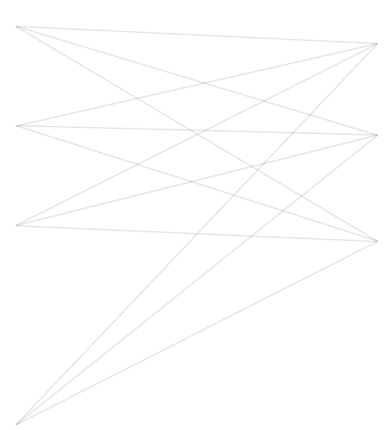
Inputs
Neurons
Neurons
1
1
1
z₁=15
Class 1
Y₁=1
2
2
2
z₂=-0.5
Class 2
Y₂=0
3
3
3
z₃=7.99
Class 3
Y₃=0
.
.
.
.
.
.
.
.
.
k
k
‘logits’
labeled output y_{j}
Y
Input pixels
Previous layer
Last layer
without softmax activation
X
P
Z = f(X, P)
Predicting
dP = a*K
dE/dP = df/dP = K
E = Y-Z
Back-propagation

