Slide 1
Neurons
Neurons
1
0.5 | =yes
w₁
1
-2.25 | =no
w₂
2
-15 | =no
.
.
.
‘logits’
w₃
0 | =blank
w_{k}
3
.
.
.
-7.35 | =no
k
output
weights
Layer n-1
Layer n
A neural network could be considered as a multi-voting system which each each neuron takes votes from previous’ layer’s neurons or from the inputs.
Each neuron gives their anwser (or their vote) on a specific feature, for example gradient of a pixel, saturation of a pixel in the very first layer .. or even very abstract features in deep layer.
Normally, outputs of neurons in the last layer is called ‘logits’. In abusive language, we could also call neuron’s output as logit. Neuron’s logit is very similar to a fuzzy logic output. So, what logit stands for ?
_logit ~ 0 : white vote or blank vote, aka. ‘no comment’
_logit >> 0 : Yes answer, higher the logit the neuron is more sure about its ‘YES’ conclusion
_logit << 0 : No answer, lower the logit the neuron is more sure about its ‘NO’ conclusion

Slide 2
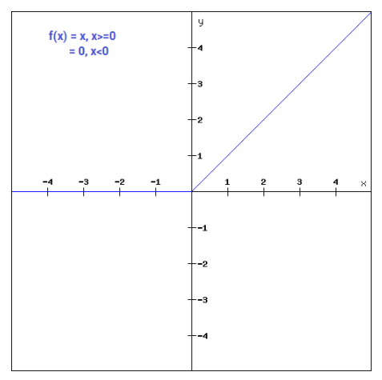
f(x)=max(0,x)
Source: https://www.analyticsvidhya.com/blog/2020/01/fundamentals-deep-learning-activation-functions-when-to-use-them/
The ReLU activation function is widely used in deep learning. ReLU get passed ‘YES’ anwser of a neuron and neutralize other types of anwser.
ReLU help the Model to have :
xNon linear behaviour
xMulti-classes classification capacity
xFaster convergence, aka. ease the back-propagation in training phase

Slide 3
Neurons
Neurons
Neurons
Neurons
1
yes
1
1
yes
yes
1
w₁
no
yes
no
blank
2
w₂
.
.
.
2
no
.
.
.
blank
3
blank
w₃
3
blank
.
.
.
.
.
.
blank
w_{k}
no
no
k
k
output
weights
Layer n-1
Layer n
Layer n-1
Layer n
without activation
ReLU activation

Slide 4
Neurons
Neurons
1
1
z₁=15
Belong to class 1 : yes
2
2
z₂=-0.5
Belong to class 2 : no
3
3
z₃=7.99
Belong to class 3 : yes
.
.
.
‘logits’
k
Previous layer
Last layer
without softmax activation

Slide 5
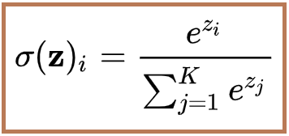
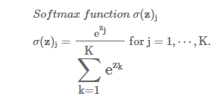
Neurons
Neurons
1
1
z₁=15
0.9530
Belong to class 1 with 95.3% of probability
2
2
z₂=-0.5
1.7682E-7
Belong to class 2 with 0.17E-4% of probability
3
3
z₃=11.99
0.0469
Belong to class 2 with 4.69% of probability
.
.
.
k
‘logits’
Previous layer
Last layer
Softmax activation
Source https://keisan.casio.com/exec/system/15168444286206

Slide 6
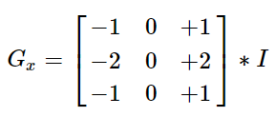
Define threshold
Sobel operator with kernel size = (3,3) to calculate derivative in x-direction
Source: https://docs.opencv.org/3.4/d2/d2c/tutorial_sobel_derivatives.html

