Slide 1
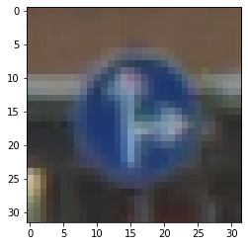
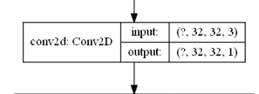
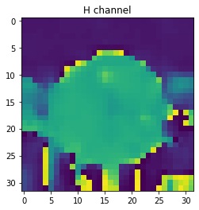
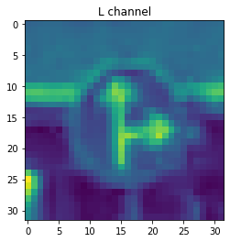
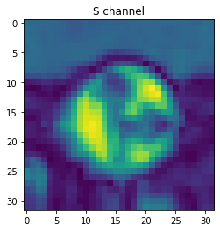

RGB color-space
HLS color-space
Convolutional filter of size(1,1) and stride(1,1)

Slide 2

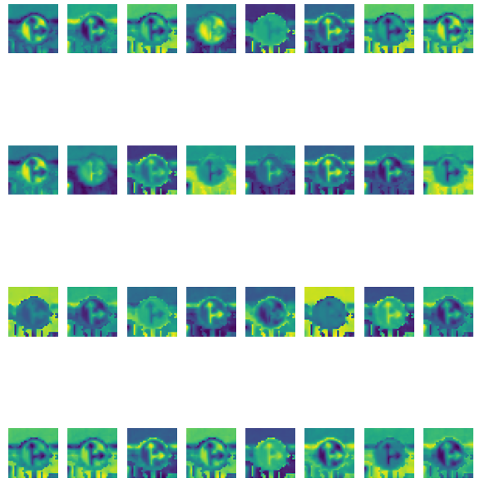
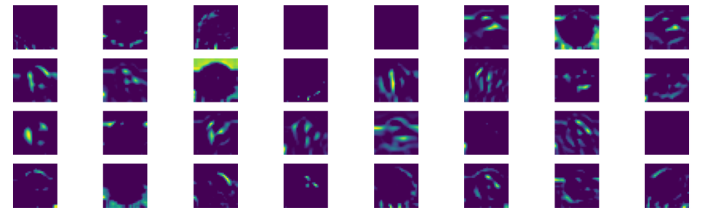
Input
Layer 1
Layer 2

Slide 3
Epoch 30/30
1087/1087 - 66s 61ms/step - loss: 0.0592 - accuracy: 0.9829 - val_loss: 0.1186 - val_accuracy: 0.9719 LeNet improved
Epoch 30/30
1087/1087 - 82s 76ms/step - loss: 0.0415 - accuracy: 0.9942 - val_loss: 1.4781 - val_accuracy: 0.9347 LeNet improved with HLS input
Epoch 30/30
543/543 - 65s 120ms/step - loss: 0.0157 - accuracy: 0.9961 - val_loss: 0.2782 - val_accuracy: 0.9535 LeNet improved with HLS input ft. Convolutional fiter 1x1
Prediction accuracy on test dataset
loss: 0.2170 - accuracy: 0.9547
Prediction accuracy on test dataset
loss: 1.0133 - accuracy: 0.9397
Prediction accuracy on test dataset
loss: 19.5847 - accuracy: 0.4000

