Slide 1
VLU Post-Grad Board Pitch 2026
Family Academy · Healthcare Leadership MBA · Lifelong Membership
Research by NA · 2026-05-21
VLU Post-Grad Research R3 · Research by NA
1

Slide 2
Executive Summary
Commit to triple-stack: Family Academy as wedge, Healthcare MBA as anchor, Membership as halo.
Use $15k/$20k/$35k Family Academy pricing for Cohort 1, with $20k/$30k/$50k reserved for post-proof scale.
Board ask: approve Y0 capability build with pre-sell gates, not a public launch promise.
VLU Post-Grad Research R3 · Research by NA
2

Slide 3
Why Now
AI reduces the value of generic lectures; judgment, network and applied proof become premium.
Vietnam post-grad demand is still protected demographically for 10-15 years.
Family succession and healthcare management are urgent operating pains, not abstract education categories.
VLU Post-Grad Research R3 · Research by NA
3

Slide 4
Market Opportunity
Family businesses need succession structures; VN has no dedicated master-grade program.
Healthcare chains and pharma operators need managers who understand both clinical and business systems.
Mid-career learners want format flexibility without losing peer depth.
VLU Post-Grad Research R3 · Research by NA
4

Slide 5
Post-Grad Selling Strategy
Sell | Use for | VLU proof
Career transition | Healthcare leadership moves | Capstone ROI + employer sponsorship
Career fast-track | Time-poor executives | 12-month/6-day-month calendar
Global network | Premium signal and vocabulary | ASEAN immersion + visiting faculty
Local peer network | Family heirs and operators | Selective confidential cohort
Applied transformation | Anti-theory objection | Family/hospital transformation project
VLU Post-Grad Research R3 · Research by NA
5

Slide 6
Competitive Landscape
VLU should create Group 5 instead of fighting existing groups.
Group | Players | Owned position | VLU response
Public prestige | UEH / NEU / FTU | Affordable degree + alumni scale | Do not price-fight
Foreign premium | RMIT | Australian credential | Out-specialize
Policy elite | Fulbright | Policy leadership | Avoid policy lane
Flexible private | FSB | Corporate convenience | Build deeper vertical proof
Group 5 | VLU | Niche premium applied verticals | Own Family + Healthcare
VLU Post-Grad Research R3 · Research by NA
6

Slide 7
Lessons From 6 Markets
Market | Steal | Do not copy
China | Network-as-product | Billionaire/status claims without proof
Australia | Fast-track + capstone | PR-pathway revenue logic
India | SPJIMR 6-day/month; ISB one-year | Placement promise for Family Academy
Singapore | Brand stack discipline | Global mobility claims VLU cannot prove
Malaysia | Private mid-tier affordability | Online-only commodity MBA
Indonesia | Family business peer-market play | Loose executive-ed without credential path
VLU Post-Grad Research R3 · Research by NA
7

Slide 8
The Triple-Stack
Wedge + Anchor + Halo
Family Academy builds distinct category ownership.
Healthcare MBA scales with VLU's real Y + Business + Design capability.
Membership compounds alumni, data and short-course revenue.
VLU Post-Grad Research R3 · Research by NA
8

Slide 9
Family Academy
Primary wedge
Target gen-2/3 successors and gen-1 sponsors.
15-month modular: 6 days/month, no placement service.
Capstone: Family Constitution + succession roadmap + growth initiative.
VLU Post-Grad Research R3 · Research by NA
9

Slide 10
Healthcare MBA
Portfolio anchor
12-month intensive + 3-month live-client capstone.
Hospital/pharma/MedTech cohort; $12k/$18k/$30k pricing.
Proof requires named partner projects, not generic cases.
VLU Post-Grad Research R3 · Research by NA
10

Slide 11
Lifelong Membership
Network halo
Embed alumni access in tuition; upsell annual membership.
Use off-shelf AI tools first; custom platform only after demand proof.
Annual reports create data moat and acquisition engine.
VLU Post-Grad Research R3 · Research by NA
11

Slide 12
Family Academy Positioning
Vietnam's school of choice for family-business successors.
Buyer is often gen-1 founder; user is gen-2 heir.
Confidential peer cohort is the product, curriculum is the delivery system.
VLU Post-Grad Research R3 · Research by NA
12

Slide 13
Family Academy Format
6 days/month copied from SPJIMR logic.
15 months: 12 months modules + 3 months capstone/advisory.
Cohort 20-25 first year to protect intimacy and selection.
VLU Post-Grad Research R3 · Research by NA
13

Slide 14
Family Academy Pricing
Mary's lean: $15k Good, $20k Better, $35k Best.
Original $12k entry risks weak premium signal.
Parity $20k/$30k/$50k only after Cohort 2 proof and advisory board credibility.
VLU Post-Grad Research R3 · Research by NA
14

Slide 15
Family Academy Financials
Y1 revenue: $330k; Y3 revenue: $1.5M.
Y0 budget should be gate-based: legal, director, advisory board, pre-sell.
Breakout depends on annual State of VN Family Business report.
VLU Post-Grad Research R3 · Research by NA
15

Slide 16
Family Academy 12-Month Rollout
M1-M3: capability/legal audit + founder dinners.
M4-M6: pricing test, director, curriculum.
M7-M12: recruit, partner, publish, Board launch checkpoint.
VLU Post-Grad Research R3 · Research by NA
16

Slide 17
Healthcare MBA Positioning
Not a generic MBA with healthcare electives.
A management program for people operating hospitals, pharma, MedTech and insurance.
VLU's Y + Business + Design combination is the capability moat.
VLU Post-Grad Research R3 · Research by NA
17

Slide 18
Healthcare MBA Format
12-month fast-track plus 3-month capstone beats 18-month friction.
65% VLU campus, 35% hospital/partner site.
Faculty mix: 40% academic, 60% practitioner.
VLU Post-Grad Research R3 · Research by NA
18

Slide 19
Healthcare MBA Financials
Y1 revenue: $450k; Y3 revenue: $2.04M.
Needs 8 partner LOIs before launch.
Capstone outcomes become the placement-equivalent proof point.
VLU Post-Grad Research R3 · Research by NA
19

Slide 20
Defensibility Framework
Program | Network | Capability | Switching | Brand | Data | Total
Family Academy | 5 | 4 | 4 | 5 | 4 | 22/25
Healthcare MBA | 4 | 5 | 4 | 4 | 4 | 21/25
Membership | 5 | 3 | 4 | 3 | 4 | 19/25
VLU Post-Grad Research R3 · Research by NA
20

Slide 21
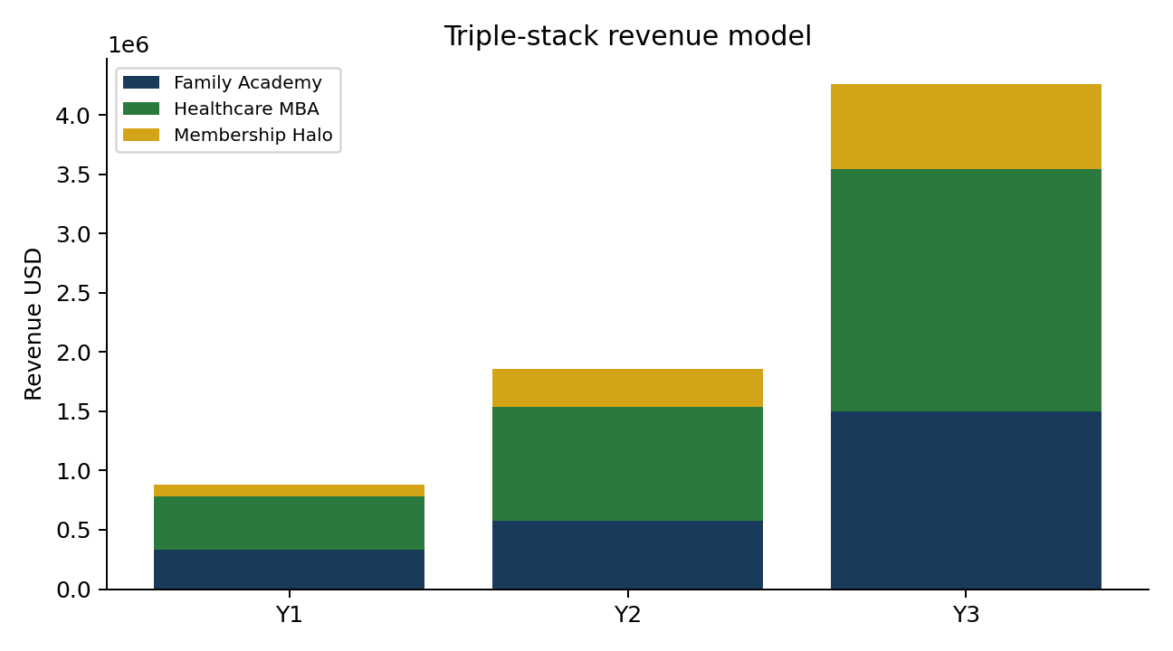
3-Year P&L
VLU Post-Grad Research R3 · Research by NA
21

Slide 22
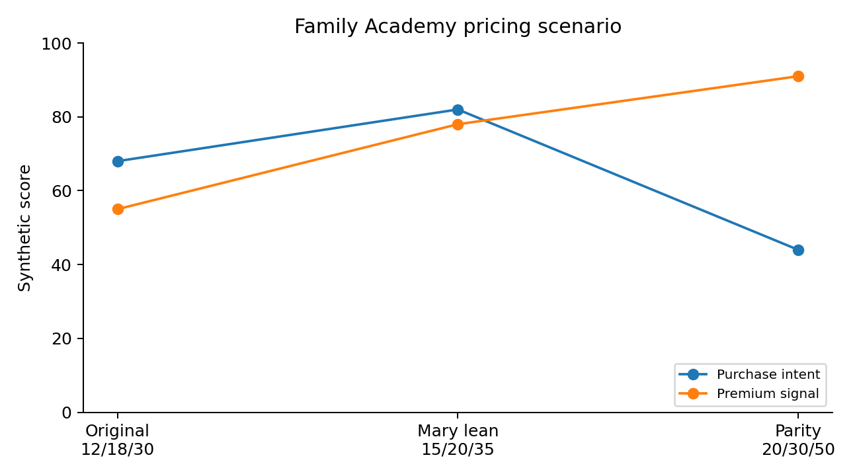
Pricing Recommendation
VLU Post-Grad Research R3 · Research by NA
22

Slide 23
Risks + Mitigations
Risk | Mitigation
Demand not payment-ready | 10-deposit pre-sell gate before public launch
No credible director | External hire or interim advisory chair before launch
Weak capstone supply | Named partner LOIs with project owners
Regulatory delay | Certificate/executive bridge while degree approval matures
VLU Post-Grad Research R3 · Research by NA
23

Slide 24
12-Month Execution Plan
Phase | Months | Output
Foundation | M1 | Capability audit, legal path, target list
Validation | M2-M4 | Founder dinners, hospital LOIs, pricing test
Build | M5-M7 | Director, curriculum, faculty, report outline
Launch readiness | M8-M12 | Admissions funnel, capstone briefs, Board checkpoint
VLU Post-Grad Research R3 · Research by NA
24

Slide 25
Investment Ask
Approve Y0 capability build, not blind full launch.
Gross Y0 envelope: $150k for director, legal, research center, partner BD.
Required gates: 10 Family Academy deposits/LOIs, 8 healthcare capstone LOIs, advisory board chair.
Decision required: commit VLU to Group 5 niche premium applied verticals.
VLU Post-Grad Research R3 · Research by NA
25

Slide 26
Appendix: 6-Layer Matrix
Excel workbook contains 36-program catalog and heat map.
R2 raw files remain source of full China/Australia/India/Singapore detail.
R3 adds Malaysia/Indonesia and VN competitors.
VLU Post-Grad Research R3 · Research by NA
26

Slide 27
Appendix: Steal-List
SPJIMR modular 6-day/month format.
ISB/IIM one-year fast-track economics.
Research center as publishing engine.
Named live-client capstone as moat.
VLU Post-Grad Research R3 · Research by NA
27

Slide 28
Appendix: Sources
Official program pages and tuition pages are listed in Excel and HTML.
Regulatory sources include MOET Circular 23/2021, Circular 07/2025, Decree 219/2025.
AACSB process and fees from official AACSB pages.
VLU Post-Grad Research R3 · Research by NA
28

