Slide 1
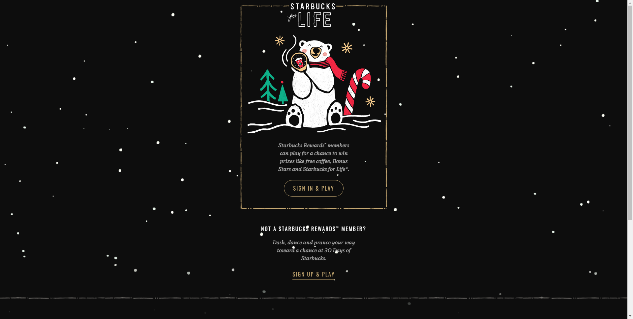
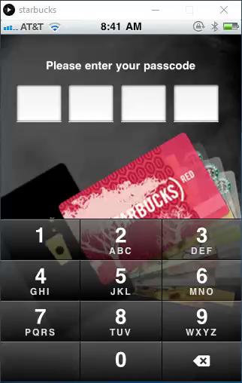
Login
Set Pin
My Card
Add Card
Order
Pay

Slide 2
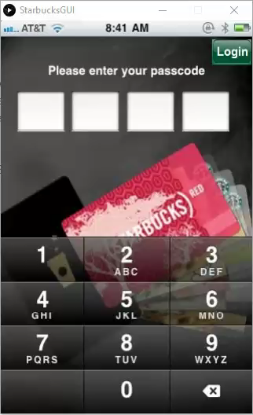
Set
Pin
Mobile App on Processing
Powered by: Mystic Team

Slide 3
My Card

Slide 4
Add Card

Slide 5
Order

Slide 6
Pay

Slide 7
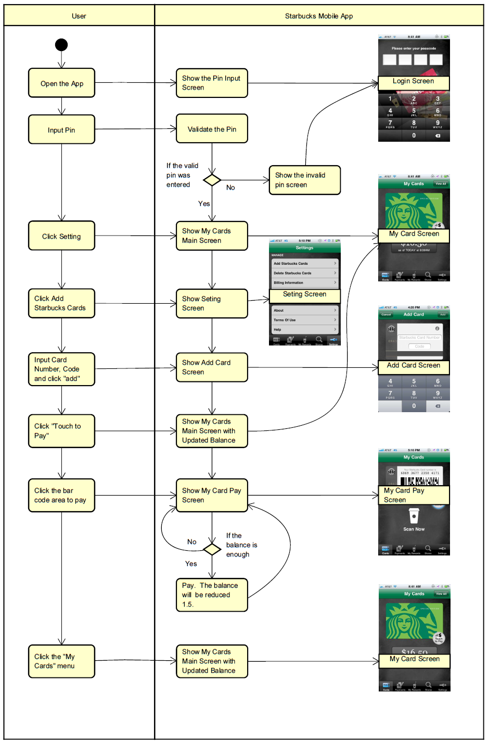
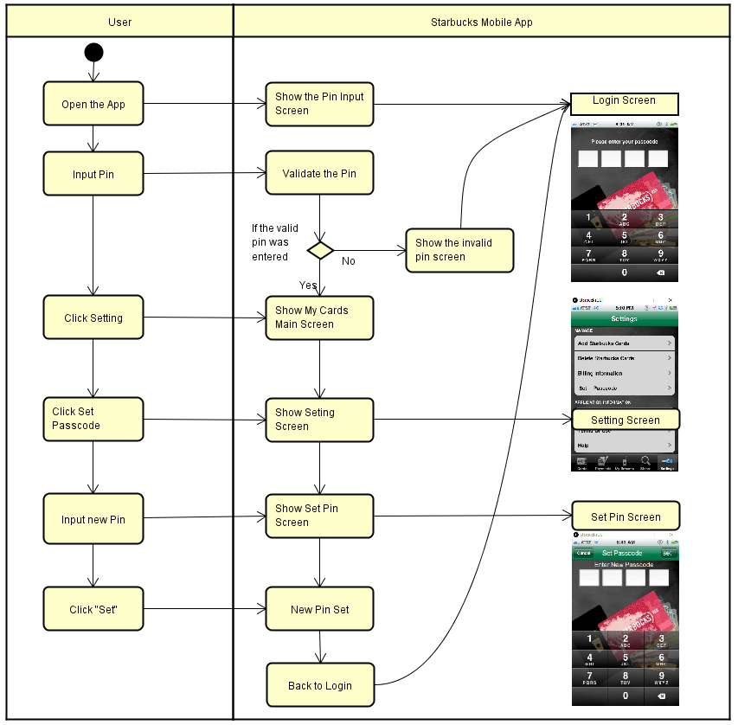

Slide 8
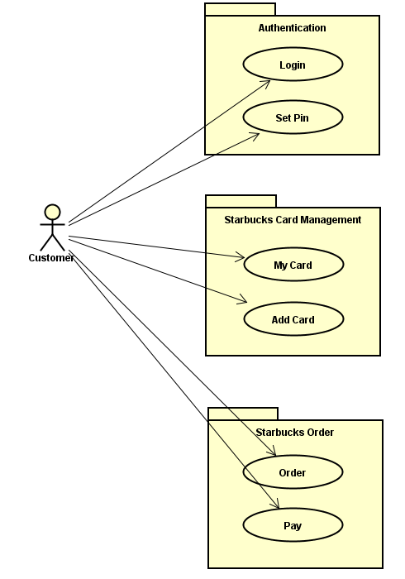
Visitor (system)
Builder (Order)
Command (set pin)
State (set pin)
Decorator (pin screen)
Decorator (set pin)

Slide 9

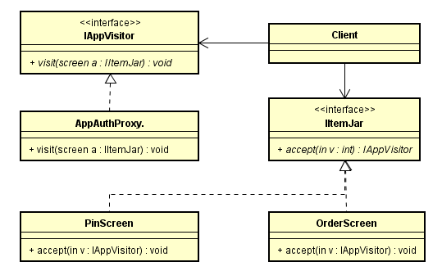


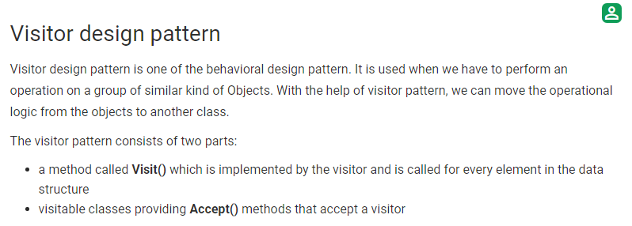

Visitor
(Source: https://www.geeksforgeeks.org/visitor-design-pattern/)

Slide 10
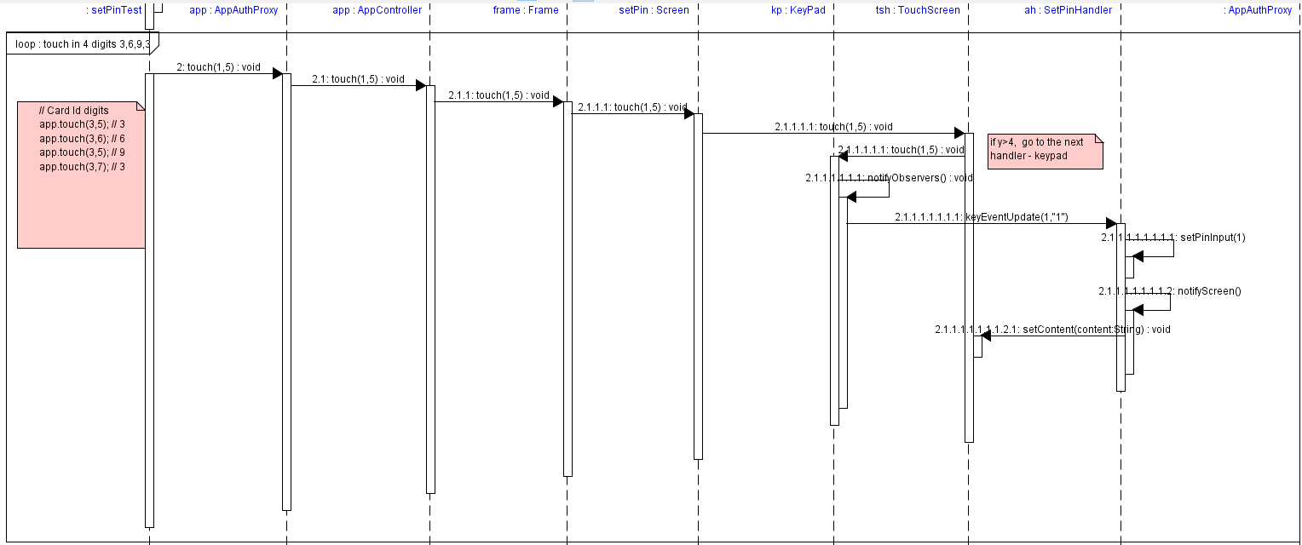
Observer

Slide 11
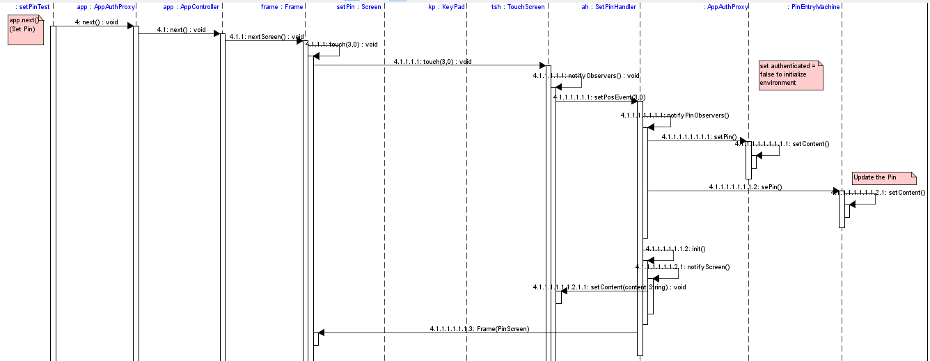
Observer

Slide 12
Thanks!

