Slide 1

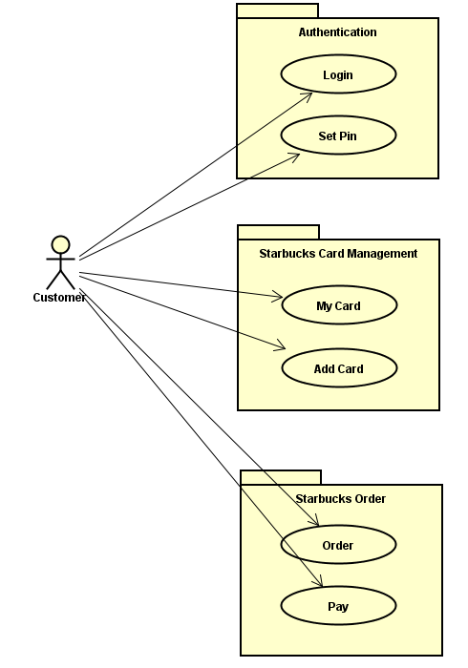
Login
Set Pin
My Card
Add Card
Order
Pay

Slide 2
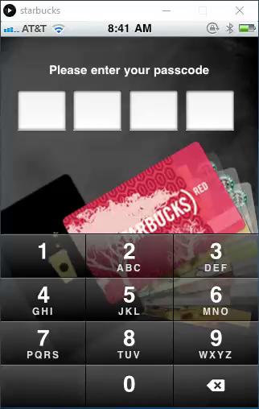
Login
Mobile App on Processing
Powered by: Mystic Team

Slide 3
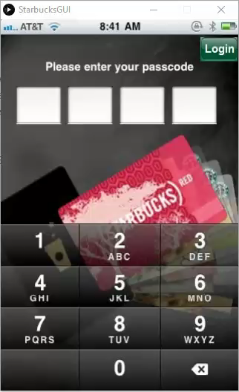
Set
Pin
Mobile App on Processing
Powered by: Mystic Team

Slide 4
My Card

Slide 5
Add Card

Slide 6
Order

Slide 7
Pay

Slide 8
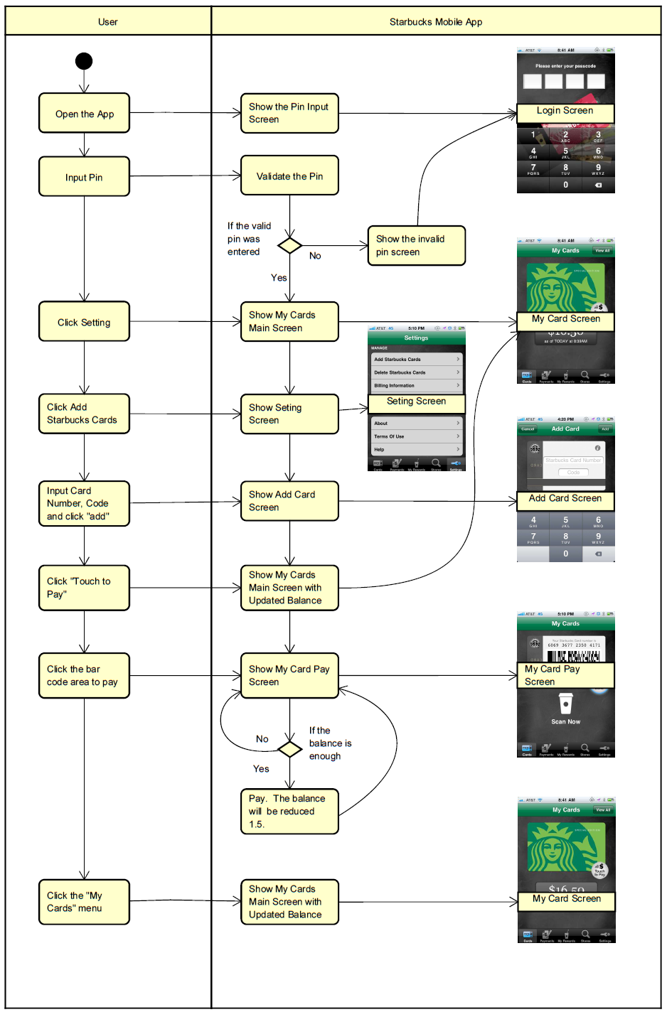
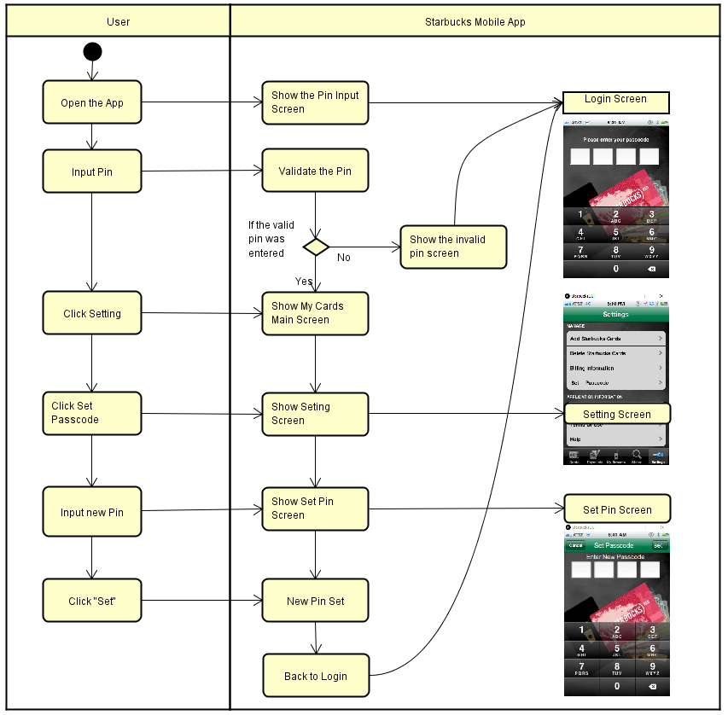

Slide 9
Observer
State
Decorator
Strategy
Command
Visitor
Thanks!

Slide 10
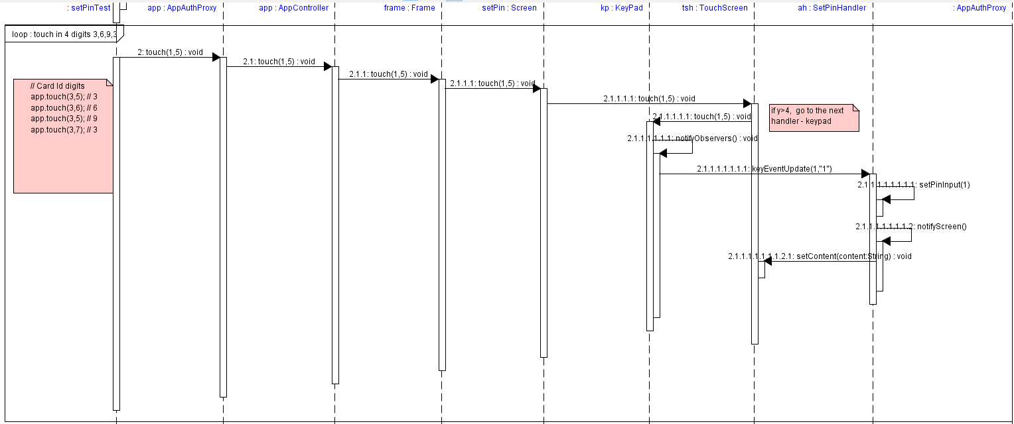
Observer

Slide 11
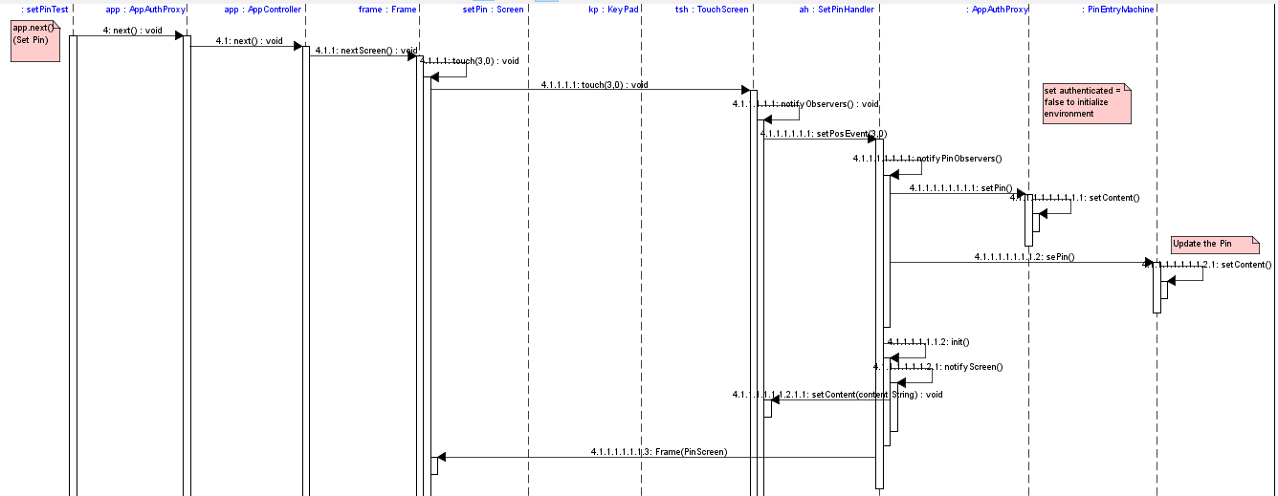
Observer

Slide 12
Thanks!

