Slide 1
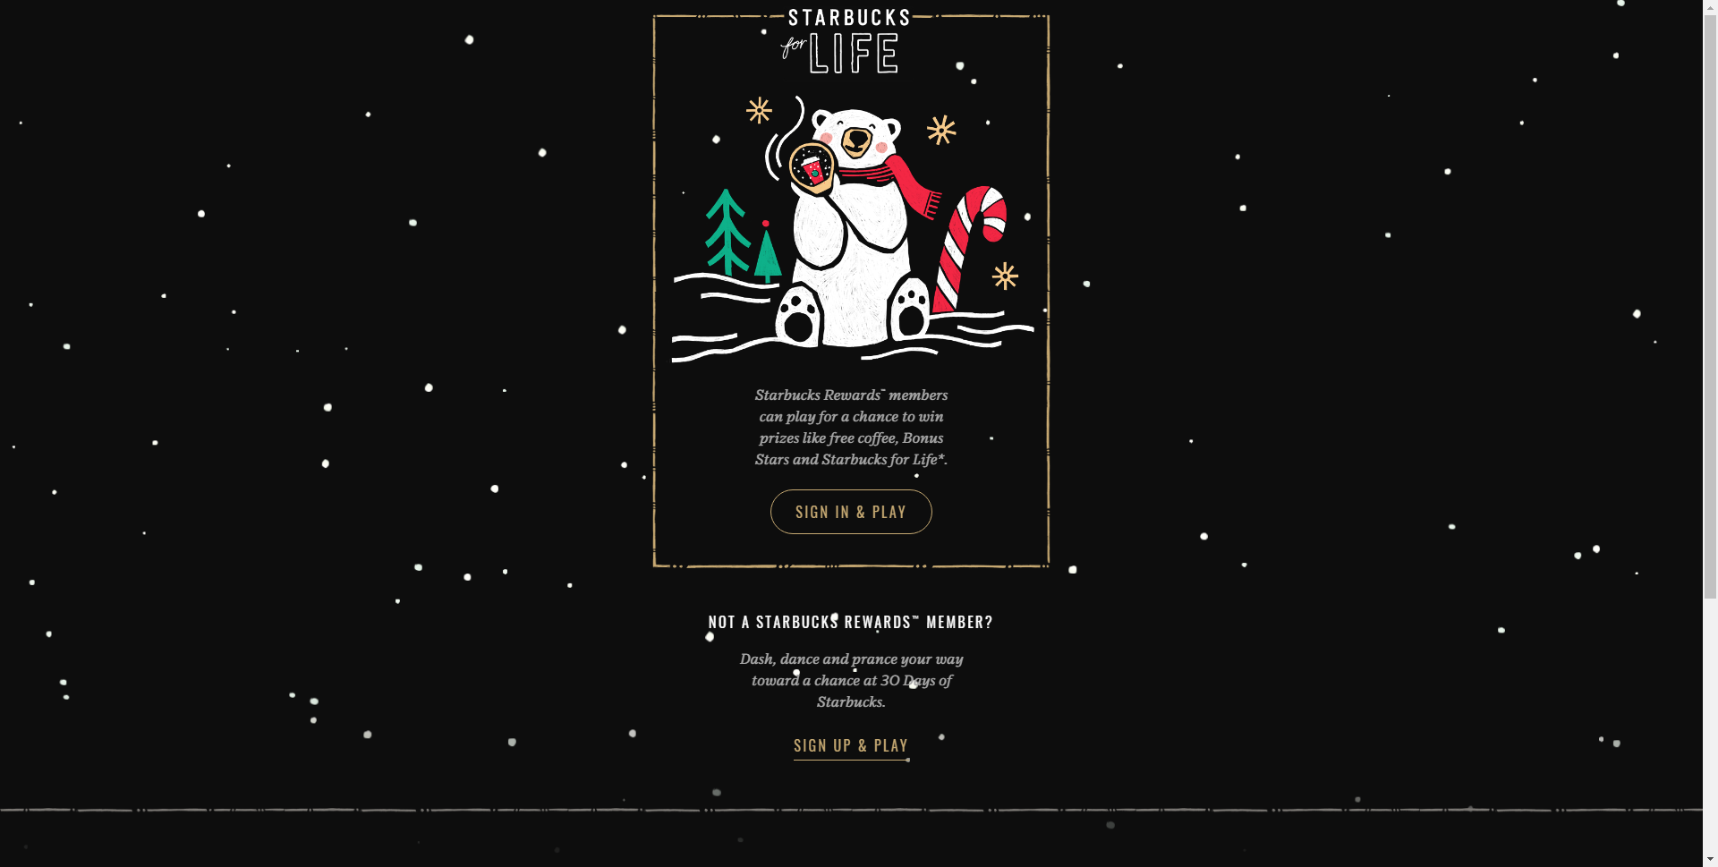
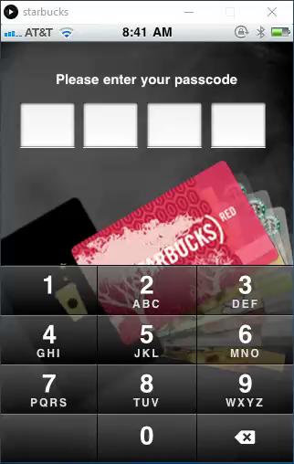
Login
Set Pin
My Card
Add Card
Order
Pay

Slide 2
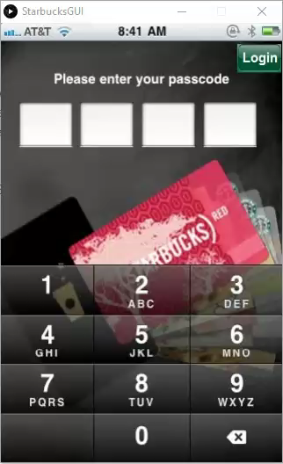
Set
Pin
Mobile App on Processing
Powered by: Mystic Team

Slide 3
My Card

Slide 4
Add Card

Slide 5
Order

Slide 6
Pay

Slide 7
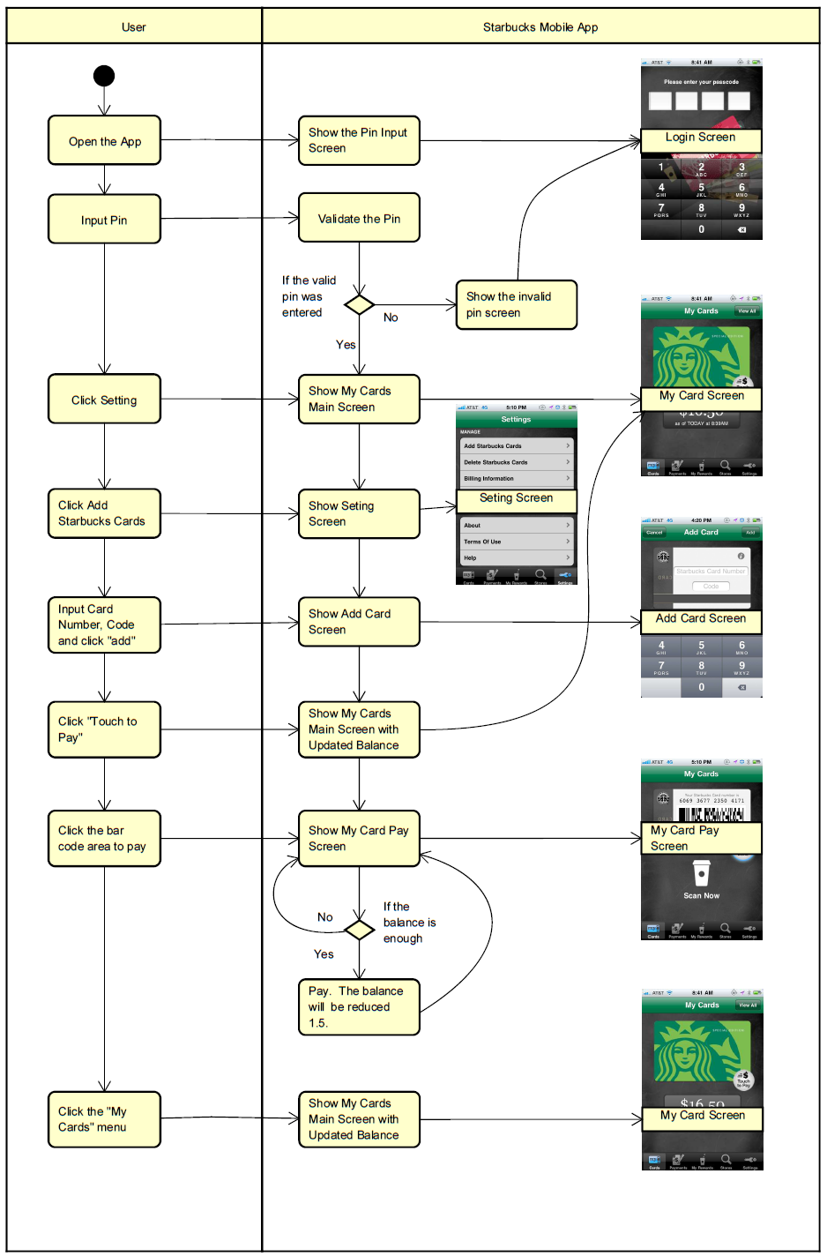
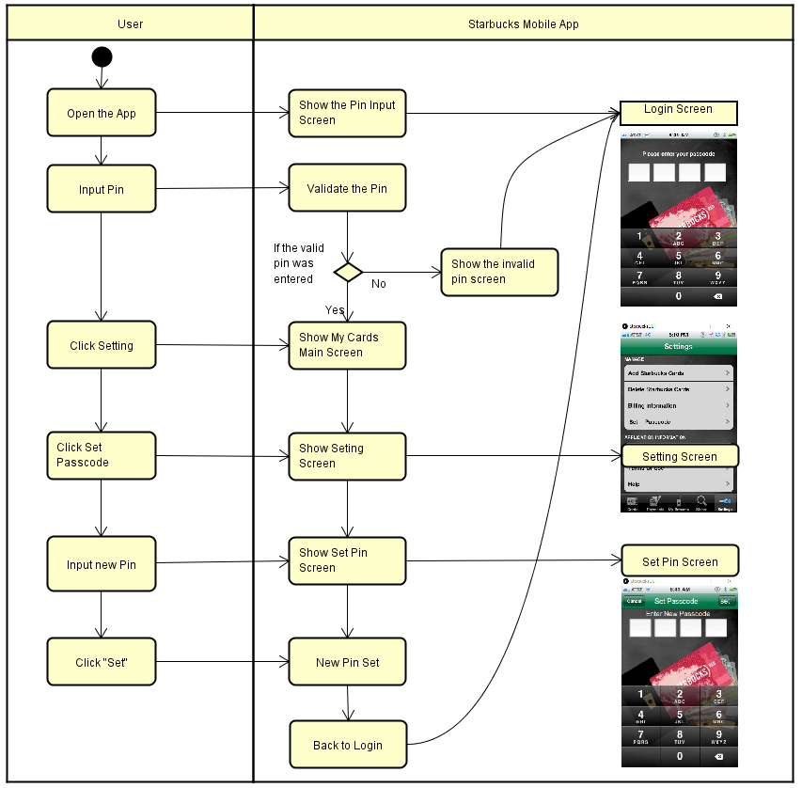

Slide 8
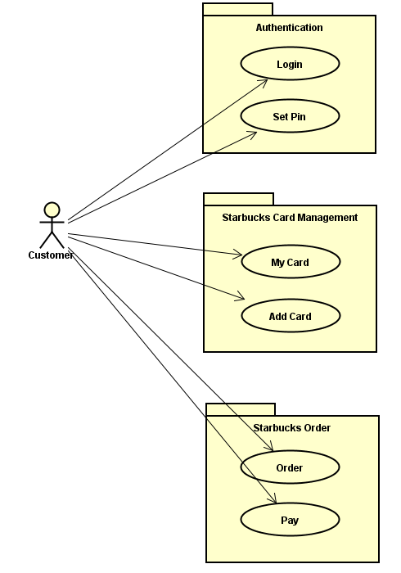
Observer
State
Decorator
Strategy
Command
Visitor

Slide 9
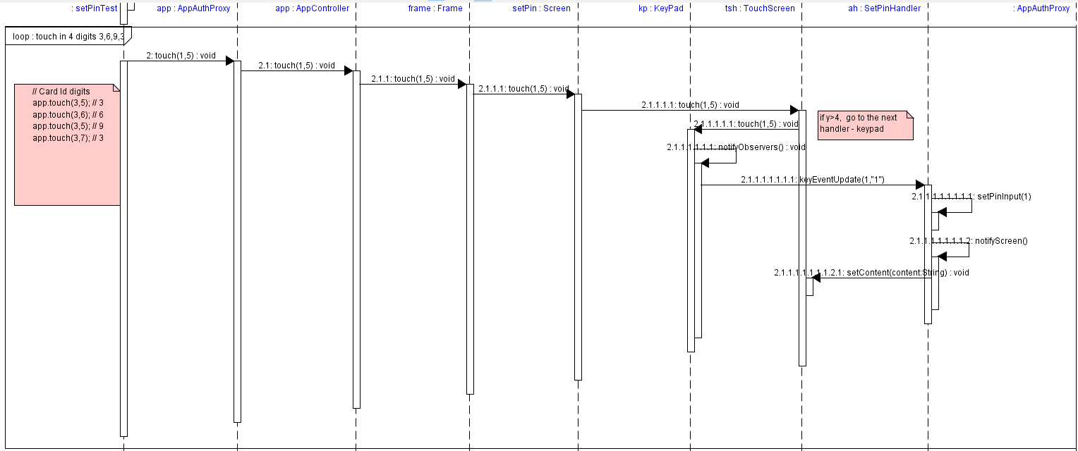
Observer

Slide 10
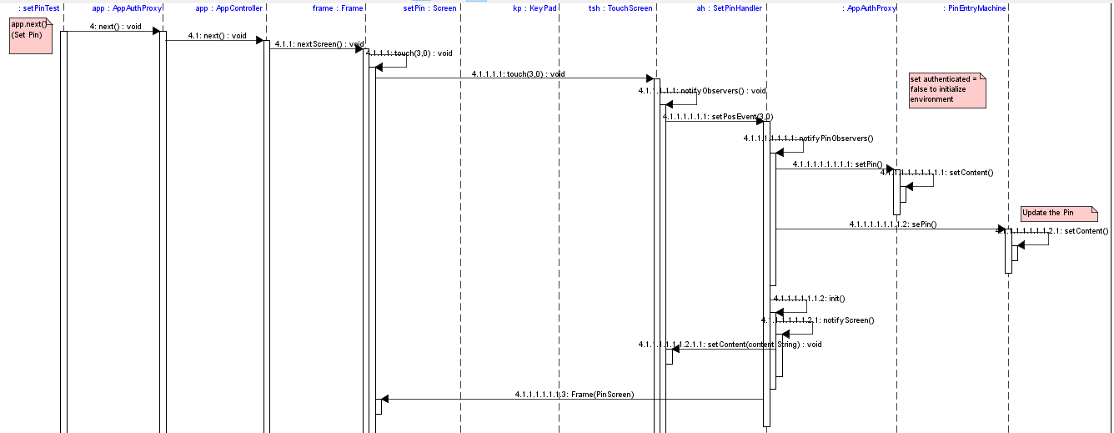
Observer

Slide 11

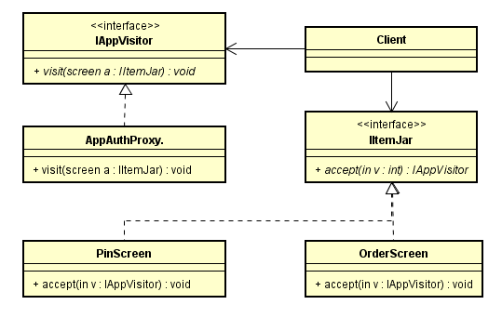


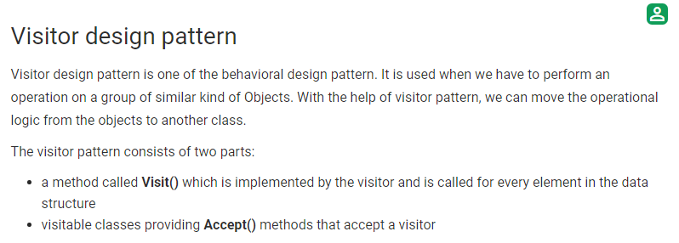

Visitor
(Source: https://www.geeksforgeeks.org/visitor-design-pattern/)

Slide 12
Thanks!

