Slide 1
Online Burger Ordering System
Vrushali Jadhav
Nitish Joshi
Rohan Santosh Kamat
Yicheng Li
Asel Salmenbayeva
Shubham Sawant

Slide 2
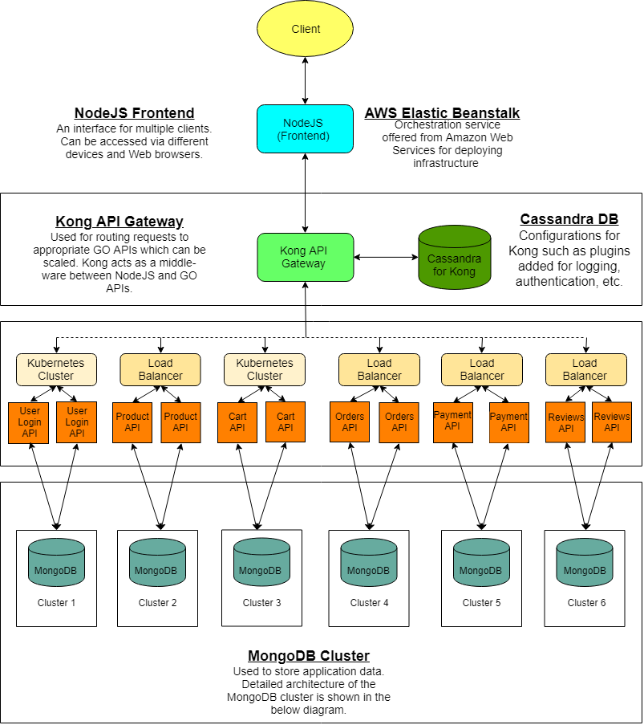
Architecture of the application

Slide 3
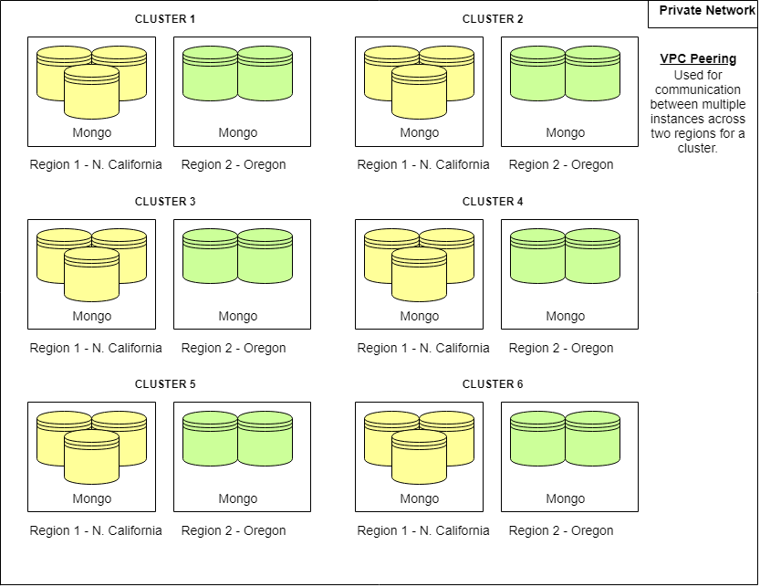
MongoDB architecture

Slide 4
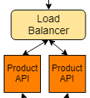
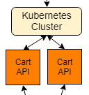
X-Axis Scalability: Horizontal Duplication
Replication
Load Balancing

Slide 5
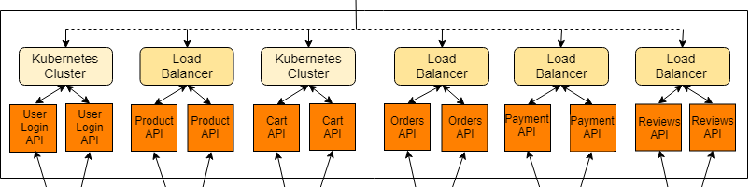
Y-Axis Scalability: Split by Function, Service or Resource
Signup/Sign in API
Products Catalogue API
Cart API
Order API
Payment API
Reviews API

Slide 6
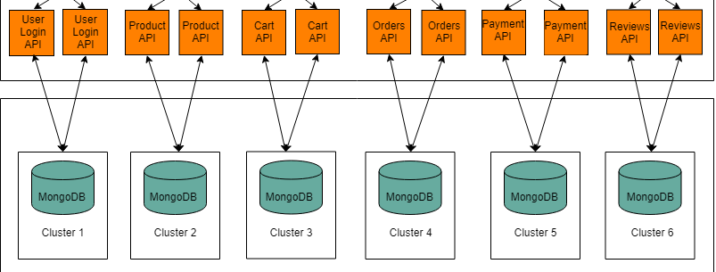
Z-Axis Scalability: Data partitioning
Separate database for each of the GoAPI services
Notes:
http://cmpe281.us-east-2.elasticbeanstalk.com

Slide 7
Technologies used
MongoDB Replica Set
Go API
Docker
Classic Load Balancer
Kong API Gateway
Cassandra for Kong
NodeJS

Slide 8
Additional technologies
VPC Peering Connection
Elastic Beanstalk
Kubernetes NodePort

Slide 9
Network partition
Partition between two MongoDB instances in different regions.
Partition between Go API instances deployed on AWS.

Slide 10
Challenges
High latency in Ohio region
Running MongoDB cluster after restarting instances
Configuring kubernetes load balancer on bitnami server
VPC Peering Configuration

Slide 11
Thank you for your attention!

