Slide 1
Robin Hood 2
CMPE 202 – project team Hydra
Bhushan Geete
Yicheng Li

Slide 2
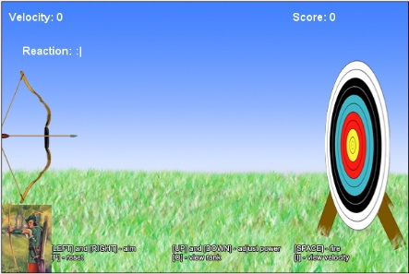
Introduction - Robin hood 2
Music: On

Slide 3
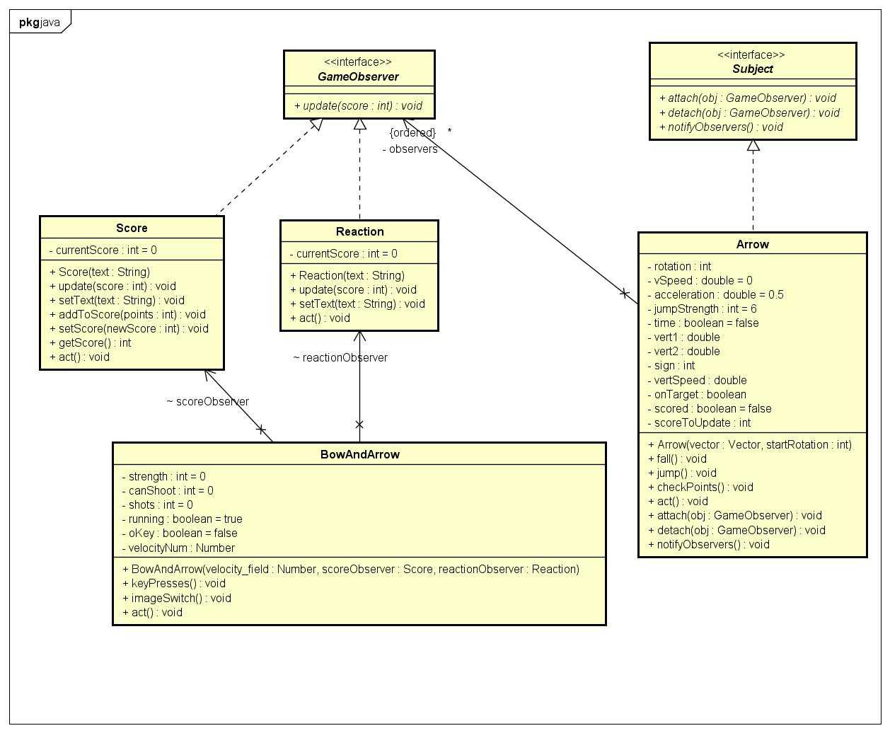
Observer Design Pattern

Slide 4
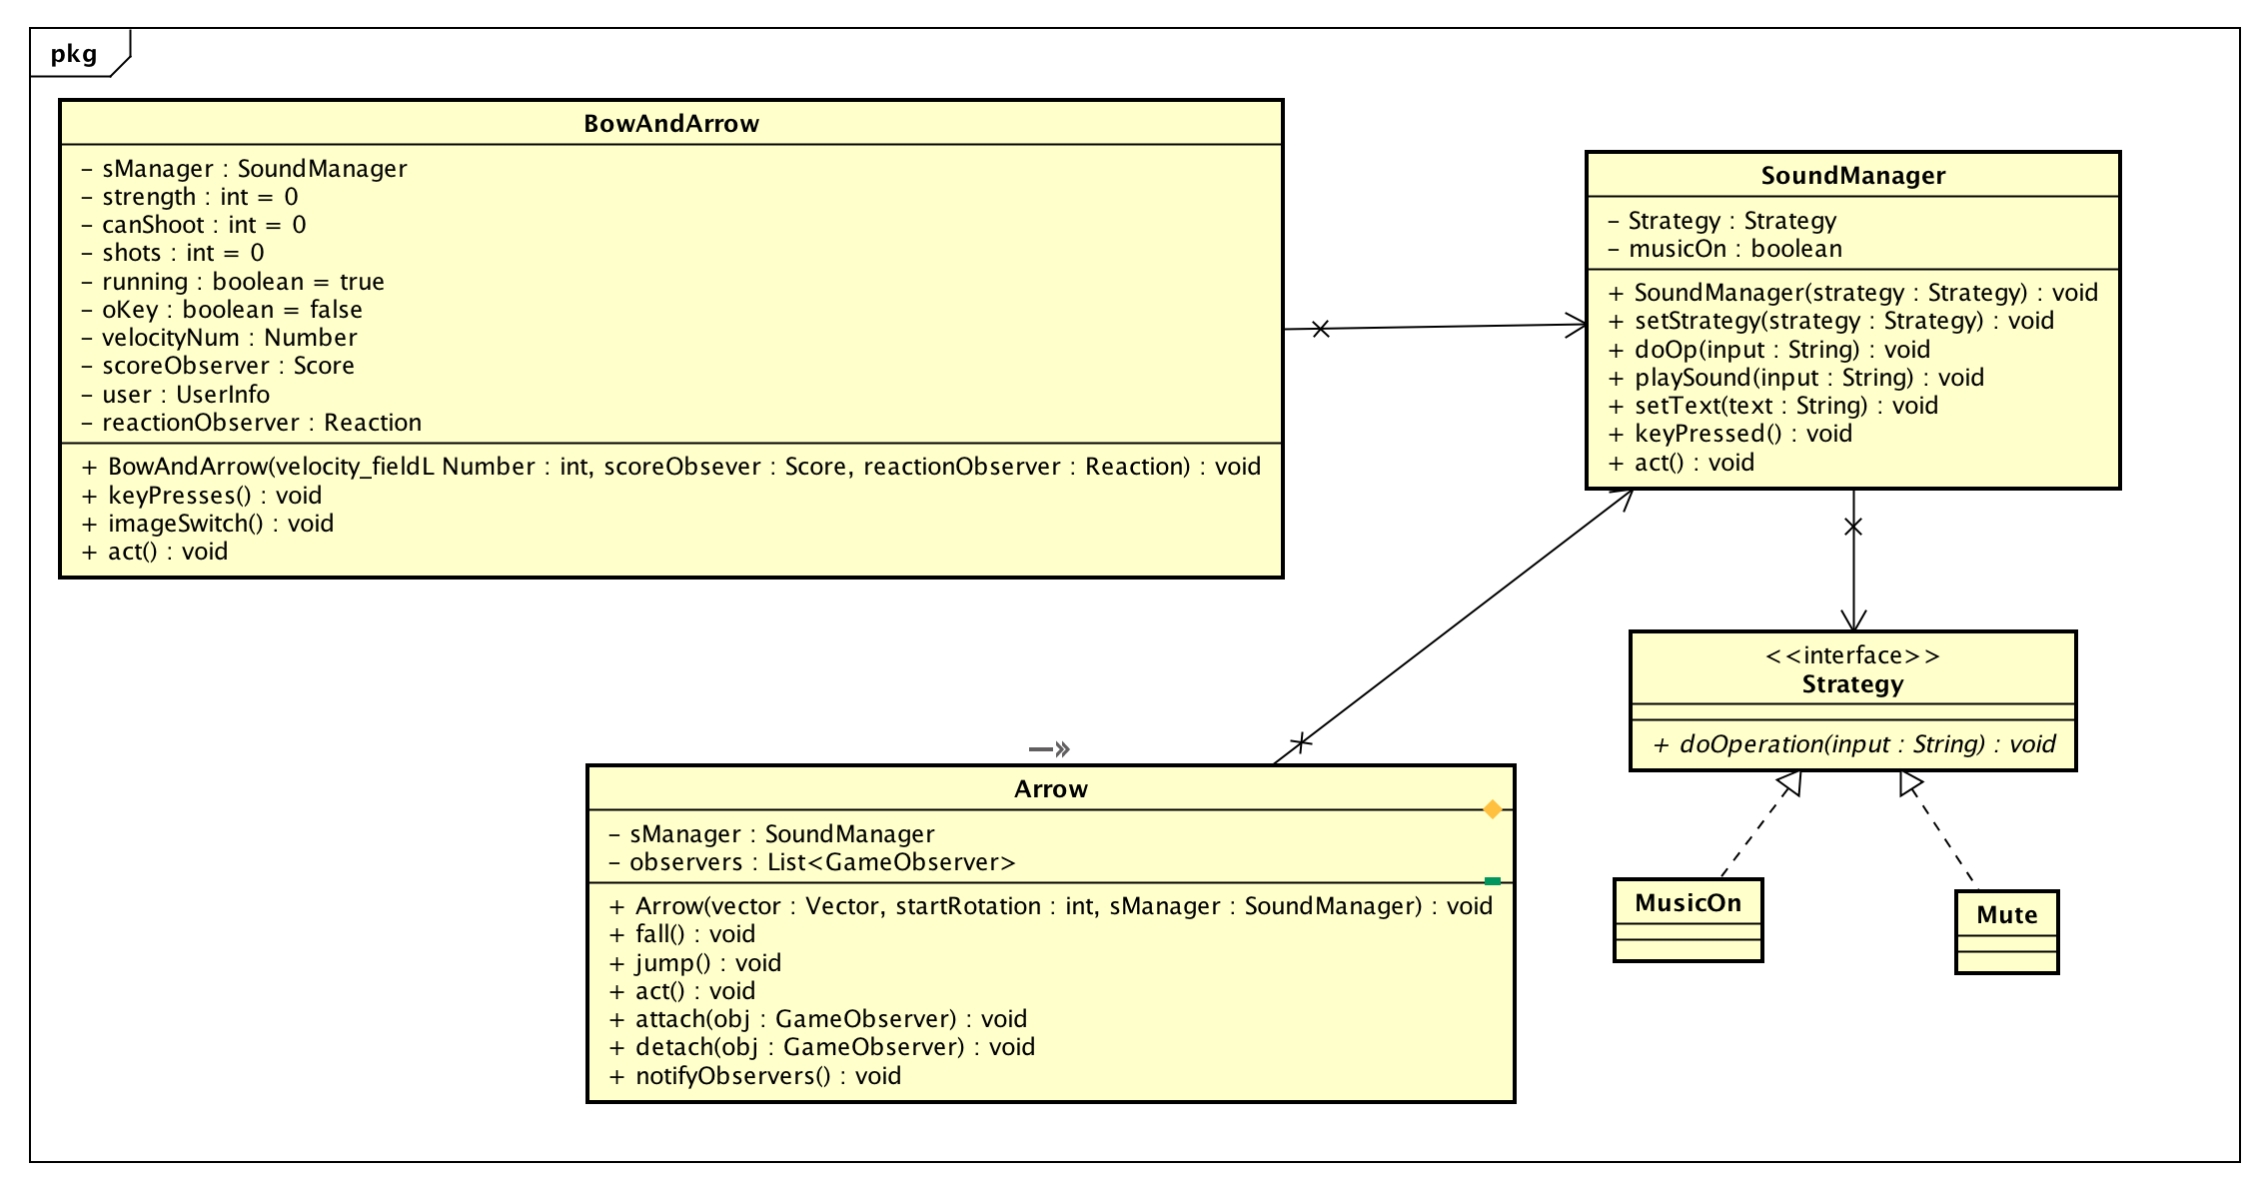
Strategy Design Pattern

Slide 5
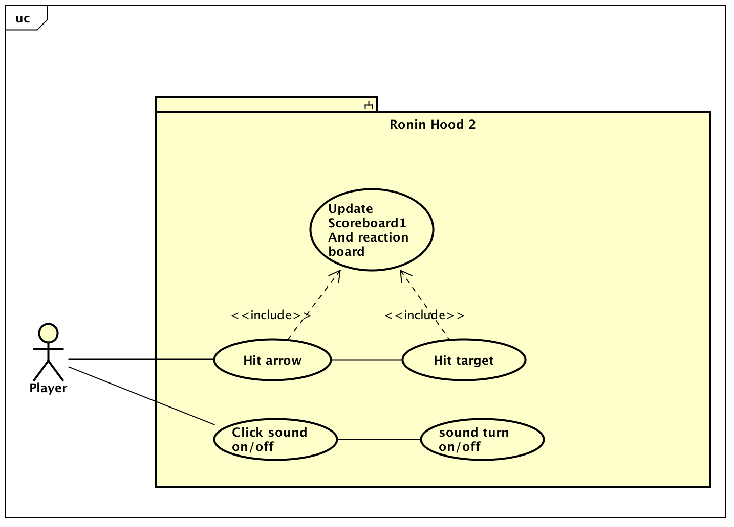
Use case Overview Diagram

Slide 6
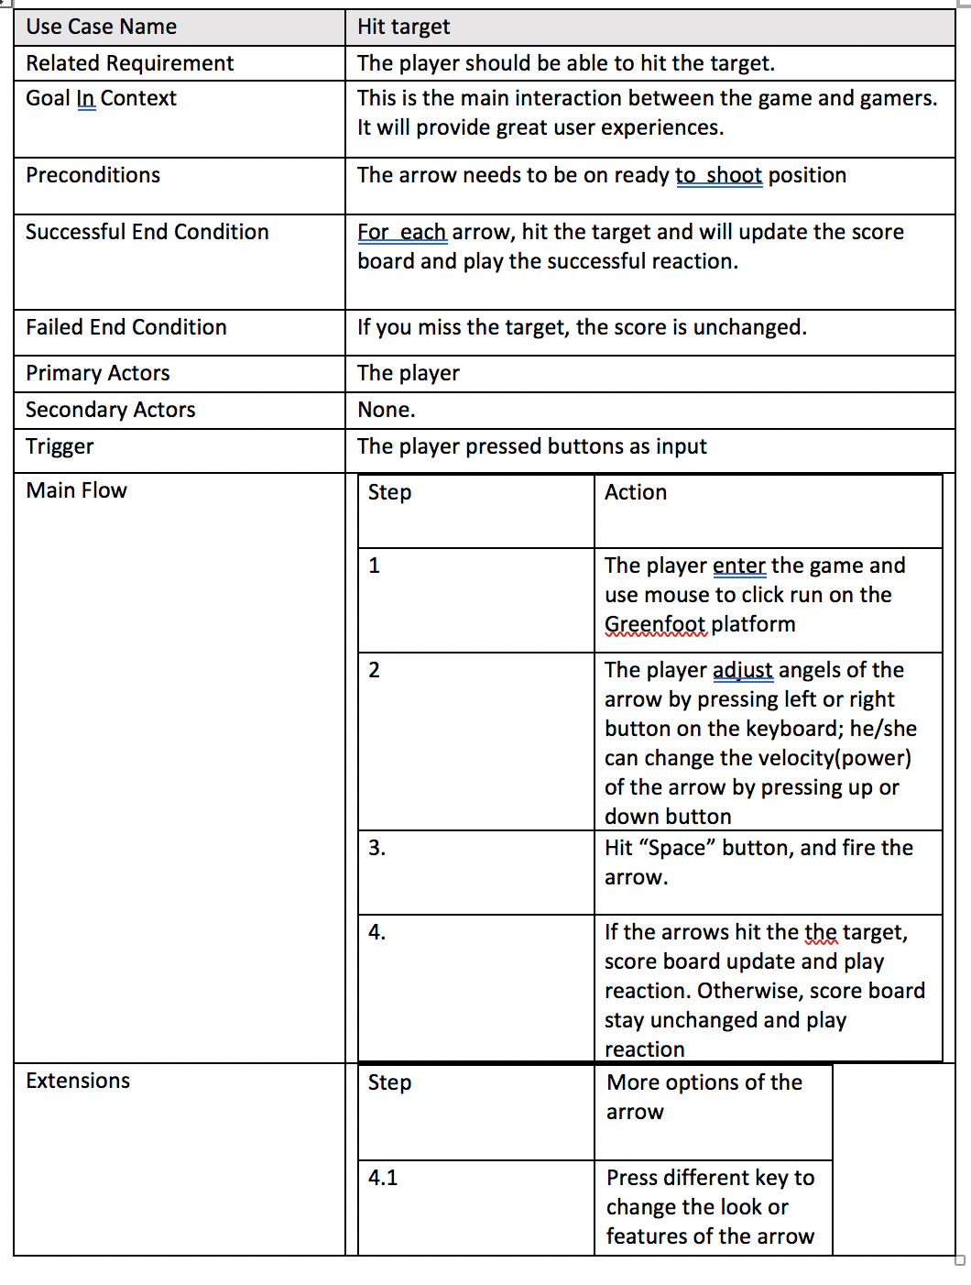
Use Case Specification

Slide 7
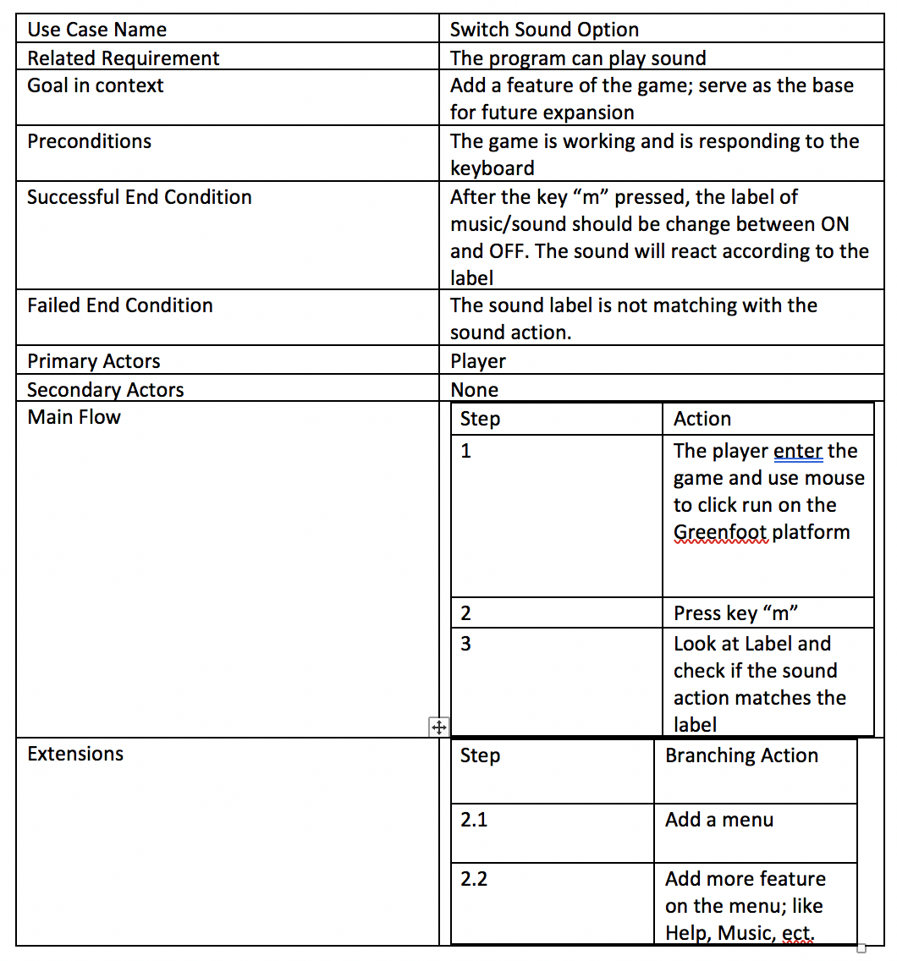
Use Case Specification 2

Slide 8
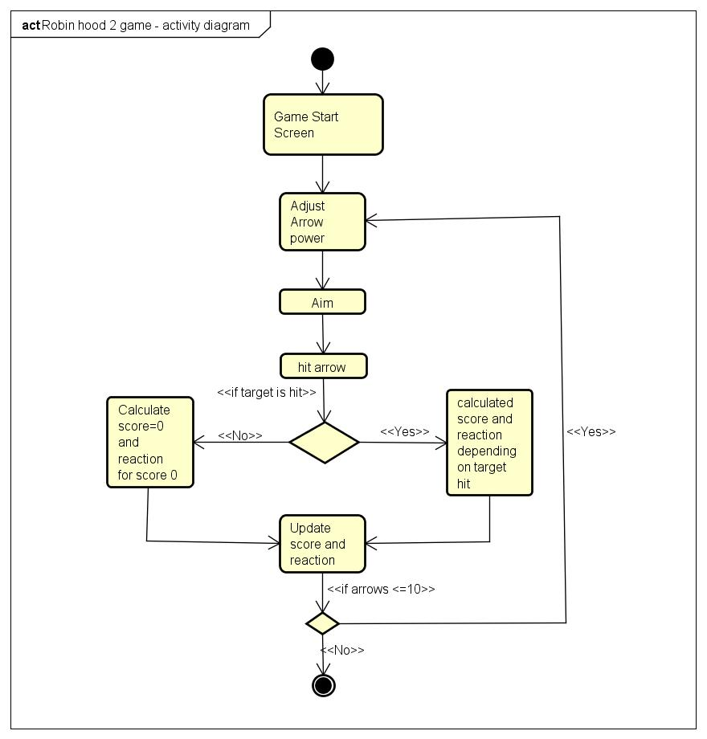
Activity Diagram

Slide 9
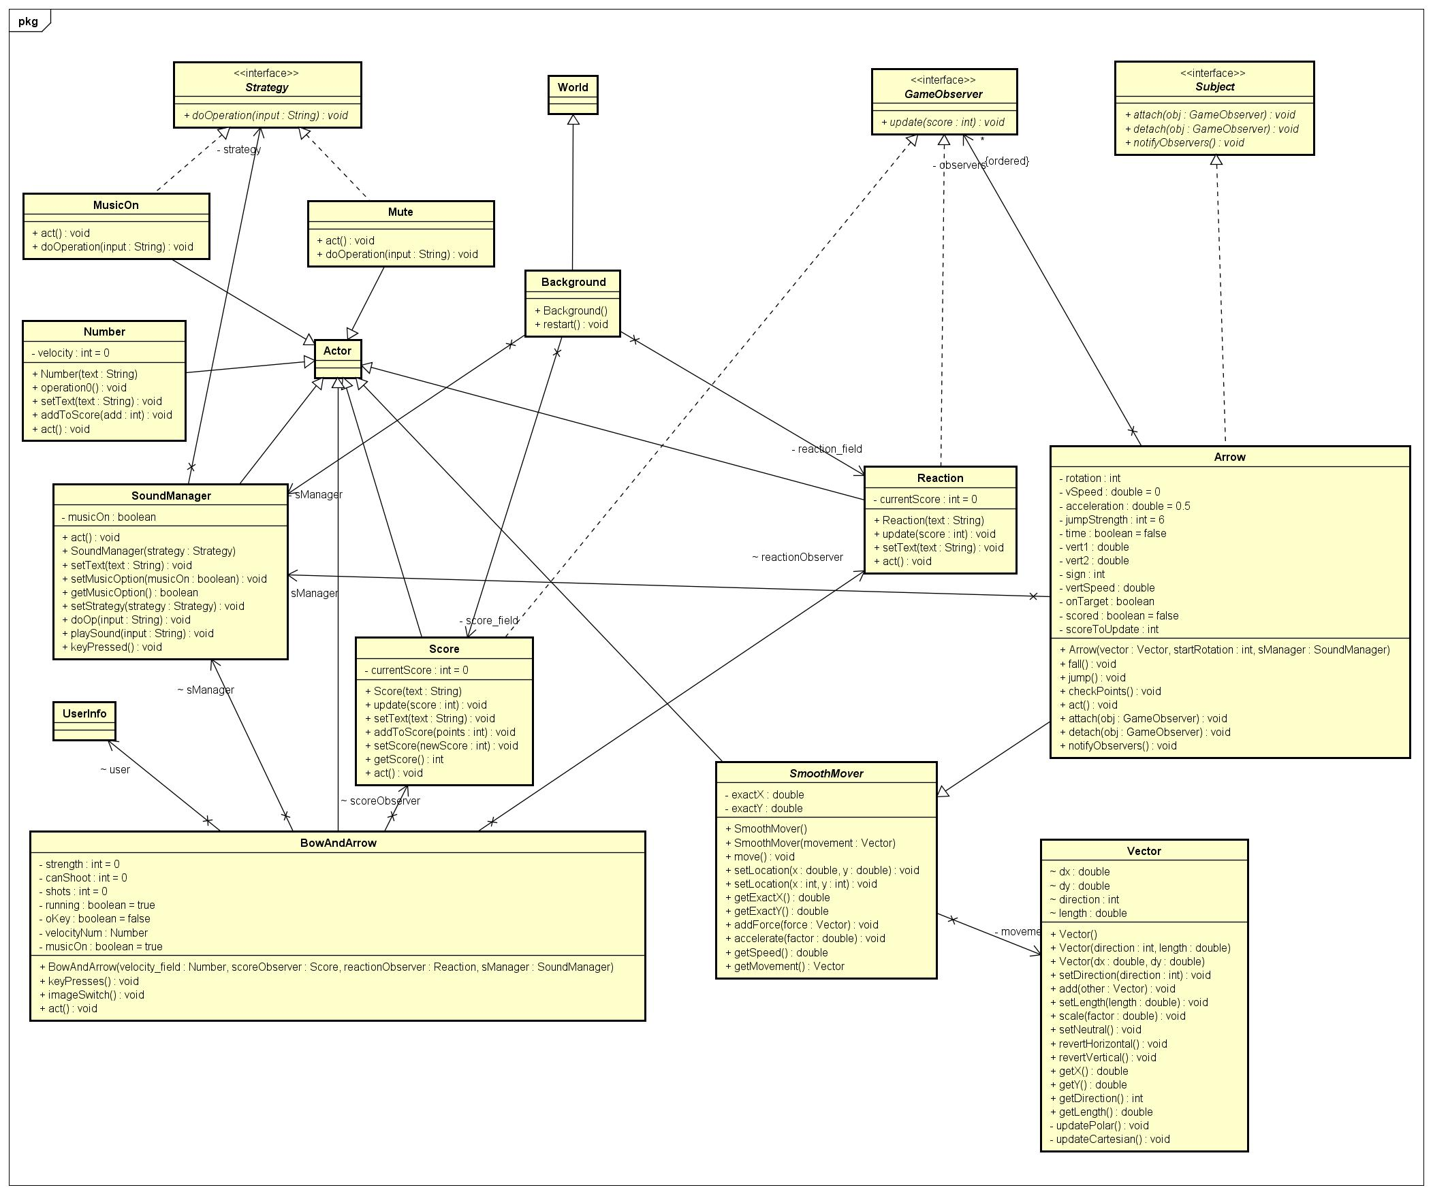
Class diagram

Slide 10
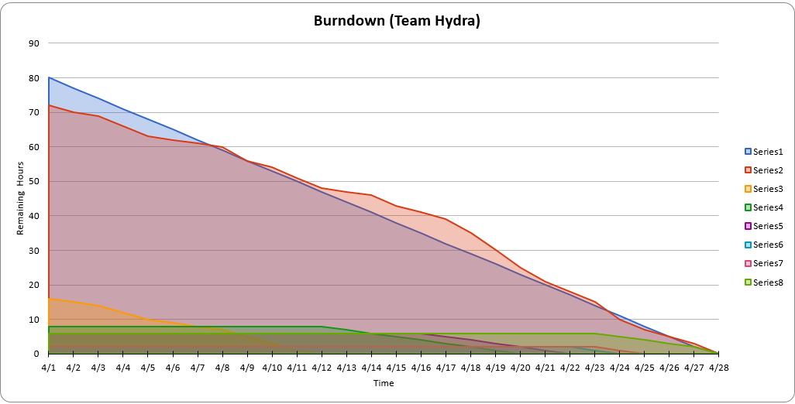
Scrum Burndown chart

Slide 11
Project Retrospective
What was good
Teamwork and collaboration
What was bad
Initial learning curve for small duration.
Ideas
Extend game to add complex type arrow and scoring scheme.
More design patterns and module.

Slide 12
Demo

