Slide 1
Turtle world PRESENTED BY GAME SQUAD
Where we turn GAME IDEAS INTO UNIQUE MASTERPIECES

Slide 2


Contents/ agenda
Team introduction
Uml diagrams
Use case diagram
Accompanied by
Use case specifications
Sequence diagrams
Mockups
Activity diagram
Class diagram
Final scrum board
Demo
Ad video

Slide 3
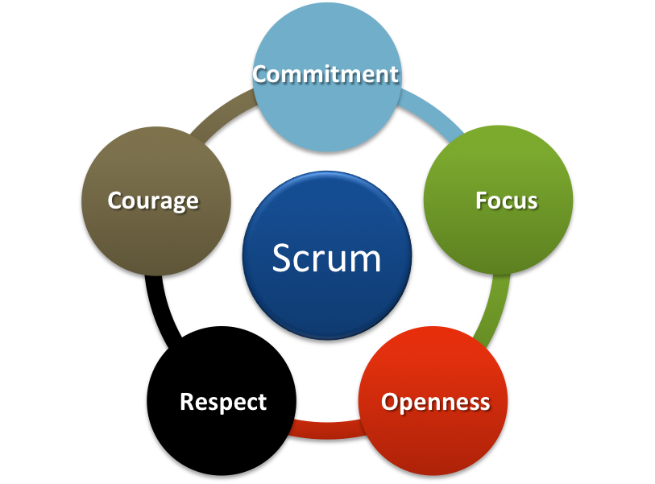
Team introduction
Anjali Deshmukh
chirag arora,
Marianne paulson
megha lnu
saumil patel

Slide 4
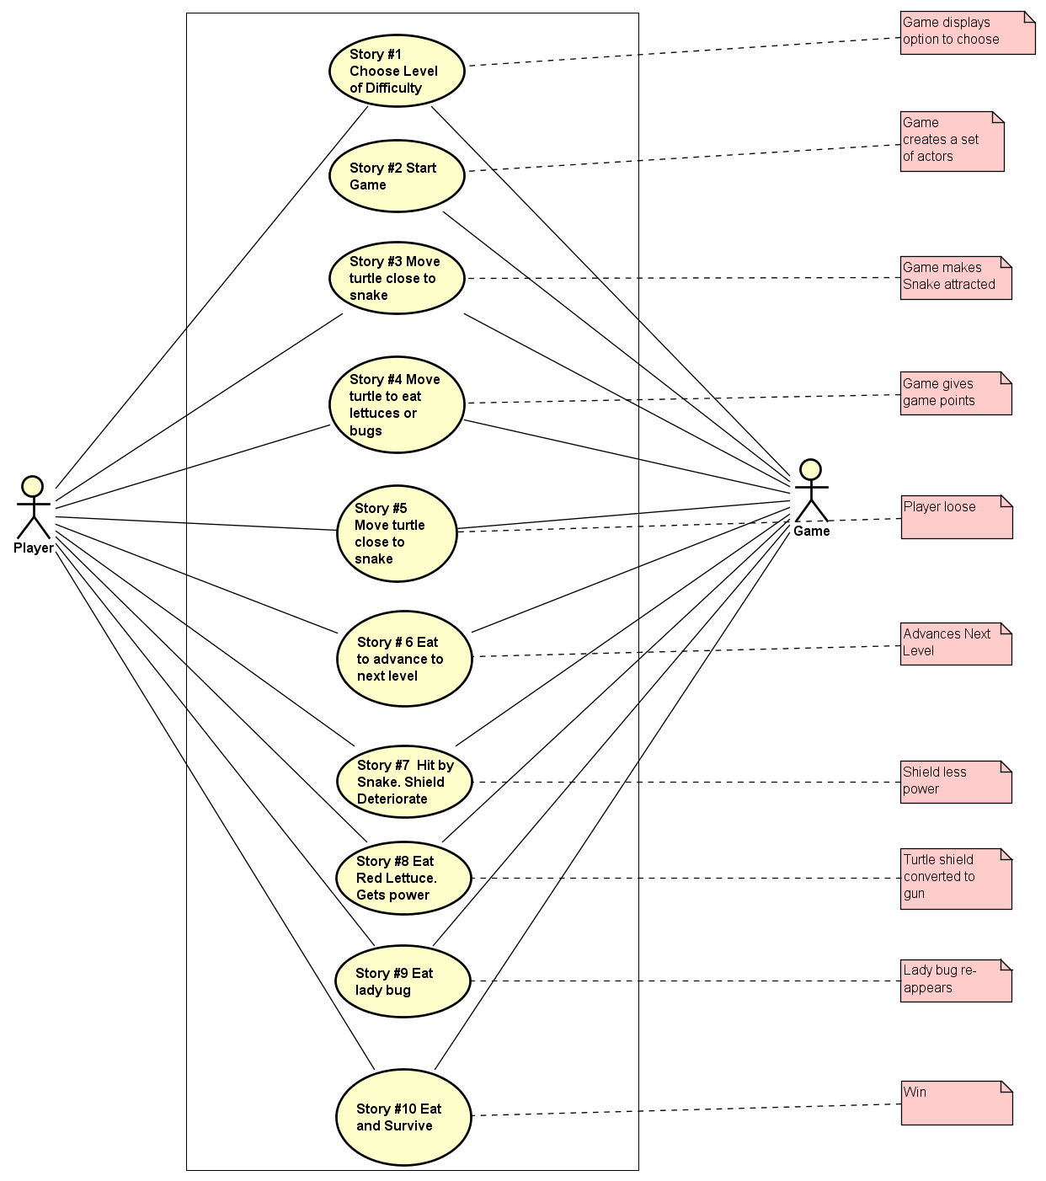
Use case diagram
10 USE CASES

Slide 5
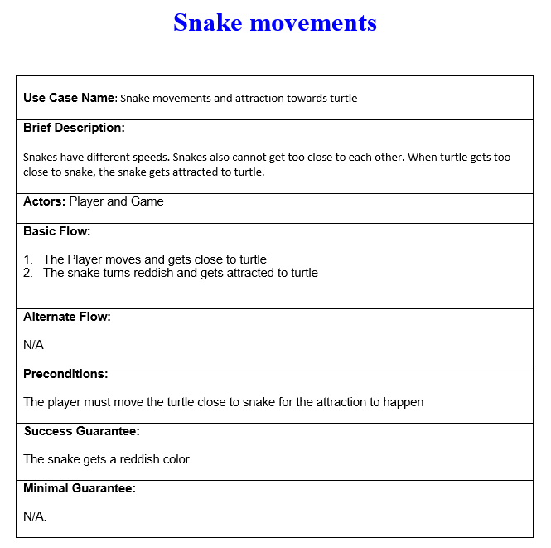
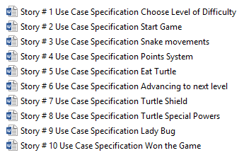
10 use case specificatins
Each specification corresponds to
1 one sequence diagram
1 one mockup screen

Slide 6
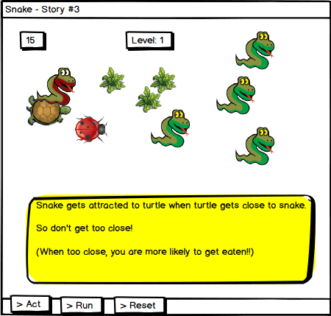
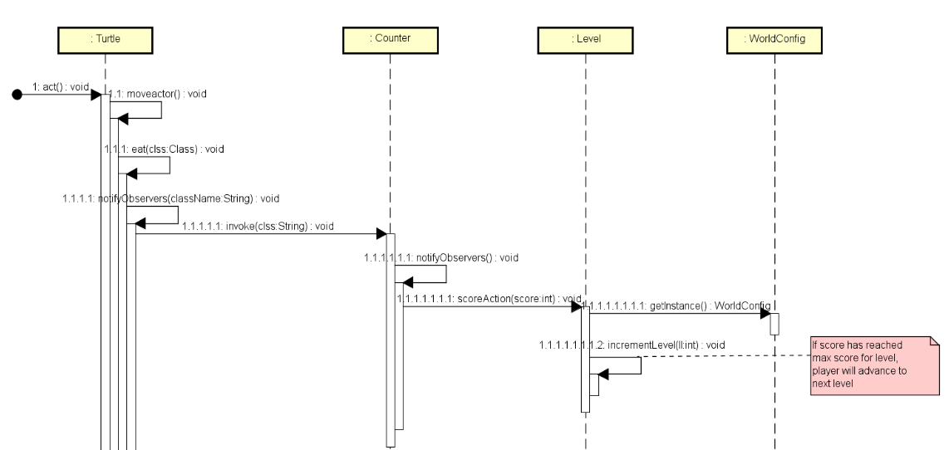
Accompany each use case
1 of 10 mockups from balsamic
https://balsamiq.cloud/s41ht0j/pcfr87k
1 of 10 sequence diagrams

Slide 7
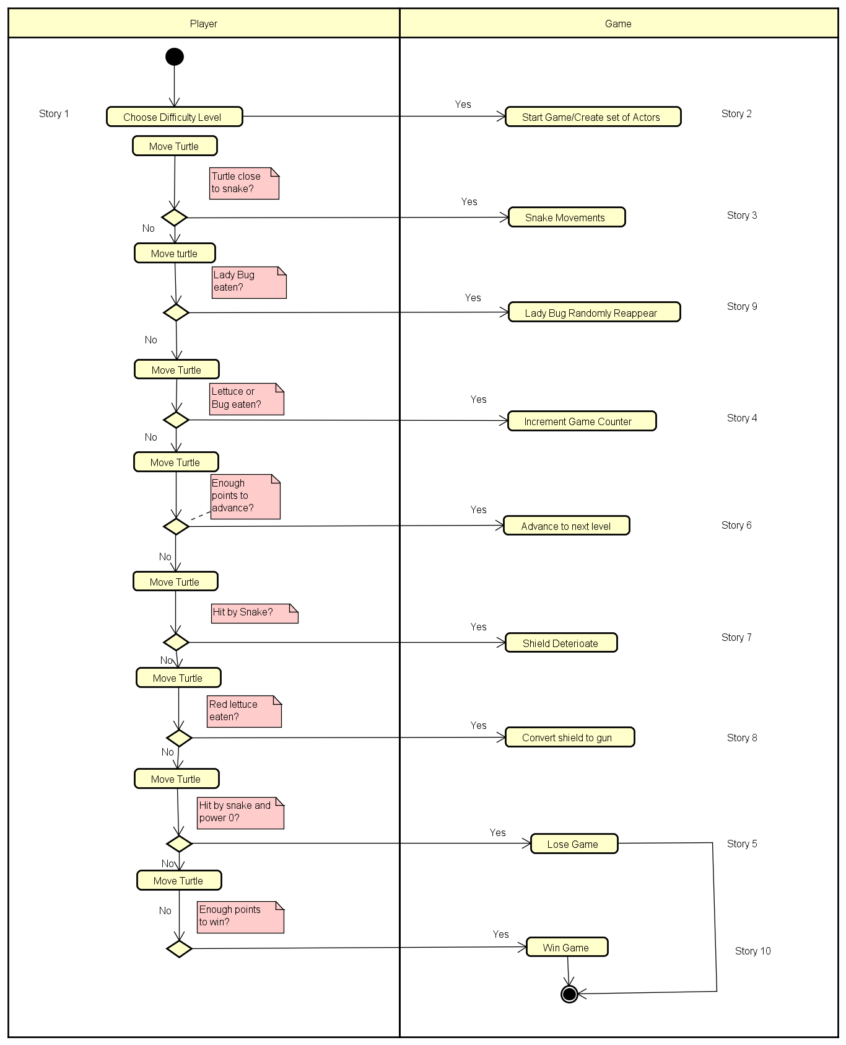
Activity diagram showing all 10 stories

Slide 8
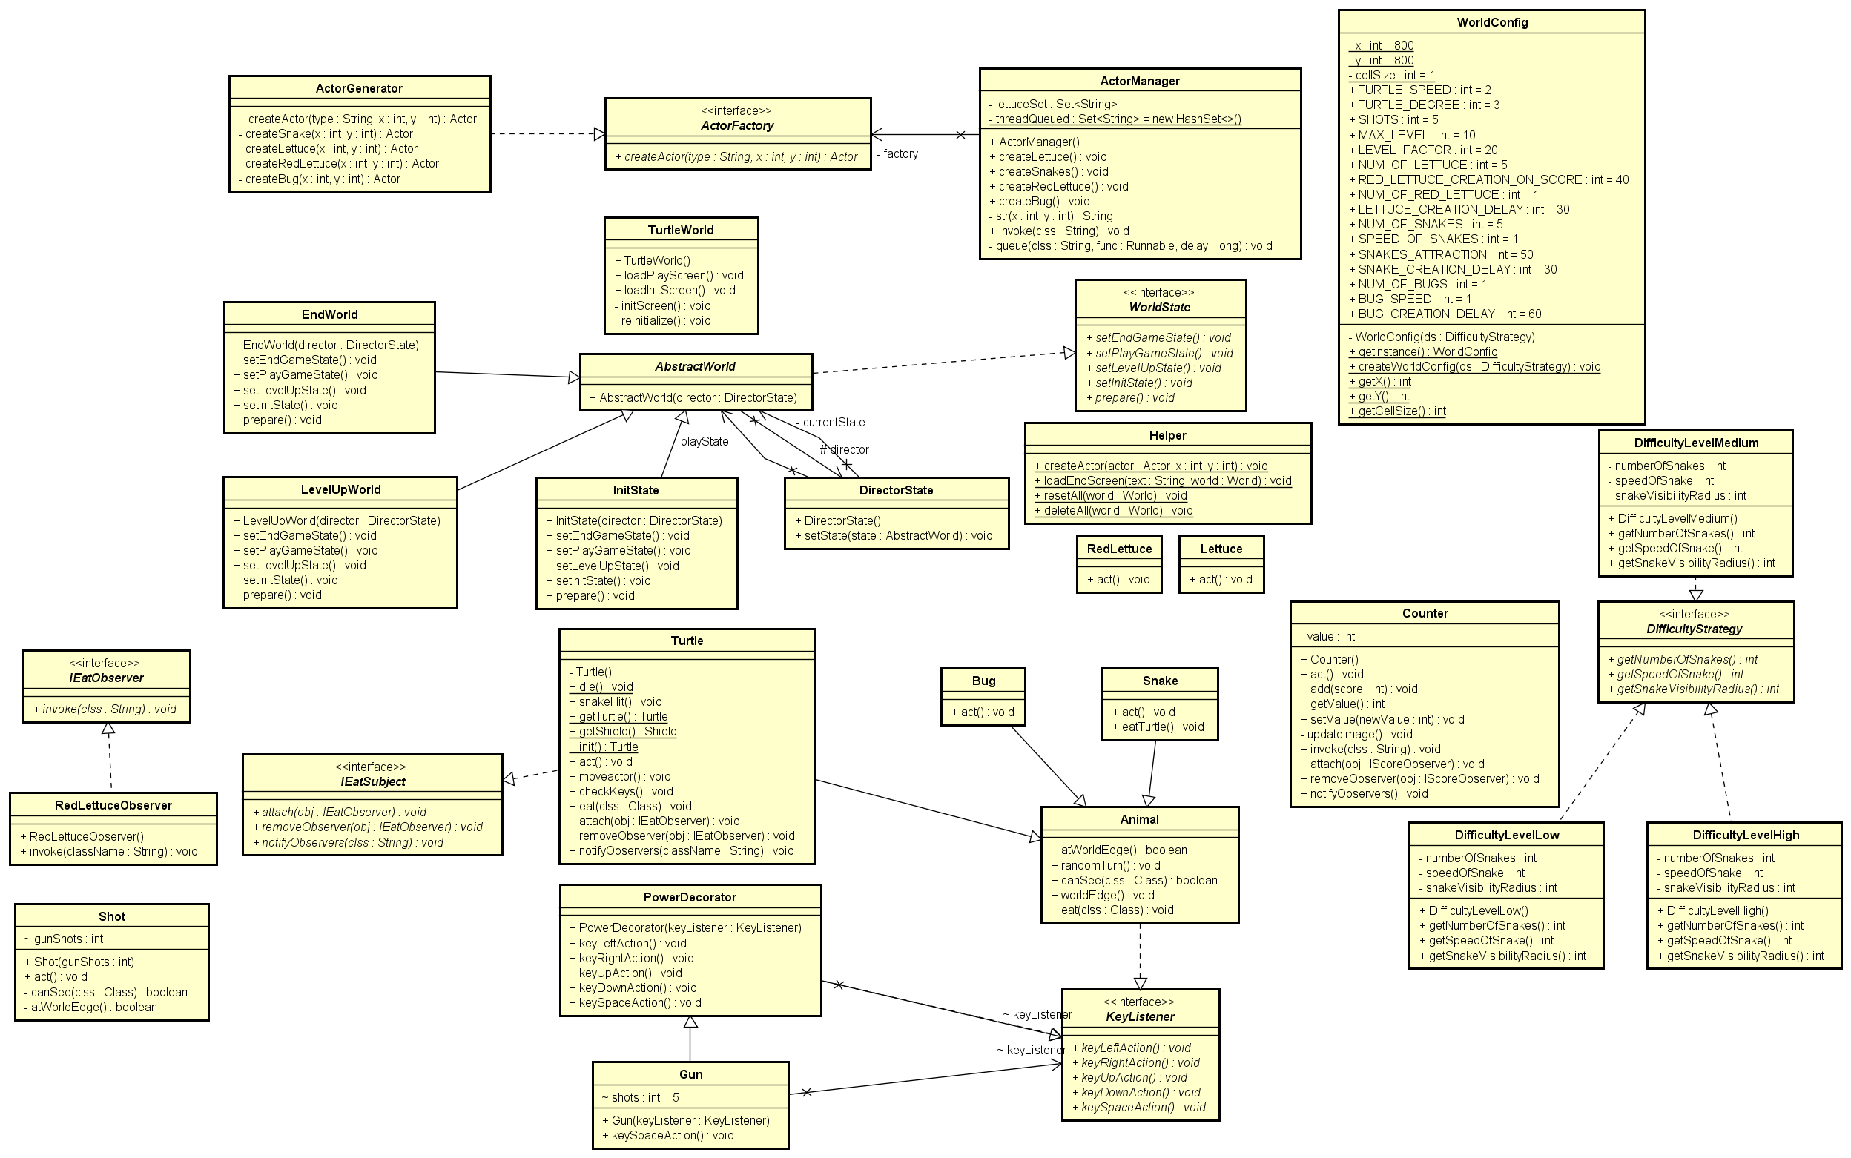

Slide 9
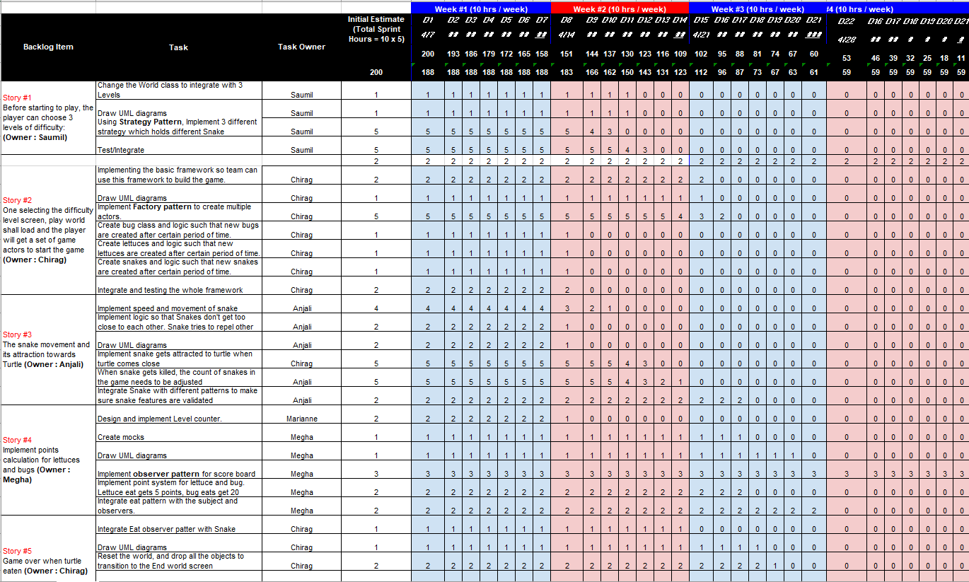

Slide 10
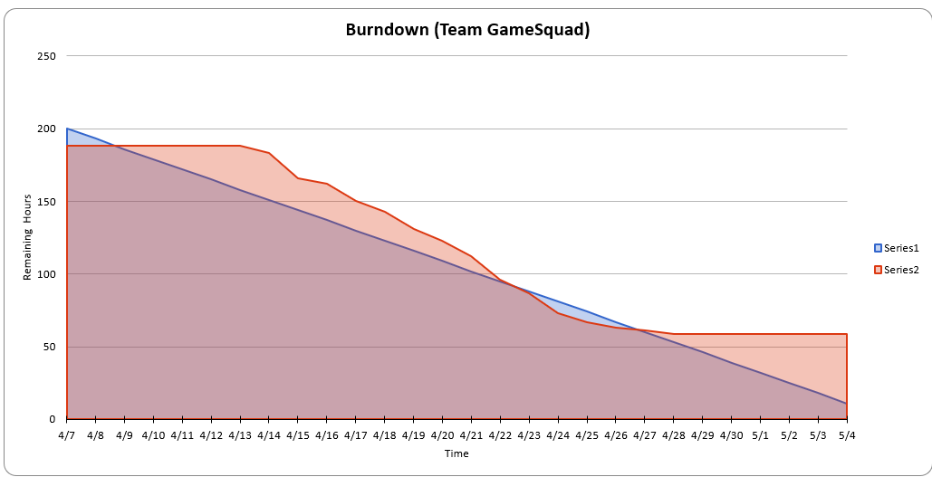

Slide 11

Next our demo
We will demo on
Android emulator

Slide 12
And finally … our advertising video
https://biteable.com/watch/mobile-app-ad-copy-2241439

