Slide 1
Online Burger Ordering System
Deep Khajanchi
Mitesh Kumar
Sarthak Sugandhi
Saumil Shah

Slide 2
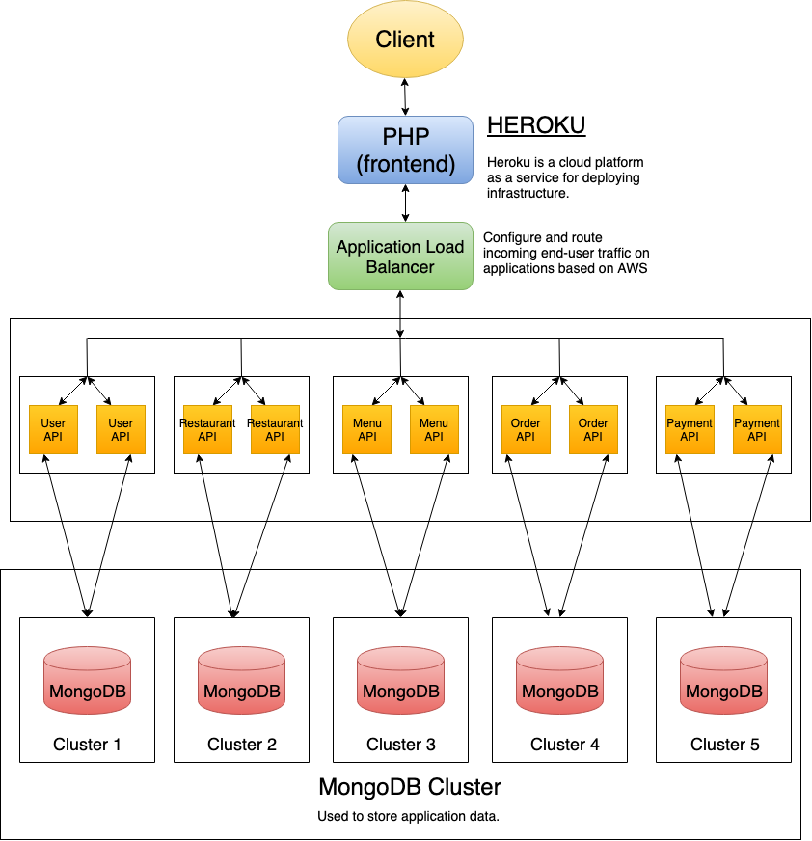
System Architecture

Slide 3
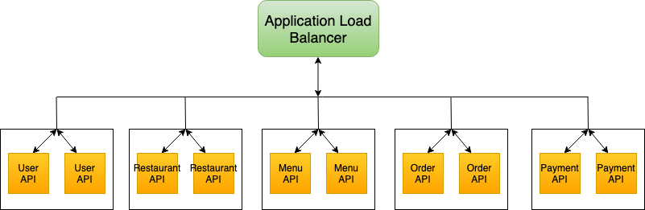
X–Axis Scalability: Horizontal Duplication
Replication
Load Balancing

Slide 4
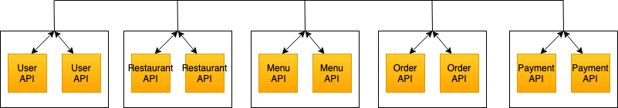
Y–Axis Scalability: Split by Function, Service or Resource
User API
Restaurant API
Menu API
Order API
Payment API

Slide 5
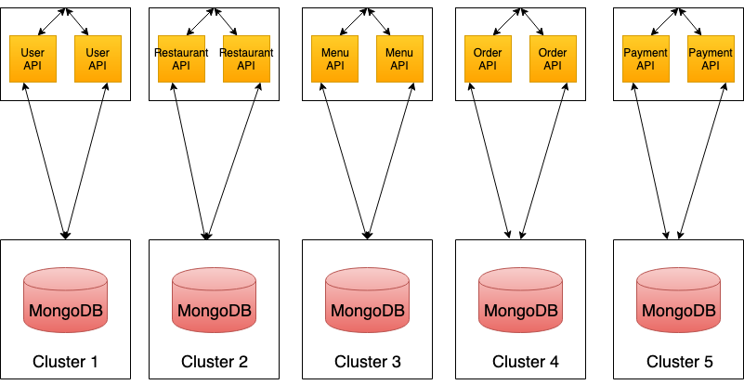
Z-Axis Scalability: Data partitioning
Separate database for each GOAPI Service.

Slide 6
Technologies
MongoDB Replica Set
GO API
Docker
Application Load Balancer
PHP
Heroku

Slide 7
Challenges
Running
Running MongoDB cluster after restarting instances.
Routing
Routing user request to appropriate microservice.
Maintaining
Maintaining state between microservices.

Slide 8
THANK YOU!

