Slide 1

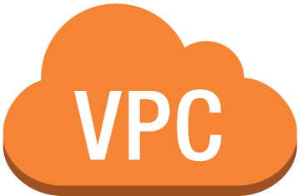




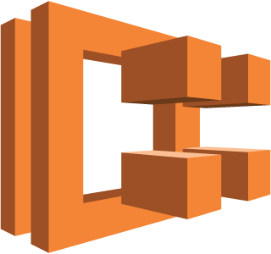
Serverless Container base Cloud Architecture
Internet
VPC subnet
got-api-task:1
got-api-task:2
got-api-task:3
Launch Type
Amazon ECR
EC2 instances
Amazon ECS Cluster got-api-cluster

Slide 2
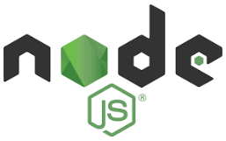


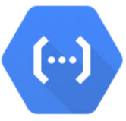
N-tier Architecture
Controller Layer
Controller Layer
Auth API
Store API
Controller Layer
Controller Layer
Express Server
Google Cloud Function
Controller Layer
Controller Layer
Google Places API

Slide 3

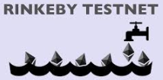
Auth API
Card API
Payment API
Web3 Interface

