Slide 1
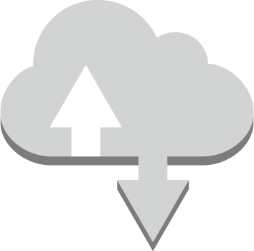
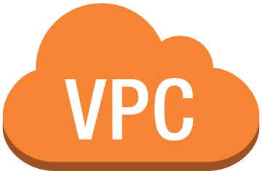

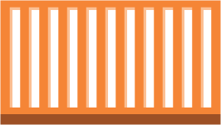


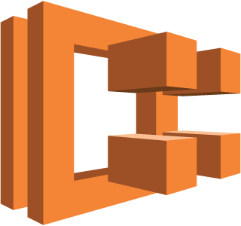
Serverless Container base Cloud Architecture
Internet
VPC subnet
got-api-task:1
got-api-task:2
got-api-task:3
Launch Type
Amazon ECR
EC2 instances
Amazon ECS Cluster got-api-cluster

Slide 2
N-tier Architecture
Controller Layer
Controller Layer
Controller Layer
Controller Layer
Controller Layer
Controller Layer

