Slide 1

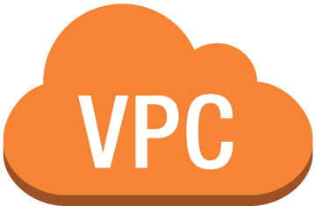




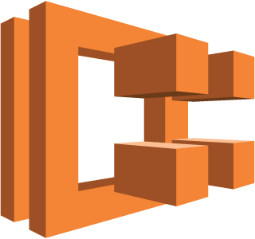
Serverless Container base Cloud Architecture
Internet
VPC subnet
got-api-task:1
got-api-task:2
got-api-task:3
Launch Type
Amazon ECR
EC2 instances
Amazon ECS Cluster got-api-cluster

Slide 2
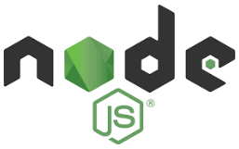


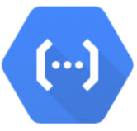
N-tier Architecture
Controller Layer
Handles HTTP Methods
Auth API
Store API
Service Layer
Business Logic
Express Server
Google Cloud Function
DAO Layer
Data Access
Google Places API

Slide 3

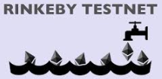
Auth API
Card API
Payment API
Web3 Interface

