Slide 1

Screentime Study
The effects of sleep and gym attendance

Slide 2
What affects my gym attendance more?
Phone screen time or hours of uninterrupted sleep?

Slide 3
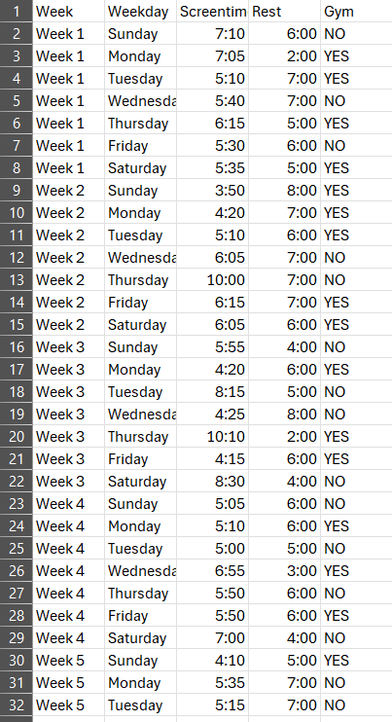
Data
63 observations
Variables
Hours of screen time and hours of rest
Samsung Digital Wellbeing Tracker
Gym?
YES or NO

Slide 4
Hypothesis Testing
Claim: Gym attendance on days that sleep time is higher than screen time is likelier than days where screen time is greater than sleep time.
Variables:
Dependent: Gym attendance
Independent: Hours of screen time and hours of sleep

Slide 5
Hypothesis Testing
Step 1
Null Hypothesis
𝑯(0) : Ps = Pr
Alternative Hypothesis
𝑯(𝒂) : Ps < Pr
Step 2
T-test

Slide 6
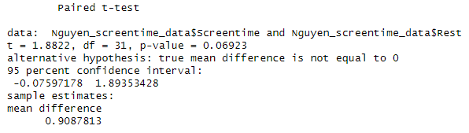

Hypothesis Testing
Step 3
Test Statistic
T = 1.8822
P-value = 0.06923
Step 4
Using a significance level of 0.05, accept the null hypothesis
$\text{H}\text{(0)}\text{ : }\text{Ps}\text{ = }\text{Pr}$

Slide 7
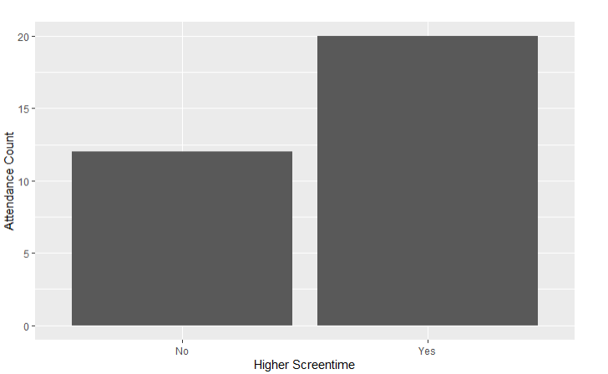
Conclusion
Since the p-value, 0.06923, is greater than 0.05, we can not reject the null hypothesis.
There is insufficient evidence that gym attendance is more likely on days with higher rest than screen time.

