Slide 1

Predicting Cars
Bin Nguyen

Slide 2
Problem
Car Market
Car Buying
As we grow older, we will eventually have to buy or sell a car
How do we know that the price of the car is fair?
Car Selling
Market Analysis
How much should I sell my car for?
The market is volatile and could be hard to figure out

Slide 3
Potential Benefits
Ease of Mind
Business
Future Timing
Know the estimate of what a car is worth for buying and selling
Start your own business in the car dealership industry
Know when a good time to buy or sell a car is

Slide 4
Methodology
I made sure to pick a data set that was already somewhat cleaned
Using this data, I changed variables types to make it compatible with the scaling
I then used visualizations to see what how variables affect each other

Slide 5
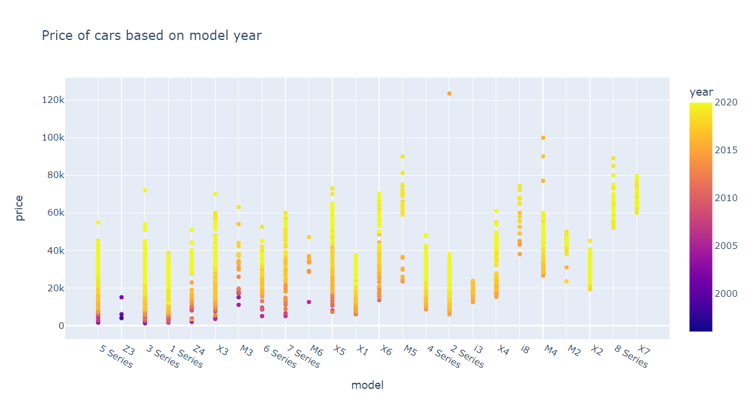
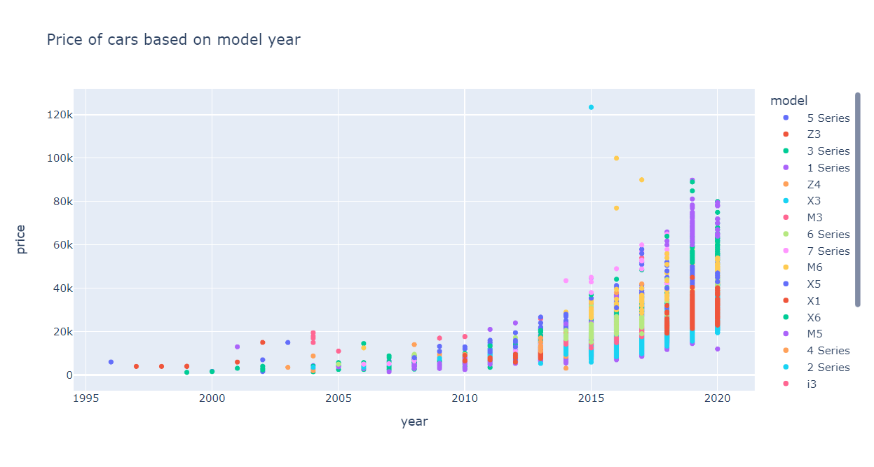
Findings
There does seem to be a correlation between price and model year as expected, but what’s more important is the specific model of the car
An older higher model can heavily influence a price more than a newer car of a lower model level

Slide 6
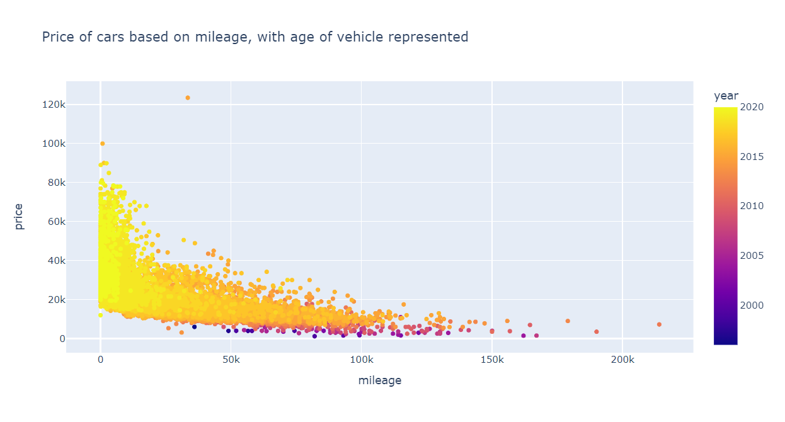
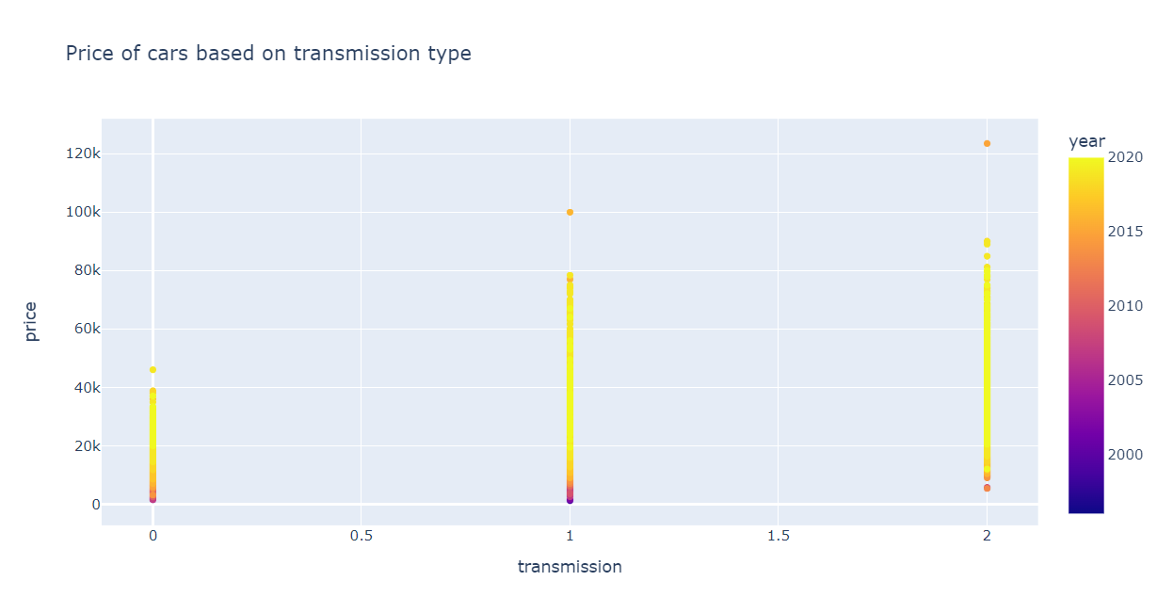
Findings
Also as expected, the car’s mileage also affects the price greatly
However, I didn’t expect that older cars with a low mileage to be worth that much less
Also unexpected is that semi-auto transmission cars (2) is a bit higher than auto (1)

Slide 7
Findings
Also as expected, the car’s mileage also affects the price greatly
However, I didn’t expect that older cars with a low mileage to be worth that much less
Also unexpected is that semi-auto transmission cars (2) is a bit higher than auto (1)

Slide 8

Findings
My machine learning model only predicted the price of a car based on the criteria listed so there’s not much to show in that regard

Slide 9
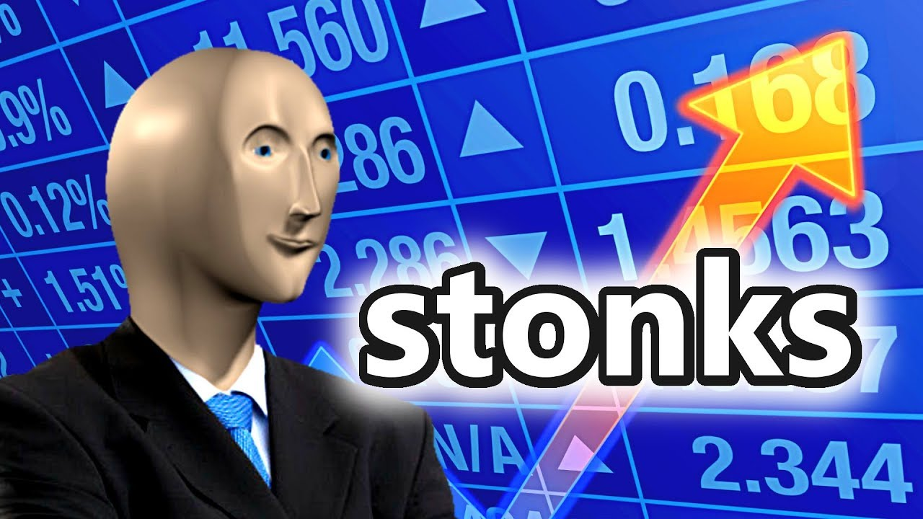
Recommendations
With this data, I would recommend pricing a car higher based on a the quality of the model, low mileage, a semi-auto or auto transmission, and newer the car

Slide 10
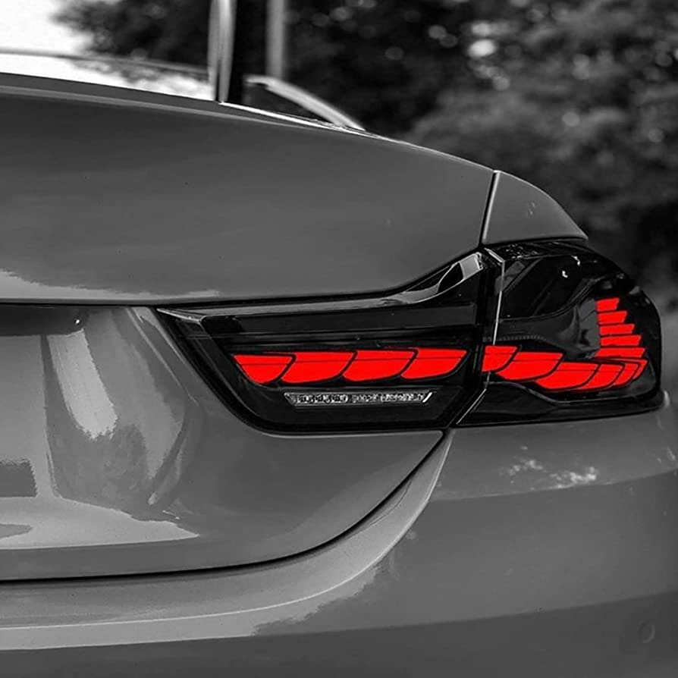
Future
The car market is ever volatile and has much more affecting it than what’s represented, and with more time I would like to be able to see what else can affect the price

