Slide 1

Clean Architecture
with FlirtingApp
Notes:
Any know the term?
Wanna be an discussion, discrupt me at anytime

Slide 2
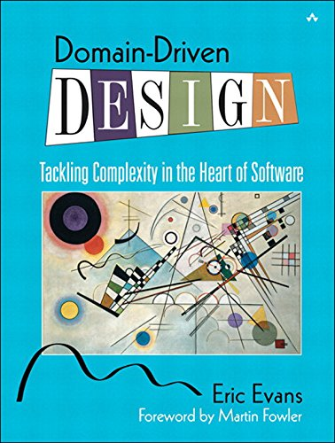
This talk is not about…
Front end.
Domain driven design.
Even sourcing.
Microservices.

Slide 3
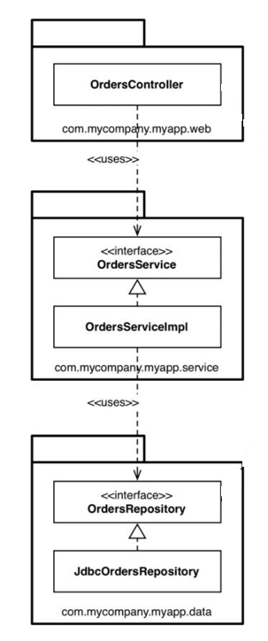
Why do n-layer architecture often fail?

Slide 4
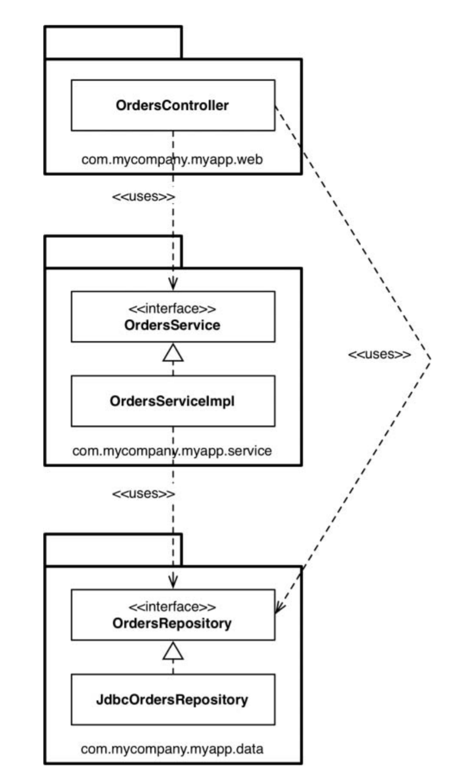
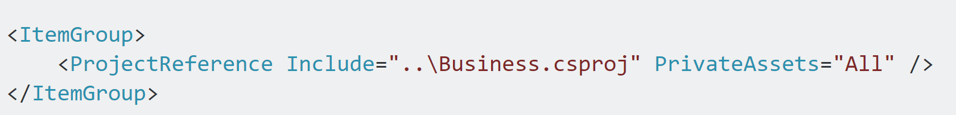
Default transitive referencing in dotnet core and dotnet standard projects
A -> B -> C (by default A -> C)

Slide 5
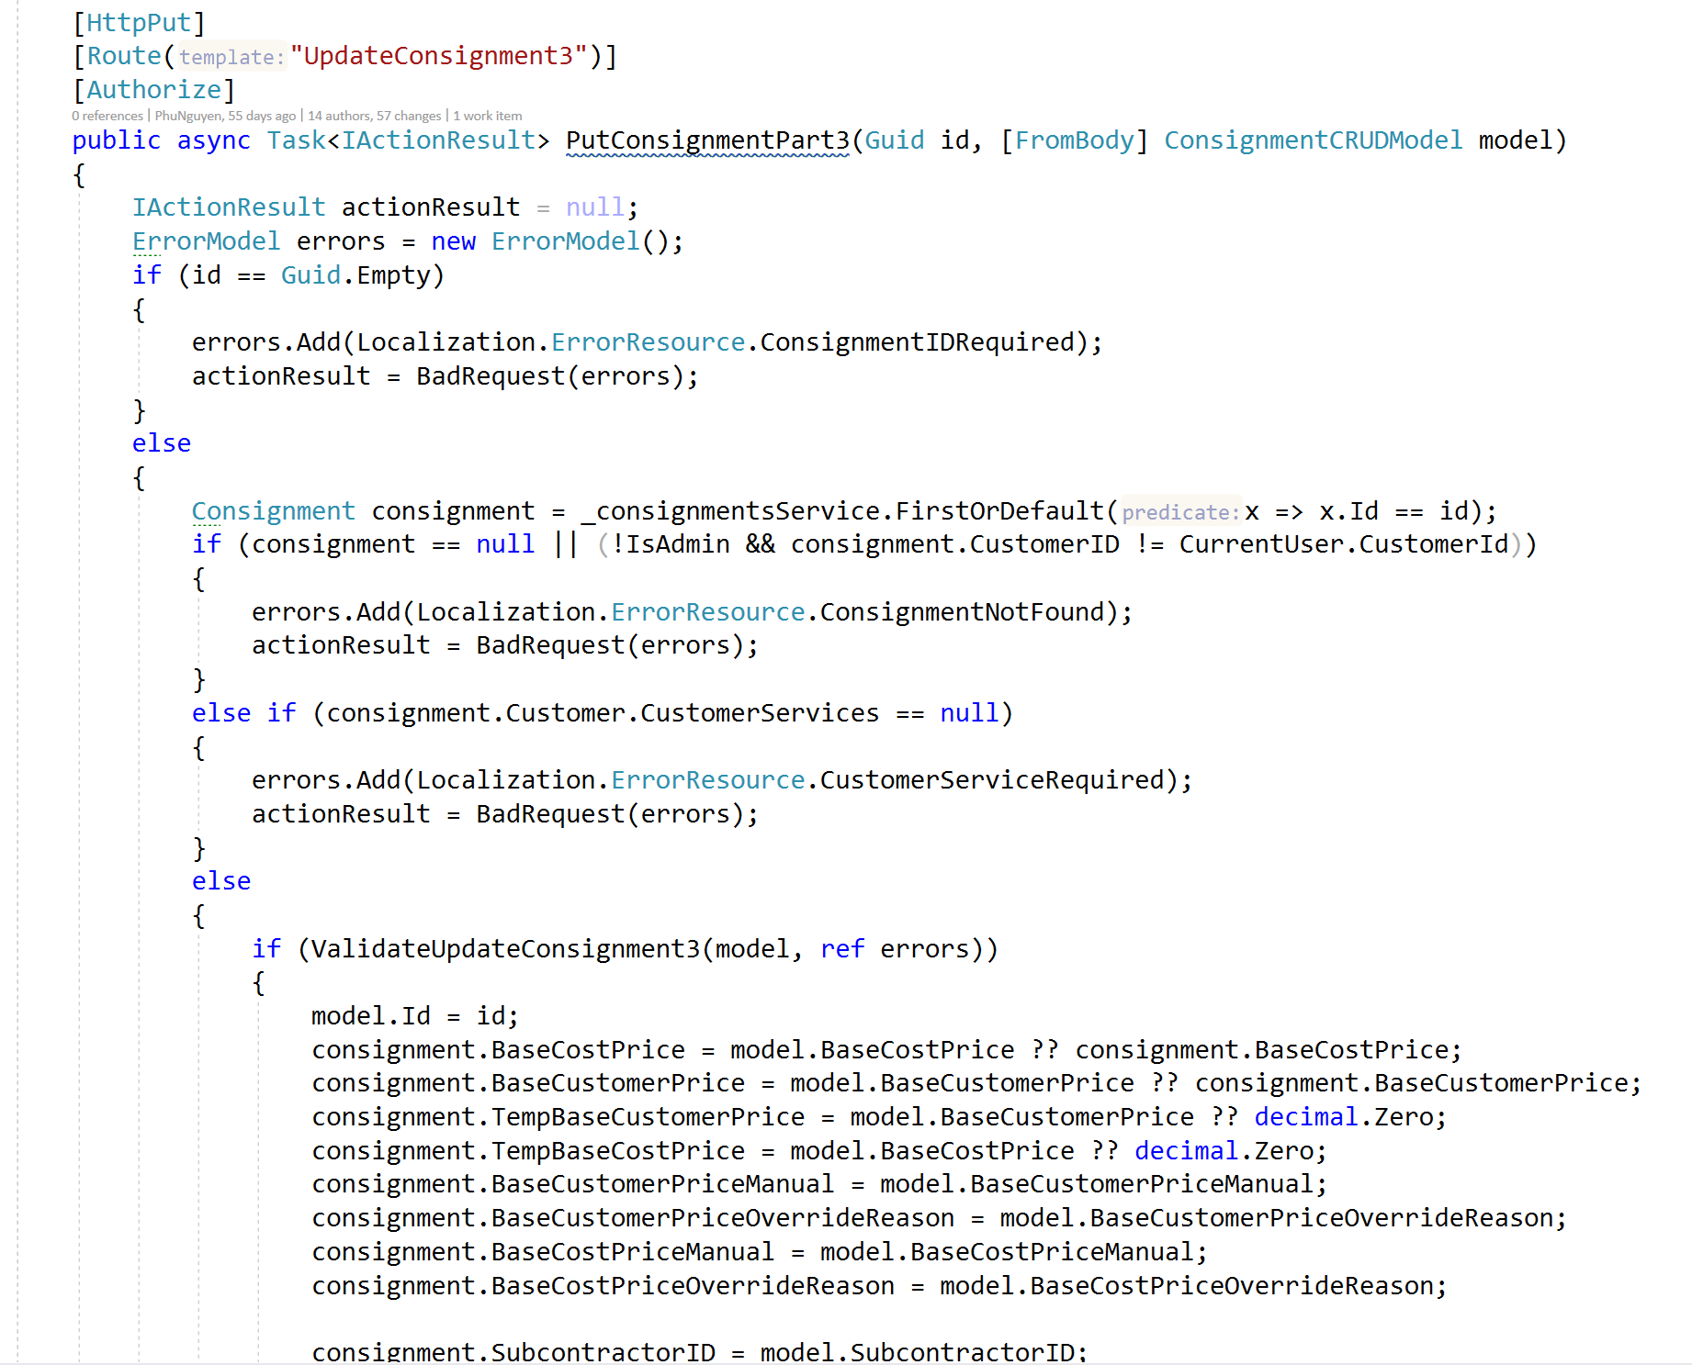
Fresher developer often…

Slide 6
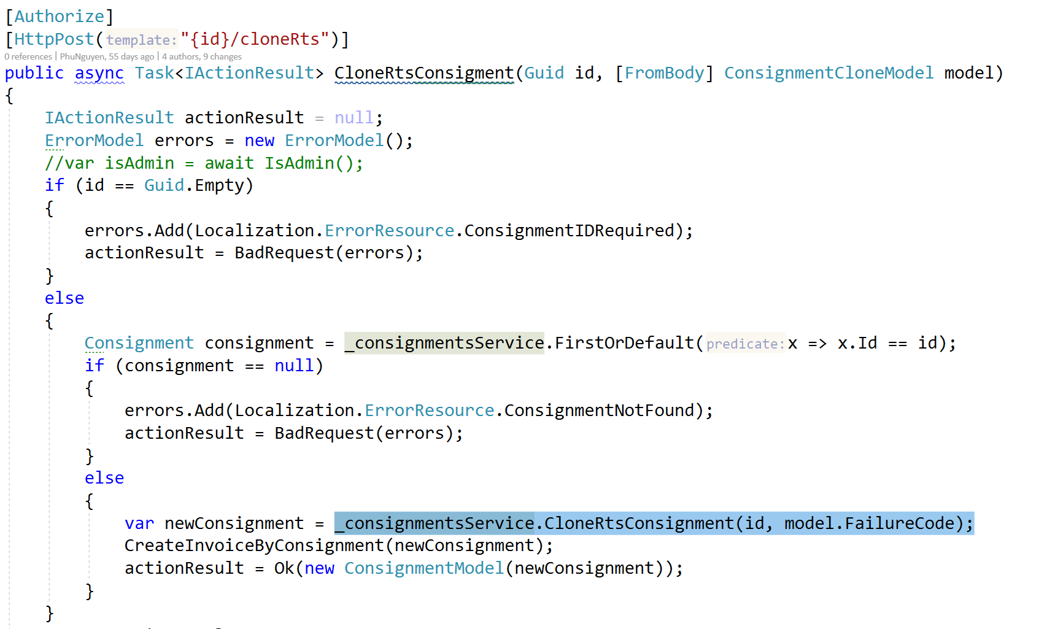
Junior developer often do ‘service’…

Slide 7
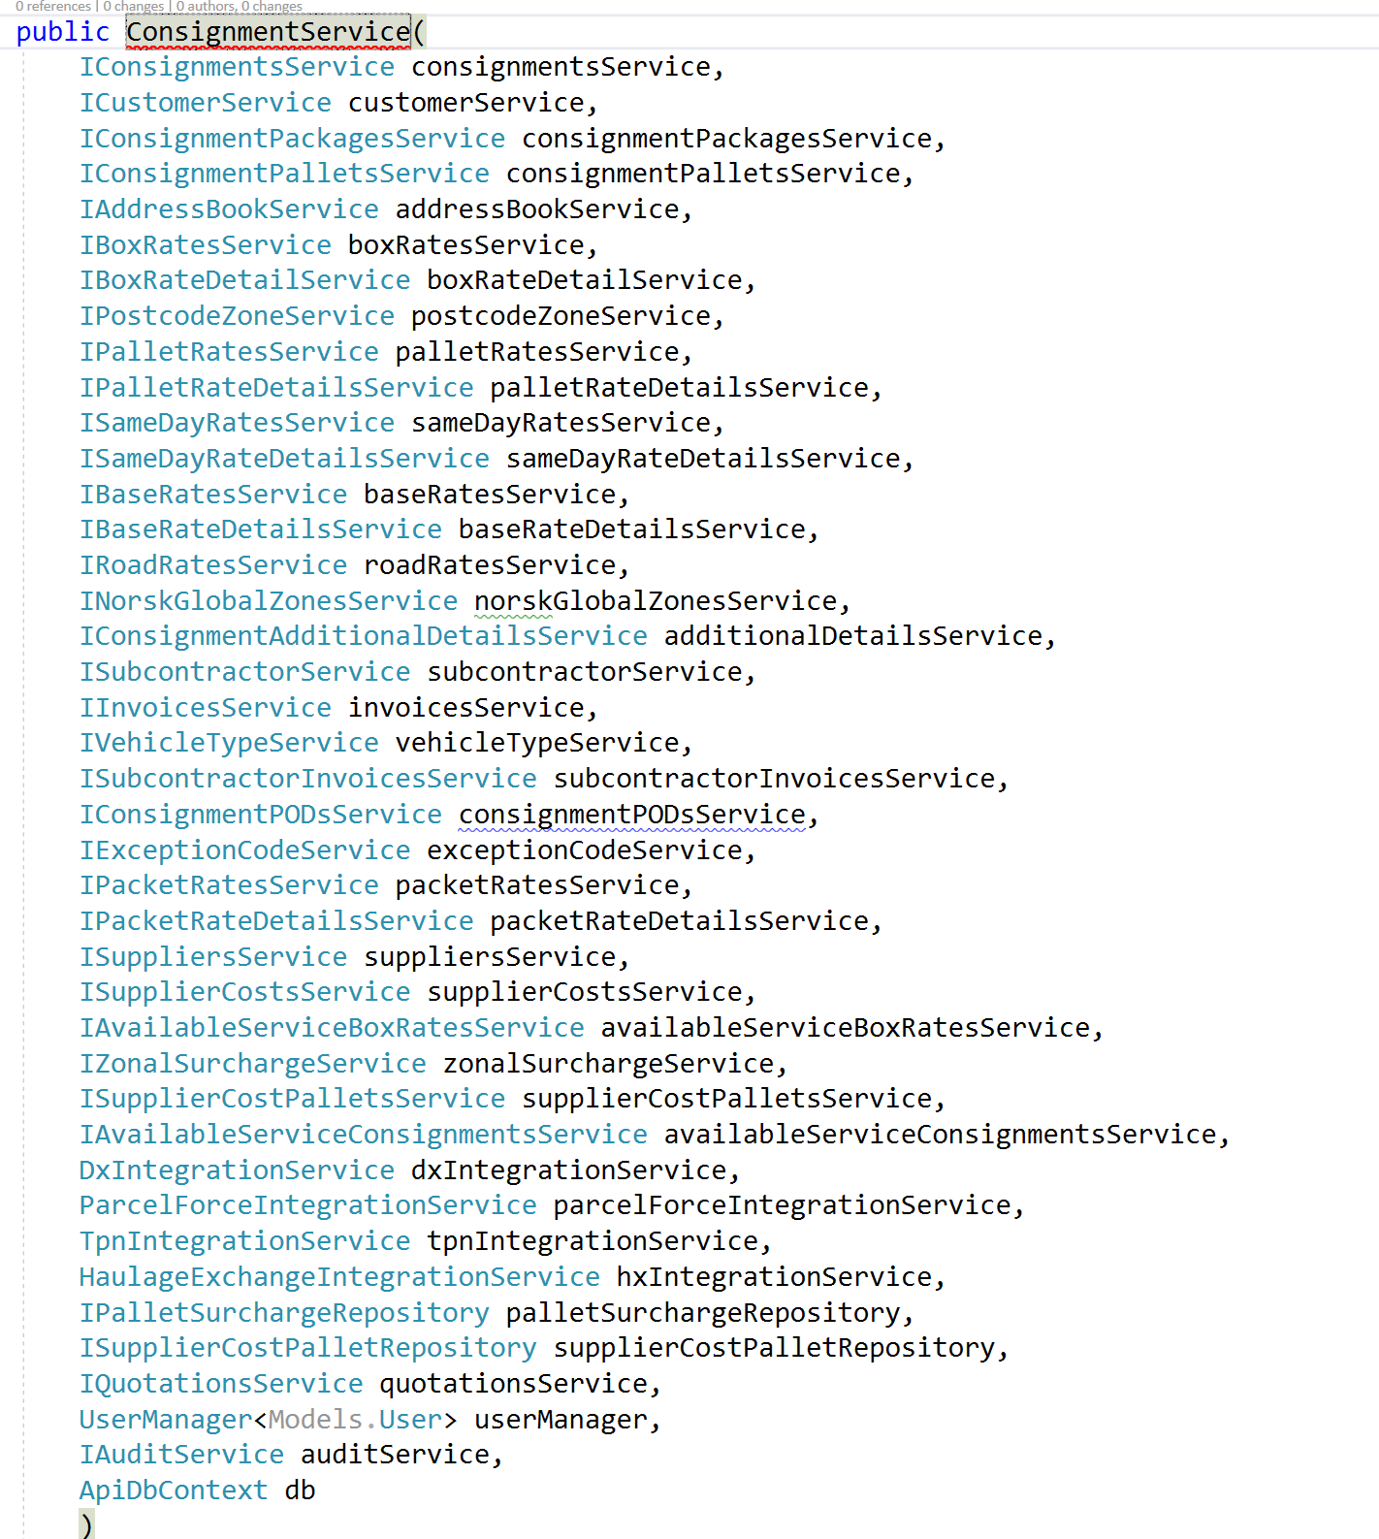
GOD service

Slide 8
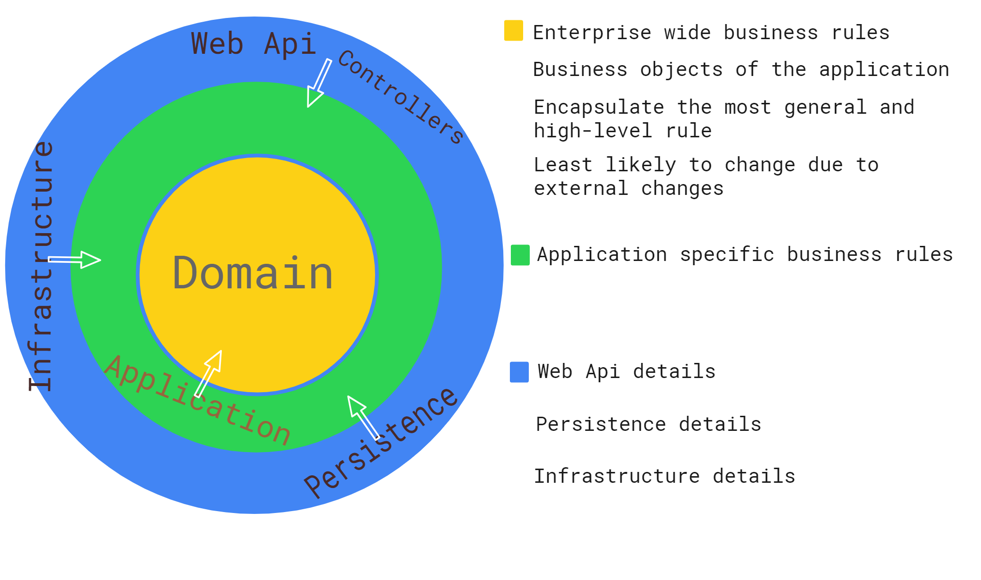
Notes:
What is a similarity between a web, a console, a desktop app

Slide 9
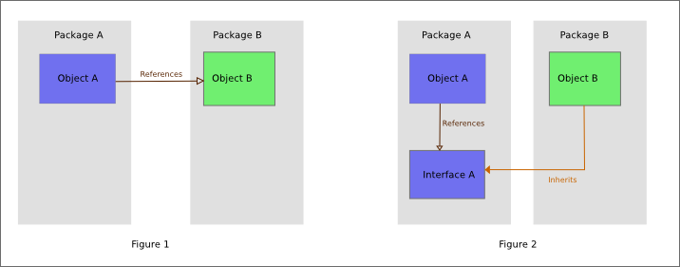
Why dependency always point inward?
The Dependency Inversion Principle (DIP) states that high level modules should not depend on low level modules; both should depend on abstractions.

Slide 10
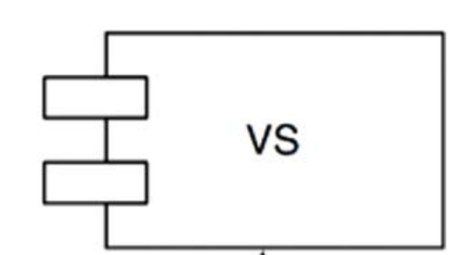
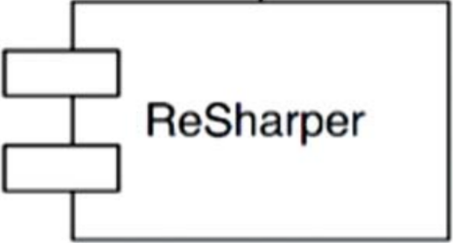

Slide 11
Clean architecture systems should be:
Independent of Frameworks.
Independent of UI.
Independent of Database.
Independent of any external agencies.
Testable.

Slide 12
Introducing FlirtingApp
ASP.NET Core 3.1 LTS, ASP.NET Core 3.1 Identity
Angular 8 with Angular material component, Angular flex-layout
CQRS with Mediator: Commands will write to both SQL Server and MongoDb, Queries will read from MongoDb for optimized performance.
2 DbContext: 1 for Application entities, 1 for IdentityDbContext.
Location searching for users and find users based on X distances using mongodb geospatial
Jwt Authentication with refresh token.
Heavily unit tested with separates test projects.
Validation with FluentValidation.
Remove usage of default ASP.NET Core validation with ModelState and move validation to Application layer as it's part of business logic.
Implement Presenter and IOutputPort to separate presentation logic from controllers
Cloudinary integration for uploading images
Custom exceptions for each layers.
Unify exceptions errors message with ExceptionMiddleware

Slide 13
Domain layer
Entities (Identifiable by Id)
Value Objects (Does not have an Id, Identifiable by all of its props)
Aggregates (A DDD aggregate is a cluster of domain objects that can be treated as a single unit)
Aggregate root (Any references from outside the aggregate should only go to the aggregate root)

Slide 14
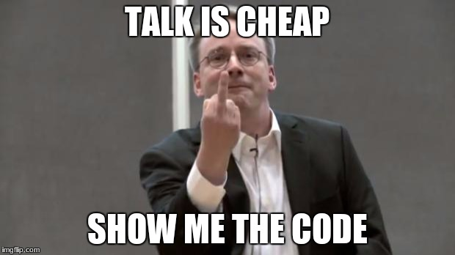
Domain layer
Contain highest level business logic.
Should be as clean as possible.
Avoid using data annotation.

Slide 15
Application layer
Contain app business logic (feature business logic)
CQRS ❤ MediatR
Commands and Queries
Validation 💖 FluentValidator
Result vs Exception

Slide 16
CQRS ❤ MediatR
Command Query Responsibility Segregation (CQRS)
Separate read (queries) from write (commands)
Every request is either a command or queries (not both)
But wait, CQRS principle is better than this

Slide 17
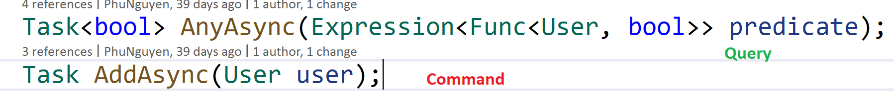
CQRS hardcore
Commands have side effect and do not return values
Queries does not have side effect and return values
Exception: var value = stack.Pop();

Slide 18
Validation
What’s wrong with ModelState validation?
Which layer should I do validation?
Fluent validation to rescue

Slide 19
Result vs Exception

Slide 20
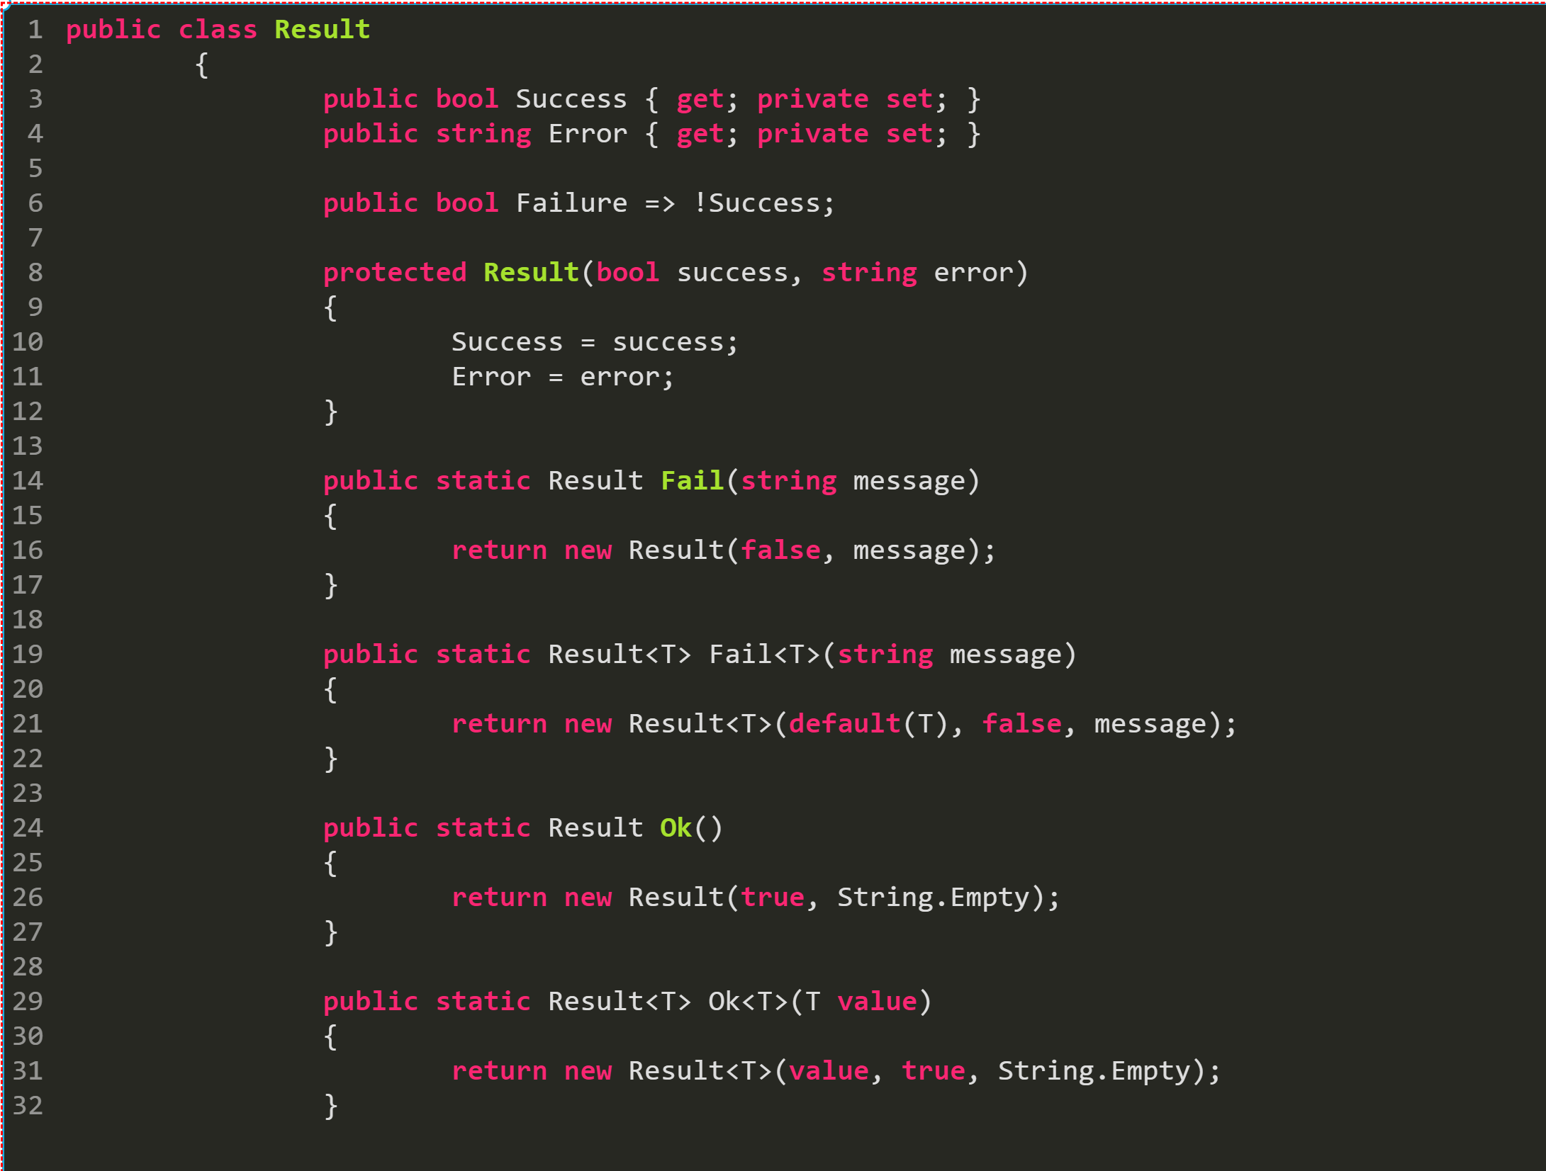
Result vs Exception

Slide 21
Exception drawbacks
Exceptions are harder to predict our application flow. Just like goto statements.
Exceptions are slow!
for (int i = 0; i<10000; i++) {
// functA call another funcB then swallow the exception!?
functA();
}

Slide 22
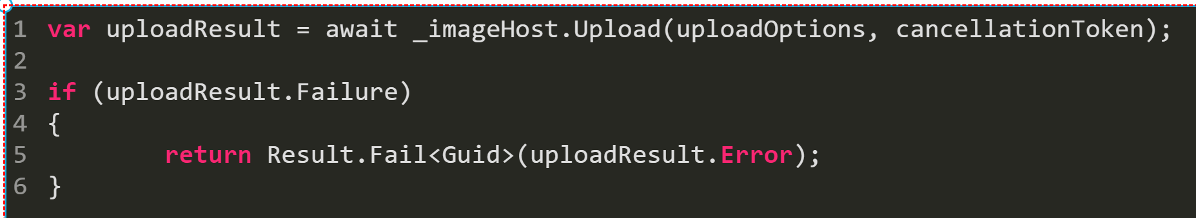
Result drawbacks
Caller always need to check whether the result fail or succeed
Result tends to be contagious just like await / async

Slide 23
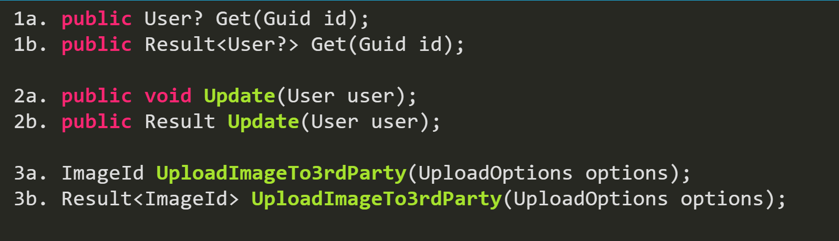
Which one should we consider?

Slide 24
Persistence layer
ORMs
Mongodb generic repository
Ef core AppDbContext, migration and entity configuration

Slide 25
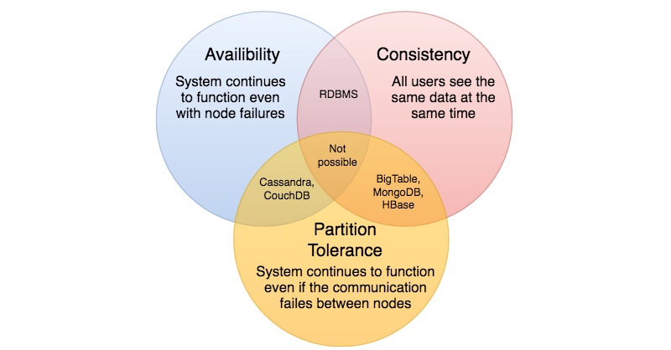
Why MongoDb + Sql Server
Mongodb is about speed.
Sql Server is about ACID(atomicity, consistency, isolation, durability) + Analysis Services (SSAS)

Slide 26
Do you need repository + UOW with EF core?
No. Ef core has DbSet and context.SaveChanges() is already repository + uow pattern.
Ef core has in memory provider so DbContext is fully testable.
Unless, you have a very specific reason to do so…

Slide 27
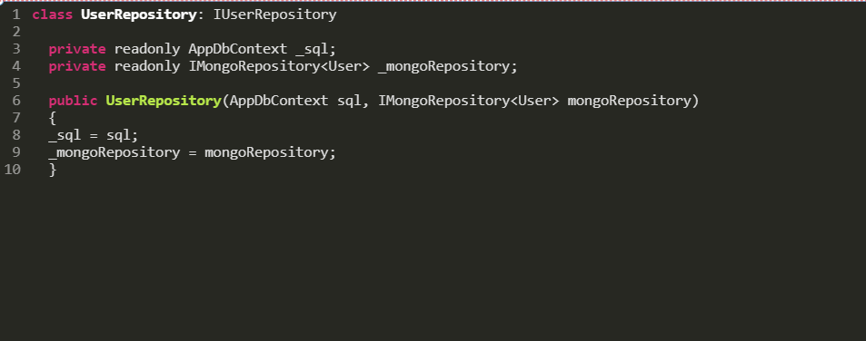

Slide 28
Infrastructure layer
IdentityDbContext, migration, token handler, etc.
Any cross-cutting concerns (e.g. storing, uploading photo using Cloudinary)

Slide 29
WebApi layer
Controllers
Dependency injection
Exception middleware
Hosted services
Presenters

Slide 30
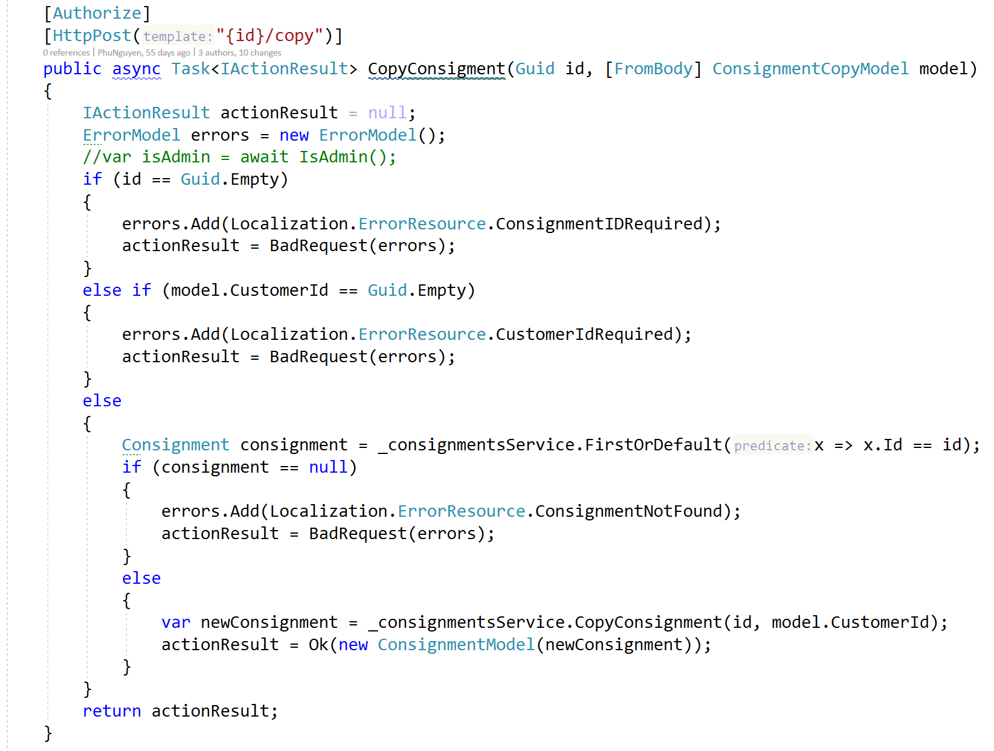
How many jobs do this controller have to do?

Slide 31
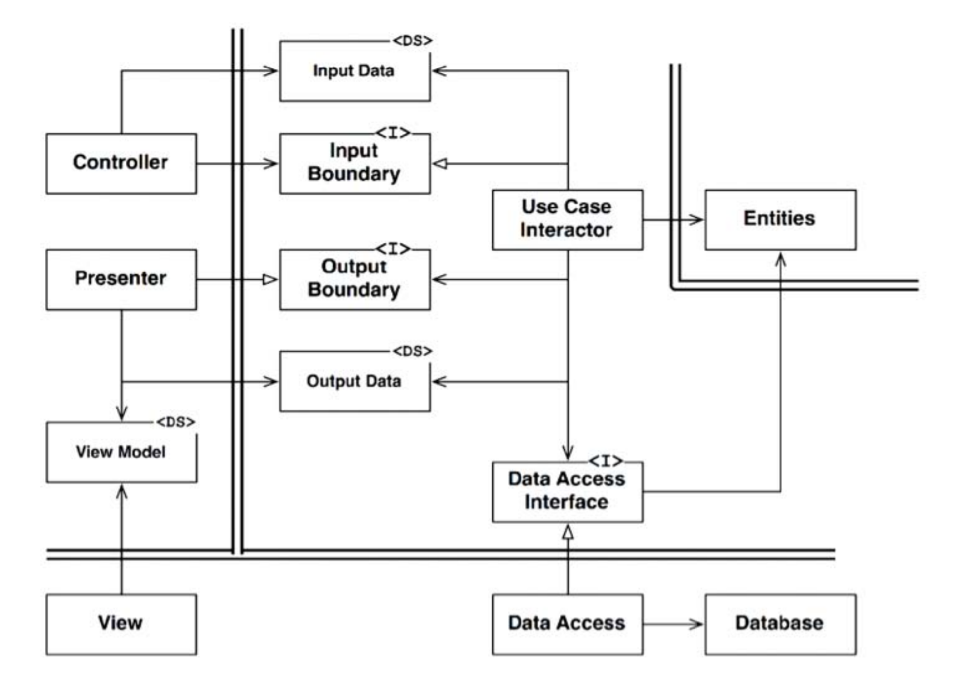
Presenter and Output port pattern

Slide 32
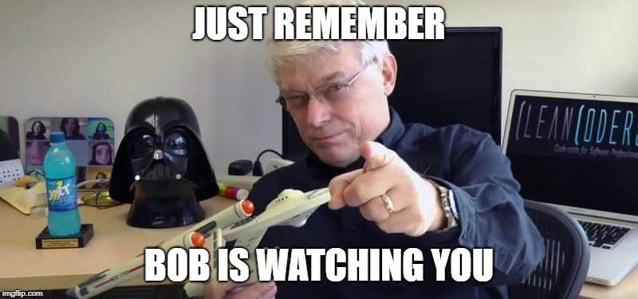

Slide 33
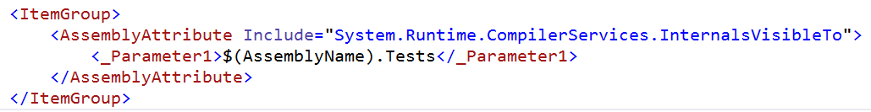
TESTING TIME!
Which parts of application should I test?

Slide 34
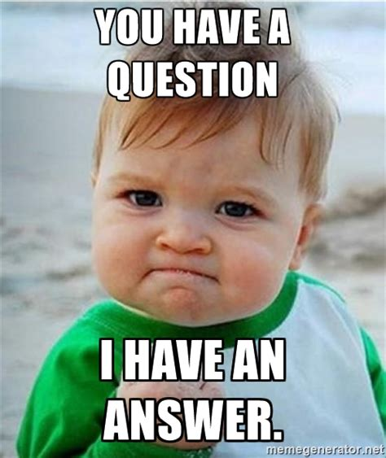

Slide 35


Credit
https://github.com/jasontaylordev/NorthwindTraders

Slide 36
Thank you!

