Slide 1
Doxygen : A Tool Review
Nguyen Minh Thang
23-08-2019 = VNP

Slide 2
Content
Concept of Doxygen
Benefit and Feature of Doxygen
Use Doxygen
Example and Result

Slide 3


What is Doxygen
Doxygen is a documentation generator, a tool for writing software reference documentation.
Compatibility of Doxygen

Slide 4
Input and Output
Doxygen
Soure code:
PHP, Folder
HTML, PDF
XML,

Slide 5
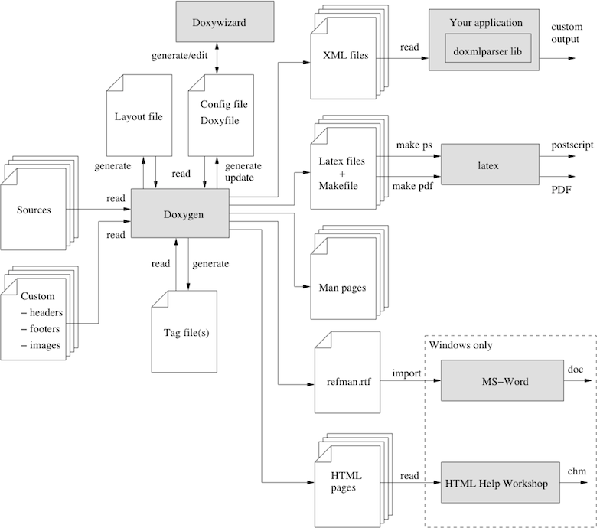
Mind Map

Slide 6
Mind Map Of Benefit and Feature
Feature
List all
class
Generate
Diagrams
HTML,
XML
Support
Function,
variables

Slide 7
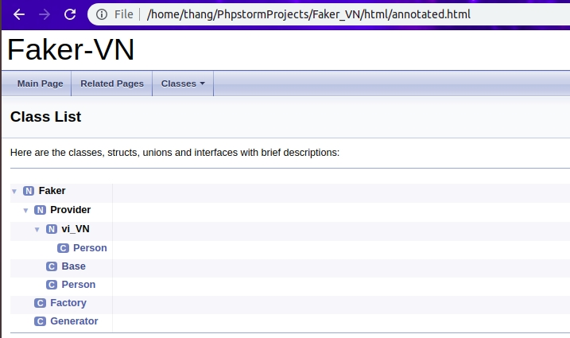
List all of class, tree map

Slide 8
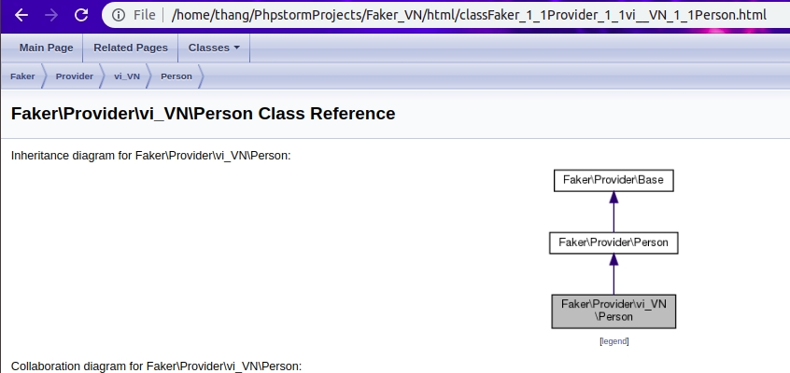
Show subclass, extend, relationship

Slide 9
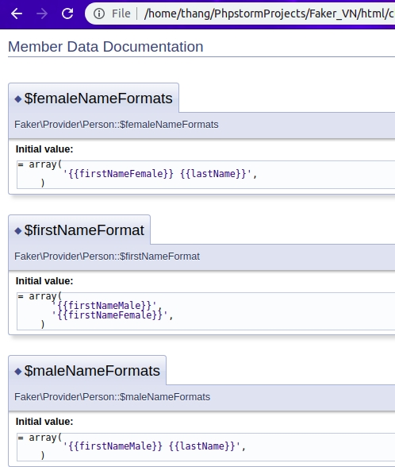
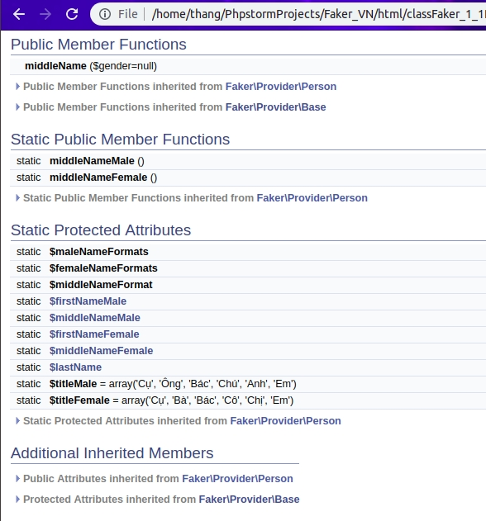
Support structure, attribute, method

Slide 10
Document Code
Document Code
Comment
Blocks
Comment
After
Members
Varaiable

Slide 11
Comment Block
Chú ý: commnet đúng chuẩn
nếu comment // thì không thể show
lên Doxygen
///
///...text…
///
Or
//!
//!...text…
//!

Slide 12
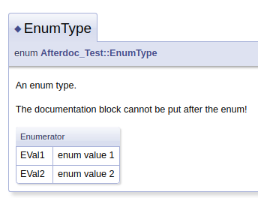
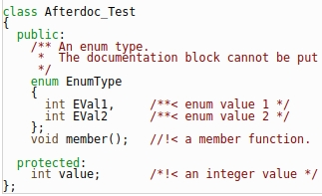
Comment after member
int var; /**< Detailed description after the member */

Slide 13
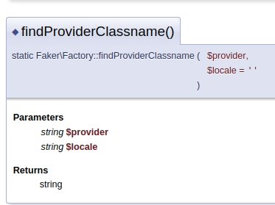
Varaiable
/*
*@param string$provider
*@param string $locate
*@return Generator
*/

Slide 14
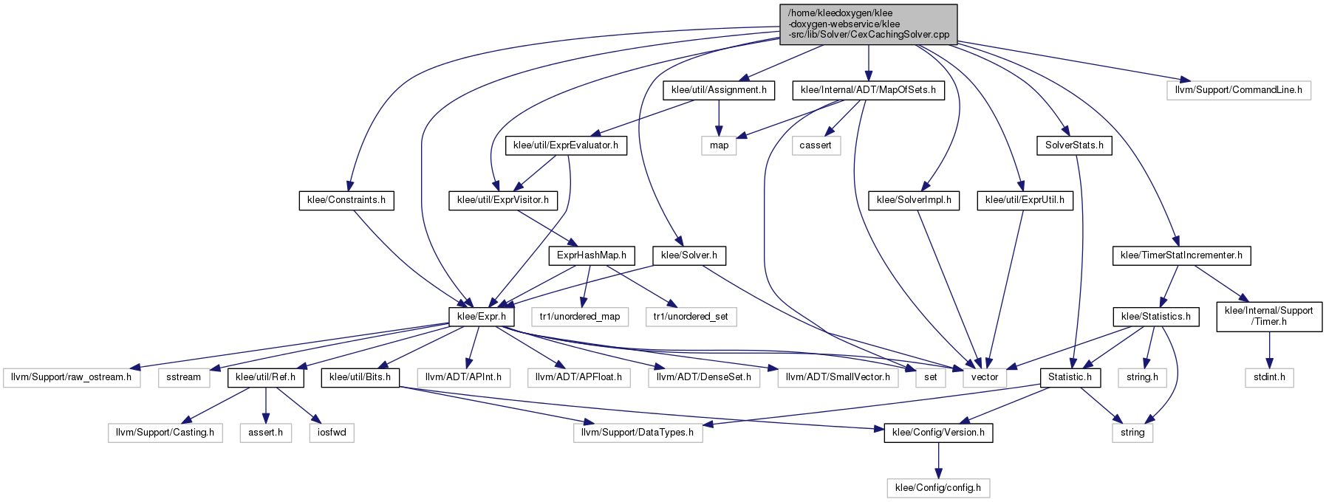
Big Project

